Slide 1
CS 121: Lecture 10 Turing Machines
Madhu Sudan
https://madhu.seas.Harvard.edu/courses/Fall2020
Book: https://introtcs.org
{
The whole staff (faster response): CS 121 Piazza
How to contact us
Only the course heads (slower): cs121.fall2020.course.heads@gmail.com

Slide 2
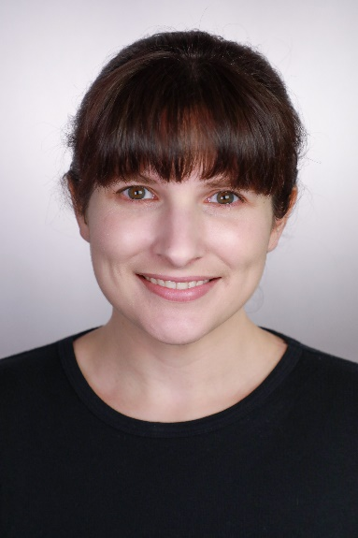
Announcements:
Midterm 1 next week:
Logistics announcement by Thursday
Prep Material: Canvas $→$ Files $→$ Midterm Prep
Likely: 2 pages of typset cheatsheet allowed. No other external refs.
Homework 3 due Thursday
Advanced Sections: Christina Ilvento on Differential Privacy!

Slide 3
Where we are:
✓
Part I: Circuits:
Finite computation,
quantitative study
✓
Part II: Automata:
Infinite restricted computation, quantitative study
Part III: Turing Machines:
Infinite computation, qualitative study
Part IV: Efficient Computation:
Infinite computation, quantitative study
Part V: Randomized computation:
Extending studies to non-classical algorithms

Slide 4
Today:
Definition of Turing Machines
A function F not computable by DFA or Circuits
Computing F with Turing Machine

Slide 5
Definition of Turing Machine (TM)
Recall: DFA = Finite state control + input on tape + move right on each step.
In a nutshell: TM = DFA + “Write” + “Move left+right on tape”
(Either “Write” / “Move left+right” on its own insufficient)
TM: Main change:
More Involved Transition function: $T$ (now $δ$):
$δ:$ (current state, read symbol) $↦$ (new state, write symbol, direction of move/halt)
Explicit halting (don’t just end after reading last input bit)
Computes functions: output = concatenation of $\left\{0,1\right\}$ symbols on tape.

Slide 6
Formal Definition
(Barak, Definition 7.1):
TM on $k$ states and alphabet $Σ⊇\left\{0,1,ω, φ\right\}$
is given by $δ:\left[k\right]×Σ→\left[k\right]×Σ×Action$,
where $Action=\left\{L,R,S,H\right\}$
$L$=Left, $R$=Right, $S$=Stay (don’t move), $H$=Halt (done!!)
Operation:
Start in state $0$, Tape $T=x_{0}…x_{n−1}φφφ…$ , Head $(i)$ at $x_{0}$
General step: current state $q$ ; input symbol $σ$:
Let $δ\left(q,σ\right)=\left(r,τ, X\right)⇒$ Write $τ$ on tape (overwriting $σ$) ; Move to state $r$; Move Head left ($i←i−1$) if $X=L$; right if $X=R$; don’t move if $X=S$.
Repeat General step until $X=H$

Slide 7
TM Example
$$\{$$
$(0,0,R)$ if $σ∈\left\{0,1\right\}$
Example: $k=1$; $Σ=\left\{0,1,ω, φ\right\}$ ; $δ\left(0,σ\right)=$
What does TM output on $101φ…$ (in future, we won’t write $$ or $φ$)
$(0,φ,H)$ if $σ∉\left\{0,1\right\}$

Slide 8
TM Example
$$\{$$
$(0,0,R)$ if $σ∈\left\{0,1\right\}$
Example: $k=1$; $Σ=\left\{0,1,ω, φ\right\}$ ; $δ\left(0,σ\right)=$
What does TM output on $101φ…$ (in future, we won’t write $$ or $φ$)
What function does TM compute.
$(0,φ,H)$ if $σ∉\left\{0,1\right\}$

Slide 9
A “hard” function
$f:{\left\{0,1\right\}}^{∗}→\left\{0,1\right\},$ $f\left(x\right)=1⇔x=1^{n}$ for $n=2^{t}$ for integer $t$

Slide 10
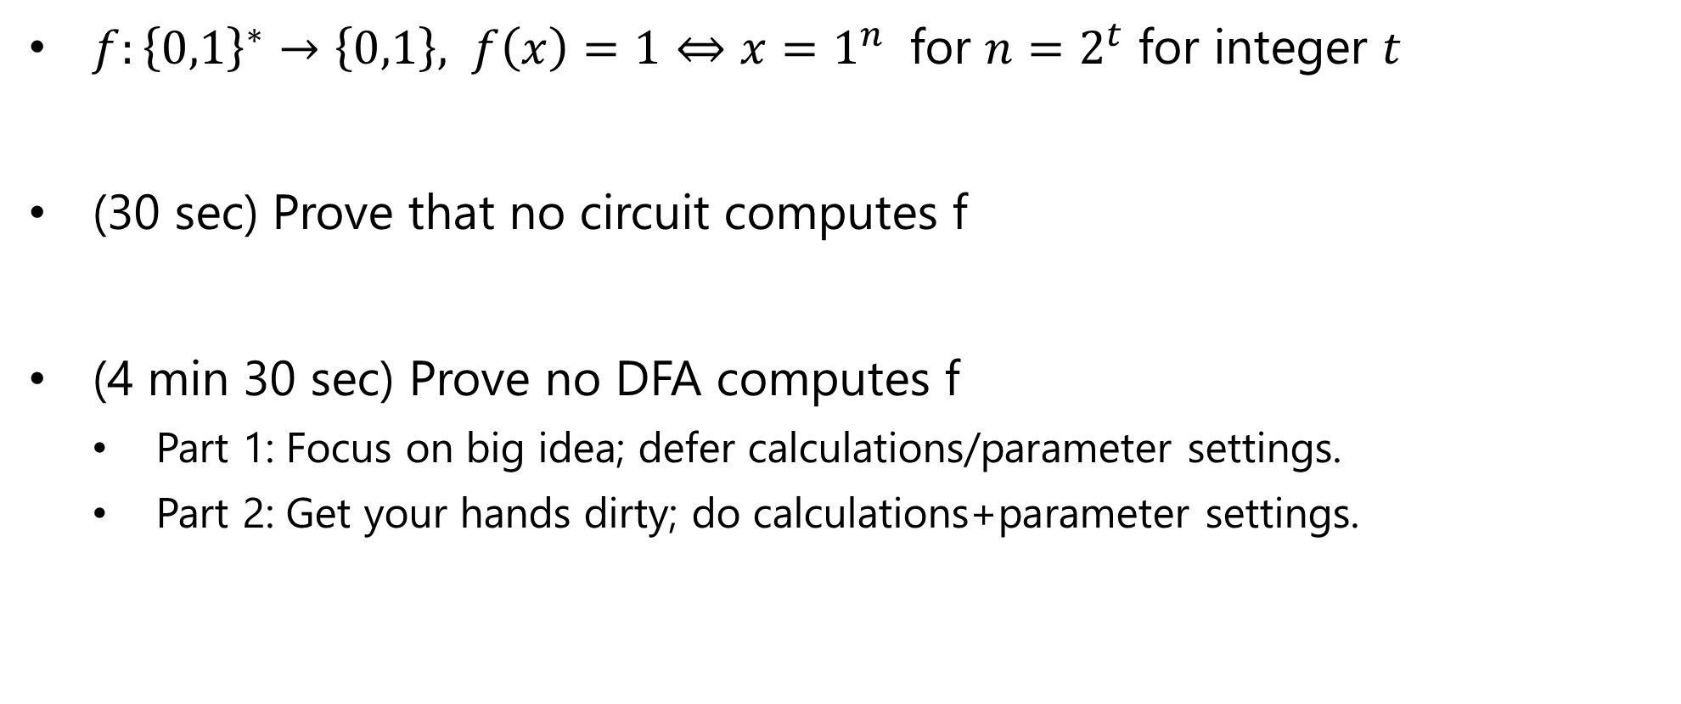
Exercise Break 1
$f:{\left\{0,1\right\}}^{∗}→\left\{0,1\right\},$ $f\left(x\right)=1⇔x=1^{n}$ for $n=2^{t}$ for integer $t$
(30 sec) Prove that no circuit computes f
(4 min 30 sec) Prove no DFA computes f
Part 1: Focus on big idea; defer calculations/parameter settings.
Part 2: Get your hands dirty; do calculations+parameter settings.

Slide 15
F is computable by a Turing Machine
Main Idea: Loop many times:
Scan string left to right
Replace every alternate 1 by 0;
reject if number of 1s is odd and greater than 2.

Slide 18

More details: Alphabet & States
Alphabet $Σ=\left\{0,1,ω, φ, \#\right\}$
0. Start/Not seen any ones
1. Move Right first one
2. Move Right even # of ones
3. Move Right odd # of ones
4. Move Left
5. Clean Right and Reject
6. Clean Left and Reject

Slide 20
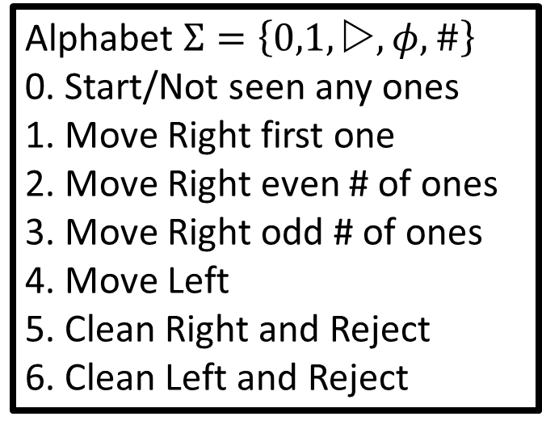
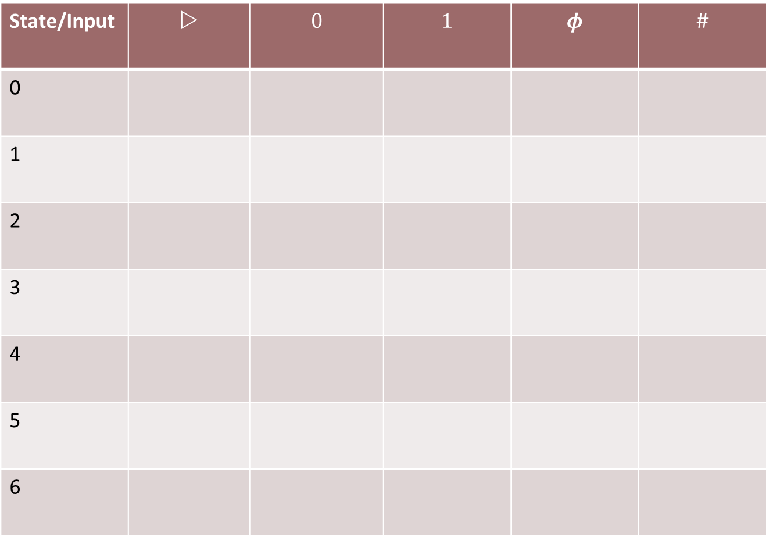
Alphabet $Σ=\left\{0,1,ω, φ, \#\right\}$
0. Start/Not seen any ones
1. Move Right first one
2. Move Right even # of ones
3. Move Right odd # of ones
4. Move Left
5. Clean Right and Reject
6. Clean Left and Reject
State/Input | $$$$ | $$0$$ | $$1$$ | $$φ$$ | $$\#$$
0
1
2
3
4
5
6

Slide 21
Alphabet $Σ=\left\{0,1,ω, φ, \#\right\}$
0. Start/Not seen any ones
1. Move Right first one
2. Move Right even # of ones
3. Move Right odd # of ones
4. Move Left
5. Clean Right and Reject
6. Clean Left and Reject
$f:{\left\{0,1\right\}}^{∗}→\left\{0,1\right\},$ $f\left(x\right)=1⇔x=1^{n}$ for $n=2^{t}$ for integer $t$
State/Input | $$$$ | $$0$$ | $$1$$ | $$φ$$ | $$\#$$
0
1
2
3
4
5
6
Exercise Break 2:
Fill in rows for states 2 & 4
Keep answer ready (5 triples) to type into chat. Use D for 

Slide 22
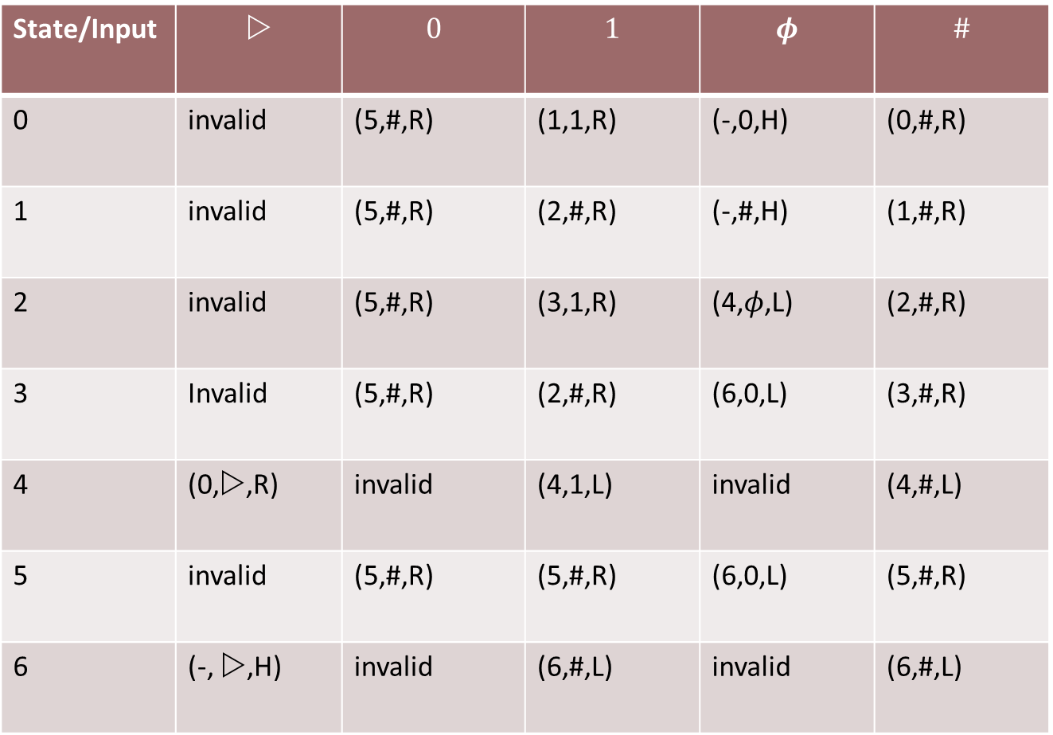
Alphabet $Σ=\left\{0,1,ω, φ, \#\right\}$
0. Start/Not seen any ones
1. Move Right first one
2. Move Right even # of ones
3. Move Right odd # of ones
4. Move Left
5. Clean Right and Reject
6. Clean Left and Reject
State/Input | $$$$ | $$0$$ | $$1$$ | $$φ$$ | $$\#$$
0 | invalid | (5,#,R) | (1,1,R) | (-,0,H) | (0,#,R)
1 | invalid | (5,#,R) | (2,#,R) | (-,#,H) | (1,#,R)
2 | invalid | (5,#,R) | (3,1,R) | (4,$φ$,L) | (2,#,R)
3 | Invalid | (5,#,R) | (2,#,R) | (6,0,L) | (3,#,R)
4 | (0,$$,R) | invalid | (4,1,L) | invalid | (4,#,L)
5 | invalid | (5,#,R) | (5,#,R) | (6,0,L) | (5,#,R)
6 | (-, $$,H) | invalid | (6,#,L) | invalid | (6,#,L)

Slide 23
Summary & Next
Achieved today:
Defined TM
Shown it computes one function that DFA and circuits can’t
Next Lecture:
More examples.
Towards equivalence with (all) programs

