Slide 1
CS 121: Lecture 14 Uncomputability
Madhu Sudan
https://madhu.seas.Harvard.edu/courses/Fall2020
Book: https://introtcs.org
{
The whole staff (faster response): CS 121 Piazza
How to contact us
Only the course heads (slower): cs121.fall2020.course.heads@gmail.com

Slide 2
Announcements:
Midterm 1 graded. Solutions to be posted today-ish.
Homework 4 due in 9 days.
Thanks for participating in Midterm Feedback Survey.

Slide 3
Where we are:
✓
Part I: Circuits:
Finite computation,
quantitative study
✓
Part II: Automata:
Infinite restricted computation, quantitative study
Part III: Turing Machines:
Infinite computation, qualitative study
Part IV: Efficient Computation:
Infinite computation, quantitative study
Part V: Randomized computation:
Extending studies to non-classical algorithms

Slide 4
Today:
Finiteness and Infinities
Cantor: #Reals $>$ #Rationals (Uncountable vs. Countable sets)
Uncomputable function by counting
Explicit Uncomputable function: HALT

Slide 5

Background: Finiteness & Infinities
Glossary of terms:
$ℕ=$ Natural numbers
$ℤ=$Integers
$ℚ=$Rationals
$ℝ$= Reals
$\left[0,1\right]=\left\{x∈ℝ | 0≤x≤1\right\}$
$E:A→B$ 1-1 (aka injective):
$$E\left(a\right)=E\left(a^{′}\right)⇒a=a^{′}$$
$F:B→A$ onto (aka surjective):
$$∀a∈A ∃b∈B s.t. F\left(b\right)=a$$
Back prior to1800s:
Understood finite vs. infinite
Set $S$ is finite if $∃ n∈ℕ$ s.t. $∃$1-1 function $E:S→[n]$
Infinite otherwise.
Example infinite sets: $ℕ, ℤ, ℤ^{2}, ℝ, ℝ^{10}$
Thinking then: All of same size? No point comparing?
…, Cantor ‘1800s:
$\left|S\right|≤\left|T\right|⇔∃ 1−1 E:S→T$ : Applies also to infinite sets.
Examples: $\left|ℕ\right|=\left|ℤ\right|=\left|ℚ\right|=\left|ℤ^{2}\right|=\left|{\left\{0,1\right\}}^{∗}\right|$
Thm: No 1-1 function $E:ℝ→ℤ$ exists. ($\left|ℚ\right|<\left|ℝ\right|$)

Slide 6

Cantor’s Proof
Suppose $∃ 1−1 E:\left[0,1\right]→ℕ.$ Then $∃$ onto $F:ℕ→[0,1]$
Then … can draw matrix with $F{\left(i\right)}_{j}=j$th bit in binary expansion of $F\left(i\right).$
Consider $\overline{F}=\overline{F{\left(0\right)}_{0}} \overline{F{\left(1\right)}_{1}} \overline{F{\left(2\right)}_{2}} \overline{F{\left(3\right)}_{3}}⋯$ where does it lie? [Can’t be $i$th row.]
Doesn’t! Hence $F$ can’t exist!

Slide 7
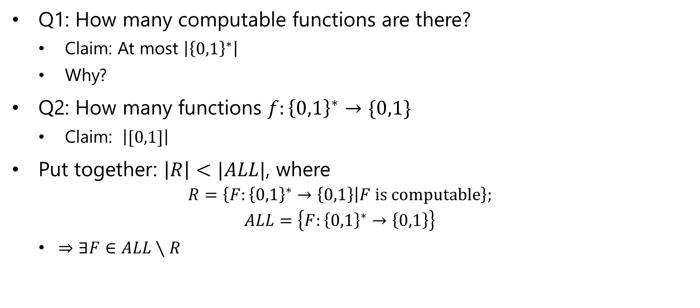
Uncomputable functions by counting
Q1: How many computable functions are there?
Claim: At most $\left|{\left\{0,1\right\}}^{∗}\right|$
Why?
Q2: How many functions $f:{\left\{0,1\right\}}^{∗}→\{0,1\}$
Claim: $\left|[0,1]\right|$
Put together: $\left|R\right|<|ALL|$, where
$$R=\left\{F:{\left\{0,1\right\}}^{∗}→\left\{0,1\right\} | F is computable\right\};$$
$$ALL=\left\{F:{\left\{0,1\right\}}^{∗}→\left\{0,1\right\}\right\}$$
$⇒∃F∈ALL∖R$

Slide 8
Exercise Break 1
Give direct proof a la Cantor that $\left|{\left\{0,1\right\}}^{∗}\right|<ALL ≝\left\{f:{\left\{0,1\right\}}^{∗}→\left\{0,1\right\}\right\}$

Slide 13
Explicit Uncomputable Functions?
Motivation: Are “uncomputable” functions of interest to us?
Maybe they exist but can’t even be described.
(#describable functions = countable! By definition!)
If they can’t be described why would we be interested in computing them?
Turns out: Many natural problems uncomputable.
As we will see, the following (very describable!) problem is uncomputable.
$HALT\left(M,x\right)=1 if M halts on input x$
$=0 otherwise$
Will see in next lecture: $HALT$ is uncomputable

Slide 14
An Explicit Uncomputable Function
$Cantor$ inspired by the diagonalization proof
Idea:
columns = ${\left\{0,1\right\}}^{∗}$ = inputs
rows $={\left\{0,1\right\}}^{∗}⊇$Turing machines
$M$th row, $x$th column = $(M,x)$
If row not TM – fill with 0s.
If $M$ does not halt on $x$ enter 0.
Consider function that computes diagonal entries and flips them.
$Cantor\left(M\right)=\overline{M(M)}$

Slide 15
Exercise Break 2
Prove $Cantor$ is uncomputable, where $Cantor\left(M\right)=\overline{M(M)}$

Slide 20
Proof:
Assume for contradiction that Turing Machine $A$ computes $Cantor$
Then we have $∀M A\left(M\right)=\overline{M(M)}$
So $A\left(A\right)=\overline{M(M)}{\left.​\right|}_{M=A}=\overline{A(A)}$. … Contradiction!!

Slide 21
Next Lecture: More Uncomputability
Uncomputability of new problems
$HALT, HALT_ON_ZERO$
Two proof techniques
Using presumed (non-existent) Turing Machine
REDUCTIONS!!!
Using a hard problem to show other problems are also hard.

