Slide 1
CS 121: Lecture 15 More Uncomputability
Madhu Sudan
https://madhu.seas.Harvard.edu/courses/Fall2020
Book: https://introtcs.org
{
The whole staff (faster response): CS 121 Piazza
How to contact us
Only the course heads (slower): cs121.fall2020.course.heads@gmail.com

Slide 2
Announcements:
Advanced Section: Nada Amin: Uncomputability & PL Design
Thanks for feedback.
Confirm – are breakouts no good?
TFs scouring the feedback also!
Sections: Week 7 cycle start, material on canvas (as usual).

Slide 3
Where we are:
✓
Part I: Circuits:
Finite computation,
quantitative study
✓
Part II: Automata:
Infinite restricted computation, quantitative study
Part III: Turing Machines:
Infinite computation, qualitative study
Part IV: Efficient Computation:
Infinite computation, quantitative study
Part V: Randomized computation:
Extending studies to non-classical algorithms

Slide 4
Review of last lecture
# of functions = uncountable
# of computable functions = countable.
So … $∃$ an uncomputable function
Further $Cantor\left(M\right)=\overline{M(M)}$ uncomputable

Slide 5
This lecture (& next)
Uncomputability much more pervasive
“Intent of a program” uncomputable

Slide 6
Today: HALT is uncomputable
Definition: HALT(M,x) = 1 if M halts on input x; 0 otherwise.
2 Proofs:
Diagonalization
Reduction from CANTOR

Slide 7
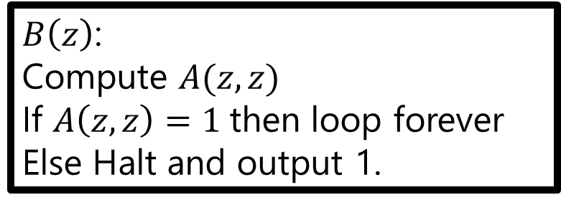
Proof 1 (Direct Diagonalization):
Let $A$ be a TM that solves $HALT$, i.e., $∀M,x, A\left(M,x\right)=HALT\left(M,x\right)$
Consider the following Algorithm (which has equivalent TM – HOCAEIT)
Note: We are defining $B$ but not running it! It does not have to halt (in fact crucial that it does not on some inputs.
Key point: $B$ is a TM.
$B\left(z\right)$:
Compute $A(z,z)$
If $A\left(z,z\right)=1$then loop forever
Else Halt and output 1.

Slide 8
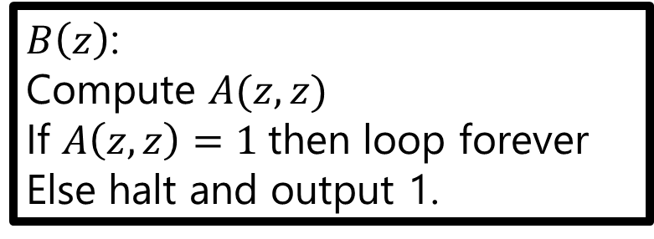
Proof 1 (Direct Diagonalization):
Let $A$ be a TM that solves $HALT$, i.e., $∀M,x, A\left(M,x\right)=HALT\left(M,x\right)$
Consider $B$
What is $A\left(B,B\right)?$
Case 1: $A\left(B,B\right)=1⇒$ (by correctness of $A$) $B$ halts on input $B$
$⇒$ (by construction of $B$) $B$ loops forever $⇒$ Contradiction.
$B\left(z\right)$:
Compute $A(z,z)$
If $A\left(z,z\right)=1$then loop forever
Else halt and output 1.

Slide 9
Proof 1 (Direct Diagonalization):
Let $A$ be a TM that solves $HALT$, i.e., $∀M,x, A\left(M,x\right)=HALT\left(M,x\right)$
Consider $B$
What is $A\left(B,B\right)?$
Case 1: $A\left(B,B\right)=1⇒$ (by correctness of $A$) $B$ halts on input $B$
$⇒$ (by construction of $B$) $B$ loops forever $⇒$ Contradiction.
Case 2: $A\left(B,B\right)=0$ $⇒$ (by correctness of $A$) $B$ does not halt on input $B$
$⇒$ (by construction of $B$) $B$ halts on $B$ (outputs 1) $⇒$ Contradiction!
$B\left(z\right)$:
Compute $A(z,z)$
If $A\left(z,z\right)=1$then loop forever
Else halt and output 1.

Slide 10
Thoughts:
Very slick!
But just an implementation of Diagonalization. (Note $B\left(B\right);A\left(z,z\right)…$)
Food for thought: What happens if $A$ does not always halt but correctly determines $HALT(M,x)$ on inputs where it halts?

Slide 15
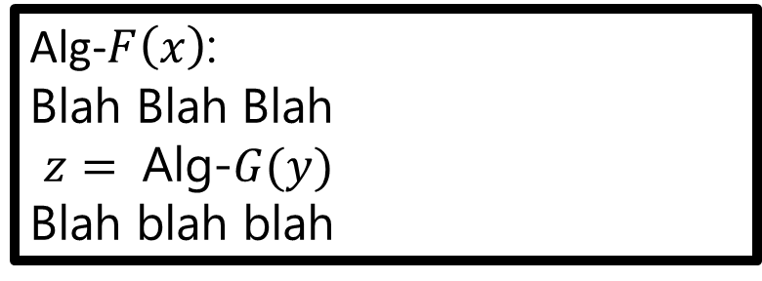
Proof 2: (General) Reduction
Reductions: Key theme in Computer Science
Function $F$ reduces to $G$ $(F≤G)$ if algorithm for $G$ implies algorithm for $F$
How to prove it?
Build algorithm for $F$ using Alg-G as subroutine.
Alg-F correctly computes $F$ if Alg-G correctly computes $G$
Usual Interpretation: Positive:
Somebody builds tools for mean, median; I just invoke it on my data with wrapper.
Our Use: Negative:
Start with $F$ known not to have algorithm. Infer $G$ does not!
Do you remember any so far in this course?
Alg-$F\left(x\right)$:
Blah Blah Blah
$z=$ Alg-$G(y)$
Blah blah blah

Slide 16
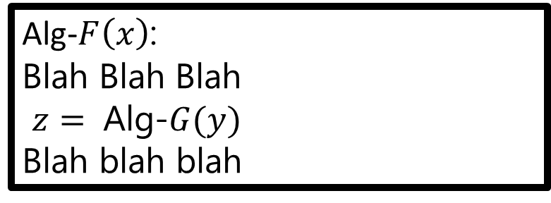
Example: $HALT$ uncomputable
Recall $CANTOR$ uncomputable.
Will use this to prove $HALT$ uncomputable.
So what do we need to do?
Alg-$F\left(x\right)$:
Blah Blah Blah
$z=$ Alg-$G(y)$
Blah blah blah

Slide 17
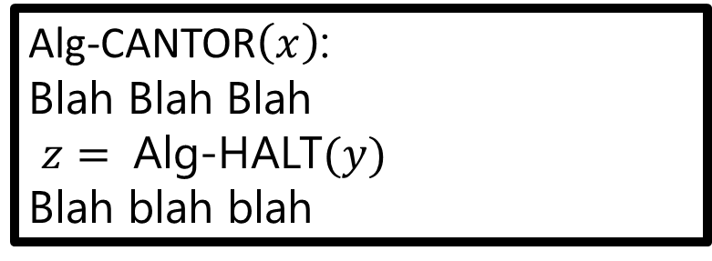
Example: $HALT$ uncomputable
Recall $CANTOR$ uncomputable.
Will use this to prove $HALT$ uncomputable.
So what do we need to do?
Alg-CANTOR$\left(x\right)$:
Blah Blah Blah
$z=$ Alg-HALT$(y)$
Blah blah blah

Slide 18
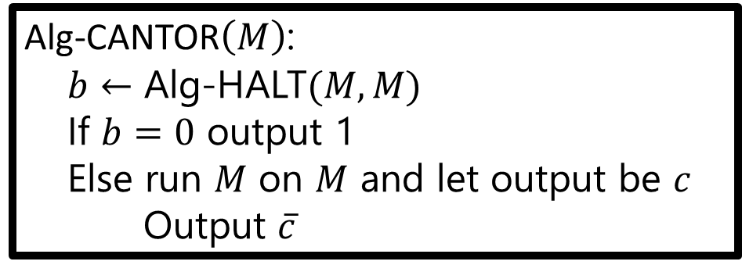
ALG-CANTOR
Recall $CANTOR\left(M\right)=\overline{M(M)}$
Claim 1: Alg-CANTOR always halts if Alg-HALT correct.
Claim 2: Alg-CANTOR correctly computes CANTOR.
Claim 1+Claim 2: Alg-CANTOR computes (the uncomputable function) CANTOR if Alg-HALT exists $⇒$ Alg-HALT does not exist $⇔$ HALT uncomputable.
Alg-CANTOR$\left(M\right)$:
$b←$ Alg-HALT$(M,M)$
If $b=0$ output 1
Else run $M$ on $M$ and let output be $c$
Output $\overline{c}$

Slide 19
What did we prove?
CANTOR $≤$ HALT ? Or HALT $≤$ CANTOR?

Slide 20
(Basic) Reduction
For many problems we will use a very basic reduction (even simpler than $CANTOR≤ HALT$)
Alg-F$\left(x\right)$:
$y=R(x)$
$Return$Alg-G$(y)$

Slide 21
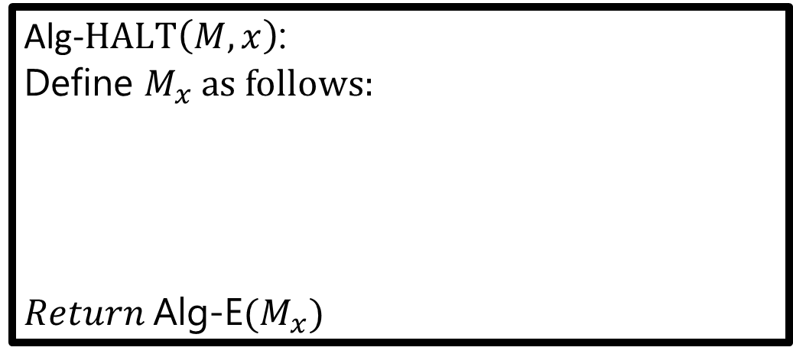
Example:
$E\left(M\right)=1⇔ ∀x, M\left(x\right)=0$ or $M$ does not halt on $x$
$HALT≤E$
Alg-$HALT\left(M,x\right)$:
Define $M_{x}$ as follows:
$Return$Alg-E$(M_{x})$
$M_{x}\left(z\right):$ Ignore $z$,
output 1 if $M$ halts on $x$
output 0 o.w.

Slide 22
Section + Next Lecture
More Uncomputability + Reductions
HALT-ON-ZERO
H-O-Z(M) = 1 if $M$ accepts “” and 0 otherwise.
Moral: It is not the infinity of inputs that makes HALT hard!
Rice’s theorem
Every non-trivial semantic property of algorithms is uncomputable!

