Slide 1
CS 121: Lecture 16 Rice’s Theorem
Adam Hesterberg
https://madhu.seas.Harvard.edu/courses/Fall2020
Book: https://introtcs.org
{
The whole staff (faster response): CS 121 Piazza
How to contact us
Only the course heads (slower): cs121.fall2020.course.heads@gmail.com

Slide 2
If eligible,
Get Ready to Vote
If you’re voting by mail, make sure to submit your absentee ballot or take action if your ballot has not arrived. Learn more at bit.ly/harvardvotebymail.
If you’re voting in person, make sure to pick a date/time, research your polling location and voter ID laws. Learn more at bit.ly/harvardvoteinperson.
Research what’s on your ballot: ballotpedia.org.
If you have voting questions or need help, text “@votinghelp” to 81010 or email voteschallenge@harvard.edu

Slide 3
Where we are:
✓
Part I: Circuits:
Finite computation,
quantitative study
✓
Part II: Automata:
Infinite restricted computation, quantitative study
Part III: Turing Machines:
Infinite computation, qualitative study
Part IV: Efficient Computation:
Infinite computation, quantitative study
Part V: Randomized computation:
Extending studies to non-classical algorithms

Slide 4
Review of last two lectures
$Cantor\left(M\right)=\overline{M(M)}$ uncomputable
HALT(M,x) uncomputable
$E\left(M\right)=1⇔ ∀x, M\left(x\right)=0$ or $M$ does not halt on $x$: uncomputable

Slide 5
This lecture
Uncomputability much more pervasive
We’ll keep doing examples until most of the class votes “Go Faster”.
“Intent of a program” uncomputable

Slide 6
Thm 1: $COMPUTESXOR\left(M\right)=1$ iff $M\left(x\right)=XOR(x)$ for all $x$. Then $COMPUTEXOR$ is uncomputable.
Thm 2: $ONLYODD\left(M\right)=1$ iff $|M\left(x\right)|$ odd for all $x$. Then $ONLYODD$ is uncomputable.
Thm 3: $NOEVENS\left(M\right)=1$ unlessss $|M\left(x\right)|$ even for some $x$. Then $NOEVENS$ is uncomputable.
Thm 4: $HALTONSHORT\left(M\right)=1$ iff $M\left(x\right)$ halts whenever $\left|x\right|≤100$. Then $HALTONSHORT$ is uncomputable.
Thm 5: $MONOTONE\left(M\right)=1$ iff $|M\left(x\right)≤M(x^{′})|$ whenever $x≼x′$. Then $MONOTONE$ is uncomputable.
Thm 6: $COMPUTESPAL\left(M\right)=1$ iff $M\left(x\right)=PAL(x)$ for all $x$. Then $COMPUTEPAL$ is uncomputable.

Slide 7
Thm 1: $COMPUTESXOR\left(M\right)=1$ iff $M\left(x\right)=XOR(x)$ for all $x$. Then $COMPUTEXOR$ is uncomputable.
Recall: $HALT$ is uncomputable.
Will use this to prove $COMPUTESXOR$ is uncomputable.
I.e. if we could solve $COMPUTESXOR$, we could solve HALT.
I.e. we’ll reduce from $HALT$ to $COMPUTEXOR$
I.e. we’ll rule out the possibility ($HALT$ hard, $COMPUTEXOR$ easy)
I.e. we’ll show that $HALT≤COMPUTEXOR$.
Alg-HALT$\left(x\right)$:
Blah Blah Blah
$z=$ Alg-$COMPUTEXOR(y)$
Blah blah blah

Slide 8
“$COMPUTESXOR$ uncomputable” doesn’t say:
…doesn’t say that there’s no machine that computes XOR.
i.e. doesn’t say that XOR is uncomputable.
E.g. Alg-XOR:
Alg-XOR$\left(x\right)$:
ans = 0
for bit in x:
ans = ans XOR bit
return ans

Slide 9
Proof of Thm 1 (COMPUTESXOR uncomp.)
$HALT≤COMPUTEXOR$
Suppose there exists an algorithm $ALG−COMPUTEXOR$…
This would be an algorithm computing HALT, which doesn’t exist!
Alg-$HALT\left(M,x\right)$:
Define $M_{x}$ as follows:
z = Alg-C$OMPUTEXOR\left(M_{x}\right)$
Return z
$M_{x}\left(y\right):$ Simulate $M$ on $x$.
Ignore the result.
Return ALG-XOR(y).

Slide 10
Break: discuss proof: COMPUTESXOR uncomp.
$HALT≤COMPUTEXOR$
Suppose there exists an algorithm $ALG−COMPUTEXOR$…
This would be an algorithm computing HALT, which doesn’t exist!
Alg-$HALT\left(M,x\right)$:
Define $M_{x}$ as follows:
z = Alg-C$OMPUTEXOR\left(M_{x}\right)$
Return z
$M_{x}\left(y\right):$ Simulate $M$ on $x$.
Ignore the result.
Return ALG-XOR(y).

Slide 11
Thm 2: $ONLYODD\left(M\right)=1$ iff $|M\left(x\right)|$ odd for all $x$. Then $ONLYODD$ is uncomputable.
Recall: $HALT$ is uncomputable.
Will use this to prove $ONLYODD$ is uncomputable.
I.e. if we could solve $ONLYODD$, we could solve HALT.
I.e. we’ll reduce from $HALT$ to $ONLYODD$.
I.e. we’ll rule out the possibility ($HALT$ hard, $ONLYODD$ easy)
I.e. we’ll show that $HALT≤ONLYODD$.
Alg-HALT$\left(x\right)$:
Blah Blah Blah
$z=$ Alg-$ONLYODD(y)$
Blah blah blah

Slide 12
“$ONLYODD$ uncomputable” doesn’t say:
…doesn’t say that there’s no machine that outputs odd-length strings on every input.
i.e. doesn’t say that if a function has only odd-length output, it’s uncomputable.
E.g. Alg-ODD:
Alg-O$DD\left(x\right)$:
ignore x.
return 1001111

Slide 13
Proof of Thm 2 (ONLYODD uncomp.)
$HALT≤ONLYODD$
Suppose there exists an algorithm $ALG−ONLYODD$…
This would be an algorithm computing HALT, which doesn’t exist!
Alg-$HALT\left(M,x\right)$:
Define $M_{x}$ as follows:
z = Alg-O$NLYODD\left(M_{x}\right)$
Return z
$M_{x}\left(y\right):$ Simulate $M$ on $x$.
Ignore the result.
Return Alg-ODD(y).

Slide 14
Thm 3: $NOEVENS\left(M\right)=1$ unlessss $|M\left(x\right)|$ even for some $x$. Then $NOEVENS$ is uncomputable.
Recall: $HALT$ is uncomputable.
Will use this to prove $NOEVENS$ is uncomputable.
I.e. if we could solve $NOEVENS$, we could solve HALT.
I.e. we’ll reduce from $HALT$ to $NOEVENS$.
I.e. we’ll rule out the possibility ($HALT$ hard, $NOEVENS$ easy)
I.e. we’ll show that $HALT≤NOEVENS$.
Alg-HALT$\left(x\right)$:
Blah Blah Blah
$z=$ Alg-$NOEVENS(y)$
Blah blah blah

Slide 15
“$NOEVENS$ uncomputable” doesn’t say:
…doesn’t say that there’s no machine that outputs only odd-length strings or doesn’t halt.
i.e. doesn’t say that if a function has no even-length output, it’s uncomputable.
E.g. Alg-LOOP:
…doesn’t say the opposite, either!
i.e. doesn’t say that if a function has even-length output, it’s uncomputable.
E.g. Alg-EVEN:
Alg-L$OOP\left(x\right)$:
while(True)
Alg-E$VEN\left(x\right)$:
return ``121_is_great’’

Slide 16
Proof of Thm 3 (NOEVENS uncomp.)
$HALT≤NOEVENS$
Suppose there exists an algorithm $ALG−NOEVENS$…
This would be an algorithm computing HALT, which doesn’t exist!
Alg-$HALT\left(M,x\right)$:
Define $M_{x}$ as follows:
z = Alg-N$OEVENS\left(M_{x}\right)$
Return z
$M_{x}\left(y\right):$ Simulate $M$ on $x$.
Ignore the result.
Return 1-(Alg-EVEN(y)).

Slide 17
Thm 4: $HALTONSHORT\left(M\right)=1$ iff $M\left(x\right)$ halts whenever $\left|x\right|≤100$. Then $HALTONSHORT$ is uncomputable.
Recall: $HALT$ is uncomputable.
Will use this to prove $HALTONSHORT$ is uncomputable.
I.e. if we could solve $HALTONSHORT$, we could solve HALT.
I.e. we’ll reduce from $HALT$ to $HALTONSHORT$.
I.e. we’ll rule out the possibility ($HALT$ hard, $HALTONSHORT$ easy)
I.e. we’ll show that $HALT≤HALTONSHORT$.
Alg-HALT$\left(x\right)$:
Blah Blah Blah
$z=$ Alg-$HALTONSHORT(y)$
Blah blah blah

Slide 18
“$HALTONSHORT$ uncomputable” doesn’t say:
…doesn’t say that there’s no machine that halts on short inputs.
E.g. Alg-EVEN:
…doesn’t say the opposite, either!
E.g. Alg-LOOP:
Alg-E$VEN\left(x\right)$:
return ``121_is_great’’
Alg-L$OOP\left(x\right)$:
while(True)

Slide 19
Proof of Thm 4 (HALTONSHORT uncomp.)
$HALT≤HALTONSHORT$
Suppose there exists an algorithm $ALG−HALTONSHORT$…
This would be an algorithm computing HALT, which doesn’t exist!
Alg-$HALT\left(M,x\right)$:
Define $M_{x}$ as follows:
z = Alg-H$ALTONSHORT\left(M_{x}\right)$
Return z
$M_{x}\left(y\right):$ Simulate $M$ on $x$.
Ignore the result.
Return Alg-EVEN(y).

Slide 20
Rice’s Theorem
Rice’s Thm: For every $F:\{0,1\}^{∗}→\{0,1\}$, if $F$ is semantic then either $F=one$ or $F=zero$ or $F$ is uncomputable.
Def: $M$ and $M′$ are functionally equivalent if for every $x∈\{0,1\}^{∗}$, $M\left(x\right)=M′(x)$
Notation: $M≅M′$
Def: $F:\{0,1\}^{∗}→\{0,1\}$ is semantic if for every $M≅M′$, $F\left(M\right)=F(M^{′})$
Q: Let $one:\{0,1\}^{∗}→\{0,1\}$ be constant one function ($one\left(w\right)=1$ for every $w$). Then $one$ is semantic.

Slide 21
Thm 3: $COMPUTEXOR\left(M\right)=1$ iff $M\left(x\right)=XOR(x)$ for all $x$. Then $COMPUTEXOR$ is uncomputable.
Thm 4: $COMPUTEPAL\left(M\right)=1$ iff $M\left(x\right)=PAL(x)$ for all $x$. Then $COMPUTEPAL$ is uncomputable.
Rice’s Theorem: If $F:\{Turing Machines\}→\{0,1\}$ has property that $F(M)$ is semantic (only depends on what $M$ computes, not how) and $F$ is not trivial (true for every M or no M), then F is uncomputable.
Thm 5: $ONLYEVEN\left(M\right)=1$ iff $|M\left(x\right)|$ even for all $x$. Then $ONLYEVEN$ is uncomputable.
Thm 6: $MONOTONE\left(M\right)=1$ iff $|M\left(x\right)≤M(x^{′})|$ whenever $x≼x′$. Then $MONOTONE$ is uncomputable.
Thm 7: $HALTONSHORT\left(M\right)=1$ iff $M\left(x\right)≠⊥$ whenever $\left|x\right|≤100$. Then $HALTONSHORT$ is uncomputable.

Slide 22
Thm n (Rice’s Theorem)
Recall: $HALT$ is uncomputable.
Will use this to prove $F$ is uncomputable.
I.e. if we could solve $F$, we could solve HALT.
I.e. we’ll reduce from $HALT$ to $F$.
I.e. we’ll rule out the possibility ($HALT$ hard, $F$ easy)
I.e. we’ll show that $HALT≤F$.
Alg-HALT$\left(x\right)$:
Blah Blah Blah
$z=$ Alg-$F(y)$
Blah blah blah

Slide 23
“$F$ isn’t trivial” means:
There’s some machine M such that F(M) = 1.
E.g. Alg-???:
There’s some machine M such that F(M) = 0
E.g. Alg-LOOP:
Alg-at-least-it-exists$\left(x\right)$:
???
Alg-L$OOP\left(x\right)$:
while(True)
(These might be switched.)

Slide 24
Proof of Thm n (Rice’s theorem: F uncomp.)
$HALT≤F$
Suppose there exists an algorithm $ALG−F$…
This would be an algorithm computing HALT, which doesn’t exist!
Alg-$HALT\left(M,x\right)$:
Define $M_{x}$ as follows:
z = Alg-F$\left(M_{x}\right)$
Return z
$M_{x}\left(y\right):$ Simulate $M$ on $x$.
Ignore the result.
Return Alg-at-least-it-exists(y).

Slide 25
Break: discuss Rice’s Theorem & proof
$HALT≤F$
Suppose there exists an algorithm $ALG−F$…
This would be an algorithm computing HALT, which doesn’t exist!
Alg-$HALT\left(M,x\right)$:
Define $M_{x}$ as follows:
z = Alg-F$\left(M_{x}\right)$
Return z
$M_{x}\left(y\right):$ Simulate $M$ on $x$.
Ignore the result.
Return Alg-at-least-it-exists(y).

Slide 26
Rice’s Theorem caveats
Rice’s Thm: For every $F:\{0,1\}^{∗}→\{0,1\}$, if $F$ is semantic then either $F=one$ or $F=zero$ or $F$ is uncomputable.
A first approximation is “functions that take a TM M as input are uncomputable”, but:
-Check whether you actually needed the TM as input.
-Functions that ask about how M computes things might or might not be computable.
“M has <100 states” vs “M has <100 states and computes HALT”
…this isn’t just a loophole; it lets us salvage things we want from uncomputability!

Slide 27
Things we’d like to do, but can’t.
Bug checking: Given a program M (say, in Python), check whether it will always return.
Type checking: Given a program M (say, in Python), check whether it ever calls the concat function with inputs that aren’t strings.
Equivalence checking: A clever programmer claims to have found a faster replacement for your function. It’s fast, but you don’t understand the code. Is it right?

Slide 28
Rice’s Theorem (Fundamental Theorem of Software Verification):
Every semantic $F$ is either trivial or uncomputable.
Is software verification doomed?
Q: Let $ValidType:\{0,1\}^{∗}→\{0,1\}$ be function that maps a C program $P$ to $1$ iff when $P$ is executed, it will never call a function with a char parameter with an int parameter.
Prove that $ValidType$ is computable.
Type mismatch error

Slide 29
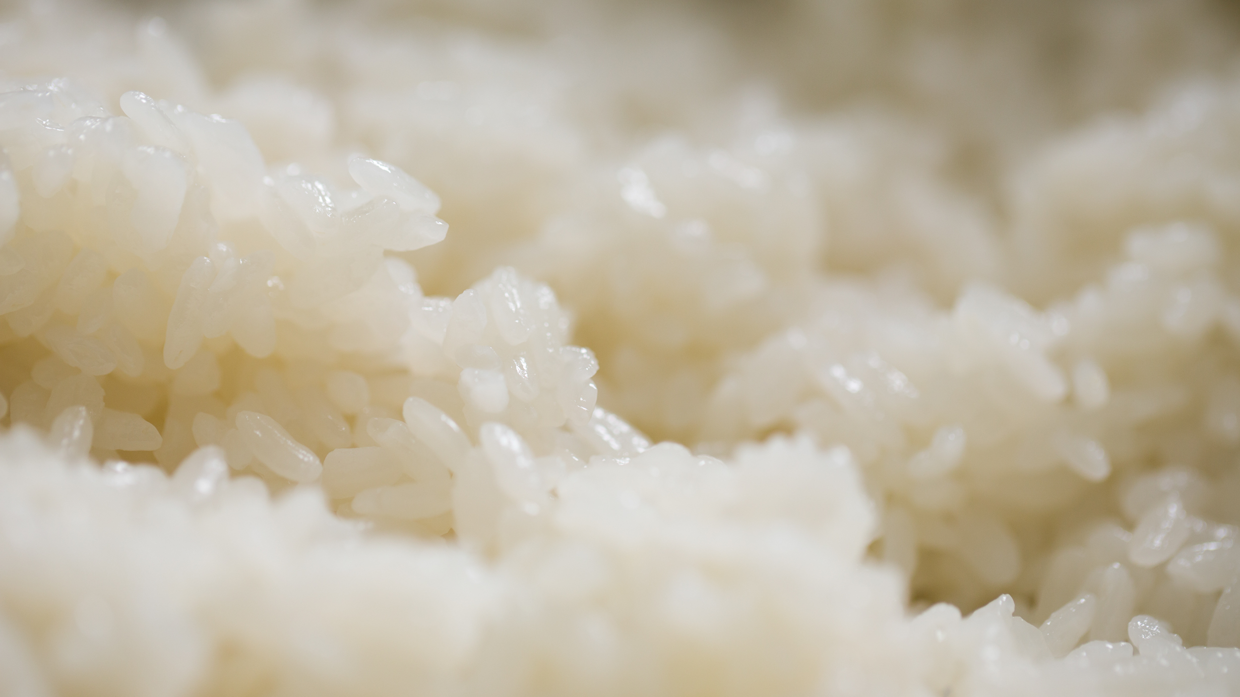
Coping with Rice
Turing Machines
General programming languages
$λ$ calculus
…
Type systems
Proof systems
Simply typed $λ$ calculus
System F
HTML
Context Free Grammars
Regular expressions
…
ANSI SQL (92)
Turing Complete Models
Restricted Computational Models
+ Stronger
- Weaker
- No semantic analysis
+ Semantic analysis

Slide 30
Section + Next Lecture
✓
✓
Part I: Circuits:
Finite computation,
quantitative study
Section: More Uncomputability + Reductions
HALT-ON-ZERO
H-O-Z(M) = 1 if $M$ accepts “” and 0 otherwise.
Moral: It is not the infinity of inputs that makes HALT hard!
Next Lecture: Efficient Computation (P)
Part II: Automata:
Infinite restricted computation, quantitative study
✓
Part III: Turing Machines:
Infinite computation, qualitative study
Part IV: Efficient Computation:
Infinite computation, quantitative study
Part V: Randomized computation:
Extending studies to non-classical algorithms

