Slide 1
CS 121: Lecture 18 Polynomial Time Reductions
Madhu Sudan
https://madhu.seas.Harvard.edu/courses/Fall2020
Book: https://introtcs.org
{
The whole staff (faster response): CS 121 Piazza
How to contact us
Only the course heads (slower): cs121.fall2020.course.heads@gmail.com

Slide 2
Announcements:
Election Today!
Midterm 2 in 2 weeks.
Same time format.
No collaboration on cheat sheets. Each person prepares their own.
Open book (Barak - searchable pdf).

Slide 3
Where we are:
✓
Part I: Circuits:
Finite computation,
quantitative study
✓
Part II: Automata:
Infinite restricted computation, quantitative study
Part III: Turing Machines:
Infinite computation, qualitative study
Part IV: Efficient Computation:
Infinite computation, quantitative study
Part V: Randomized computation:
Extending studies to non-classical algorithms

Slide 4
Review of last lecture
Defined time complexity measure
Defined classes: TIME(t(n)), P, EXP
Watch out for category error: All the above are sets of functions, not algorithms!
Stated+Proved: TIME Hierarchy theorem.
$⇒ P≠EXP$
Stated:
RAM-TIME $≈$ TM-TIME (up to polynomial factors)
SIZE $≤≈$ TM TIME (up to polynomial factors)
Extended Turing-Church Thesis

Slide 5
Today
Some problems in $P$ and $EXP$
Polytime Reductions $≤_{P}$: Relate problems of unknown complexity
Specific example: $SAT≤_{P} ISET$

Slide 6
Some example problems
Warning: Will flash lots of slides quickly!
Don’t have to know individual definitions/problems … just get a flavor of variety.

Slide 7
Solving Linear Equations
Input: $n$ linear equations in $n$ variables: $Ax=b$, with $A∈ℝ^{n×n}$ and $b∈R^{n}$.
Output: “No solution” or assignment satisfying equations.
Notation: Equations are $\left\langle A_{i},x\right\rangle =b_{i}$ where $A_{i}$ is $i$-th row of $A$, and $\left\langle u,v\right\rangle ≝\sum_{i=0}^{n−1}{u_{i}v_{i}}$
Gaussian elimination Algorithm:
If $n=1$: trivial
Rearrange equations, variables, so that $A_{0}^{0}≠0$
(first equation involves first variable)
Change equation from$\left\langle A^{0},x\right\rangle =b_{0}$to $\frac{1}{A_{0}^{0}}\left\langle A_{0}^{0},x\right\rangle =\frac{b_{0}}{A_{0}^{0}}$ to get
$$x_{0}=\frac{b_{0}}{A_{0}^{0}} −\sum_{j=1}^{n−1}{v_{j}x_{j}} where { v}_{j}=\frac{A_{j}^{0}}{A_{0}^{0}} (∗)$$
Replace $x_{0}$ with RHS of (*) in equations $1,…,n−1$.
Now have $n−1$ equations with $n−1$ variables! Repeat.
Analysis:
Let $T\left(n\right)$ denotes number of arithmetic operations
Then $T\left(n\right)=T\left(n−1\right)+O\left(n^{2}\right)$
Yields $T\left(n\right)=O\left(n^{3}\right)$
Counts #arithmetic operations. Should multiply by cost of arithmetic. (poly(#bits) per number).
Summary: Linear equations can be solved in polynomial time.
Notes:
3y+2z=4 ; x+y+z = 1; x+2y = 1

Slide 8
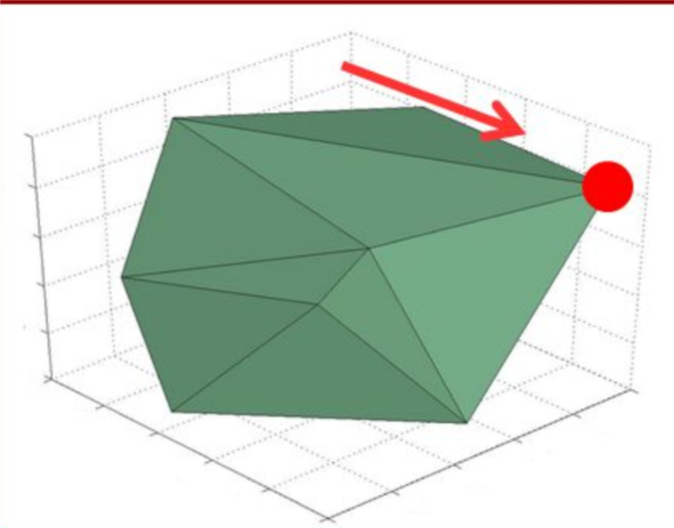
Linear Programming
Compute $\min_{x∈𝕂}f(x)$ where $f$ is linear and $𝕂$ is polytope:
$𝕂=\{x∈ℝ^{n} | Ax≤b\}$
Example: Startup resource allocation:
Business customer: yields $r$ revenue while costing $a$ developer hours and $b$ customer support hours.
End user: yields $r′$ revenue while costing $a′$ dev hours and $b′$ support hours.
Maximize revenue subject to $A$ total dev hours and $B$ total support hours:
Aside: Max, not Min! Still LP?
Thm: (Khachiyan 79, Karmakar 84) There is $poly(n)$ time algorithm for linear programming on $n$ variables.
$$\begin{matrix}\max_{x_{0},x_{1}∈ℝ}r⋅x_{0} & +r′⋅x_{1} & & s.t. \\ a⋅x_{0} & +a′⋅x_{1} & & ≤A \\ b⋅x_{0} & +b′⋅x_{1} & & ≤B\end{matrix}$$

Slide 9
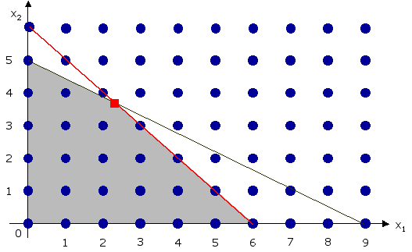
Integer Programming
Compute $\min_{x∈I}f(x)$ where $f$ linear and $I=𝕂∩ℤ^{n}$ ;$𝕂=\left\{x | Ax≤b\right\}$
($I$ integer points in polytope $𝕂$)
Motivation: Can’t support half a client
Depressing fact: No known polynomial time algorithm for integer programming.

Slide 10
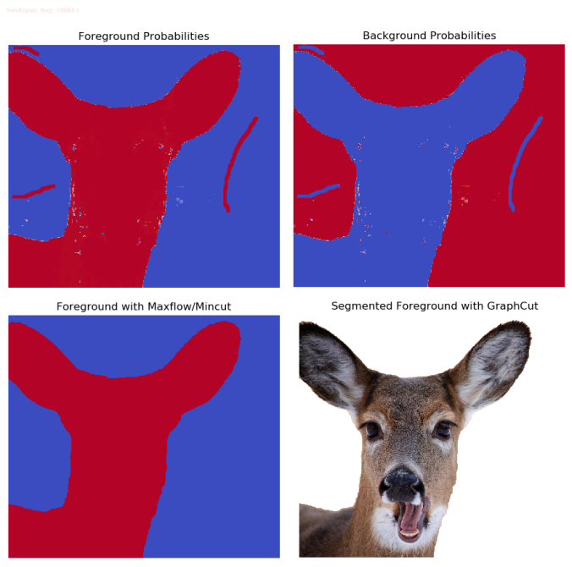
Minimum s-t Cut Problem
$$S$$
$$\overline{S}$$
$$s$$
$$t$$
Def: A cut in $G=(V,E)$ is $S⊆V$ with $∅≠S≠V$.
Notation: Edges cut by $S$, $E\left(S,\overline{S}\right)=\left\{\left(u,v\right)∈E| u∈S⇔v∉S\right\}$
Minimum s-t cut problem:
Minimize $|E(S,\overline{S})|$ over all $S⊆V$ s.t. $s∈S$ and $t∉S$
(sample motivation: image segmentation)
Good News: Can be solved in time $O(VE)$
© Sandypan Dey (UMBC)

Slide 11
Maximum Cut Problem
Problem: Find cut $S$ that maximizes $|E(S,\overline{S})|$.
Sample applications:
Register allocation in compilers,
Ising model, X-ray crystallography, cryo-electron microscopy, more
Depressing news: Best known algorithms are exponential in the worst case.

Slide 12
3-SAT Problem
Input: A “3CNF formula” $φ= C_{0}∧C_{1}∧⋯∧C_{m−1}$ on $n$ variables $x_{0}…x_{n−1}$
3CNF Formula = AND of $m$ 3-clauses ($φ= C_{0}∧C_{1}∧⋯∧C_{m−1}$)
3-Clause = OR of 3 literals ($C_{j}=ℓ_{1}∨ℓ_{2}∨ℓ_{3})$
literal = variable or its negation $\left(ℓ=x_{i} or ℓ=\overline{x_{i}}\right)$
Goal: Output 1 if there is assignment $x∈\{0,1\}^{n}$ that makes formula true.
Output 0 otherwise.
Example: $(x_{7}∨{\overline{x}}_{17}∨x_{29})∧({\overline{x}}_{7}∨x_{15}∨x_{22})∧(x_{22}∨{\overline{x}}_{29}∨x_{55})$
$$\left(x_{1}∨x_{2}∨x_{3}\right)∧\left(\overline{x_{1}}∨x_{2}∨x_{3}\right)∧\left(x_{1}∨\overline{x_{2}}∨x_{3}\right)∧\left(x_{1}∨x_{2}∨\overline{x_{3}}\right)$$
$$∧\left(x_{1}∨\overline{x_{2}}∨\overline{x_{3}}\right)∧\left(\overline{x_{1}}∨x_{2}∨\overline{x_{3}}\right)∧\left(\overline{x_{1}}∨\overline{x_{2}}∨x_{3}\right)∧\left(\overline{x_{1}}∨\overline{x_{2}}∨\overline{x_{3}}\right)$$

Slide 13
3-SAT Problem
Input: A “3CNF formula” $φ= C_{0}∧C_{1}∧⋯∧C_{m−1}$ on $n$ variables $x_{0}…x_{n−1}$
Goal: Determine if there is assignment $x∈\{0,1\}^{n}$ that makes formula true.
Depressing news: Best known algorithms require exponential time.
Better news: Exponent has improved, decent heuristic “SAT SOLVERS”, can solve the 2SAT problem.
Exercise: Show “INTEGER PROGRAMMING can be solved in poly time $⇒$3SAT can be solved in poly time”.

Slide 14
Summary of problems:
The following problems are in $P$
Does the linear system $Ax=b$ have a solution?
Does the linear program $Max \left\langle c,x\right\rangle s.t. Ax≤b$ have a real solution of value $≥v$
Given $G$does $G$ have a cut of value at most $k$ (min cut)
Given a 2CNF formula $φ=C_{0}∧C_{1}∧⋯∧C_{m−1}$ is there a satisfying $x∈{\left\{0,1\right\}}^{n}$
The following problems are in $EXP$ but not known to be in $P$
Does linear program $Max \left\langle c,x\right\rangle s.t. Ax≤b$ have an integer solution of value $≥v$
Given $G$ does $G$ have a cut of value at least $k$ (max cut)
Given a 3CNF formula $φ=C_{0}∧C_{1}∧⋯∧C_{m−1}$ is there a satisfying $x∈{\left\{0,1\right\}}^{n}$
HALT is not in $P$ or even $EXP$ !
HAL$T_{2^{n}}$ is in EXP but not P.

Slide 15
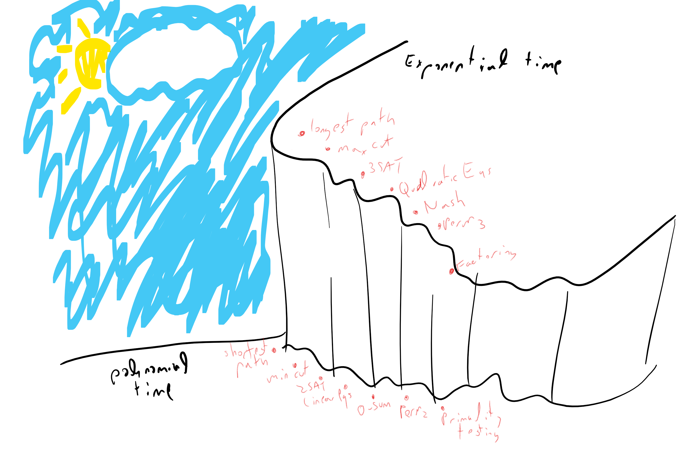
Artwork representing lecture thus far!

Slide 16
Relating problems to each other?
EXP seems to have many interesting problems we would like to solve.
Questions: Which ones are in P?
Answer: “Don’t know!”
If we can’t determine the answer to any of these questions, can we at least relate the answers?
Answer: Yes!
Tool: (Polynomial time) Reductions!

Slide 17
Maximum Cut as Integer Program
Input: $G=(V,E)$ with $n$ vertices and $m$ edges Goal: Find cut $∅≠S≠V$ maximizing $|E(S,\overline{S})|$.
IP formulation: Find $x∈ℤ^{n}, y∈ℤ^{m}$ maximizing $\sum_{j=0}^{m−1}{y_{j}}$ s.t.
$0≤x_{i}≤1$ for $i∈[n]$ (i.e., $x∈\{0,1\}^{n}$)
$0≤y_{j}≤1$for $j∈\left[m\right]$ ($y∈\{0,1\}^{m}$)
For $j$th edge $\left(u,v\right)$:
$y_{j}≤x_{u}+x_{v}$ ($x_{u}=x_{v}=0 ⇒ y_{j}=0)$
$y_{j}≤\left(1−x_{u}\right)+\left(1−x_{v}\right)$ $(x_{u}=x_{v}=1 ⇒ y_{j}=0)$

Slide 18
Reductions:
Previous page was a reduction from X to Y.
X = ?, Y = ?
Consequence:
 | In P? | Not in P?
In P?
Not in P?

Slide 19
Polynomial Time Reductions
For Boolean functions $F,G:{\left\{0,1\right\}}^{∗}→\left\{0,1\right\}$, $F≤_{P}G$if there is a polynomial time algorithm $R:{\left\{0,1\right\}}^{∗}→{\left\{0,1\right\}}^{∗}$s.t. for every $x∈{\left\{0,1\right\}}^{∗},$
$$F\left(x\right)=1⇔G\left(R\left(x\right)\right)=1$$
In the example before:
$F\left(H,k\right)=MAXCUT\left(H,k\right)=1⇔H has a cut of size≥k$
$G\left(A,b,c,v\right)=IP\left(A,b,c,v\right)=1⇔∃x∈ℤ^{n} s.t. c.x≥v and Ax≤b$
Reduction $R\left(H,k\right)=\left(A,b,c,v\right)$ … (all the constraints and objective).
Worked because:
$R$ polytime computable!
$IP(A,b,c,v) = MaxCut(H,k)$

Slide 20
Example 2: $SAT≤_{P}IP$:
Input: A 3CNF formula $C_{0}∧C_{1}∧⋯∧C_{m−1}$on $n$ variables (where $C_{j}$’s are 3-clauses)
Goal: Find out if there is assignment $x∈\{0,1\}^{n}$ that makes formula true.
IP formulation: Maximize over $x∈ℤ^{n}, y∈ℤ^{m}$, the quantity $\sum_{j=0}^{m−1}{y_{j}}$ subject to:
$0≤x_{i}≤1$, $0≤y_{j}≤1$
For $j$th clause, say $C_{j}=({\overline{x}}_{17}∨x_{55}∨x_{22})$:
($x_{17}=1$ and $x_{55}=0$ and $x_{22}=0$ $⇒$ $y_{j}=0$)
$y_{j}≤\left(1−x_{17}\right)+x_{55}+x_{22}$
Surprising fact: (Converse is also true) If you can solve 3SAT in poly time then you can solve INTEGER PROGRAMMING in poly time!
Claim: $φ$ satisfiable
$$⇔∑y_{j}=m$$

Slide 21
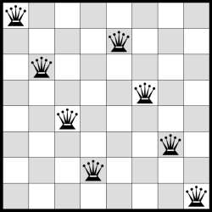
Independent Set (ISET):
Input: $\left(G=(V,E),k\right)$
Question: Does there exists an independent set of size $≥k$ in $G$
where $S⊆V$ is independent if no edges within $S$
( $∀u,v∈S, \left(u,v\right)∉E$ )

Slide 22
3SAT $≤_{p}$ ISET
Theorem: Suppose that $ISET∈P$ then $3SAT∈P$
Why?
Corollary: Suppose that $3SAT∉P$ then $ISET∉P$
Proof: We will show poly-time $R:\{0,1\}^{∗}→\{0,1\}^{∗}$
$R:\{3CNF formulas\}→\{ \left(graphs, numbers\right)\}$
s.t. for every 3CNF $φ$ , $3SAT\left(φ\right)=ISET(R\left(φ\right))$
Q: Why is this enough?

Slide 23
Theorem: Suppose that $ISET∈P$ then $3SAT∈P$
Proof: We will show poly-time $R:\{0,1\}^{∗}→\{0,1\}^{∗}$
$R:\{3CNF formulas\}→\{ \left(graphs, numbers\right)\}$
s.t. for every 3CNF $φ$ , $3SAT\left(φ\right)=ISET(R\left(φ\right))$
Example: $φ= \left(x_{0}∨\overline{x_{1}}∨x_{2}\right)∧\left(\overline{x_{0}}∨x_{1}∨\overline{x_{2}}\right)∧(x_{1}∨x_{2}∨\overline{x_{3}})$
(has $n=4$ variables, $m=3$ clauses)

Slide 24
Theorem: Suppose that $ISET∈P$ then $3SAT∈P$
Proof: We will show poly-time $R:\{0,1\}^{∗}→\{0,1\}^{∗}$
$R:\{3CNF formulas\}→\{ \left(graphs, numbers\right)\}$
s.t. for every 3CNF $φ$ , $3SAT\left(φ\right)=ISET(R\left(φ\right))$
Algorithm $R$: Input: $φ$ – 3CNF with $n$ variables and $m$ clauses
Let $G$ be graph with $3m$ vertices we will name $\left(j,1\right),\left(j,2\right),(j,3)$ for $j∈[m]$
For every $j∈[m]$, add edges $\left(j,1\right)−(j,2)$ , $\left(j,2\right)−(j,3)$ , $\left(j,3\right)−(j,1)$
For every pair of clauses $C_{j}$ and $C_{j^{′}}$ if literals $(j,a)$ and $(j′,b)$ conflict (one negation of the other) then add the edge $\left(j,a\right)−(j^{′},b)$
Return $(G,m)$
Claim 1 (completeness): If $3SAT\left(φ\right)=1$ then $ISET\left(G,m\right)=1$.
Claim 2 (soundness): If $ISET(G,m)=1$ then $3SAT(φ)=1$.

Slide 27
Theorem: Suppose that $ISET∈P$ then $3SAT∈P$
Proof: We will show poly-time $R:\{0,1\}^{∗}→\{0,1\}^{∗}$
$R:\{3CNF formulas\}→\{ \left(graphs, numbers\right)\}$
s.t. for every 3CNF $φ$ , $3SAT\left(φ\right)=ISET(R\left(φ\right))$
Example: $φ= \left(x_{0}∨\overline{x_{1}}∨x_{2}\right)∧\left(\overline{x_{0}}∨x_{1}∨\overline{x_{2}}\right)∧(x_{1}∨x_{2}∨\overline{x_{3}})$
(has $n=4$ variables, $m=3$ clauses)
$$x_{0}=0$$
$$x_{0}=1$$
$$x_{1}=1$$
$$x_{2}=0$$
$$x_{1}=1$$
$$x_{1}=0$$
$$x_{2}=1$$
$$x_{2}=1$$
$$x_{3}=0$$

Slide 28
Theorem: Suppose that $ISET∈P$ then $3SAT∈P$
Proof: We will show poly-time $R:\{0,1\}^{∗}→\{0,1\}^{∗}$
$R:\{3CNF formulas\}→\{ \left(graphs, numbers\right)\}$
s.t. for every 3CNF $φ$ , $3SAT\left(φ\right)=ISET(R\left(φ\right))$
Example: $φ= \left(x_{0}∨\overline{x_{1}}∨x_{2}\right)∧\left(\overline{x_{0}}∨x_{1}∨\overline{x_{2}}\right)∧(x_{1}∨x_{2}∨\overline{x_{3}})$
(has $n=4$ variables, $m=3$ clauses)
$$x_{0}=0$$
$$x_{0}=1$$
$$x_{1}=1$$
$$x_{2}=0$$
$$x_{1}=1$$
$$x_{1}=0$$
$$x_{2}=1$$
$$x_{2}=1$$
$$x_{3}=0$$
$$x=1101$$

Slide 29
Algorithm $R$: Input: $φ$ – 3CNF with $n$ variables and $m$ clauses
Let $G$ be graph with $3m$ vertices we will name $\left(j,1\right),\left(j,2\right),(j,3)$ for $j∈[m]$
For every $j∈[m]$, add edges $\left(j,1\right)−(j,2)$ , $\left(j,2\right)−(j,3)$ , $\left(j,3\right)−(j,1)$
For every pair of clauses $C_{j}$ and $C_{j^{′}}$ if literals $(j,a)$ and $(j′,b)$ conflict (one negation of the other) then add the edge $\left(j,a\right)−(j^{′},b)$
Return $(G,m)$
Claim 1 (completeness): If $3SAT\left(φ\right)=1$ then $ISET\left(G,m\right)=1$.
Proof: Assume $x$ satisfies $φ$. Then for every clause $C_{j}$ there is a literal $(j,a)$ satisfied.
add $(j,a)$ to set $S$.
The size of $S$ is $m$.
We claim that $S$ is an independent set:
$S$ contains one vertex in each triangle so no “black” edges.
If vertex tagged as “$x_{i}=0“$ in $S$ then “$x_{i}=1$” can’t be in $S$ so no “red” edges.

Slide 30
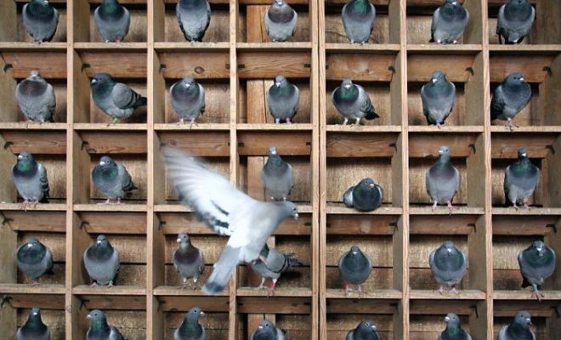
Algorithm $R$: Input: $φ$ – 3CNF with $n$ variables and $m$ clauses
Let $G$ be graph with $3m$ vertices we will name $\left(j,1\right),\left(j,2\right),(j,3)$ for $j∈[m]$
For every $j∈[m]$, add edges $\left(j,1\right)−(j,2)$ , $\left(j,2\right)−(j,3)$ , $\left(j,3\right)−(j,1)$
For every pair of clauses $C_{j}$ and $C_{j^{′}}$ if literals $(j,a)$ and $(j′,b)$ conflict (one negation of the other) then add the edge $\left(j,a\right)−(j^{′},b)$
Return $(G,m)$
Claim 2 (soundness): If $ISET(G,m)=1$ then $3SAT(φ)=1$.
Proof: Assume $S$ independent set of size $m$ in $G$.
Q: Show that $S$ contains exactly one vertex per triangle
Hint:
Set $x_{i}^{∗}=1$ if $S$ contains vertex tagged “$x_{i}=1$” otherwise $x_{i}=0$.
For every clause $C_{j}$ there is vertex in $S$ tagged “$x_{i}=b$”. We claim $x_{i}^{∗}=b$
If $b=1$: by definition.
If $b=0$: $S$ can’t contain vertex tagged “$x_{i}=1$” since it’s independent.

Slide 31
Polynomial-time reductions
$$3SAT≤_{p}ISET$$
We showed: Poly time $A$ for $ISET$ $⇒$ Poly time $B$ for $3SAT$
Alg $B$
Alg $A$
$$φ$$
$$ISET\left(G,k\right)=3SAT(φ)$$
$$G,k=R(φ)$$
Def: Let $F,G:\{0,1\}^{∗}→\{0,1\}$. We say $F≤_{p}G$ if $∃$ poly-time $R:\{0,1\}^{∗}→\{0,1\}^{∗}$ s.t. $∀_{x∈\{0,1\}^{∗}} F\left(x\right)=G(R\left(x\right))$
Q: Prove that if $F≤_{p}G$ and $G≤_{p}H$ then $F≤_{p}H$

Slide 32
Next Lecture:
More systematic exploration of the “hard” problems from today.
All share a common feature: What?
Leads us to NP and NP-completeness!

