Slide 1
CS 121: Lecture 19 NP and NP-Completeness
Madhu Sudan
https://madhu.seas.Harvard.edu/courses/Fall2020
Book: https://introtcs.org
{
The whole staff (faster response): CS 121 Piazza
How to contact us
Only the course heads (slower): cs121.fall2020.course.heads@gmail.com

Slide 2
Announcements:
121.5: Santhoshini Velusamy: Streaming Algorithms
Sections: Midterm 2 review this week
Homework 5 due in one week.
General: CS Sophomore advising events:
Monday 10:30-11:30 & 4-5 (EST)

Slide 3
Where we are:
✓
Part I: Circuits:
Finite computation,
quantitative study
✓
Part II: Automata:
Infinite restricted computation, quantitative study
Part III: Turing Machines:
Infinite computation, qualitative study
Part IV: Efficient Computation:
Infinite computation, quantitative study
Part V: Randomized computation:
Extending studies to non-classical algorithms

Slide 4
Review of last lecture
Host of problems:
2SAT, MinCut, LinearProgramming, (Shortest Path): All in polynomial time (Boolean versions in P).
3SAT, MaxCut, IntegerProgramming, (Longest Path), ISET: All not known to be in polynomial time. (Boolean versions in EXP).
Reductions: $F≤_{P}G⇔∃R such that ∀x F\left(x\right)=G\left(R\left(x\right)\right), R$ polytime.
3SAT $≤_{P}$ ISET
3SAT $≤_{P}$ IP (flashed)
MaxCut $≤_{P}$ IP (flashed)

Slide 5
Previously
$$EXP$$
$$P$$
$$IP$$
$$ISET$$
$$SUBSETSUM$$
$$LONGPATH$$
$$MAXCUT$$
$3SAT$

Slide 6
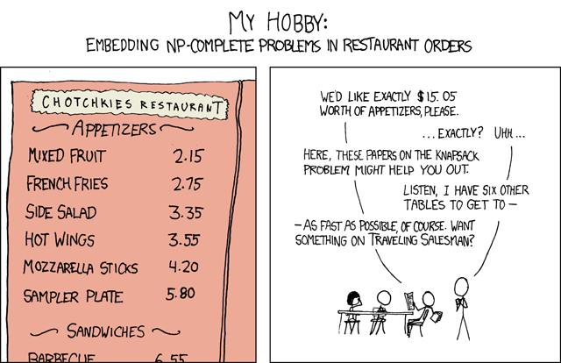

Slide 7
Today:
What brings all the “hard” problems above together
“Verifiability”
Definition of NP:
How to show problems in NP
3SAT in NP
MaxCut in NP
ISET in NP
Definition of NP-Hardness and NP-Completeness:
Some NP-complete problems …

Slide 8
Verifying “Solutions”
Claim: SAT, MaxCUT, ISET are example of functions $F:{\left\{0,1\right\}}^{∗}→\left\{0,1\right\}$ (defined/designed so that) the claim $F\left(x\right)=1$ is “easy” to “verify”.
Example:
$SAT\left((x_{7}∨{\overline{x}}_{17}∨x_{29})∧({\overline{x}}_{7}∨x_{15}∨x_{22})∧(x_{22}∨{\overline{x}}_{29}∨x_{55}) \right)=1$

Slide 9
Verifying “Solutions”
Claim: SAT, MaxCUT, ISET are example of functions $F:{\left\{0,1\right\}}^{∗}→\left\{0,1\right\}$ (defined/designed so that) the claim $F\left(x\right)=1$ is “easy” to “verify”.
Example:
$SAT\left((x_{7}∨{\overline{x}}_{17}∨x_{29})∧({\overline{x}}_{7}∨x_{15}∨x_{22})∧(x_{22}∨{\overline{x}}_{29}∨x_{55}) \right)=1$
Proof: $x_{7}=1 , x_{22}=1$

Slide 10
Verifying “Solutions”
Claim: SAT, MaxCUT, ISET are example of functions $F:{\left\{0,1\right\}}^{∗}→\left\{0,1\right\}$ (defined/designed so that) the claim $F\left(x\right)=1$ is “easy” to “verify”.
Example:
$SAT\left((x_{7}∨{\overline{x}}_{17}∨x_{29})∧({\overline{x}}_{7}∨x_{15}∨x_{22})∧(x_{22}∨{\overline{x}}_{29}∨x_{55}) \right)=1$
Proof: $x_{7}=1 , x_{22}=1$
$MaxCut\left( , 4\right)=1$

Slide 11
Verifying “Solutions”
Claim: SAT, MaxCUT, ISET are example of functions $F:{\left\{0,1\right\}}^{∗}→\left\{0,1\right\}$ (defined/designed so that) the claim $F\left(x\right)=1$ is “easy” to “verify”.
Example:
$SAT\left((x_{7}∨{\overline{x}}_{17}∨x_{29})∧({\overline{x}}_{7}∨x_{15}∨x_{22})∧(x_{22}∨{\overline{x}}_{29}∨x_{55}) \right)=1$
Proof: $x_{7}=1 , x_{22}=1$
$MaxCut\left( , 4\right)=1$
Proof:

Slide 12
Verifying “Solutions”
Claim: SAT, MaxCUT, ISET are example of functions $F:{\left\{0,1\right\}}^{∗}→\left\{0,1\right\}$ (defined/designed so that) the claim $F\left(x\right)=1$ is “easy” to “verify”.
Example:
$SAT\left((x_{7}∨{\overline{x}}_{17}∨x_{29})∧({\overline{x}}_{7}∨x_{15}∨x_{22})∧(x_{22}∨{\overline{x}}_{29}∨x_{55}) \right)=1$
Proof: $x_{7}=1 , x_{22}=1$
$MaxCut\left( , 4\right)=1$
Proof:
But what do “Verify”, “easy”, “Proof” mean?

Slide 13
Formalizing “Verification”
Input: String $x∈{\left\{0,1\right\}}^{∗}$
“Proof” : Another String $w∈{\left\{0,1\right\}}^{∗}$ (aka “witness”)
“Verify” Verification Function $V_{F}:{\left\{0,1\right\}}^{∗}×{\left\{0,1\right\}}^{∗}→{\left\{0,1\right\}}^{∗}$
“Easy”: $V_{F}$ computable in polynomial time (in first input length!)
Putting it together: $F:{\left\{0,1\right\}}^{∗}→\left\{0,1\right\}$ easy to verify
if $∃V_{F}:{\left\{0,1\right\}}^{∗}×{\left\{0,1\right\}}^{∗}→{\left\{0,1\right\}}^{∗}$ s.t. $∀x∈{\left\{0,1\right\}}^{∗},$
$$F\left(x\right)=1⇔∃w∈{\left\{0,1\right\}}^{∗} such that V_{F}\left(x,w\right)=1$$
and$V_{F}\left(x,w\right)$ computable in time $poly\left(\left|x\right|\right)$

Slide 14
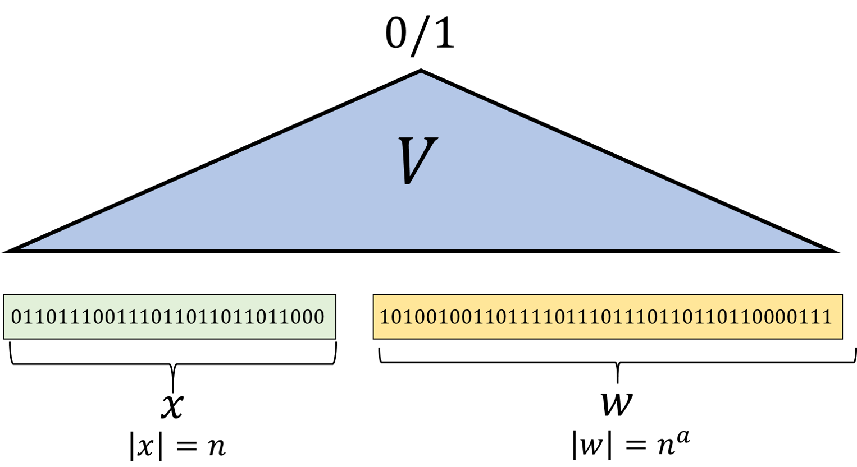
Main definition of today
Def (informal): $NP$ is the set of problems for which a solution can be efficiently verified.
Example: 3SAT . It might be hard to find an satisfying assignment for given $φ$ but given assignment $x$, we can verify that $φ\left(x\right)=1$
Slightly more formal: $NP$ is set of functions $F:\{0,1\}^{∗}→\{0,1\}$ s.t. for every $x∈\{0,1\}^{∗}$, $F\left(x\right)=1$ if and only if there is some polynomial size “witness” / “solution” / “proof” demonstrating this.
Def: Let $F:\{0,1\}^{∗}→\{0,1\}$. Then $F∈NP$ if there is poly-time $V_{F}$ and poly $q:ℕ→ℕ$ such that for every $x∈\{0,1\}^{∗}$
$$F\left(x\right)=1⇔∃_{w∈\{0,1\}^{∗}} \left|w\right|≤q\left(\left|x\right|\right) and V_{F}\left(x,w\right)=1$$

Slide 15
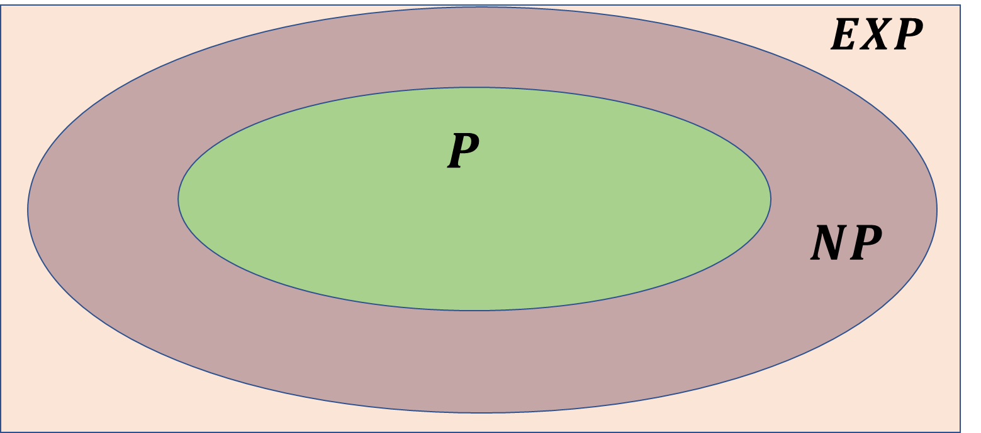
Main definition of today
Known: (1) $P⊆NP⊆EXP$ (2) $P⊊EXP$
Unknown: Does $P=NP$? Does $NP=EXP$?
Central Open Question of CS: Does $P=NP$?

Slide 16
Example 1: $3SAT∈NP$
Proof ingredients.
(Idea: What is $w$ and what would verifier $V_{3SAT}$ try to verify.)
The verifier $V_{3SAT}$
Proof that $∀φ$ s.t. $3SAT\left(φ\right)=1 ∃ w$ s.t. $V_{3SAT}\left(φ,w\right)=1$
$V_{3SAT}∈P$ and $\left|w\right|= poly\left(\left|φ\right|\right)$

Slide 17
Example 1: $3SAT∈NP$
Proof ingredients.
(Idea: What is $w$ and what would verifier $V_{3SAT}$ try to verify.)
The verifier $V_{3SAT}$
Proof that $∀φ$ s.t. $3SAT\left(φ\right)=1 ∃ w$ s.t. $V_{3SAT}\left(φ,w\right)=1$
$V_{3SAT}∈P$ and $\left|w\right|= poly\left(\left|φ\right|\right)$
Actual Proof:
(Idea: $w$ = assignment to variables $x_{0}…x_{n−1}$; Verifier verifies every clause satisfied.)
$V_{3SAT}\left(C_{0}∧C_{2}⋯∧C_{m−1}, w\right)=1⇔∀ j∈\left[m−1\right],$ $≥1$ literal in $C_{j}$ is set to $1$ by $w$
By definition $3SAT\left(φ\right)=1 ∃ w$ s.t. $V_{3SAT}\left(φ,w\right)=1.$
$V_{3SAT}∈P$ and $\left|w\right|≤\left|φ\right|$

Slide 18
Example 2: $ISET∈NP$
Recall $ISET\left(G=(V,E),k\right)=1⇔∃S⊆V, \left|S\right|≥k, ∀u,v∈S, \left(u,v\right)∉E$
Idea = ? $V_{ISET}=$?

Slide 19
Example: $MaxCut∈NP$
Recall: $Maxcut\left(G=(V,E),k\right)=1⇔∃S⊆V s.t. \left|E∩S×S\right|≥k$
(In English: vertices of G can be partitioned in two sets with $≥k$ edges across partitions.)
$MaxCut∈NP$? Idea = ? $V_{MaxCut}=?$

Slide 20
Preview of Next Lecture:
Cook/Levin Theorem: $3SAT$ is $NP$-complete.
$F$ is $NP$-hard if $∀G∈NP$, $G≤_{P}F$
“every problem in $NP$ reduces to $F$”
“No problem in $NP$ harder than $F$”
$F$ is $NP$-complete if $F∈NP$ and $F$ is $NP$-hard
Q: How many reductions needed to show $3SAT$ is $NP$-hard?

Slide 21
$$EXP$$
$$P$$
$$NP$$
$$IP$$
$$NPC$$
$$ISET$$
$$SUBSETSUM$$
$$LONGPATH$$
$$MAXCUT$$
$3SAT$
Cook Levin Theorem implies: If $3SAT∈P$ then $P=NP$ .
Cook Levin Theorem implies: If $MaxCut∉P$ then $3SAT∉P$.

Slide 22
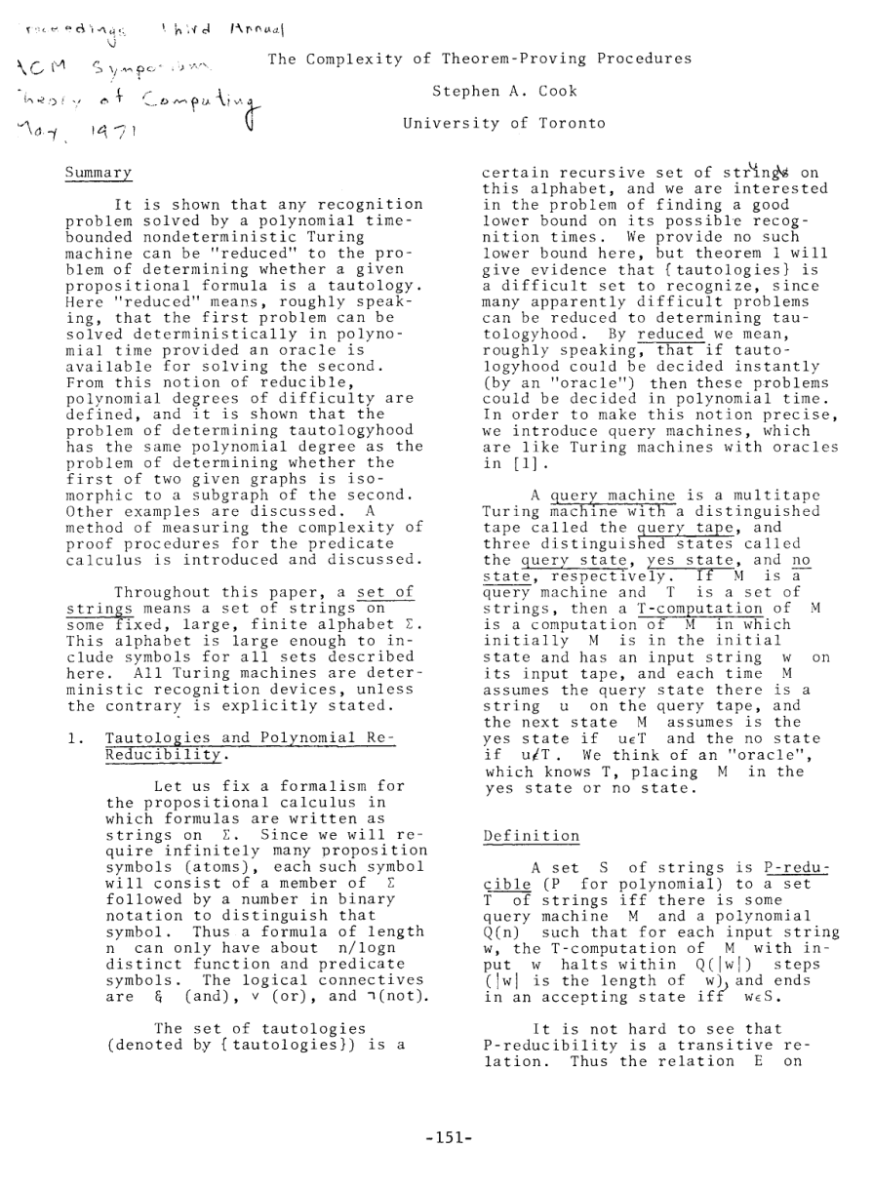
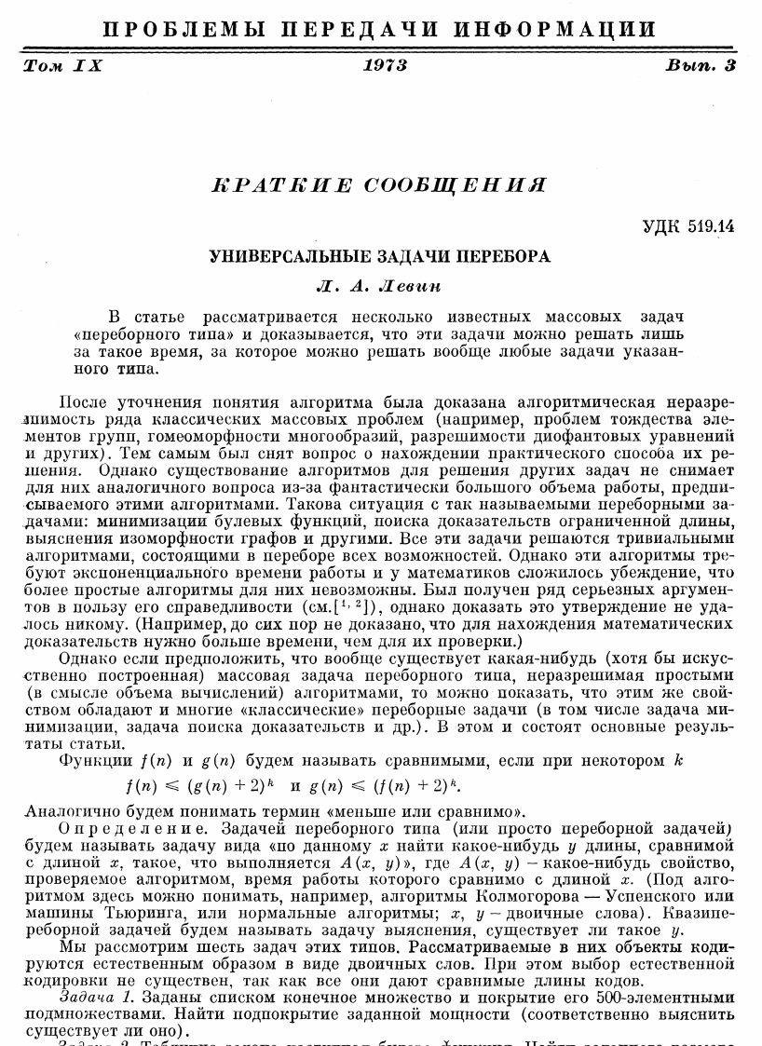
Вы здесь?
*66

Slide 23
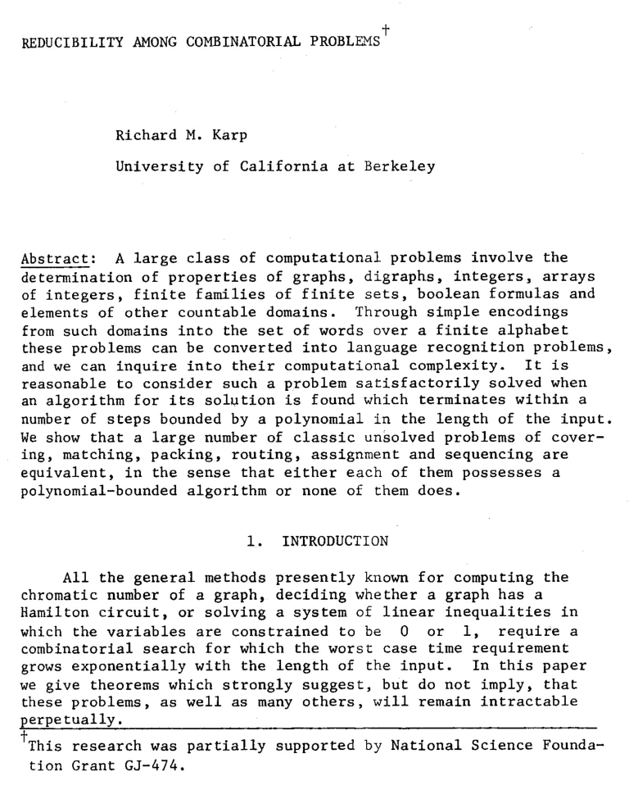
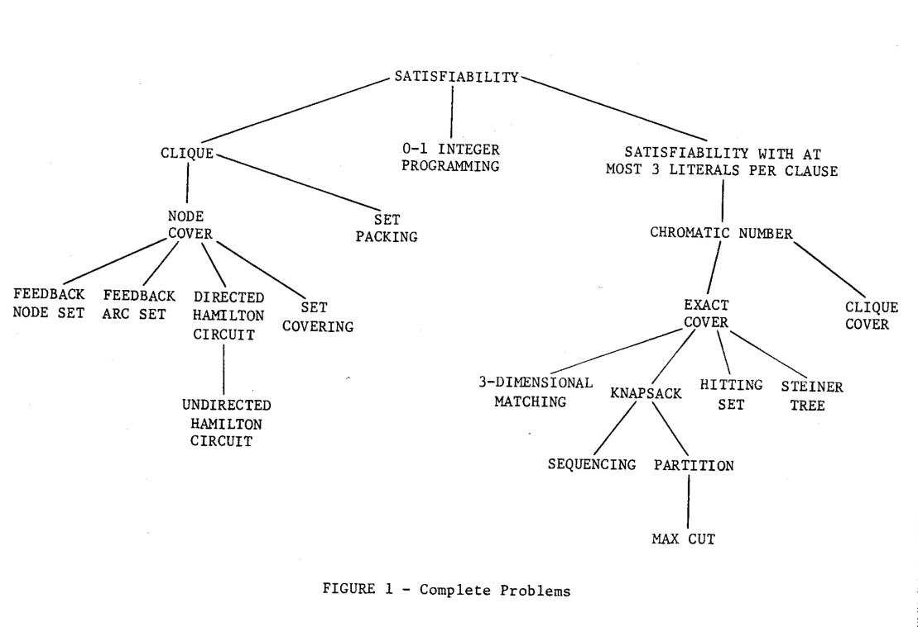
*59
Conf on 1972

Slide 24
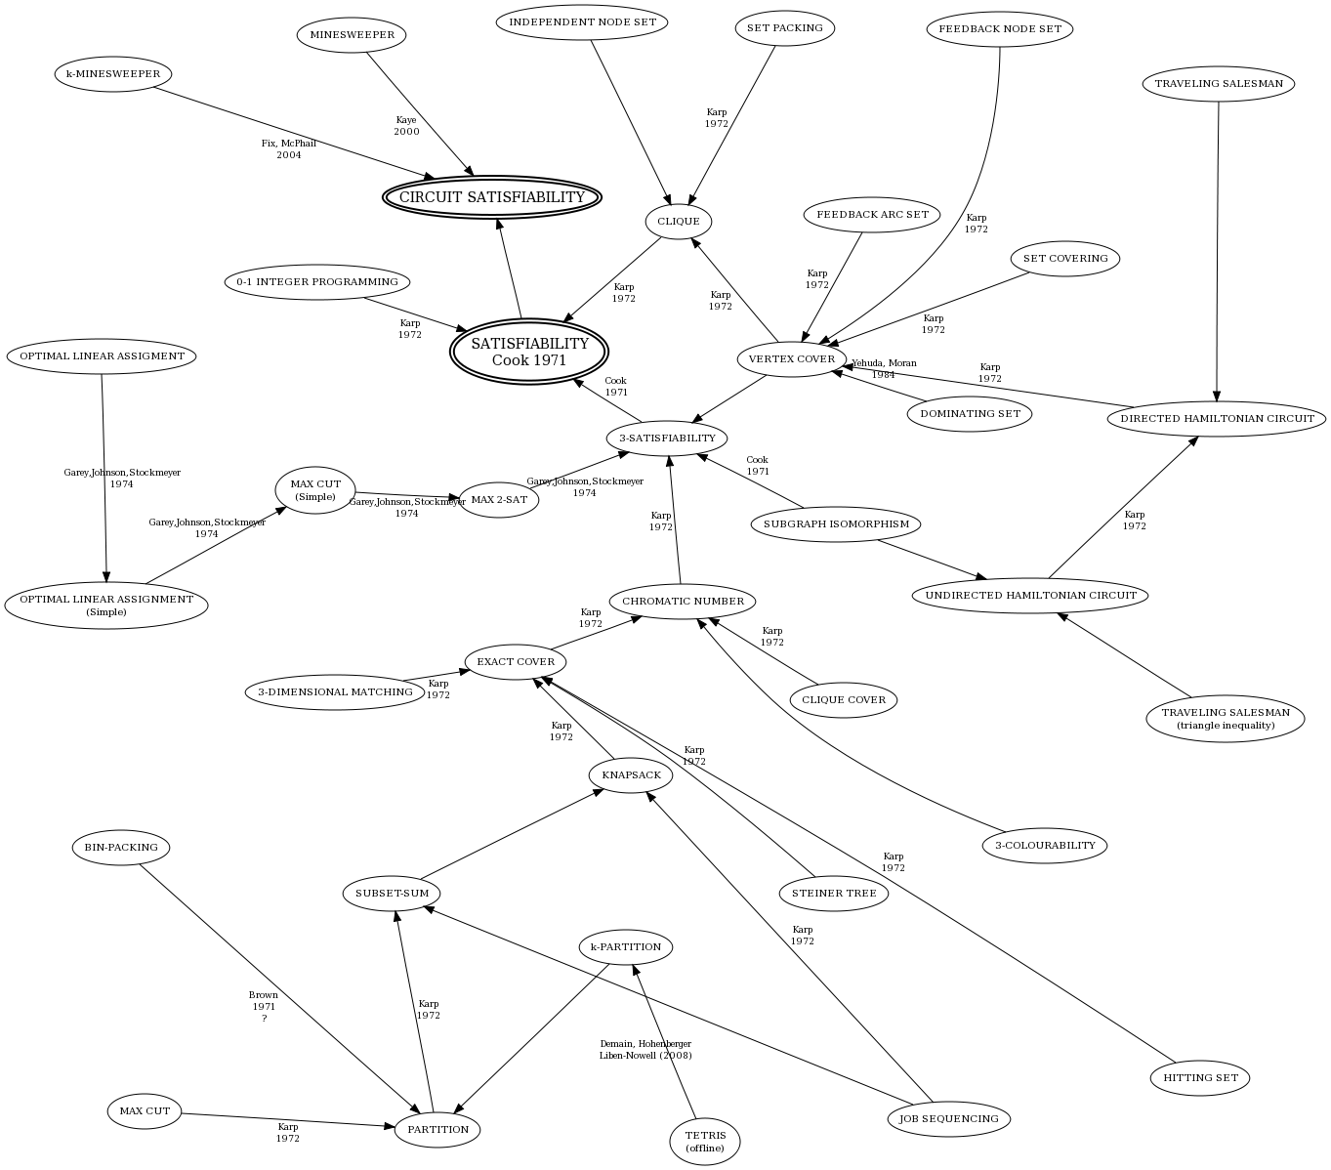
gradient_dissent / reddit

Slide 25
Assuming Cook/Levin: $ISET$ is $NP$-complete
Proof:
$ISET∈NP$ – already done!
$3SAT≤_{P}ISET$– already done!
…

Slide 26
Assuming Cook/Levin: $ISET$ is $NP$-complete
Proof:
$ISET∈NP$ – already done!
$3SAT≤_{P}ISET$– already done!
$∀F∈NP, F≤_{P}SAT≤_{P}ISET ⇒ F≤_{P}ISET$. QED

Slide 27
Summary of Lecture:
Introduced NP
Class of “verifiable” problems. (Warning: Only $F\left(x\right)=1$ verifiable.)
Example problems in NP: 3SAT, MaxCUT, ISET
Introduced NP-hard and NP-complete
Stated Cook/Levin Theorem (proof next lecture).
Implications of Cook-Levin
3SAT in P $⇔$ P=NP
$MaxCut∉P⇒3SAT∉NP$
$3SAT NP$-complete $⇒ ISET NP$-complete

