Slide 1
CS 121: Lecture 20 Cook-Levin Theorem
Madhu Sudan
https://madhu.seas.Harvard.edu/courses/Fall2020
Book: https://introtcs.org
{
The whole staff (faster response): CS 121 Piazza
How to contact us
Only the course heads (slower): cs121.fall2020.course.heads@gmail.com

Slide 2
Announcements:
Advanced section Thursday: Nicole Immorlica on EconCS
Midterm 2 in 1 week.
Open book (Barak only). 2 pages cheat sheet (no collaboration).
90 minutes long. (70 if handwritten.)
Homework 5 due Thursday.

Slide 3
Where we are:
✓
Part I: Circuits:
Finite computation,
quantitative study
✓
Part II: Automata:
Infinite restricted computation, quantitative study
Part III: Turing Machines:
Infinite computation, qualitative study
Part IV: Efficient Computation:
Infinite computation, quantitative study
Part V: Randomized computation:
Extending studies to non-classical algorithms

Slide 4
Review of last lecture
Defined NP (solutions/witnesses/proofs polytime verifiable)
$F:{\left\{0,1\right\}}^{∗}→\left\{0,1\right\}∈\backslash NP⇔∃V_{F} polytime comp. s.t. F\left(x\right)=1⇔∃w s.t. V_{F}\left(x,w\right)=1$
Defined NP-Hard and NP-complete
$F$ NP-hard $⇔∀G∈NP, G≤_{P}F$
$F$ NP-complete $⇔F∈NP$ and $F$ NP-complete.
Asserted: 3SAT is NP-Complete
3SAT$\left(C_{1}∧C_{2}⋯C_{m}\right)=1⇔∃x_{1},…,x_{n}∈\left\{0,1\right\} s.t. ∀j ∃$ literal in $C_{j}$ that is 1.
Will prove today
Proved: ISET is NP-Complete (assuming assertion)

Slide 5
Today
Cook-Levin Theorem: 3SAT is NP-Complete

Slide 6
NP-Completeness historically
Many mathematicians sensed NP-hardness:
Gauss (1800s): Can you factor integers?
Godel (1956): Can you automate proving of theorems?
Edmonds (1967): Travelling Salesperson has no polynomial time algorithm?
If [$3SAT$ has $O(n^{2})$ time algorithm] then in spite of the undecidability of the Entscheidungsproblem, the mental work of a mathematician concerning Yes-or-No questions could be completely replaced by a machine
Kurt Gödel to John von-Neumann, 1956

Slide 7
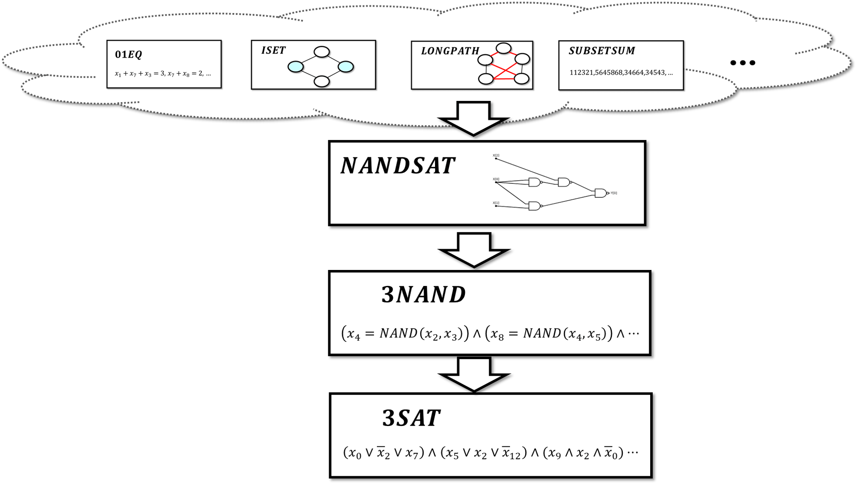
Today’s Theorem
$3SAT$ is $NP$-hard. $NP$-hard + in $NP$ = $NP$ complete
Cook Levin Theorem: $∀F∈NP$ $F≤_{p}3SAT$
Proof:
Define $NANDSAT, 3NAND$
Lemma 1: $∀F∈NP$, $F≤_{p}NANDSAT$
Lemma 2: $NANDSAT≤_{p}3NAND$
Lemma 3: $3NAND≤_{p}3SAT$

Slide 9
3NAND
Input: $Ψ$ is AND of constraints of form $z_{i}=NAND(z_{j},z_{k})$
Output: $1$ iff there is assignment $z∈\{0,1\}^{r}$ satisfying $Ψ$
Q: If $Ψ= (z_{0} = NAND(z_{2}, z_{3}) ) ∧ (z_{3} = NAND(z_{2},z_{1}) ) ∧ (z_{1} = NAND(z_{2},z_{3}) )$
what is $3NAND\left(Ψ\right)$?
Lemma 2: $NANDSAT≤_{p}3NAND$

Slide 10
Lemma 3: $3NAND≤_{p}3SAT$
Key claim: For every $a,b,c∈\{0,1\}$,
$$\overline{a}∨\overline{b}∨\overline{c}$$
$$∧$$
$c=NAND(a,b)$
$$c∨a$$
$$∧$$
$$c∨b$$
Q: Prove key claim.
Key claim $⇒$ lemma.

Slide 13
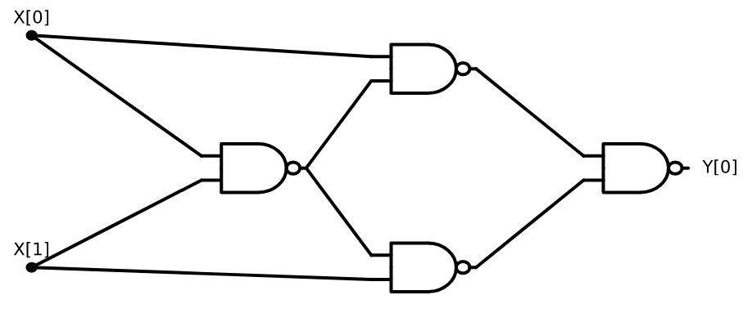
NANDSAT
Input: NAND-CIRC program $P$ (aka circuit with NAND gates)
Output: 1 iff there is $x∈\{0,1\}^{n}$ s.t. $P\left(x\right)=1$
Q: What is $NANDSAT( )$?

Slide 14
Input: $Ψ$ is AND of constraints of form $z_{i}=NAND(z_{j},z_{k})$
Output: $1$ iff there is assignment $z∈\{0,1\}^{r}$ satisfying $Ψ$
Lemma 2: $NANDSAT≤_{p}3NAND$
“Proof by example:”
$$z_{2}=NAND(z_{0},z_{1})$$
$$z_{0}$$
$$z_{3}$$
$$z_{3}=NAND(z_{0},z_{2})$$
$$z_{2}$$
$$z_{5}$$
$$z_{4}=NAND(z_{1},z_{2})$$
$$z_{5}=NAND(z_{3},z_{4})$$
$$z_{1}$$
$$z_{4}$$
$$z_{6}=NAND(z_{0},z_{0})$$
$$z_{5}=1$$
$$z_{5}=NAND(z_{0},z_{6})$$

Slide 17
Input: NAND-CIRC program $P$ (aka circuit with NAND gates)
Output: 1 iff there is $x∈\{0,1\}^{n}$ s.t. $P\left(x\right)=1$
Lemma 1: For every $F∈NP$, $F≤_{p}NANDSAT$
Proof: If $F∈NP$ we know $∃$ poly-time TM $V_{F}$ s.t. $∀x∈\{0,1\}^{n}$
$≤n^{b}$ steps
$$n$$
$$x$$
$$V_{F}$$
$$F\left(x\right)=1$$
$$∃w∈\{0,1\}^{n^{a}}$$
$$1$$
$$n^{a}$$
$$w$$

Slide 18
Input: NAND-CIRC program $P$ (aka circuit with NAND gates)
Output: 1 iff there is $x∈\{0,1\}^{n}$ s.t. $P\left(x\right)=1$
Lemma 1: For every $F∈NP$, $F≤_{p}NANDSAT$
Proof: If $F∈NP$ we know $∃$ poly-time TM $M$ s.t. $∀x∈\{0,1\}^{n}$
By proof of $P⊆P_{/poly}$ (Time $≤≈$ SIZE) can find $n^{2b}$ sized circuit $C$ s.t.
$≤n^{2b}$ gates
$$n$$
$≤n^{b}$ steps
$$x$$
$$n$$
$$x$$
=
$$C$$
$$V_{F}$$
$$n^{a}$$
$$n^{a}$$
$$w$$
$$w$$

Slide 19
Input: NAND-CIRC program $P$ (aka circuit with NAND gates)
Output: 1 iff there is $x∈\{0,1\}^{n}$ s.t. $P\left(x\right)=1$
Lemma 1: For every $F∈NP$, $F≤_{p}NANDSAT$
Proof: If $F∈NP$ we know $∃$ poly-time TM $V_{F}$ s.t. $∀x∈\{0,1\}^{n}$
By proof of $P⊆P_{/poly}$ can find $n^{2b}$ sized circuit $C$ s.t.
$≤n^{2b}$ gates
$$n$$
$$x$$
$$C$$
$$F\left(x\right)=1$$
$$∃w∈\{0,1\}^{n^{a}}$$
$$1$$
$$n^{a}$$
$$w$$

Slide 20
Input: NAND-CIRC program $P$ (aka circuit with NAND gates)
Output: 1 iff there is $x∈\{0,1\}^{n}$ s.t. $P\left(x\right)=1$
Lemma 1: For every $F∈NP$, $F≤_{p}NANDSAT$
Proof: If $F∈NP$ we know $∃$ poly-time TM $M$ s.t. $∀x∈\{0,1\}^{n}$
By proof of $P⊆P_{/poly}$ can find $n^{2b}$ sized circuit $C$ s.t.
$≤n^{2b}$ gates
$$x$$
‘
$$C$$
$$F\left(x\right)=1$$
$$∃w∈\{0,1\}^{n^{a}}$$
$$1$$
$$n^{a}$$
$$w$$

Slide 23
Example to illustrate proof
Example: $ISET≤_{p}3SAT$
Input: Graph $G$ integer $k$
Step 1: NAND circuit $C_{G}$ such that $C_{G}\left(S\right)=1$ iff $\left|S\right|≥k$ and $S$ independent in $G$
Step 2: 3NAND formula $Ψ$ s.t. $∃z$ with $Ψ\left(z\right)=1$ iff $∃S$ s.t. $C_{G}\left(S\right)=1$
Step 3: 3CNF formula $φ$ s.t. $φ\left(z\right)=Ψ(z)$ for every $z$

Slide 25
Next lecture
More reductions. See more diverse NP-complete problems.

