Slide 1
CS 121: Lecture 23 Probability Review
Madhu Sudan
https://madhu.seas.Harvard.edu/courses/Fall2020
Book: https://introtcs.org
{
The whole staff (faster response): CS 121 Piazza
How to contact us
Only the course heads (slower): cs121.fall2020.course.heads@gmail.com

Slide 2
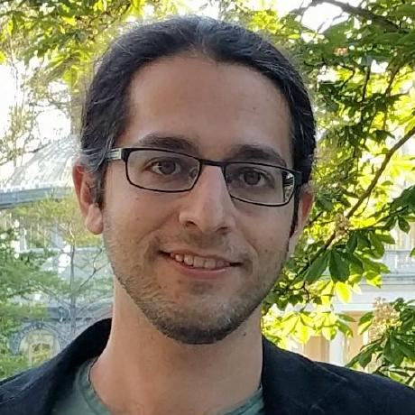
Announcements:
Advanced section: Roei Tell (De)Randomization
2nd feedback survey
Homework 6 out today. Due 12/3/2020
Section 11 week starts

Slide 3
Where we are:
✓
Part I: Circuits:
Finite computation,
quantitative study
✓
Part II: Automata:
Infinite restricted computation, quantitative study
Part III: Turing Machines:
Infinite computation, qualitative study
Part IV: Efficient Computation:
Infinite computation, quantitative study
Part V: Randomized computation:
Extending studies to non-classical algorithms

Slide 4
Review of course so far
Circuits:
Compute every finite function … but no infinite function
Measure of complexity: SIZE. ${ALL}_{n}⊆SIZE\left(O\left(\frac{2^{n}}{n}\right)\right) ;∃f∉SIZE\left(o\left(\frac{2^{n}}{n}\right)\right)$
Finite Automata:
Compute some infinite functions (all Regular functions)
Do not compute many (easy) functions (e.g. $EQ\left(x,y\right)=1⇔x=y$)
Turing Machines:
Compute everything computable (definition/thesis)
HALT is not computable:
Efficient Computation:
$P$ Polytime computable Boolean functions – our notion of efficiently computable
$NP$ Efficiently verifiable Boolean functions. Our wishlist …
$NP$-complete: Hardest problems in $NP$: 3SAT, ISET, MaxCut, EU3SAT, Subset Sum
Counting
Pumping/Pigeonhole
Diagonalization, Reductions
Polytime Reductions

Slide 5
Last Module: Challenges to STCT
Strong Turing-Church Thesis: Everything physically computable in polynomial time can be computable in polynomial time on Turing Machine.
Challenges:
Randomized algorithms: Already being computed by our computers:
Weather simulation, Market prediction, …
Quantum algorithms:
Status:
Randomized: May not add power?
Quantum: May add power?
Still can be studied with same tools. New classes: $BPP, BQP$:
$B$ – bounded error; $P$ – Probabilistic, $Q$ - Quantum

Slide 6
Today: Review of Basic Probability
Sample space
Events
Union/intersection/negation – AND/OR/NOT of events
Random variables
Expectation
Concentration / tail bounds

Slide 7
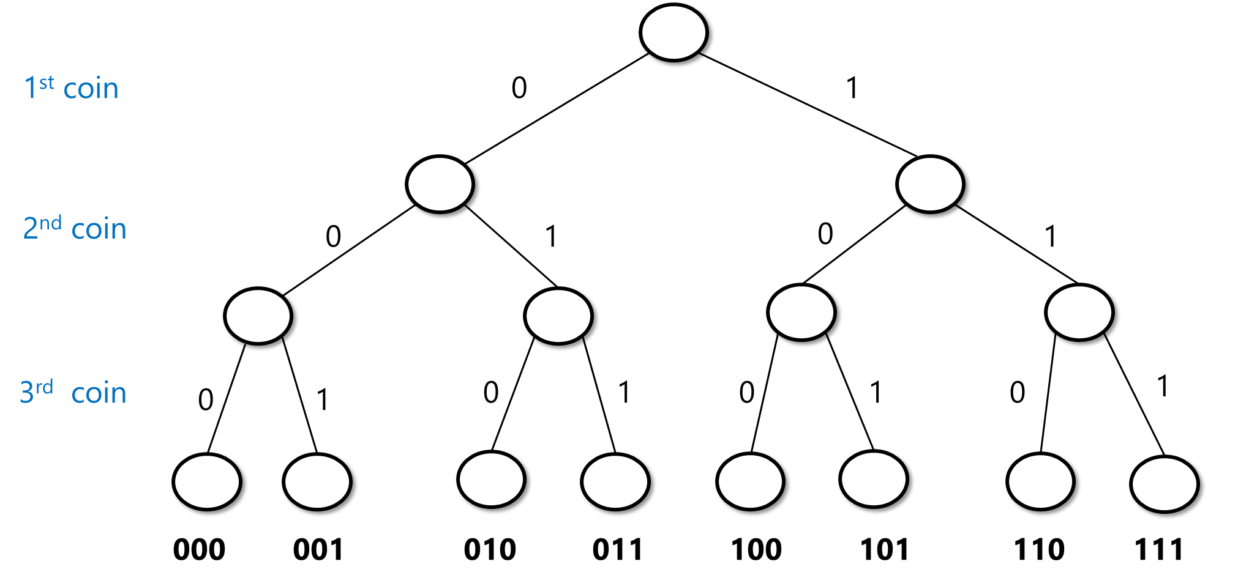
Throughout this lecture
Probabilistic experiment: tossing $n$ independent unbiased coins.
Equivalently: Choose $x∼\{0,1\}^{n}$

Slide 8
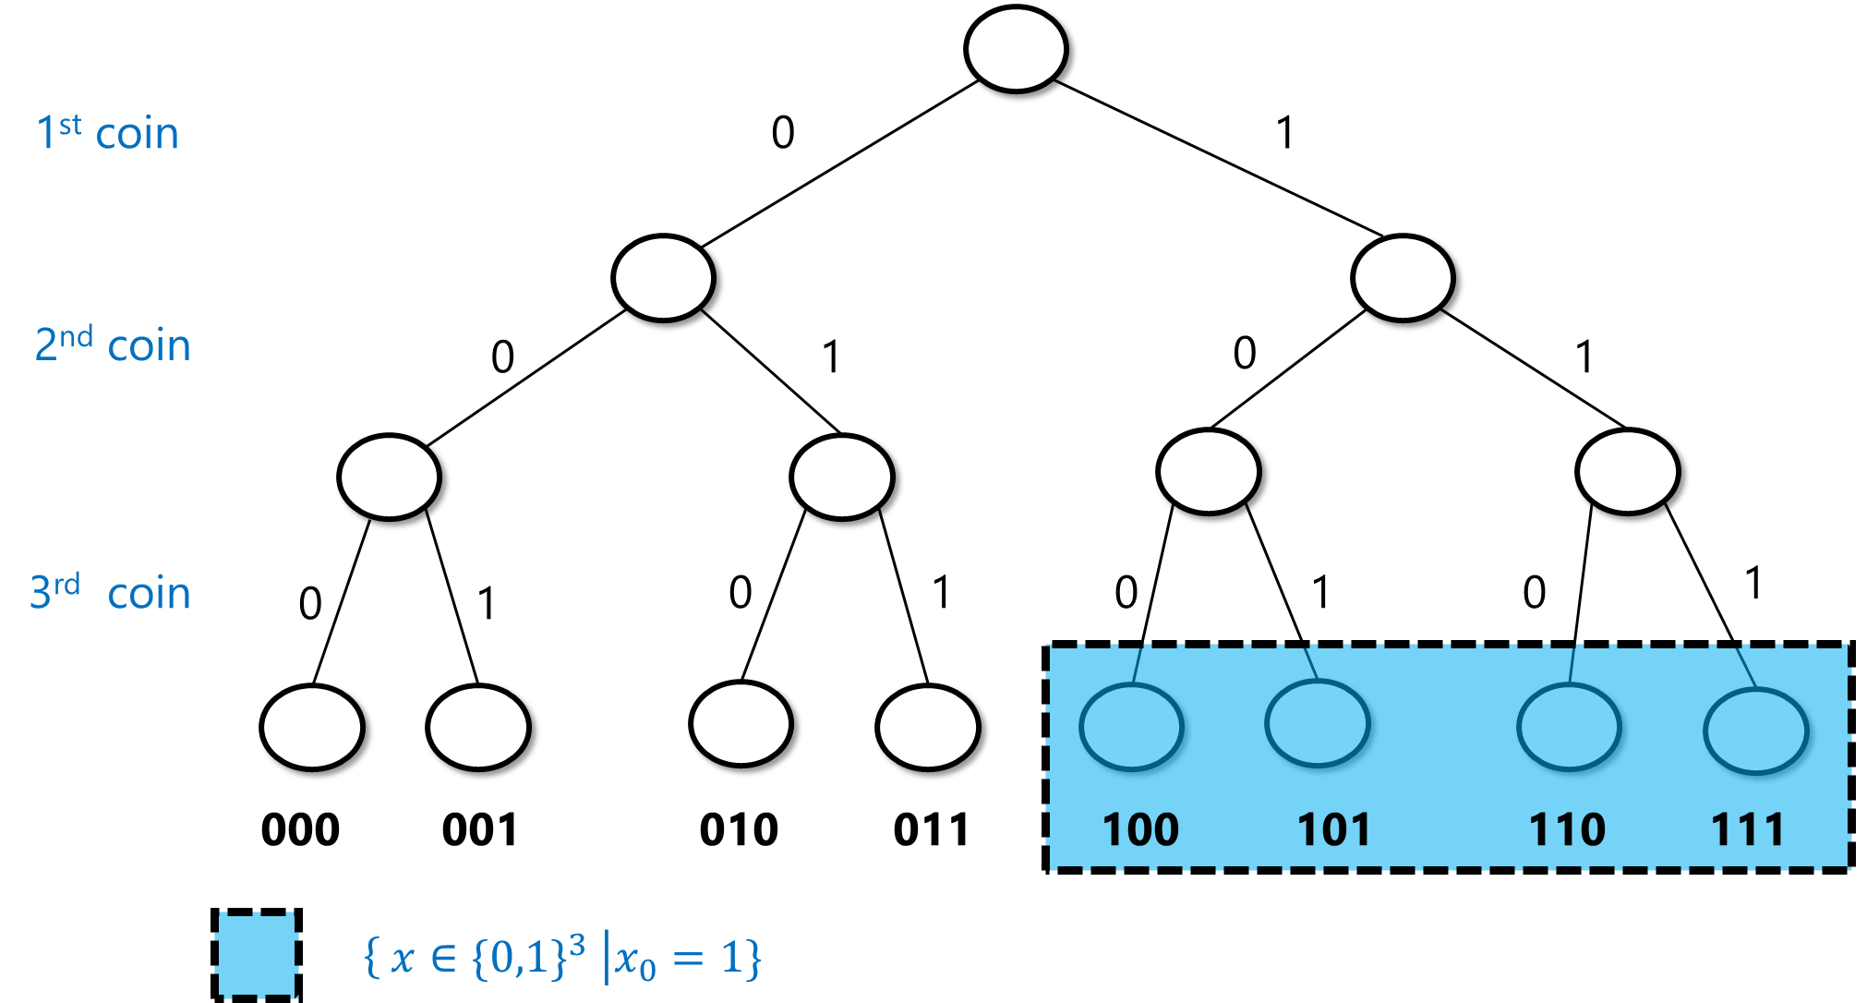
Events
Fix sample space to be $x∼\{0,1\}^{n}$
Probability that $A$ happens is $\operatorname{Pr}\left[A\right]=\frac{\left|A\right|}{2^{n}}$
An event is a set $A⊆\{0,1\}^{n}$.
Example: If $x∼\{0,1\}^{3}$ , $\operatorname{Pr}\left[x_{0}=1\right]=\frac{4}{8}=\frac{1}{2}$

Slide 9
Q: Let $n=3$, $A=\left\{x_{0}=1\right\}, B=\left\{x_{0}+x_{1}+x_{2}≥2\right\}, C=\{x_{0}+x_{1}+x_{2}=1 mod 2\}$ . What are (i) $Pr⁡[B]$, (ii) $Pr⁡[C]$, (iii) $\operatorname{Pr}{[A∩B]}$, (iv) $Pr⁡[A∩C]$ (v) $Pr⁡[B∩C]$ ?
0
1
0
1
0
1
0
1
0
1
0
1
0
1
000 001 010 011 100 101 110 111

Slide 10
Q: Let $n=3$, $A=\left\{x_{0}=1\right\}, B=\left\{x_{0}+x_{1}+x_{2}≥2\right\}, C=\{x_{0}+x_{1}+x_{2}=1 mod 2\}$ . What are (i) $Pr⁡[B]$, (ii) $Pr⁡[C]$, (iii) $\operatorname{Pr}{[A∩B]}$, (iv) $Pr⁡[A∩C]$ (v) $Pr⁡[B∩C]$ ?
$\frac{1}{2}$ $\frac{4}{8}=\frac{1}{2}$ $\frac{2}{8}=\frac{1}{4}$ $\frac{2}{8}=\frac{1}{4}$ $\frac{1}{8}$
0
1
0
1
0
1
0
1
0
1
0
1
0
1
000 001 010 011 100 101 110 111

Slide 11
Q: Let $n=3$, $A=\left\{x_{0}=1\right\}, B=\left\{x_{0}+x_{1}+x_{2}≥2\right\}, C=\{x_{1}+x_{2}+x_{3}=1 mod 2\}$ . What are (i) $Pr⁡[B]$, (ii) $Pr⁡[C]$, (iii) $\operatorname{Pr}{[A∩B]}$, (iv) $Pr⁡[A∩C]$ (v) $Pr⁡[B∩C]$ ?
$\frac{1}{2}$ $\frac{4}{8}=\frac{1}{2}$ $\frac{2}{8}=\frac{1}{4}$ $\frac{2}{8}=\frac{1}{4}$ $\frac{1}{8}$
0
1
Compare $\operatorname{Pr}\left[A∩B\right]$ vs $\operatorname{Pr}\left[A\right]Pr⁡[B]$ $\operatorname{Pr}{[A∩C]}$vs $\operatorname{Pr}\left[A\right]\operatorname{Pr}{[C]}$
0
1
0
1
0
1
0
1
0
1
0
1
000 001 010 011 100 101 110 111

Slide 12
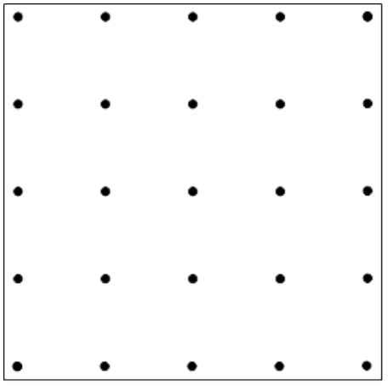
Operations on events
$\operatorname{Pr}\left[ A or B happens\right]=Pr⁡[ A∪B]$
$\operatorname{Pr}\left[ A and B happen\right]=Pr⁡[ A∩B]$
$\operatorname{Pr}\left[ A doesn^{′}t happen\right]=\operatorname{Pr}\left[ \overline{A}\right]=\operatorname{Pr}\left[\{0,1\}^{n}∖A\right]=1−Pr{[A]}$
Q: Prove the union bound: $\operatorname{Pr}\left[A∨B\right]≤\operatorname{Pr}\left[A\right]+Pr⁡[B]$
Example: $\operatorname{Pr}\left[A\right]=4/25,\operatorname{Pr}\left[B\right]=6/25$, $\operatorname{Pr}\left[A∪B\right]=9/25$

Slide 13
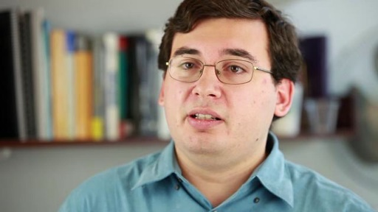
Independence
$$\operatorname{Pr}\left[B | A\right]=\operatorname{Pr}\left[B\right]$$ “Conditioning is the soul of statistics”
Informal: Two events $A,B$ are independent if knowing $A$ happened doesn’t give any information on whether $B$ happened.
Formal: Two events $A,B$ are independent if $\operatorname{Pr}\left[A∩B\right]=\operatorname{Pr}\left[A\right]Pr⁡[B]$
Q: Which pairs are independent?
(i)
(ii)
(iii)

Slide 14
More than 2 events
Informal: Two events $A,B$ are independent if knowing whether $A$ happened doesn’t give any information on whether $B$ happened.
Formal: Three events $A,B,C$ are independent if every pair $A,B$ , $A,C$ and $B,C$ is independent and $\operatorname{Pr}\left[A∩B∩C\right]=\operatorname{Pr}\left[A\right]Pr⁡[B]\operatorname{Pr}{[C]}$
(i)
(ii)

Slide 15
Random variables
Assign a number to every outcome of the coins.
Formally r.v. is $X:\{0,1\}^{n}→ℝ$
Example: $X\left(x\right)=x_{0}+x_{1}+x_{2}$
$$v$$ | $$Pr[X=v]$$
0 | 1/8
1 | 3/8
2 | 3/8
3 | 1/8
0 1 1 2 1 2 2 3

Slide 16
Expectation
Average value of $X$ : $𝔼\left[X\right]=\sum_{x∈\{0,1\}^{n}}{2^{−n}X(x)}=\sum_{v∈ℝ}{v⋅\operatorname{Pr}{[X=v]}}$
Example: $X\left(x\right)=x_{0}+x_{1}+x_{2}$
$$v$$ | $$Pr[X=v]$$
0 | 1/8
1 | 3/8
2 | 3/8
3 | 1/8
0 1 1 2 1 2 2 3
$$0⋅\frac{1}{8}+1⋅\frac{3}{8}+2⋅\frac{3}{8}+3⋅\frac{1}{8}=\frac{12}{8}=1.5$$
Q: What is $𝔼[X]$?

Slide 17
Linearity of expectation
Lemma: $𝔼\left[X+Y\right]=𝔼\left[X\right]+𝔼[Y]$
Corollary: $𝔼\left[x_{0}+x_{1}+x_{2}\right]=𝔼\left[x_{0}\right]+𝔼\left[x_{1}\right]+𝔼\left[x_{2}\right]=1.5$
Proof:
$$𝔼\left[X+Y\right]=2^{−n}\sum_{x}{(X\left(x\right)+Y\left(x\right))}=2^{−n}\sum_{x}{X\left(x\right)}+2^{−n}\sum_{x}{Y(x)}=𝔼\left[X\right]+𝔼[Y]$$

Slide 18
Independent random variables
Def: $X,Y$ are independent if $\{X=u\}$ and $\{Y=v\}$ are independent $∀u,v$
Def: $X_{0},…,X_{k−1},$ independent if $\left\{X_{0}=v_{0}\right\},…,\{X_{k−1}=v_{k−1}\}$ ind. $∀u_{0}…u_{k−1}$
i.e. $∀v,…,v_{k−1} ∀S⊆[k]$
$$\operatorname{Pr}\left[{\bigwedge_{i∈S}{X_{i}=v_{i}}}_{}\right] = \prod_{i∈S}{\operatorname{Pr}{[X_{i}=v_{i}]}}$$
Q: Let $x ∼\{0,1\}^{n}$. Let $X_{0}=x_{0},X_{1}=x_{1},…,X_{n−1}=x_{n−1}$
Let $Y_{0}=Y_{1}=⋯=Y_{k−1}=x_{0}$
Are $X_{0},…,X_{n−1}$ independent?
Are $Y_{0},…,Y_{n−1}$ independent?

Slide 19
Independence and concentration
Q: Let $x ∼\{0,1\}^{n}$. Let $X_{0}=x_{0},X_{1}=x_{1},…,X_{n−1}=x_{n−1}$
Let $Y_{0}=Y_{1}=⋯=Y_{k−1}=x_{0}$
Let $X=X_{0}+⋯+X_{n−1}$ , $Y=Y_{0}+⋯+Y_{n−1}$
Compute $𝔼[X]$, compute $𝔼[Y]$
For $n=100$, estimate $Pr⁡[Y∉\left(0.4n,0.6n\right)]$ , $\operatorname{Pr}{[X∉\left(0.4n,0.6n\right)]}$

Slide 20
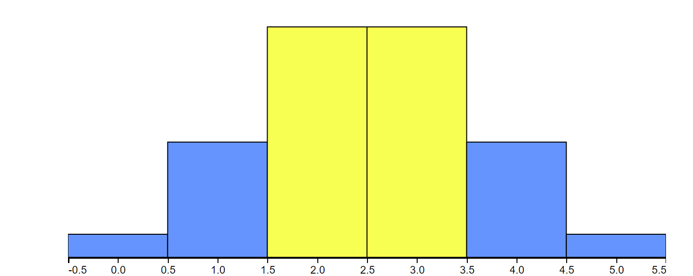
Sums of independent random variables
$$n=5$$
$Pr⁡[X∉\left(0.4,0.6\right)n]$=
$$37.5\%$$
https://www.stat.berkeley.edu/~stark/Java/Html/BinHist.htm

Slide 21
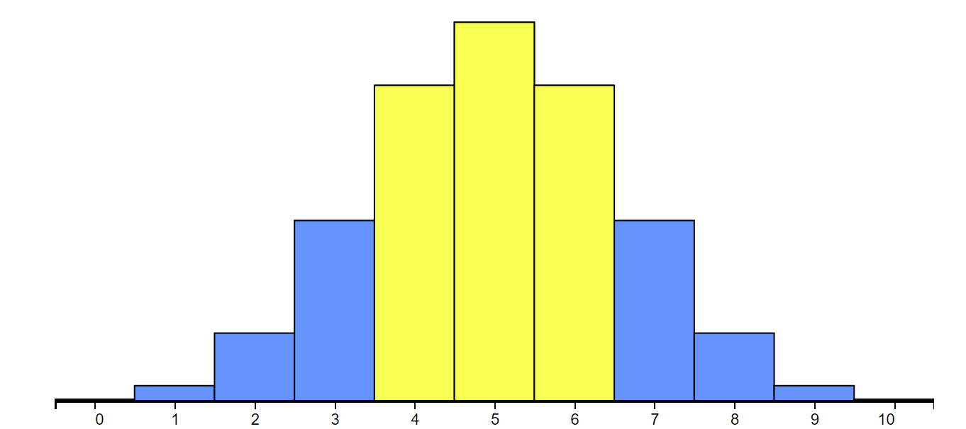
Sums of independent random variables
$$n=10$$
$Pr⁡[X∉\left(0.4,0.6\right)n]$=
$$34.4\%$$
https://www.stat.berkeley.edu/~stark/Java/Html/BinHist.htm

Slide 22
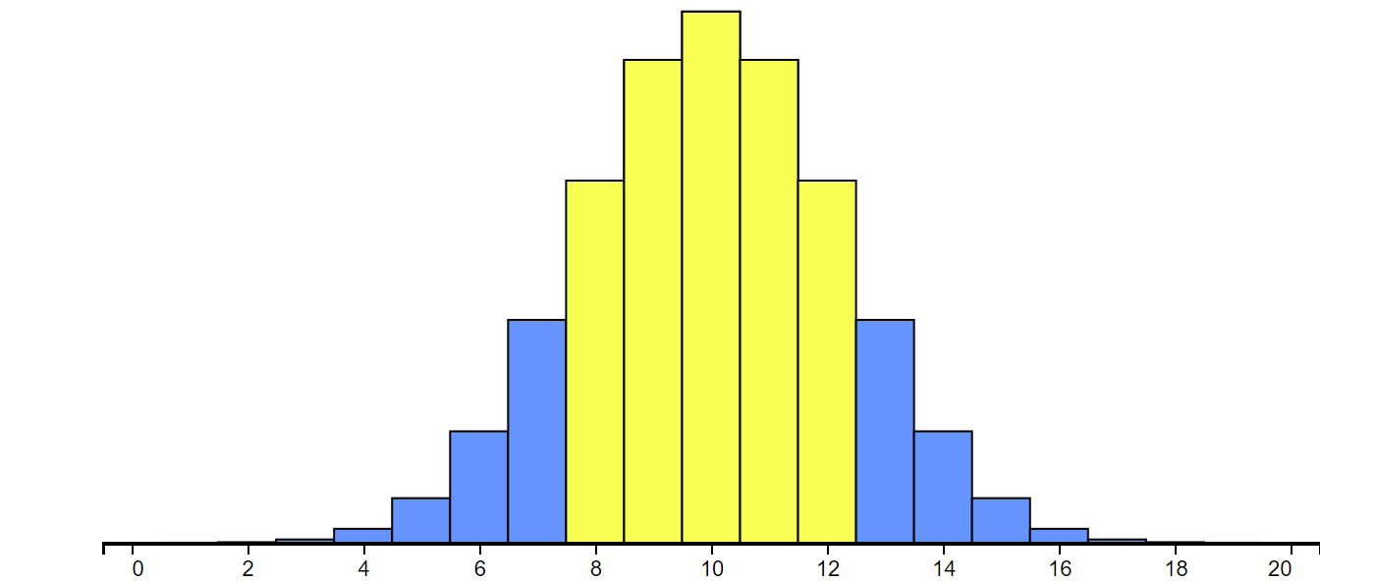
Sums of independent random variables
$$n=20$$
$Pr⁡[X∉\left(0.4,0.6\right)n]$=
$$26.3\%$$
https://www.stat.berkeley.edu/~stark/Java/Html/BinHist.htm

Slide 23
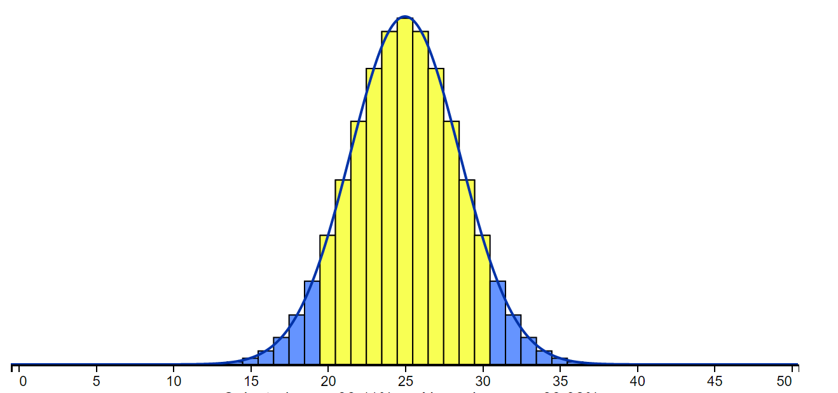
Sums of independent random variables
$$n=50$$
$Pr⁡[X∉\left(0.4,0.6\right)n]$=
$$11.9\%$$
https://www.stat.berkeley.edu/~stark/Java/Html/BinHist.htm

Slide 24
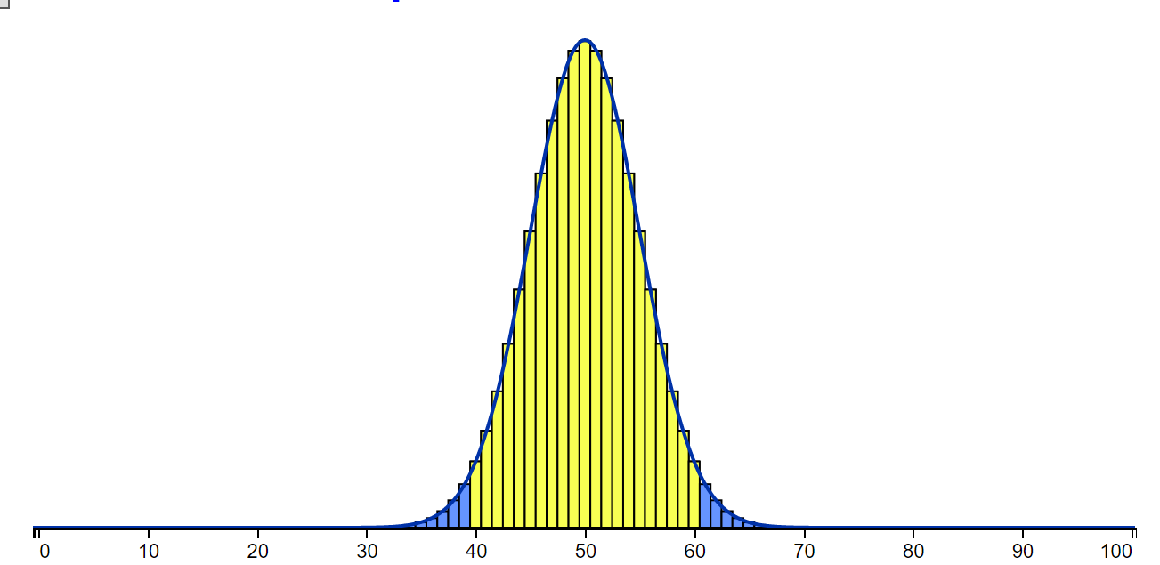
Sums of independent random variables
$$n=100$$
$Pr⁡[X∉\left(0.4,0.6\right)n]$=
$$3.6\%$$
https://www.stat.berkeley.edu/~stark/Java/Html/BinHist.htm

Slide 25
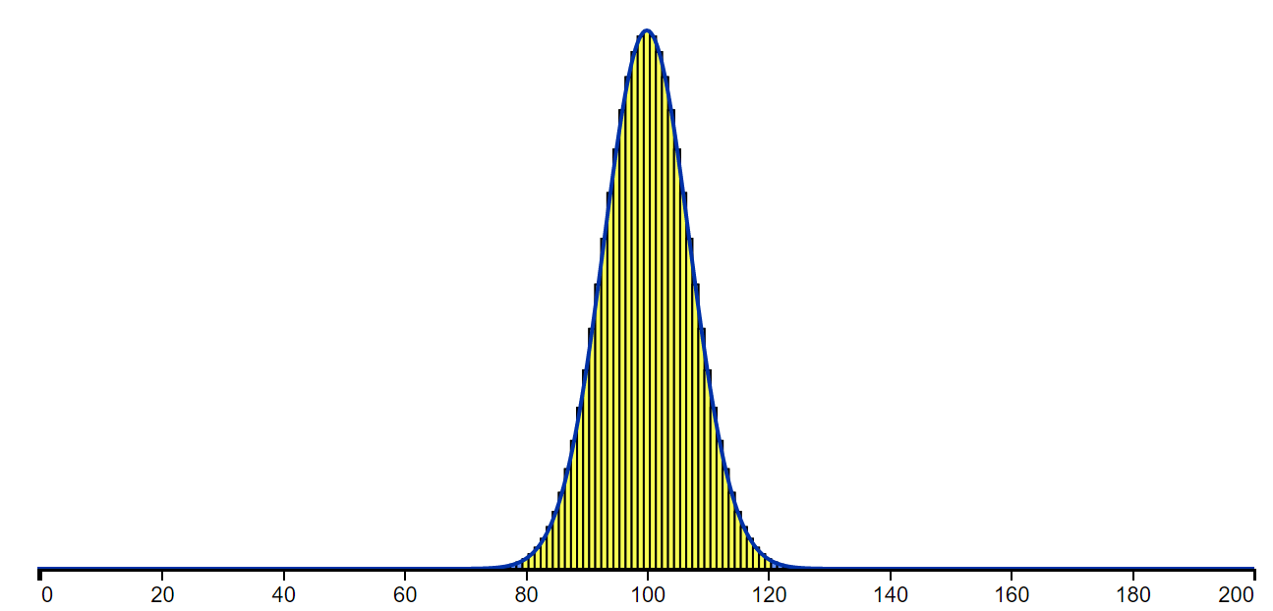
Sums of independent random variables
$$n=200$$
$Pr⁡[X∉\left(0.4,0.6\right)n]$=
$$0.4\%$$
https://www.stat.berkeley.edu/~stark/Java/Html/BinHist.htm

Slide 26
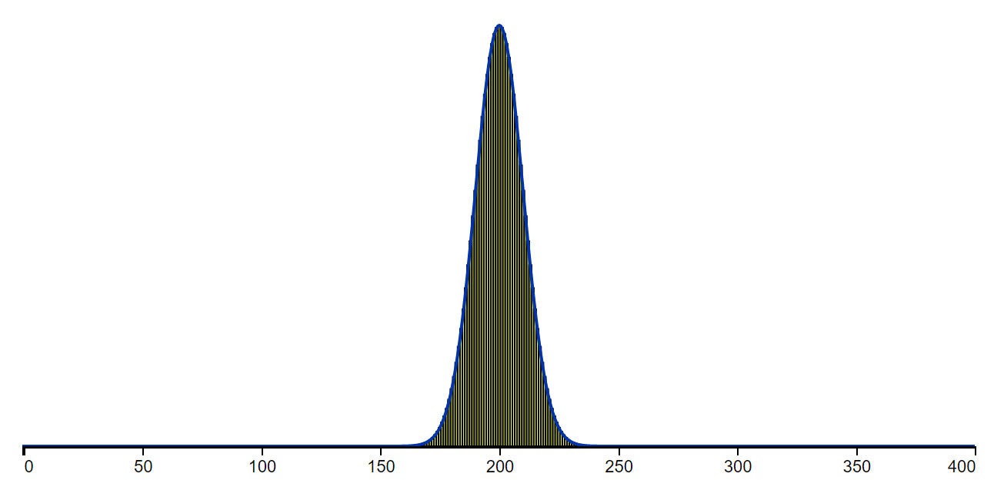
Sums of independent random variables
$$n=400$$
$Pr⁡[X∉\left(0.4,0.6\right)n]$=
$$0.01\%$$
https://www.stat.berkeley.edu/~stark/Java/Html/BinHist.htm

Slide 27
Concentration bounds
$X$ sum of $n$ independent random variables – $≈$“Normal/Gaussian/bell curve”:
$$\operatorname{Pr}\left[ X∉\left(0.99,1.01\right)𝔼\left[X\right]\right]<exp⁡(−δ⋅n)$$
Otherwise: weaker bounds
Independent & identically distributed
In concentrated r.v.’s, expectation, median, mode, etc.. $≈$ same
Chernoff Bound: Let $X_{0},…,X_{n−1}$ i.i.d. r.v.’s with $X_{i}∈[0,1]$. Then if $X=X_{0}+⋯+X_{n−1}$ and $p=𝔼\left[X\right]$ for every $ε>0$,
$$\operatorname{Pr}\left[ \left|X−np\right|>εn\right]<2⋅exp⁡(−{2ε}^{2}⋅n)$$

Slide 28
Concentration bounds
$X$ sum of $n$ independent random variables – $≈$“Normal/Gaussian/bell curve”:
$$\operatorname{Pr}\left[ X∉\left(0.99,1.01\right)𝔼\left[X\right]\right]<exp⁡(−δ⋅n)$$
Otherwise: weaker bounds
Independent & identically distributed
In concentrated r.v.’s, expectation, median, mode, etc.. $≈$ same
Chernoff Bound: Let $X_{0},…,X_{n−1}$ i.i.d. r.v.’s with $X_{i}∈[0,1]$. Then if $X=X_{0}+⋯+X_{n−1}$ and $p=𝔼\left[X\right]$ for every $ε>0$,
$$\operatorname{Pr}\left[ \left|X−np\right|>εn\right]<2⋅exp⁡(−{2ε}^{2}⋅n)$$
$$<\exp\left(−ε^{2}⋅n\right) \left(if n>\frac{1}{ε^{2}}\right)$$

Slide 29
Simplest Bound: Markov’s Inequality
Q: Suppose that the average age in a neighborhood is $20$. Prove that at most 1/4 of the residents are 80 or older.
A: Suppose otherwise:
80
Contribute enough to make avg>20
Avg $>\frac{1}{4}⋅80=20$
0
$$>\frac{1}{4}$$
Thm (Markov’s Inequality): Let $X$ be non-negative r.v. and $μ=𝔼[X]$. Then for every $k>1$, $\operatorname{Pr}\left[ X≥kμ\right]≤1/k$
Proof: Same as question above

Slide 30
Variance & Chebychev
If $X$ is r.v. with $μ=𝔼[X]$ then $Var\left(X\right)=𝔼\left[{\left(X−μ\right)}^{2}\right]=𝔼\left[X^{2}\right]−𝔼{\left[X\right]}^{2}$
$$σ\left(X\right)=\sqrt{Var(X)}$$
Chebychev’s Inequality: For every r.v. $X$
$$\operatorname{Pr}\left[ X ≥k deviations from μ\right]≤\frac{1}{k^{2}}$$
(Proof: Markov on $Y={\left(X−μ\right)}^{2}$ )
Compare with $X=∑X_{i}$ i.i.d or other r.v.’s well approx. by Normal where
$$\operatorname{Pr}\left[ X ≥k deviations from μ\right]≈exp⁡(−k^{2})$$

Slide 31
Next Lectures
Randomized Algorithms
Some examples
Randomized Complexity Classes
$BPTIME\left(T\left(n\right)\right)$, $BPP$
Properties of randomized computation (Reducing error …)

