Slide 1
CS 121: Lecture 24 Intro to Randomized Algorithms
Adam Hesterberg
https://madhu.seas.Harvard.edu/courses/Fall2020
Book: https://introtcs.org
{
The whole staff (faster response): CS 121 Piazza
How to contact us
Only the course heads (slower): cs121.fall2020.course.heads@gmail.com

Slide 2
Announcements:
Midterm 2 graded. Solutions to be posted today-ish.
Thanks for participating in Midterm Feedback Survey.
Happy Thanksgiving! (Next lecture Tuesday.)

Slide 3
Where we are:
✓
Part I: Circuits:
Finite computation,
quantitative study
✓
Part II: Automata:
Infinite restricted computation, quantitative study
✓
Part III: Turing Machines:
Infinite computation, qualitative study
✓
Part IV: Efficient Computation:
Infinite computation, quantitative study
Part V: Randomized computation:
Extending studies to non-classical algorithms

Slide 4
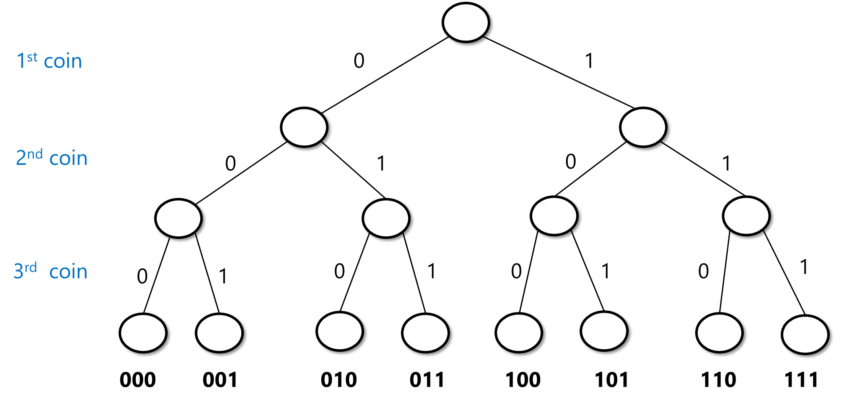
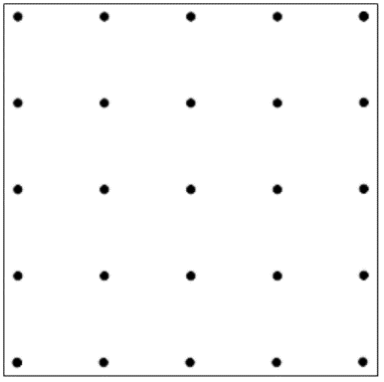
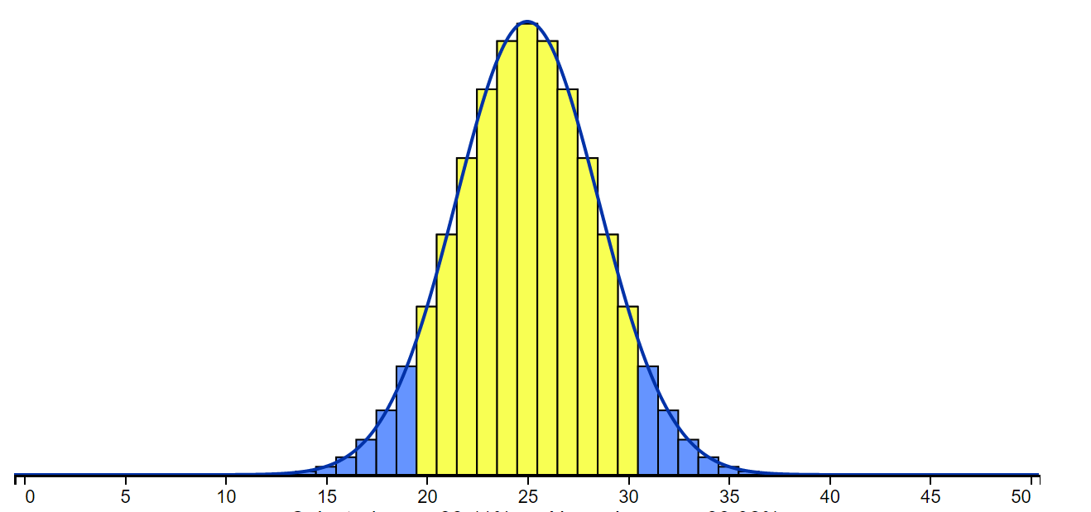
Last lecture
Sample space
Events
Union/intersection/negation – AND/OR/NOT of events
Random variables
Expectation
Concentration / tail bounds
$$X:\{0,1\}^{n}→ℝ$$
Average value of $X$ : $𝔼\left[X\right]=\sum_{x∈\{0,1\}^{n}}{2^{−n}X(x)}=\sum_{v∈ℝ}{v⋅\operatorname{Pr}{[X=v]}}$

Slide 5
Today:
Randomized Algorithms
Polynomial Identity Testing
Approximation for maximum cut
Randomized Complexity Class $BPP$
Properties of randomized computation (Reducing error …)

Slide 6
Informal
A randomized algorithm has a special operation:
foo =
i.e. foo $∼\{0,1\}$
By repeating can choose foo $∼\{0,1\}^{n}$ or $∼[0,1]$

Slide 7
Randomized algorithms
Two equivalent views:
input
output
Internal “coin tosses”
input
output
Random coins
Get input $x∈\{0,1\}^{n}$
Run alg $A(x)$ that has special operation $r_{i}←RAND( )$ ($r_{i}∼\{0,1\}$)
Get input $x∈\{0,1\}^{n}$
Choose $r∼\{0,1\}^{m}$
Run deterministic algorithm $A(x,r)$
$$output=ALG(input,randomness)$$

Slide 8
Computing a function
Not random input – has to work in the worst case
Randomized algorithm $ALG$ computes $F$ if for every input $x$
$$\operatorname{Pr}\left[ ALG\left(x\right)=F\left(x\right)\right]≥\frac{2}{3}$$
Probability over the randomness of the algorithm, not the input
The constant $2/3$ is arbitrary – can be replaced by $0.51$, $0.99$, even $1−2^{−n}$. Not by $1/2.$
BPP: {Boolean functions computable by some randomized algorithm}

Slide 9
Polynomial Identity Testing: Problem
Q: ${(x+yz)}^{7}−x^{7}−y^{7}z^{7}=7x\left(x+yz\right)\left(x^{2}+y^{2}z^{2}\right)\left(x^{2}+xyz+y^{2}z^{2}\right)?$
Standard form: $\left(x+yz\right)\left(x+yz\right)\left(x+yz\right)\left(x+yz\right)\left(x+yz\right)\left(x+yz\right)\left(x+yz\right)−xxxxxxx−yyyyyyyzzzzzzz−7x\left(x+yz\right)\left(xx+yyzz\right)\left(xx+xyz+yyzz\right)=0$?
Input $φ$: an expression like the above, with sums/products of variables.
Output $PIT(φ)$: 1 iff $φ$ is the 0 polynomial.
Why is the following not a polynomial-time algorithm for PIT?
Alg-PIT$(φ)$:
Multiply everything out,
Add/subtract like terms,
Return 1 iff all terms cancel.

Slide 10
Polynomial Identity Testing: Algorithm
Q: $\left(x+yz\right)\left(x+yz\right)\left(x+yz\right)\left(x+yz\right)\left(x+yz\right)\left(x+yz\right)\left(x+yz\right)−xxxxxxx−yyyyyyyzzzzzzz−7x\left(x+yz\right)\left(xx+yyzz\right)\left(xx+xyz+yyzz\right)=0$?
Randomized algorithm for PIT (note: polynomial time!):
RandAlg-PIT$(φ)$:
For each variable, choose a random number between 0 and 3n.
Plug in those values and do all the integer arithmetic.
Return 1 iff the result is 0.
Can give the wrong answer! Give an example.
.

Slide 11
Polynomial Identity Testing: Correctness (1/2)
Randomized algorithm for PIT:
RandAlg-PIT$(φ)$:
For each variable, choose a random number between 0 and 3n.
Plug in those values and do all the integer arithmetic.
Return 1 iff the result is 0.
Goal: $\operatorname{Pr}\left[ RandAlg−PIT\left(x\right)=PIT\left(x\right)\right]≥\frac{2}{3}$
If $PIT\left(φ\right)=1$, $\operatorname{Pr}\left[ RandAlg−PIT(φ)=1\right]=1$
If $PIT\left(φ\right)=0$…

Slide 12
Polynomial Identity Testing: Correctness (2/2)
$\left(x+yz\right)\left(x+yz\right)\left(x+yz\right)\left(x+yz\right)\left(x+yz\right)\left(x+yz\right)\left(x+yz\right)−xxxxxxx−yyyyyyyzzzzzzz=7x(x+yz)(xx+yyzz)(xx+xyz+yyzz)$?
RandAlg-PIT$(φ)$:
For each variable, choose a random number between 0 and 3n.
Plug in those values and do all the integer arithmetic.
Return 1 iff the result is 0.
If $PIT\left(φ\right)=0$: note that the degree is at most $n$.
Fact: A 1-variable polynomial $p≠0$ is 0 for $≤deg⁡(p)$ inputs in $\{0,…,3n\}$
Fact: A k-variable polynomial $p≠0$ is 0 for $≤deg⁡(p){(3n+1)}^{k−1}$ inputs in ${\{0,…,3n\}}^{k}$
So $\operatorname{Pr}\left[ RandAlg−PIT\left(φ\right)=0\right]=\operatorname{Pr}\left[φ\left(x\right)=0\right]≤\frac{\deg\left(p\right)}{3n+1}<\frac{2}{3}$.

Slide 13
Success amplification
We have an algorithm RandAlg-PIT for which:
$$\operatorname{Pr}\left[RandAlg−PIT\left(φ\right)=F\left(x\right)\right]≥\frac{2}{3}$$
Give an algorithm BetterRandAlg-PIT for which:
$$\operatorname{Pr}\left[RandAlg−PIT\left(φ\right)=F\left(x\right)\right]≥1−2^{−60}$$
Note: $\operatorname{Pr}\left[ failure\right]<Pr⁡[ asteroid hits us this minute]$
Bottom line: randomized algorithms as good as deterministic for all practical purposes.
Recall: randomized algorithms – work on worst case inputs. Randomness is only over the coins of the algorithm.

Slide 15
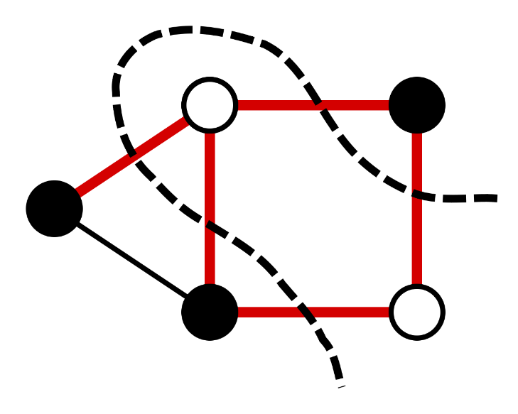
Input: Graph $G=(V,E)$.
Output: Partition of $V$ maximizing # of crossing edges.
Define: $OPT\left(G\right)=\max_{S⊆V} |E\left(S,\overline{S}\right)|$ to be max # of cut edges.
If $P≠NP$,no poly-time alg computes $OPT(G)$ / produces cut achieving it.
We’ll show: Poly-time randomized algorithm that w/ probability $≥0.99$ outputs cut $S$ that cuts at least $0.5⋅OPT(G)$ edges.
$$α=\min_{0≤θ≤π}{\frac{2}{π}⋅\frac{θ}{1−\cos{θ}}}≈0.87857$$
Best known: Alg cutting $α⋅OPT(G)$ edges for
Central open question: is this optimal?

Slide 16
Input: Graph $G=(V,E)$.
Output: Partition of $V$ maximizing # of crossing edges.
Define: $OPT\left(G\right)=\max_{S⊆V} |E\left(S,\overline{S}\right)|$ to be max # of cut edges.
We’ll show: Poly-time randomized algorithm that w/ probability $≥0.99$ outputs cut $S$ that cuts at least $0.5⋅OPT(G)$ edges.
Thm: $∃$ randomized poly time algorithm $A$ s.t. with prob $≥0.99$
$A\left(G\right)=S$ s.t. $\left|E\left(S,\overline{S}\right)\right|≥|E|/2$
Q: Why does Thm imply what we need to show?

Slide 17
Thm: $∃$ randomized poly time algorithm $A$ s.t. with prob $≥0.99$
$A\left(G\right)=S$ s.t. $\left|E\left(S,\overline{S}\right)\right|≥|E|/2$
Lemma: $∃$ randomized poly time algorithm $A$ s.t. if $S=A(G)$ then
$$𝔼\left[\left|E\left(S,\overline{S}\right)\right|\right]≥|E|/2$$
Over randomness of $A$
Q: Why does Lemma not immediately imply the theorem?

Slide 18
Lemma: $∃$ randomized poly time algorithm $A$ s.t. if $S=A(G)$ then
$$𝔼\left[\left|E\left(S,\overline{S}\right)\right|\right]≥|E|/2$$
Proof: Given $G$ on $n$ vertices, $A$ picks $x∼\{0,1\}^{n}$ and output $S=\left\{ i \right|x_{i}=1 \}$
For every edge $\left(i,j\right)∈E$ , define $X_{i,j}=\left\{\begin{aligned}1, x_{i}≠x_{j} \\ &0, x_{i}=x_{j}\end{aligned}\right.$
Q: What is $𝔼[X_{i,j}]$?
A: $1/2$
Q: Prove that $\left|E\left(S,\overline{S}\right)\right|=\sum_{\left(i,j\right)∈E}{X_{i,j}}$

Slide 19
From expectation to high probability
Success amplification
Given: Poly-time alg $A$ s.t. that $𝔼 \left[val(A\left(G\right))\right]≥k$
Goal: Poly-time alg $B$ s.t. that $\operatorname{Pr}{[val\left(B\left(G\right)\right)≥k]}≥0.99$
Algorithm $B$
$m$: # of edges
Input: $G$
for $i=1…1000m:$
$S_{i}←A(G)$ # fresh randomness each time
return $S_{i}$ maximizing edges cut

Slide 20
Given: Poly-time alg $A$ s.t. that $𝔼 \left[val(A\left(G\right))\right]≥k$
Goal: Poly-time alg $B$ s.t. that $\operatorname{Pr}{[val\left(B\left(G\right)\right)≥k]}≥0.99$
Algorithm $B$
Input: $G$
for $i=1…1000m:$
$S_{i}←A(G)$ # fresh randomness each time
return $S_{i}$ maximizing edges cut
Lemma: $\operatorname{Pr}{[val\left(A\left(G\right)\right)≥k]}≥1/m$
Q: Prove that Lemma $⇒$ $\operatorname{Pr}{[val\left(B\left(G\right)\right)≥k]}≥0.99$

Slide 21
Given: Poly-time alg $A$ s.t. that $𝔼 \left[val(A\left(G\right))\right]≥k$
Lemma: $\operatorname{Pr}{[val\left(A\left(G\right)\right)≥k]}≥1/m$
Proof: Suppose that $\operatorname{Pr}\left[ val\left(A\left(G\right)\right)≥k \right]<\frac{1}{m}$
then
prob $<1/m$
val $≤m$
prob $≤1$
val $≤k−1$
$$𝔼[val\left(A\left(G\right)\right] < \frac{1}{m}⋅m + 1⋅(k−1)$$
$$=k$$
Contribution from case that $val\left(A\left(G\right)\right)≥k$
Contribution from case that $val\left(A\left(G\right)\right)<k−1$

Slide 22
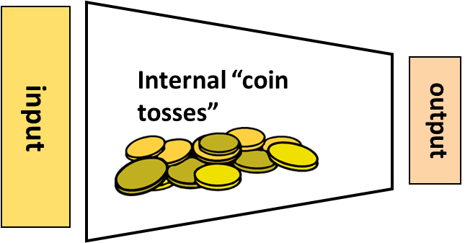
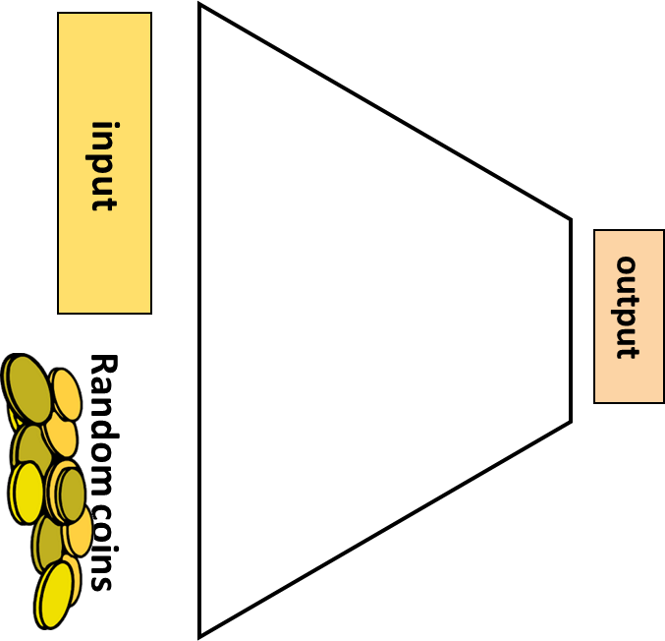
Recap
Def: $F:\{0,1\}^{∗}→\{0,1\}$ is in $BPP$ is there is a poly-time randomized algorithm $A$ s.t. $∀n ∀x∈{\left\{0,1\right\}}^{n}$
$$\underset{A^{′}s randomness}{Pr}{[A\left(x\right)=F(x)]}≥\frac{2}{3}$$
Def: $F:\{0,1\}^{∗}→\{0,1\}$ is in $BPP$ is there is a poly-time algorithm $A$ , poly $q\left(n\right)$ s.t. $∀n ∀x∈{\left\{0,1\right\}}^{n}$
$$\underset{r∼\{0,1\}^{q\left(n\right)}}{Pr}{[A\left(x;r\right)=F(x)]}≥\frac{2}{3}$$

Slide 23
All functions $F:\{0,1\}^{∗}→\{0,1\}$
$R$ Computable functions
$HALT_{2^{2^{n}}}$
$$EXP$$
$HALT$
$$P_{/poly}$$
$HALT_{2^{n}}$
$$BPP$$
$$P$$
Functions with unbounded input lengths: inclusion diagram – not to scale!!
Some classes might “collapse” to one another.
$2SAT$
$$PIT$$
U$HALT$
$PRIMALITY$
$$NP$$
$$NPC$$
$3SAT$
$FACTORING$

Slide 24
All functions $F:\{0,1\}^{∗}→\{0,1\}$
$R$ Computable functions
$HALT_{2^{2^{n}}}$
$$EXP$$
$HALT$
$$P_{/poly}$$
$HALT_{2^{n}}$
$$=$$
$$P$$
$$BPP$$
Functions with unbounded input lengths: inclusion diagram – not to scale!!
Some classes might “collapse” to one another.
$2SAT$
$PRIMALITY$
U$HALT$
$$NP$$
$$PIT$$
$$NPC$$
$3SAT$
$FACTORING$
Unknown but believed to be true

Slide 25
Next Lecture
BPP vs EXP
BPP vs P/poly
BPP vs NP

