Slide 1
CS 121: Lecture 26 What we didn’t cover
Madhu Sudan
https://madhu.seas.Harvard.edu/courses/Fall2020
Book: https://introtcs.org
{
The whole staff (faster response): CS 121 Piazza
How to contact us
Only the course heads (slower): cs121.fall2020.course.heads@gmail.com

Slide 2
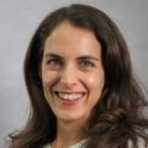
Announcements:
Advanced section: Yael Kalai (Proofs in CS: Probabilistic Checking, Interaction, Zero Knowledge, Delegation)
Final Exam (any 3hrs between [1:21pm 12/10 – 1:21pm 12/12])

Slide 3
Where we are:
✓
Part I: Circuits:
Finite computation,
quantitative study
✓
Part II: Automata:
Infinite restricted computation, quantitative study
✓
Part III: Turing Machines:
Infinite computation, qualitative study
✓
Part IV: Efficient Computation:
Infinite computation, quantitative study
✓
Part V: Randomized computation:
Extending studies to non-classical algorithms

Slide 4
Summary of the course
Turing Machines!
Compute everything computable …
(weaker models exist (circuits, DFA) but they don’t compute everything)
In fact … there exists one TM that computes everything computable!
… but some problems not computable ☹
Can be used to measure complexity …
P = poly time = efficient
EXP $≠$ P inefficient
NP $≠$ P? desired to be efficient, believed inefficient.
STCT Challengers: Randomness and Quantum
BPP (can do stuff not known to be in P), status also unknown ….

Slide 5
1. Quantum computing

Slide 6
Physics 500BC-1920’s: Clockwork universe
A physical theory has basic objects (“particles”) and forces between them.
Given state of all particles at time $t$, can compute state at time $t+1$
If universe has $N$ particles, we can represent state with $O(N)$ numbers and compute one time-step in $O(N)$ or $O(N^{2})$ time.
Examples: Newtonian mechanics, Maxwell’s equations, Special and general relativity (& TM Configurations!)
Quantum Mechanics is not a “clockwork” theory!

Slide 7
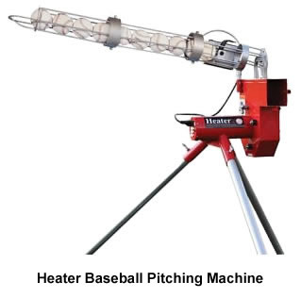
Double slit experiment: classical view
$Pr⁡[hit]$ only grows if both slits are open
$$\operatorname{Pr}\left[ top slit \right]=\frac{1}{10}$$
$$\operatorname{Pr}\left[ hit | top slit \right]=\frac{1}{10}$$
$$\operatorname{Pr}\left[ bottom slit \right]=\frac{1}{10}$$
$$\operatorname{Pr}\left[ hit | bot slit \right]=\frac{1}{10}$$
$$\operatorname{Pr}\left[ hit\right]=\operatorname{Pr}\left[hit | top\right]⋅\operatorname{Pr}\left[top\right]+\operatorname{Pr}\left[hit | bot\right]⋅\operatorname{Pr}\left[bot\right]=\frac{1}{10}⋅\frac{1}{10}+\frac{1}{10}⋅\frac{1}{10}=\frac{2}{100}$$

Slide 8
Double slit experiment: quantum view*
$$\operatorname{Pr}\left[ hit | top slit \right]=\frac{1}{10}$$
$Pr⁡[hit]$ can be smaller when both slits open
$$\operatorname{Pr}\left[ top slit \right]=\frac{1}{10}$$
$$α\left[hit | top slit\right]=+\frac{1}{\sqrt{10}}$$
$$α\left[top slit\right]=+\frac{1}{\sqrt{10}}$$
$$α\left[bottom slit\right]=+\frac{1}{\sqrt{10}}$$
$$α\left[hit | bot slit\right]=−\frac{1}{\sqrt{10}}$$
$$\operatorname{Pr}\left[ bottom slit \right]=\frac{1}{10}$$
$$\operatorname{Pr}\left[ hit | bot slit \right]=\frac{1}{10}$$
Destructive interference
$$Pr\left[hit\right]={\left(α\left[hit | top\right]⋅α\left[top\right]+α\left[hit | bot\right]⋅α\left[bot\right]\right)}^{2}={\left(\frac{1}{\sqrt{10}}⋅\frac{1}{\sqrt{10}} −\frac{1}{\sqrt{10}}⋅\frac{1}{\sqrt{10}}\right)}^{2}=0$$

Slide 9
Quantum weirdness II
Measuring if an event happens collapses the amplitude – the event happens with probability $α^{2}$ and doesn’t happen with probability $1−α^{2}$
An event can depend on particles that are far from each other – measurement can create “spooky correlations at a distance”.

Slide 10
Implications to computing
Probabilistic computing:
Let $f:{\left\{0,1\right\}}^{n}→{\left\{0,1\right\}}^{m}$ be polytime computable
Can put computer in the configuration $2^{−n}⋅\sum_{x∈{\left\{0,1\right\}}^{n}}{f\left(x\right)}$
Allows us to compute “average(f)”, “variance(f)” etc.
Quantum computing:
Let $f:{\left\{0,1\right\}}^{n}→{\left\{0,1\right\}}^{m}$ be polytime computable
Can put computer in the configuration $2^{−\frac{n}{2}}⋅\sum_{x∈{\left\{0,1\right\}}^{n}}{{\left(−1\right)}^{x_{0}}f\left(x\right)}$
Allows us to compute ?

Slide 11
Some quantum computing history
1981: Feynman talks about difficulty of simulating quantum physics with classical computers, speculates maybe a different computer would work.
1985: David Deutsch starts studying quantum computers in their own right.
1993: Bernstein and Vazirani give formal definitions, first formal evidence of exponential speedup.
Spring 1994: Simons gives “period finding” algorithm for functions $f:ℤ_{2}^{n}→ℤ_{2}^{n}$ .
Fall 1994: Shor gives “period finding” algorithm for functions $f:ℤ_{N}→ℤ_{N}$ and show it implies a polynomial-time factoring algorithm. Field explodes.

Slide 12
More details:
Model: Quantum Turing Machine or (uniform) Quantum circuits
Uniform circuit = constructed in time poly in its size.
Complexity Measure: Quantum time/Quantum size (equal up to poly factors, due to uniformity)
Complexity Class: BQP – Boolean functions computable in Poly time.
Thms: $P⊆BQP$ , $BPP⊆BQP$, $BQP⊆EXP$

Slide 13
Moral of the story
Importance of STCT!
Axioms of quantum physics being tested by STCT!
Tools used to establish tests: from CS 121/221/321….

Slide 14
2. Cryptography

Slide 15
Cryptography
Very subtle – long history of people getting it wrong
Can’t be taught in one class, not even one term
Our focus is connection between cryptography, computational complexity, and randomness.

Slide 16
History of Crypto: 3000BC-1976
Design crypto system
Fix crypto system
Believe impossible to break
Use for life or death applications
Die
System is broken

Slide 17
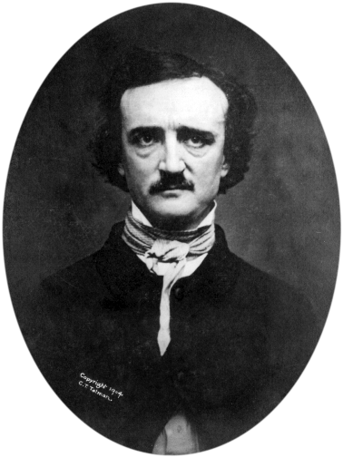
History of Crypto: 3000BC-1976
Design crypto system
“Human ingenuity cannot concoct a cipher which human ingenuity cannot resolve.”
Fix crypto system
Believe impossible to break
Use for life or death applications
Die
Edgar Allan Poe, 1841
System is broken

Slide 18
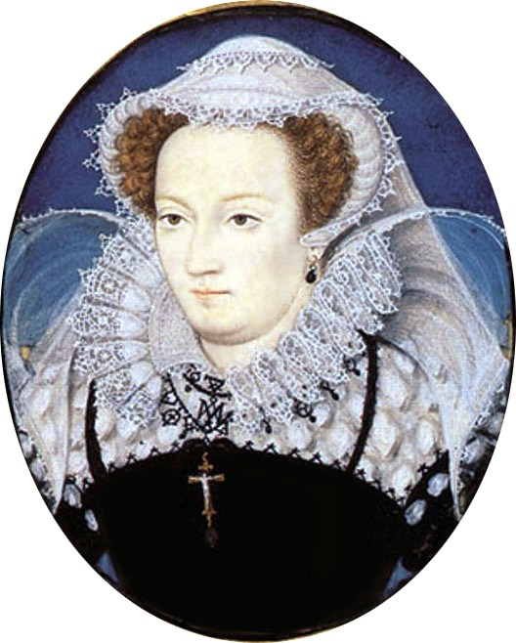
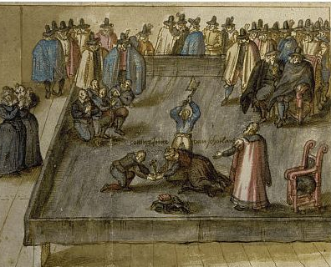
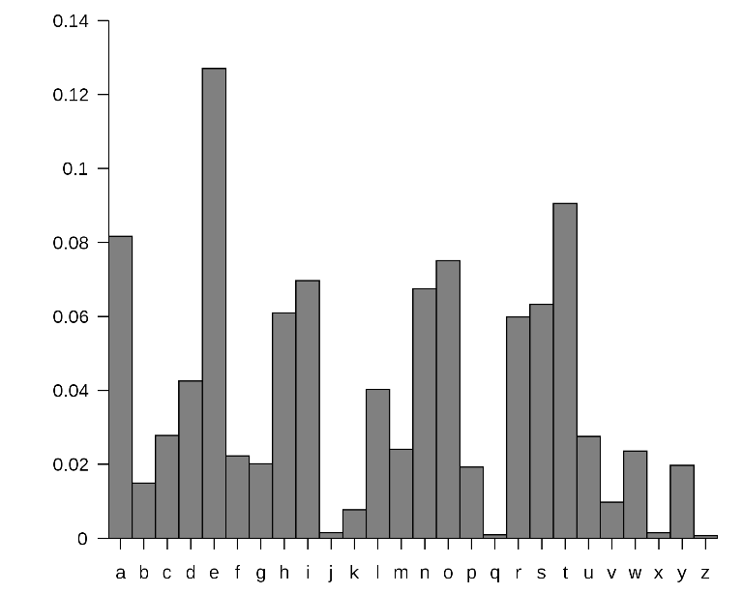
Example 1: Mary’s cipher
Mary queen of Scot planned to assassinate her cousin queen Elisabeth in 1587.
Communicated plot using substitution cipher
Sir Francis Walsingham broke it using frequency analysis

Slide 19
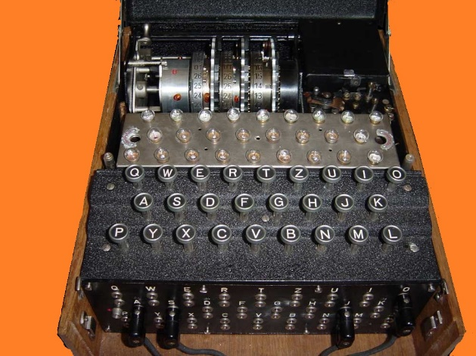
Example 2: Enigma
A typewriter that based on wires and rotor setting would emit different letter for every keypress.
current state
new state
letter typed
letter output
About ${10}^{113}$ possibilities to set the wirings and rotors.
Lightspeed supercomputer will take ${≫10}^{17}$ years to check them all
(universe is only ${10}^{10}$ years old)
Believed impossible to break by Germans.
Broken (following Polish advances) via heroic efforts by British at Bletchley park
Cut German U-Boat success in sinking ships by ~90%
Sank about 60% of German U-Boats in Mediterranean
Crucial to success of Normandy D-day landing.

Slide 20
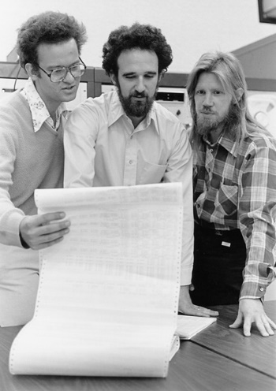
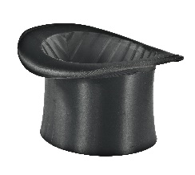
Modern Cryptography (1976- )
“We stand today on the brink of a revolution in cryptography”
Whit Diffie and Martin Hellman, 1976
Data
Cycles
Person-years
Result
Mary’s cipher
${10}^{4}$ bytes
N/A
$$1$$
Broken
Enigma
${10}^{7}$ bytes
$${10}^{13}$$
$${10}^{5}$$
Broken
1976
Diffie-Hellman/RSA
${10}^{22}$ bytes
$${10}^{25}$$
$${10}^{8}$$
Unbroken!
DH/RSA are simpler than Enigma, and allow public encryption key
Security through obscurity
Security through
simplicity
Notes:
Yottabyte, exaflop
Source: https://www.intel.com/content/dam/www/public/us/en/documents/white-papers/cost-efficient-ssl-application-delivery-paper.pdf assume about 1-10% of SSL traffic is the handshake.
Cycles, persons based on NSA capabilities

Slide 21
Modern cryptography
Key insight: $NP≠P$ on steroids
There exist “one-way” functions $f:{\left\{0,1\right\}}^{n}→{\left\{0,1\right\}}^{n}$ such that:
$f$ is easy to compute (in poly(n) time)
$f$ is hard to invert (Given $f\left(x\right)$, hard to find any $x^{′}$ such that $f\left(x^{′}\right)=f(x)$)
(Exercise: Prove that if NP=P, then such functions don’t exist!)
3 Phases of modern crypto:
Phase 1: Diffie/Hellman, Rivest/Shamir/Adleman: Realized above, and used sheer ingenuity to build some crypto primitives (encryption, signature, key distribution)
Phase 2: Blum/Goldwasser/Micali/Yao: Used principles of CS (!!!reductions!!!) to “automate” development of cryptography. Start with o.w.f., + build almost everything else from them! Proven secure unless owf breaks.
Phase 3: … Barak/Gentry/Sahai/Waters … : Ingenuity+Principles: Homomorphic Encryption, Obfuscation

Slide 22
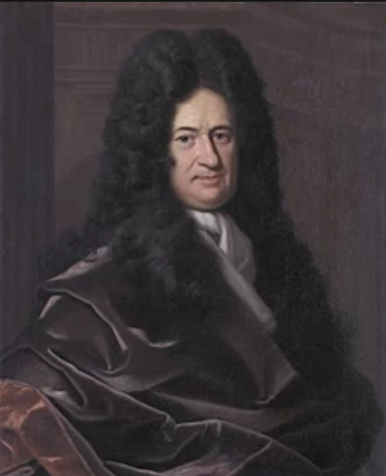
Computational Secrecy
There are not in nature two real, absolute beings, indiscernible from each other”, Gottfried Wilhelm Leibniz “Identity of Indiscernibles Principle”
a.k.a “If two distributions cannot be distinguished by polynomial-time algorithms, they may as well be the same”

Slide 23
Cryptography vs. security

Slide 24
What we didn’t see
(and where to see it.)

Slide 25
input
output
Algorithm

Slide 26
input
output
Algorithm
input
output
Algorithm
input
output
Algorithm
Data
Decisions

Slide 27
input
output
Algorithm
Who supplies the input?
And what do we do with the output?
Incentives, mechanism design (CS 13x, 23x)
Privacy , Fairness (CS126, CS208)
Cryptography/security(CS 127/227, CS 263, MIT 6.857, MIT 6.875 )
Average case complexity, learning, generalization (CS 181, 183, 228)

Slide 28
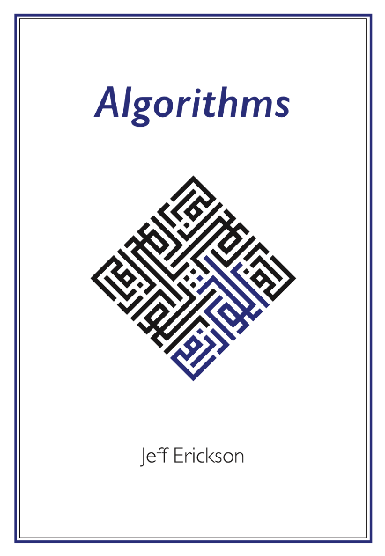
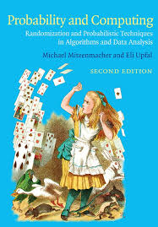
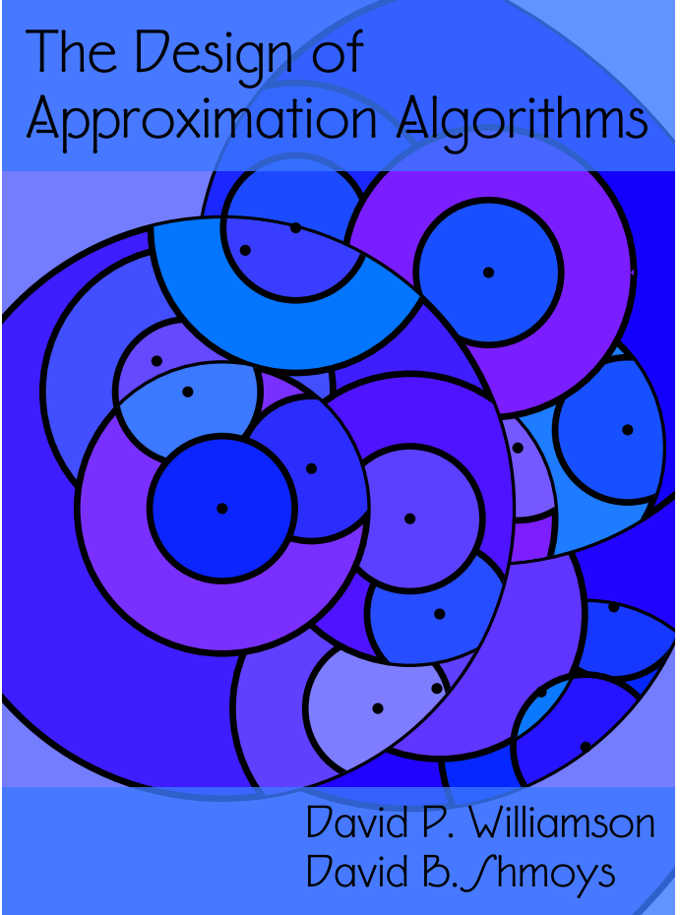
Surprising algorithms and data structures
http://algorithms.wtf/
Multiply $n$ bit numbers in $≪n^{2}$ time.
Multiply $n×n$ matrices in $≪n^{3}$ time.
Solve linear programming in $poly(n)$ time.
http://www.designofapproxalgs.com/
Answer query “$i∈S$?” in $O(1)$ time. (dictionaries, hash tables)
Answer query “$dist\left(u,v\right)<k$?” in $≪n$ time. (distance oracles, nearest neighbors)
CS 124, CS 222/223, MIT 6.854

Slide 29
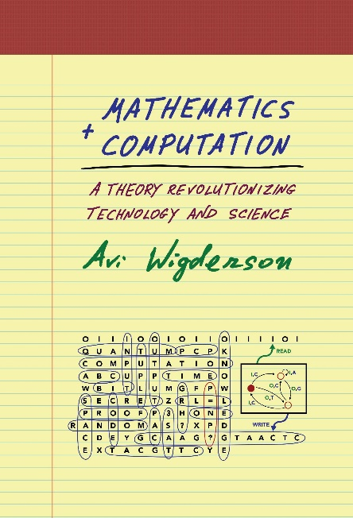
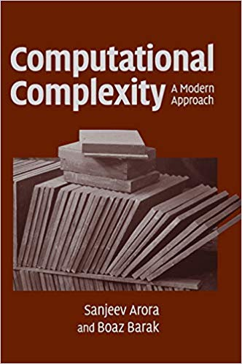
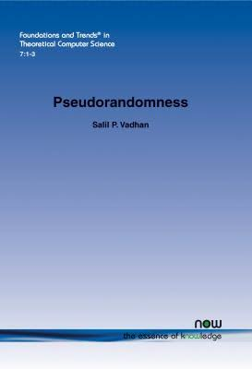
More on computational complexity
Hardness of approximation and probabilistically checkable proofs.
Lower bounds for concrete computational models. (For general Boolean circuits, can’t rule out $6n$ gate circuit for 3SAT!)
Derandomization from weaker assumptions.
CS 221 , MIT 6.841
https://www.math.ias.edu/avi/book
https://theory.cs.princeton.edu/complexity/
https://people.seas.harvard.edu/~salil/ pseudorandomness/

Slide 30
Information Theory / Entropy
Shannon capacity
KL div. VC dim.
Communication Complexity
Error correcting codes
Machine Learning
CS 224/226
Data structures lower bounds
CS 229
CS 18x/28x/ 228

Slide 31
CS 124/223/222/226 CS 127/227
AM 106, 107, 121
Mathematics
CS 28x, CS 228
(other) Computer Science
Statistics
CS 229
Logic
Randomness
Communication Complexity
CS 208 CS126
Engineering
Property
testing
Theoretical Computer Science
Theoretical
Computer
Science
Learning Theory
Theoretical
Computer Science
Verification
Social
Science
Crypto
Distributed
PHIL 144
Algorithmic Game Theory
Lower
bounds
Philosophy
Quantum Computing
Biology
Economics
Physics
CS 13x, 23x
MIT 2.111, 6.443
Machine Learning
Pseudorandomness
Machine Learning
Pseudorandomness
Machine Learning
Pseudorandomness
Cryptography
Cryptography
Core TCS
Cryptography
Core TCS
Core TCS
Coding
Theory
Coding
Theory
Coding
Theory
Quantum Computing
Quantum Computing
Sublinear Algorithms
Quantum Computing
Interactive Computation
Sublinear Algorithms
Interactive Computation
Sublinear Algorithms
Interactive Computation

Slide 32
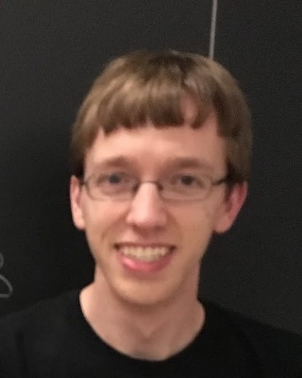
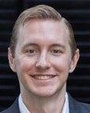
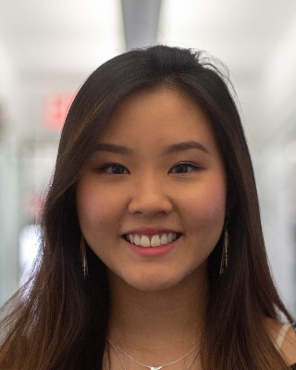
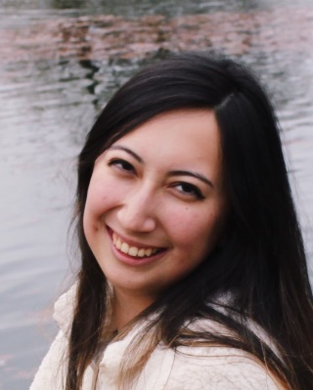
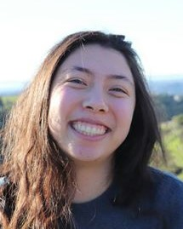
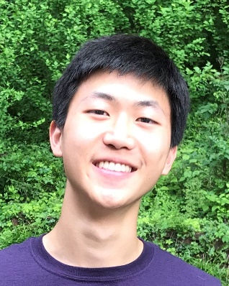
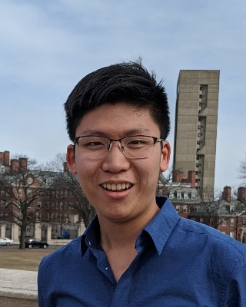
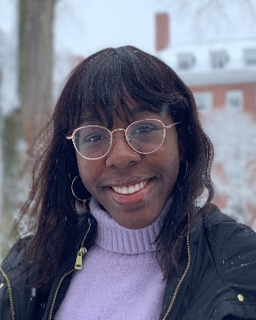
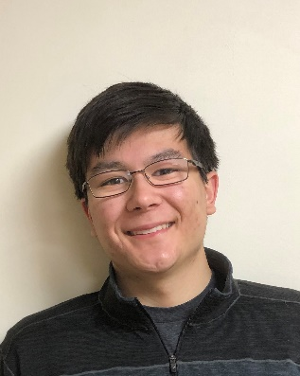
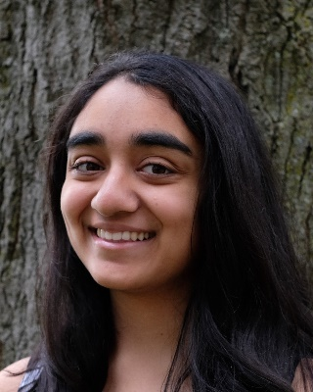
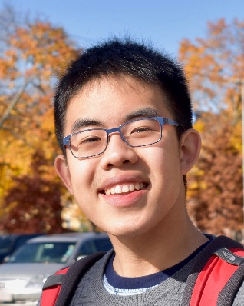
Thank You to …
Adam Hesterberg
William Burke
Amy Wang
Serena Davis
Nari Johnson
Joanna Boyland
Kevin Chen
Max Guo
Diego Gutierrez
Eric Lin
Ife Omidiran
James Roney
Noah Singer
Zuzanna Skoczylas
Sahana Srinivasan
Richard Xu

