Slide 1
CS 121: Lecture 4 Defining Computation: Circuits
Madhu Sudan
https://madhu.seas.Harvard.edu/courses/Fall2020
Book: https://introtcs.org
{
The whole staff (faster response): CS 121 Piazza
How to contact us
Only the course heads (slower): cs121.fall2020.course.heads@gmail.com

Slide 2
Reminder
Homework 1 due Thursday!
CS 121.5: Sasha Golovnev on “circuit lower bounds” on Thursday.
Reminder: Sign up for active participation, Lectures 8-11.
Other modes of participation: Sections+OH+Piazza!
TFs standing by!!

Slide 3
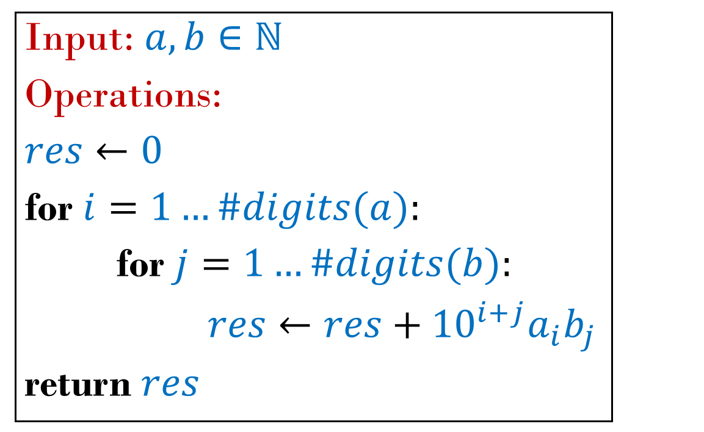
What
How
$a,b∈ℕ$
$$a⋅b$$
input
output
Function
Formula/Algorithm/ Program/Circuit/..

Slide 4
How
Formula/Algorithm/ Program/Circuit/..

Slide 5
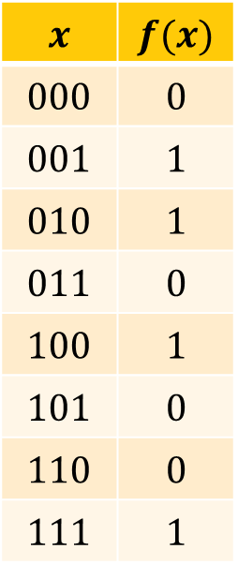
Today’s goals
Example:
$$x$$ | $$f(x)$$
$$000$$ | $$0$$
$$001$$ | $$1$$
$$010$$ | $$1$$
$$011$$ | $$0$$
$$100$$ | $$1$$
$$101$$ | $$0$$
$$110$$ | $$0$$
$$111$$ | $$1$$
$f:\{0,1\}^{n}→\{0,1\}^{m}$ finite function
Compute $f$ : map $x$ to $f(x)$ using sequence of “basic operations”.
Define “basic operations”.
Formally define “$f$ can be computed using the basic operations”
Formally define “$f$ can be computed using $≤s$ operations”

Slide 6
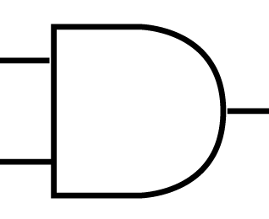
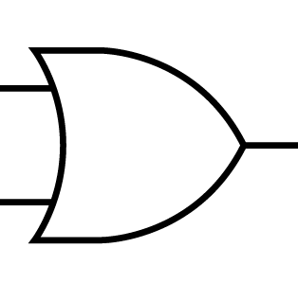
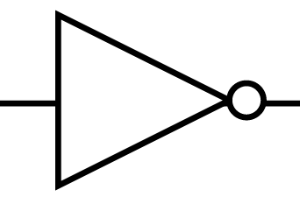
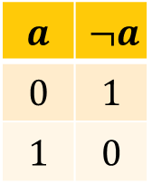
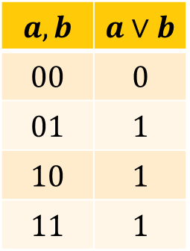
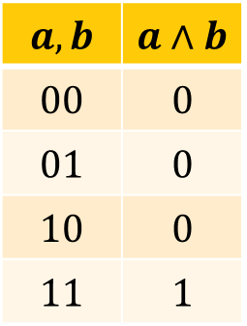
Basic Operations
$AND,OR :\{0,1\}^{2}→\{0,1\}$, $NOT:\{0,1\}→\{0,1\}$
$$a,b$$ | $$a∧b$$
$$00$$ | $$0$$
$$01$$ | $$0$$
$$10$$ | $$0$$
$$11$$ | $$1$$
$AND\left(a,b\right)=a∧b=\left\{\begin{aligned} 1, a=b=1 \\ 0, otherwise\end{aligned}\right.$
$$a$$
$$a∧b$$
$$b$$
$$a,b$$ | $$a∨b$$
$$00$$ | $$0$$
$$01$$ | $$1$$
$$10$$ | $$1$$
$$11$$ | $$1$$
$OR\left(a,b\right)=a∨b=\left\{\begin{aligned} 0, a=b=0 \\ & 1, otherwise\end{aligned}\right.$
$$a$$
$$a∨b$$
$$b$$
$NOT\left(a\right)=¬a=\overline{a}=\left\{\begin{aligned} 1, a=0 \\ &0, a=1\end{aligned}\right.$
$$a$$ | $$¬a$$
$$0$$ | $$1$$
$$1$$ | $$0$$
$$a$$
$$¬a$$
Continue on Jupyter

Slide 7
Circuit = Sequence of Basic Operations
Two equivalent ways of thinking:
As a graph
As a “straightline” program (no loops – simple sequence of instructions).

Slide 8
(AON)-Circuit Computing Majority

Slide 10
Circuit = Sequence of Basic Operations
Two equivalent ways of thinking:
As a graph
As a “straightline” program (no loops – simple sequence of instructions).

Slide 12
Exercise Break 1
Describe circuit computing Exactly-2:${\left\{0,1\right\}}^{3}→\left\{0,1\right\}$:
Exactly-2$\left(x_{0},x_{1},x_{2}\right)=1 ⇔ x_{0}+x_{1}+x_{2}=2$
How many gates did you use?
Food for thought/If you have extra time:
How would you extend to circuit computing Exactly-$m$:${\left\{0,1\right\}}^{n}→\left\{0,1\right\}$ given by Exactly-$m\left(x_{0}…x_{n−1}\right)=1⇔x_{0}+⋯+x_{n−1}=m$.
How many gates would Exactly-$m$ require? (say if $m ≅\frac{n}{2}$)

Slide 13
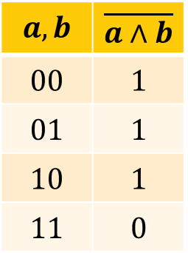
NAND Operation
$$a,b$$ | $$\overline{a∧b}$$
$$00$$ | $$1$$
$$01$$ | $$1$$
$$10$$ | $$1$$
$$11$$ | $$0$$
$NAND\left(a,b\right)=\overline{a∧b}= \left\{\begin{aligned}0, a=b=1 \\ &1, otherwise\end{aligned}\right.$
$$a$$
$$\overline{a∧b}$$
$$b$$
Exercise (Part 1): Show how to compute $NAND$ using $AND$, $OR$, $NOT$
Corollary: If we can compute $f$ using combinations of $NAND$ then we can compute $f$ using $AND$/$OR$/$NOT$

Slide 14
NAND Operation
$$a,b$$ | $$\overline{a∧b}$$
$$00$$ | $$1$$
$$01$$ | $$1$$
$$10$$ | $$1$$
$$11$$ | $$0$$
$NAND\left(a,b\right)=\overline{a∧b}= \left\{\begin{aligned}0, a=b=1 \\ &1, otherwise\end{aligned}\right.$
$$a$$
$$\overline{a∧b}$$
$$b$$
Exercise (Part 2): Show how to compute (1) $NOT$ , (2) $AND$ , (3) $OR$ using $NAND$
Corollary: If we can compute $f$ using combinations of $AND$/$OR$/$NOT$ then we can compute $f$ using $NAND$
$f$ computable by $≤s$ $NANDs$
$f$ computable by $≤2s$ $AND$/$OR$/$NOT$
$f$ computable by $≤6s$ $NANDs$

Slide 15
Exercise Break 2:
Exercise 1: Compute NOT, AND, OR using NAND
(how many gates per operation?)
Exercise 2: Compute NAND using AND, OR, NOT
(how many gates per operation?)
Food for thought:
Did you use all three gates in Exercise 2? If not what do you learn from this?

Slide 19
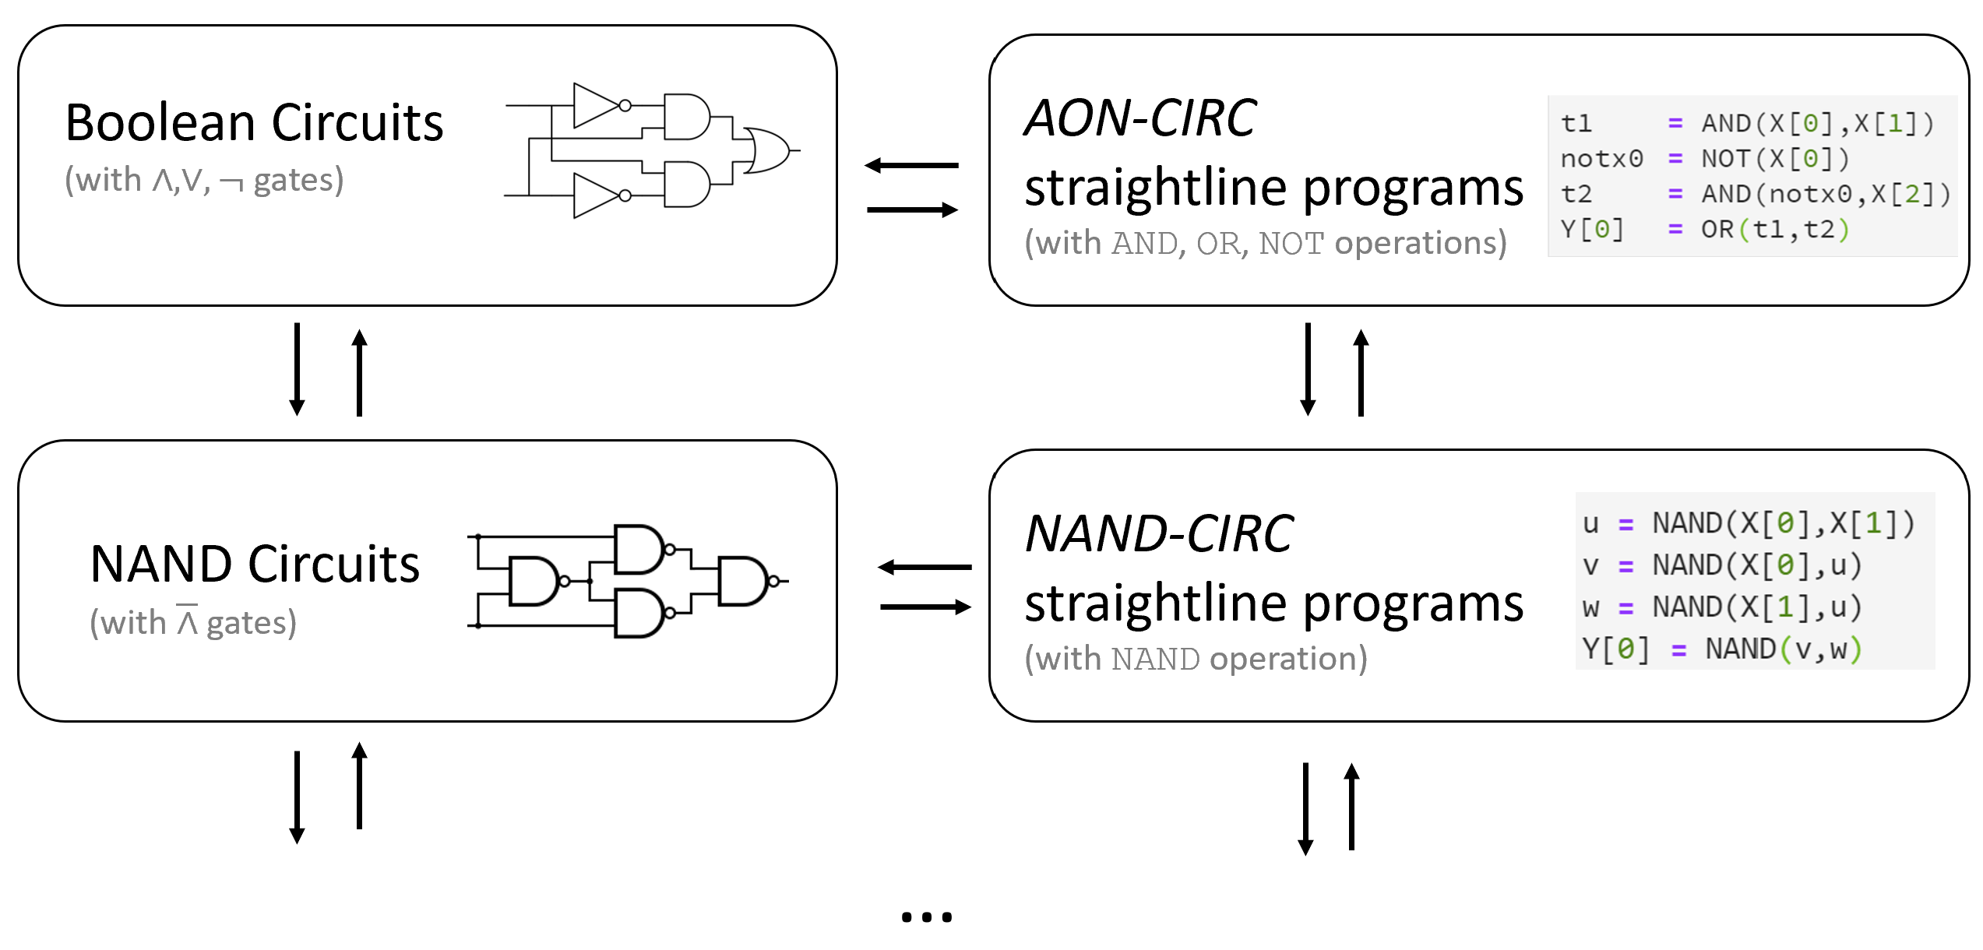

Slide 20
Universality-1
Have seen $\left\{AND,OR,NOT\right\}≡\left\{NAND\right\}$
$f:{\left\{0,1\right\}}^{n}→{\left\{0,1\right\}}^{m}$ has $\left\{AND,OR,NOT\right\}$-circuit iff it has $\left\{NAND\right\}$-circuit
Is $\left\{NOT\right\}≡\{NAND\}$?
Is $\left\{AND,OR\right\}≡\left\{NAND\right\}$?
Is $\left\{AND,NOT\right\}≡\left\{NAND\right\}$?
Is $\left\{AND,XOR\right\}≡\left\{NAND\right\}$? Is $\left\{AND,XOR\right\}≡\left\{AND,OR,NOT\right\}$?
Not immediate, but same answer!

Slide 21
Universality-2
Let $S=\left\{f_{1},..,f_{ℓ}\right\}$ be Boolean functions, $f_{i}:{\left\{0,1\right\}}^{k_{i}}→\left\{0,1\right\}$.
$S$-circuit is a sequence of operations where each operation is of the form $z=f_{i}\left(y_{1},…,y_{k_{i}}\right)$ - where $y_{1},…,y_{k_{i}}$ input or previously computed.
$S$ is (NAND-)Universal iff there exists an $S$-circuit computing NAND$\left(x_{0},x_{1}\right)$.
Can define $\left\{AND,OR,NOT\right\}$-Universal similarly.
($∃$ $S$-circuit computing AND, $∃$ $S$-circuit computing OR, $∃$ $S$-circuit computing NOT)
$S$ is $\left\{AND,OR,NOT\right\}$-Universal iff $S$ is $\left\{NAND\right\}$-Universal.
So … abbreviate to “$S$ is Universal”.

Slide 22
Summary:
“Basic operations”: $\{NAND\}$ (or equivalently $AON= \{AND,OR,NOT\}).$
“$f$ can be computed with basic operations”: $∃$ NAND-circuit computing $f$
Or equivalently NAND-CIRC program, or AON circuit, or AON-CIRC program.
“$f$ can be computed with $≤s$ basic operations”:
$∃$ NAND-circuit program with $≤s$ gates computing $f$
Or equivalently NAND-CIRC program with $≤s$ lines
$S$ is universal iff $∃S$-circuit computing NAND.
Exercise: $S$ is universal $⇒∃c$ such that the following holds for every $f$
if $f$ can be computed with $≤s$ basic operations, then $f$ can be computed by an S-circuit with at most $cs$ gates.

Slide 23
Next Lecture
Every function $f:{\left\{0,1\right\}}^{n}→\{0,1\}$ can be computed by basic operations.
NAND-universality is really universal!!
Every function $f$ can be computed by circuit with $O\left({n2}^{n}\right)$-gates. (complexity upper bound)
Some (most!) functions require $Ω\left(\frac{2^{n}}{n^{2}}\right)$-gates. (Complexity lower bound. Limits of circuits!)

