Slide 1
If eligible,
Get Ready to Vote
Today is National Voter Registration and Request your Ballot Day
This year, young people are the largest voting bloc in the country.
Less than 50% of Harvard students voted in 2018.
Visit bit.ly/HVCpledge. If eligible, make sure to check your voter registration (and make sure that the right addresses are listed) and either request a mail ballot or make a plan to vote in person.
If you have already completed these steps, still fill out the form to double check! Sometimes people think they are registered when they’re not! Not everyone is eligible to vote – encourage your friends to turn out and take action in other ways.
Questions? Email voteschallenge@harvard.edu!
Notes:
Professor talking points:
Voting is important to [your field or me] because….
Less than 50% of Harvard students vote!
If Sep 22: Today is National Voter Registration & Request Your Ballot Day! If eligible, your assignment today is to check your voter registration (pay special attention to your address), register to vote, or update your registration.
If you would like to vote by-mail, request your ballot ASAP.
If you would like to vote in person, find your polling place, add a visit to the polls into your calendar and invite three friends.
Not everyone is eligible to vote, encourage your friends to turn out and take action in other ways. The pledge form has other ways to engage.
Visit the Harvard Votes Challenge website - www.voteschallenge.harvard.edu/voting - for more information.

Slide 2
CS 121: Lecture 6 Code = Data
Madhu Sudan
https://madhu.seas.Harvard.edu/courses/Fall2020
Book: https://introtcs.org
{
The whole staff (faster response): CS 121 Piazza
How to contact us
Only the course heads (slower): cs121.fall2020.course.heads@gmail.com

Slide 3
Administrative
HW1 Graded?
HW2 out, Section 2 cycle ongoing, 1st Midterm in 3 weeks
121.5: Ryan O’Donnell:

Slide 4
Where we are:
Part I: Circuits:
Finite computation,
quantitative study
Part II: Automata:
Infinite restricted computation, quantitative study
Definition of Circuits
Universality of NAND
All functions can be computed
$∀f:{\left\{0,1\right\}}^{n}→\left\{0,1\right\}$: Size(f)$≤O\left(\frac{2^{n}}{n}\right)$
Claimed: $∃f, \backslash Size\left(f\right)≥Ω\left(\frac{2^{n}}{n}\right)$
Today: Will prove above.
Show: Code = Data
Show how to interpret Data as Code.
Part III: Turing Machines:
Infinite computation, qualitative study
Part IV: Efficient Computation:
Infinite computation, quantitative study
Part V: Randomized computation:
Extending studies to non-classical algorithms

Slide 5
Today: Code as Data
Circuits can be represented by bits
Exercise break: Quantify above. Prove lower bound on Circuit size (for hardest function).
Universality: Circuit Interpreter I(C,x) = C(x)
As immediate consequence of “Code as data” - Inefficient
Efficient Circuit Interpreter (sketch)
Exercise break: Some Ingredients

Slide 6
Notation: $SIZE(s)$
$SIZE\left(s\right)=\left\{f:{\left\{0,1\right\}}^{n}→\left\{0,1\right\} | ∃C with≤s NAND gates computing f\right\}$
$SIZE\left(s\right)=$Our first complexity class!
Always a set (aka “class”) of functions, not algorithms !
Is the following in $SIZE_{1}\left(3\right)? {SIZE}_{1}\left(10\right)?$
${ALL}_{n}=\left\{f:{\left\{0,1\right\}}^{n}→\left\{0,1\right\}\right\}$
Thm: ${ALL}_{n}⊆SIZE\left(O\left(\frac{2^{n}}{n}\right)\right)$
(Claimed) Thm: ${ALL}_{n} ⊈SIZE\left(o\left(\frac{2^{n}}{n}\right)\right)$
$$SIZE (n^{3})$$
$$SIZE(10n)$$
$$SIZE(n)$$

Slide 7
Reminder: SIZE class
Def: $f:\{0,1\}^{n}→\{0,1\}^{m}$ is in $SIZE (s)$ if there exists NAND-CIRC program of $≤s$ lines that computes $f$.
Class $SIZE$ often defined using Boolean circuits. No difference since only constant factor.
$$SIZE (n^{3})$$
$$SIZE(10n)$$
$f∈SIZE(10n)$ iff $f$ can be computed by circuit of $≤10n$ NAND gates
$$SIZE(n)$$
$SIZE_{n,m}\left(s\right)=\left\{ f:\{0,1\}^{n}→\{0,1\}^{m} \right| f∈SIZE\left(s\right)\}$
Nothing special about NAND.
!

Slide 8
Reminder: Circuit $≡$ Straightline Program
Temp[0] $←$ NAND$\left(X\left[0\right],X[1]\right)$ Encode to ${\left\{0,1\right\}}^{∗}$ in class
Temp[1] $←$ NAND$\left(X\left[2\right],X[2]\right)$
…
Temp[i] $←$ NAND$\left(Temp\left[j\right],X[k]\right)$
…
Y[0] $←$ NAND$\left(X\left[0\right],X[1]\right)$
…
Y[m-1] $←$ NAND$\left(X\left[0\right],X[1]\right)$

Slide 10
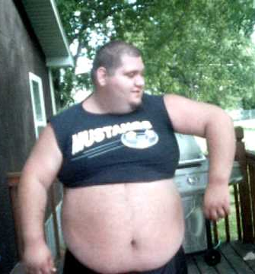
Exercise Break 1:
Make Representation quantitative:
Give (prefix-free) $E:Circuits→{\left\{0,1\right\}}^{∗},$ such that $∀ C$ with $≤s$ gates, $\left|E\left(C\right)\right|=O\left(s\log{s}\right)$
Show $\left|SIZE\left(s\right)\right|= 2^{O(s \backslash log s)}$
Show $∃f:{\left\{0,1\right\}}^{n}→\left\{0,1\right\}$ s.t. $f∉SIZE\left(o\left(\frac{2^{n}}{n}\right)\right)$ ($⇔ {ALL}_{n}⊈SIZE\left(o\left(\frac{2^{n}}{n}\right)\right)$)
Bonus question (0 points):
Why do Boaz Barak’s slides
associate this picture with
3rd exercise!

Slide 14
Interpreting Code
Objective: Show Data representing Code can be interpreted as code.
Have just shown: $∃E: Circuits↦ binary string$, 1-to-1
$$C has≤s NAND Gates ⇒ \left|E\left(C\right)\right|=O(s log s)$$
$EVAL:\left(E\left(C\right),x\right)↦C\left(x\right), ∀C with n inputs,x∈{\left\{0,1\right\}}^{n}$
$EVAL$ is a partial function – why?
${EVAL}_{m,n}=$restriction of $EVAL$ to $E\left(C\right)∈{\left\{0,1\right\}}^{m}, x∈{\left\{0,1\right\}}^{n}$
Thm: ${EVAL}_{m,n}$ computed by circuit of size $O\left(2^{m+n}\right)$
Proof: Obvious!
Implication: Power of Code$↔$Data-duality!

Slide 15
Interpreting Circuits Efficiently.
Goal: Show ${EVAL}_{m,n}∈SIZE\left(O\left({\left(m+n\right)}^{2}\log^{2}{n}\right)\right)$
Theorem 5.3 in Barak’s IntroTCS.
Best bound in literature: close to $O\left(\left(m+n\right)\log^{2}\left(m+n\right)\right)$
Great, but not “Meta-circular interpreter” (small interpreter that interprets bigger functions).

Slide 16
Sketch of $EVAL$
Recall: $E\left(C\right)=\left(\left(i_{0},j_{0},k_{0}\right)…\left(i_{s−1},j_{s−1},k_{s−1}\right)\right)$ ($s≤m$)
Define: $W_{t}∈{\left\{0,1\right\}}^{n+s}$: Values of $n$ inputs, $s$ TEMPs after $t$ execution steps
Define:
$EVAL−ITER:\left(E\left(C\right),x,t\right)↦W_{t}$
$EVALHELP:\left(W_{t−1}, i_{t},j_{t},k_{t}\right)↦W_{t}$ ;
$EVAL−ITER\left(E\left(C\right),x,t\right)=EVALHELP\left(EVAL−ITER\left(E\left(C\right),x,t−1\right),i_{t},j_{t},k_{t}\right)$
Suffices to show $EVALHELP∈SIZE(\left(m+n\right)\log{m+n})$

Slide 17
Sketch of $EVALHELP$
Key Ingredients:
$LOOKUP\left(W,i\right)=W_{i}$ where $W=W_{0}…W_{m−1}∈{\left\{0,1\right\}}^{m}$, $i∈\left[m\right]$ represented in binary.
$UPDATE\left(W,k,b\right)=\hat{W}$ where ${\hat{W}}_{k}=b$ and ${\hat{W}}_{ℓ}=W_{ℓ}$ for $ℓ≠k$
Claims:
$LOOKUP∈SIZE\left(m\right)$
Exercise: $UPDATE∈SIZE\left(m^{2}\right)$ (even better $SIZE\left(m\log{m}\right)$)
Don’t have to work out details. Think of the high-level plan.
$EVALHELP\left(W,i,j,k\right)=UPDATE\left(W,k,NAND\left(LOOKUP\left(W,i\right), LOOKUP\left(W,j\right)\right)\right)$

Slide 18
Exercise Break 2:
$UPDATE\left(W,k,b\right)=\hat{W}$ where ${\hat{W}}_{k}=b$ and ${\hat{W}}_{ℓ}=W_{ℓ}$ for $ℓ≠k$
$W,\hat{W}∈{\left\{0,1\right\}}^{m}, k∈[m]$ represented in binary
Exercise:
Show$UPDATE∈SIZE\left(m^{2}\right)$ (even better $SIZE\left(m\log{m}\right)$)
Don’t have to work out details. Think of the high-level plan.

Slide 23
Circuits: What you need to know
Theorem I: Every function $f:\{0,1\}^{n}→\{0,1\}$ can be computed by circuit of size $O(2^{n}/n)$.
Theorem II: Some functions $f:\{0,1\}^{n}→\{0,1\}$ cannot be computed by circuits of size $o(2^{n}/n)$.
SIZE Hierarchy Theorem: Book + Section/HW
Thm 5.11: $∃C$ ($C=1000$ will do) .s.t $∀s<\frac{2^{n}}{Cn}$ , $SIZE_{n,1}\left(s\right) ⊊SIZE_{n,1}(C⋅s)$
* If $f$ outputs $m$ bits then add factor $m$ to Thm I,II

Slide 24
Size Hierarchy Theorem (Sec 5.5)
Thm 5.11: $∃C$ ($C=1000$ will do) .s.t $∀s<\frac{2^{n}}{Cn}$ , $SIZE_{n,1}\left(s\right) ⊊SIZE_{n,1}(C⋅s)$
Special case: $SIZE_{n,1}\left(n\right) ⊊SIZE_{n,1}(n^{2})$
Proof: we know for every $ℓ$:
$∀ f:\{0,1\}^{ℓ}→\{0,1\}$, $f∈SIZE_{ℓ,1}\left(c⋅2^{ℓ}/ℓ\right)$
$∃f^{∗}:\{0,1\}^{ℓ}→\{0,1\}$, $f ∉SIZE_{ℓ,1}(δ⋅2^{ℓ}/ℓ)$
Set $ℓ$ s.t. $n^{2}=c2^{ℓ}/ℓ$, define: $g^{∗}\left(x_{0}⋯x_{n−1}\right)=f^{∗}(x_{0}⋯x_{ℓ−1})$
$g^{∗}∈SIZE_{n,1}\left(c2^{ℓ}/ℓ\right)∖SIZE_{n,1}\left(δ⋅2^{ℓ}/ℓ\right)$
$=$
$SIZE_{n,1}\left(\frac{δ}{c}⋅n^{2}\right) ⊇SIZE_{n,1}(n)$

Slide 25
Equality follows from Thm 4.15
$ALL_{n}∖SIZE\left(2^{\sqrt{n}}\right)$ is not empty by the counting lower bound
$ALL_{n,n}=\left\{ f \right|f:\{0,1\}^{n}→\{0,1\}^{n} \}=SIZE_{n,n}( c⋅2^{n}$)
Not empty by the size hierarchy theorem
$SIZE_{n,n}( 2^{ \sqrt{n}}$)
$SAT_{n}$?
$FACT_{n}$?
$SIZE_{n,n}( n^{3}$)
$SIZE_{n,n}( 100n$)
$MULT_{n}$?
$$ADD_{n}$$
Based on best-known algorithms for these problems. We don’t know what is their true complexity. It could be that all are in $SIZE_{n,n}(100n)$

Slide 26
Extended Church Turing Thesis (circuit version)
If $f:\{0,1\}^{n}→\{0,1\}^{m}$ can be computed in the physical world using $s$ resources then $f$ can be computed by circuit of $≈s$ (e.g. $O(s^{2})$ or $O(s^{3})$) gates.
(finite function version – we’ll see unbounded function version soon)
TL;DR: So far still stands. Only serious challenge is quantum computing which we’ll see later.
Non-serious challenges: (Following slides stolen from Boaz Barak who stole it from Scott Aaronson)

Slide 27
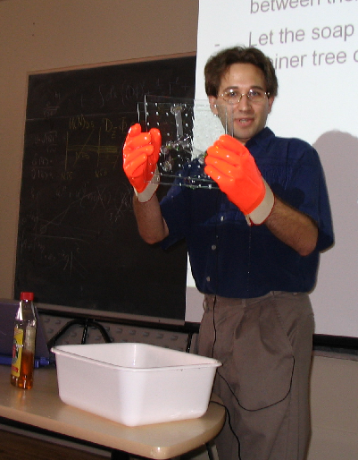
Soap Bubble Computer

Slide 28
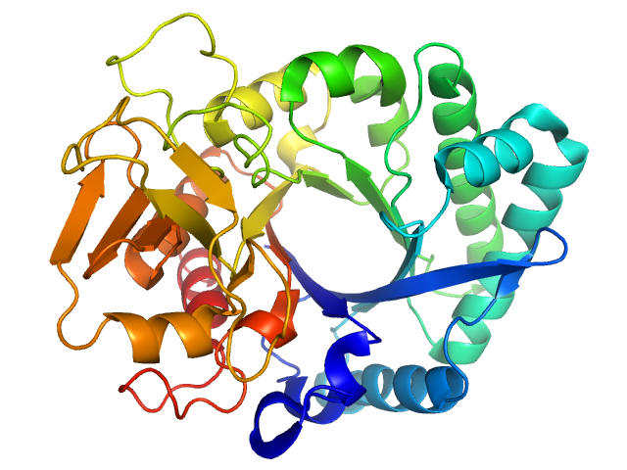
Protein Folding

Slide 29
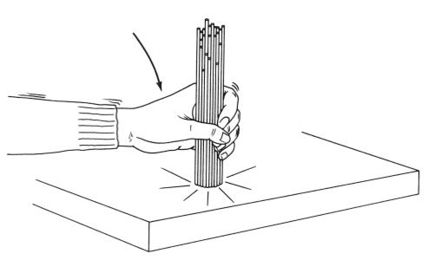
Spaghetti Sort

Slide 30
Relativity Computer (cf. Malament and Hogarth)
DONE

Slide 31
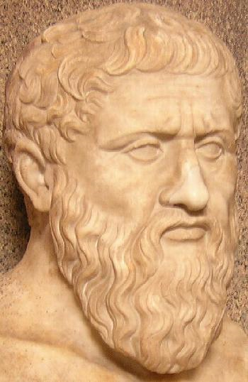
Zeno’s Computer
STEP 1
STEP 2
Time (seconds)
STEP 3
STEP 4
STEP 5

Slide 32
Where we are:
Part I: Circuits:
Finite computation,
quantitative study
Part II: Automata:
Infinite restricted computation, quantitative study
Part III: Turing Machines:
Infinite computation, qualitative study
Part IV: Efficient Computation:
Infinite computation, quantitative study
Part V: Randomized computation:
Extending studies to non-classical algorithms

Slide 33
Where we are:
Part I: Circuits:
Finite computation,
quantitative study
Part II: Automata:
Infinite restricted computation, quantitative study
Part III: Turing Machines:
Infinite computation, qualitative study
Part IV: Efficient Computation:
Infinite computation, quantitative study
Part V: Randomized computation:
Extending studies to non-classical algorithms

Slide 34
End of Lecture

Slide 35
RIP: RBG
https://www.theguardian.com/us-news/gallery/2020/sep/19/tributes-to-ruth-bader-ginsburg-in-pictures

Slide 36
If eligible,
Get Ready to Vote
Today is National Voter Registration and Request your Ballot Day
This year, young people are the largest voting bloc in the country.
Less than 50% of Harvard students voted in 2018.
Visit bit.ly/HVCpledge. If eligible, make sure to check your voter registration (and make sure that the right addresses are listed) and either request a mail ballot or make a plan to vote in person.
If you have already completed these steps, still fill out the form to double check! Sometimes people think they are registered when they’re not! Not everyone is eligible to vote – encourage your friends to turn out and take action in other ways.
Questions? Email voteschallenge@harvard.edu!
Notes:
Professor talking points:
Voting is important to [your field or me] because….
Less than 50% of Harvard students vote!
If Sep 22: Today is National Voter Registration & Request Your Ballot Day! If eligible, your assignment today is to check your voter registration (pay special attention to your address), register to vote, or update your registration.
If you would like to vote by-mail, request your ballot ASAP.
If you would like to vote in person, find your polling place, add a visit to the polls into your calendar and invite three friends.
Not everyone is eligible to vote, encourage your friends to turn out and take action in other ways. The pledge form has other ways to engage.
Visit the Harvard Votes Challenge website - www.voteschallenge.harvard.edu/voting - for more information.

