Slide 1
CS 121: Lecture 7 Infinite Functions
Madhu Sudan
https://madhu.seas.Harvard.edu/courses/Fall2020
Book: https://introtcs.org
{
The whole staff (faster response): CS 121 Piazza
How to contact us
Only the course heads (slower): cs121.fall2020.course.heads@gmail.com

Slide 2
Today
Infinite vs. Finite functions
Example: Addition as finite state algorithm
(Deterministic) Finite Automata:
Break 1: Understand DFA
Break 2: Design DFA
Preview of next lecture: Regular Expressions

Slide 3
So far
Have seen Circuits/NAND-CIRC Programs
Compute all finite functions:
Given $f:{\left\{0,1\right\}}^{n}→{\left\{0,1\right\}}^{m},$exists NAND-CIRC $C$, s.t. $∀x∈{\left\{0,1\right\}}^{n}, C\left(x\right)=f\left(x\right)$
Sounds great?

Slide 4
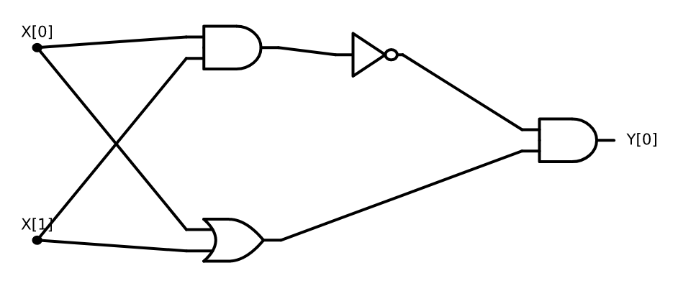
$XOR$ on 2 variables

Slide 5
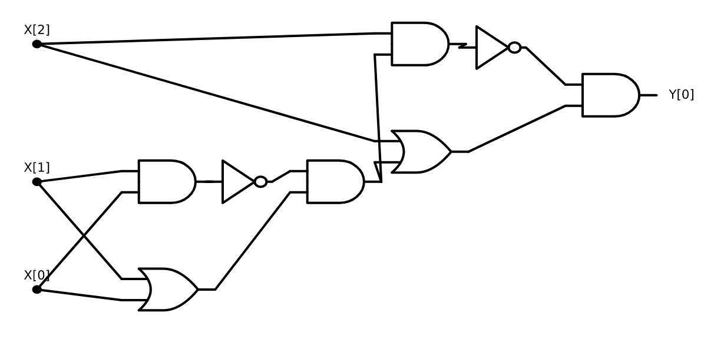
$XOR$ on 3 variables

Slide 6
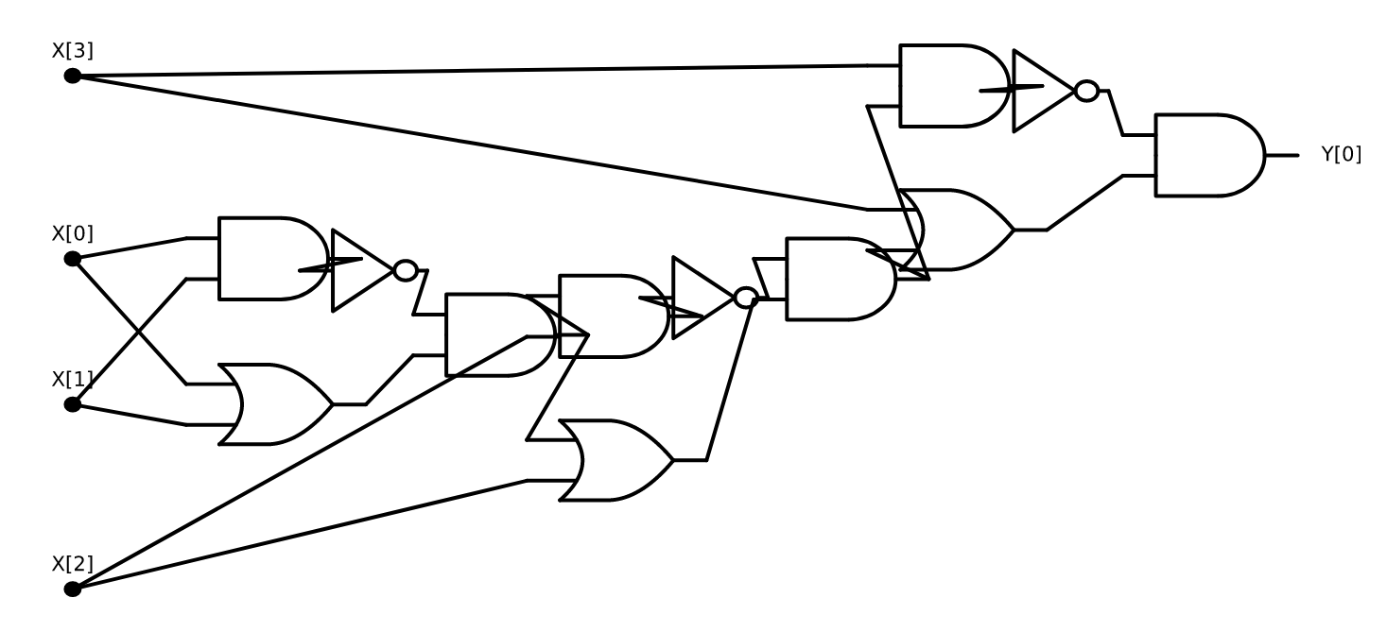
$XOR$ on 4 variables

Slide 7
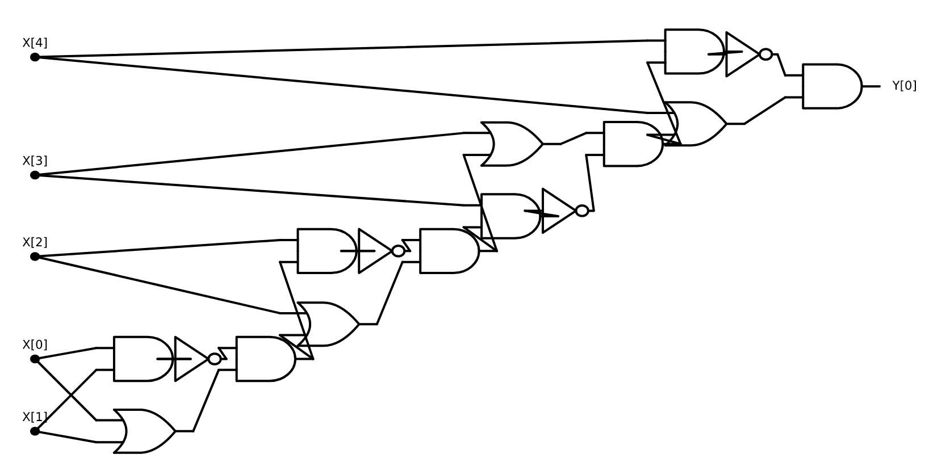
$XOR$ on 5 variables

Slide 8
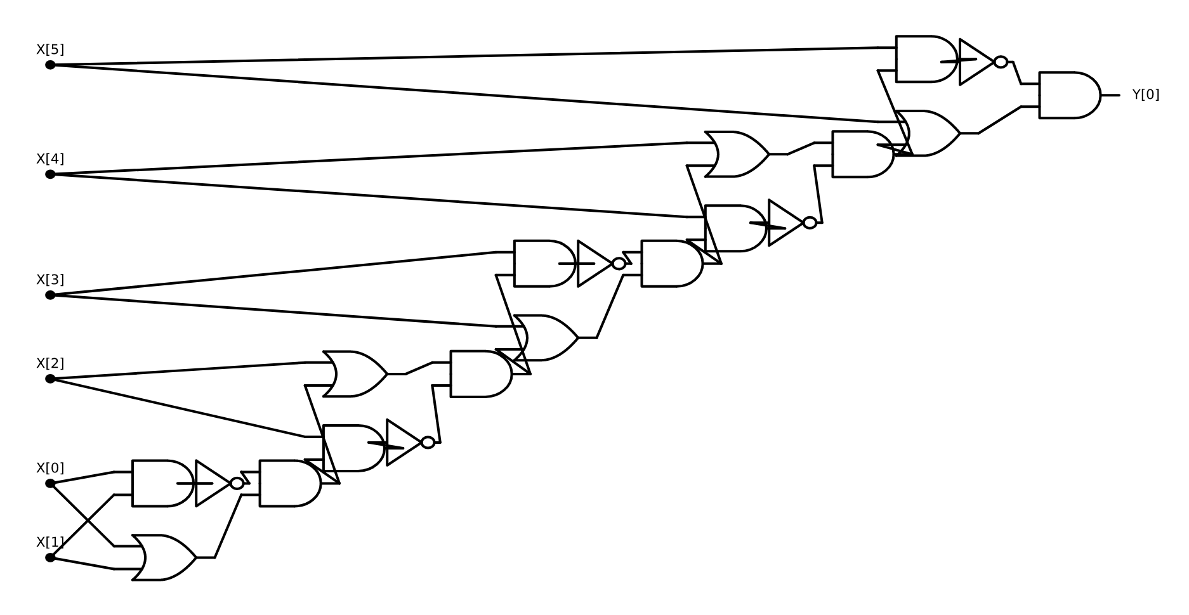
$XOR$ on 6 variables

Slide 9
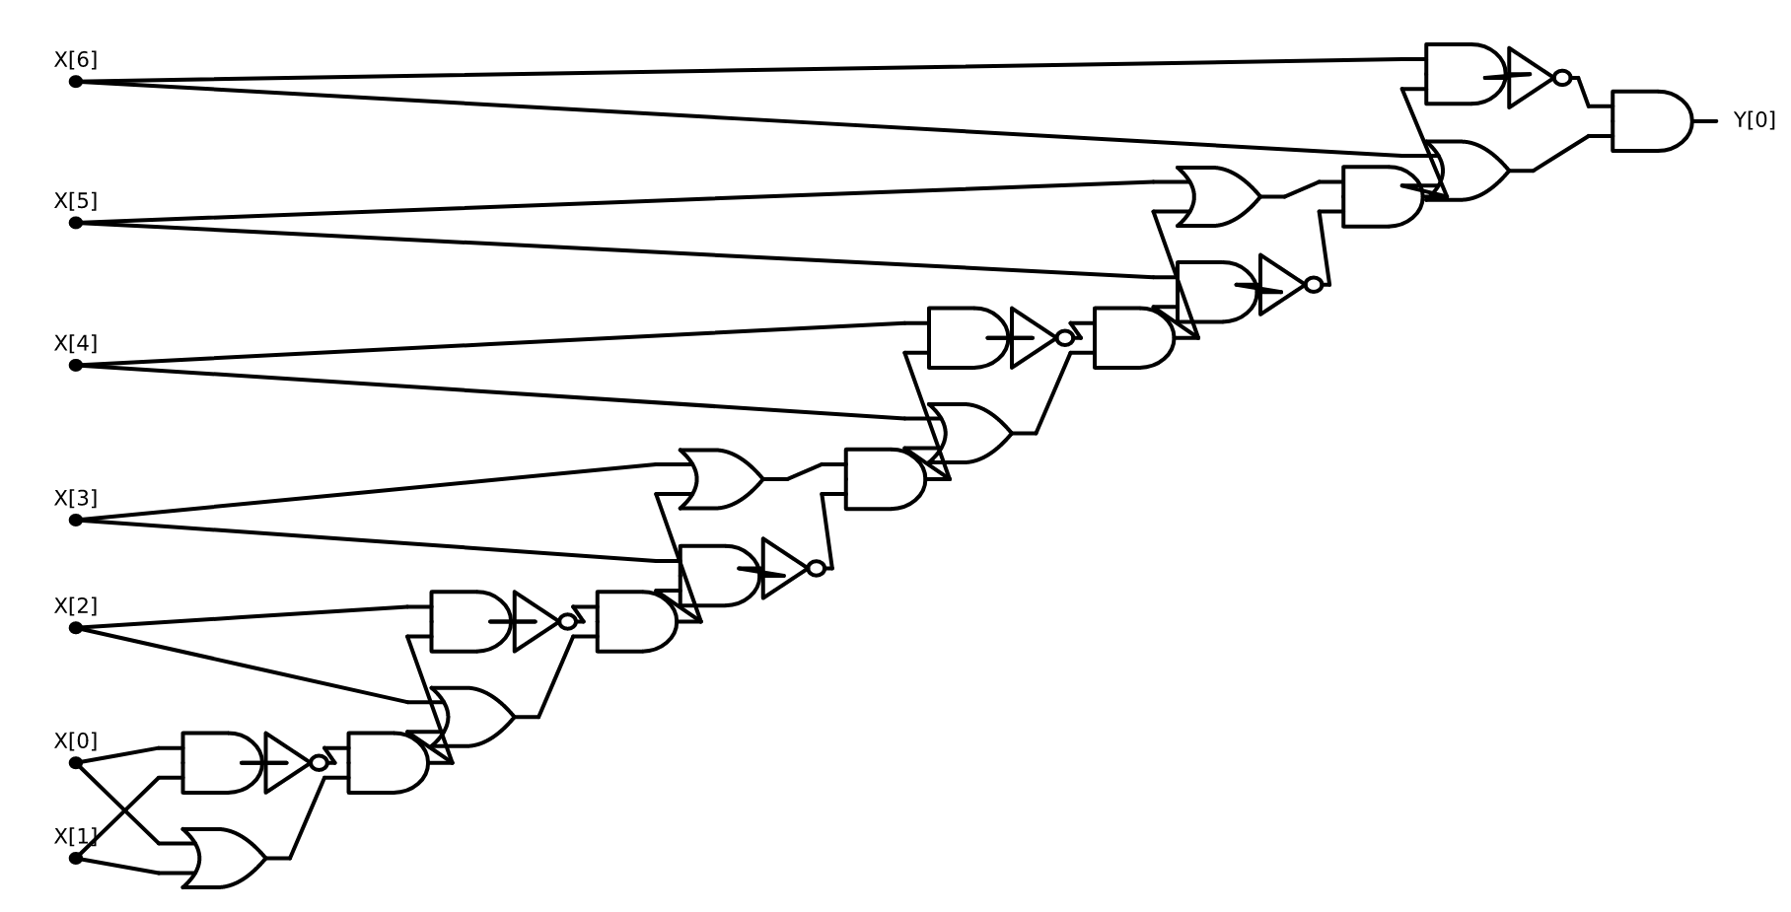
$XOR$ on 7 variables

Slide 10
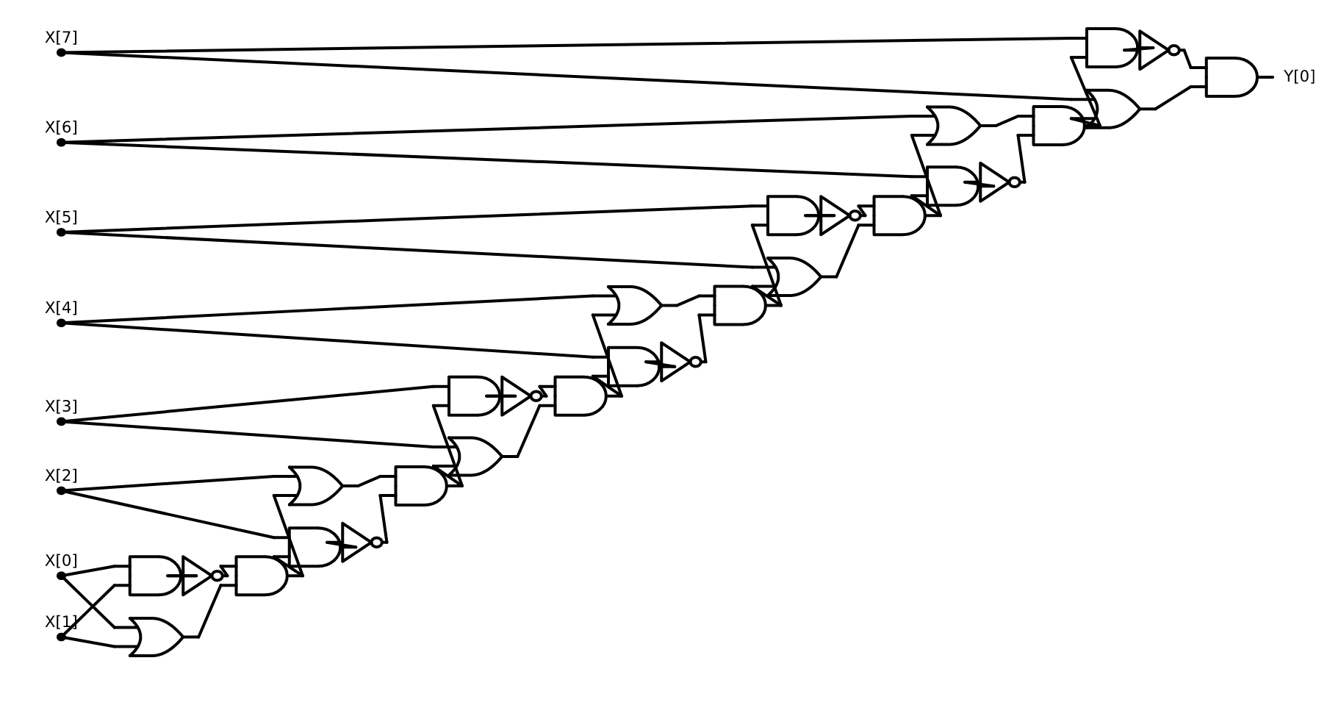
$XOR$ on 8 variables

Slide 11
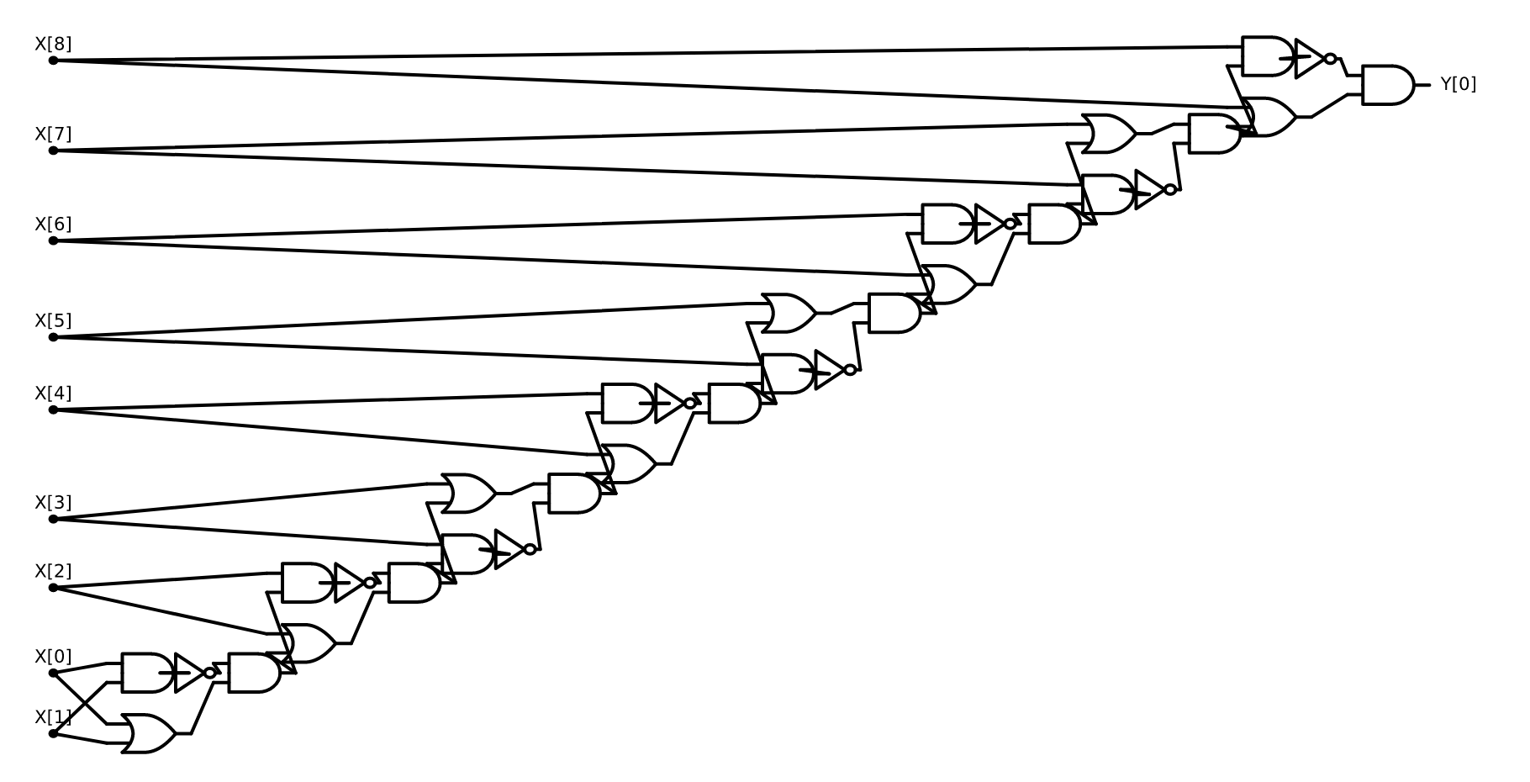
$XOR$ on 9 variables

Slide 12
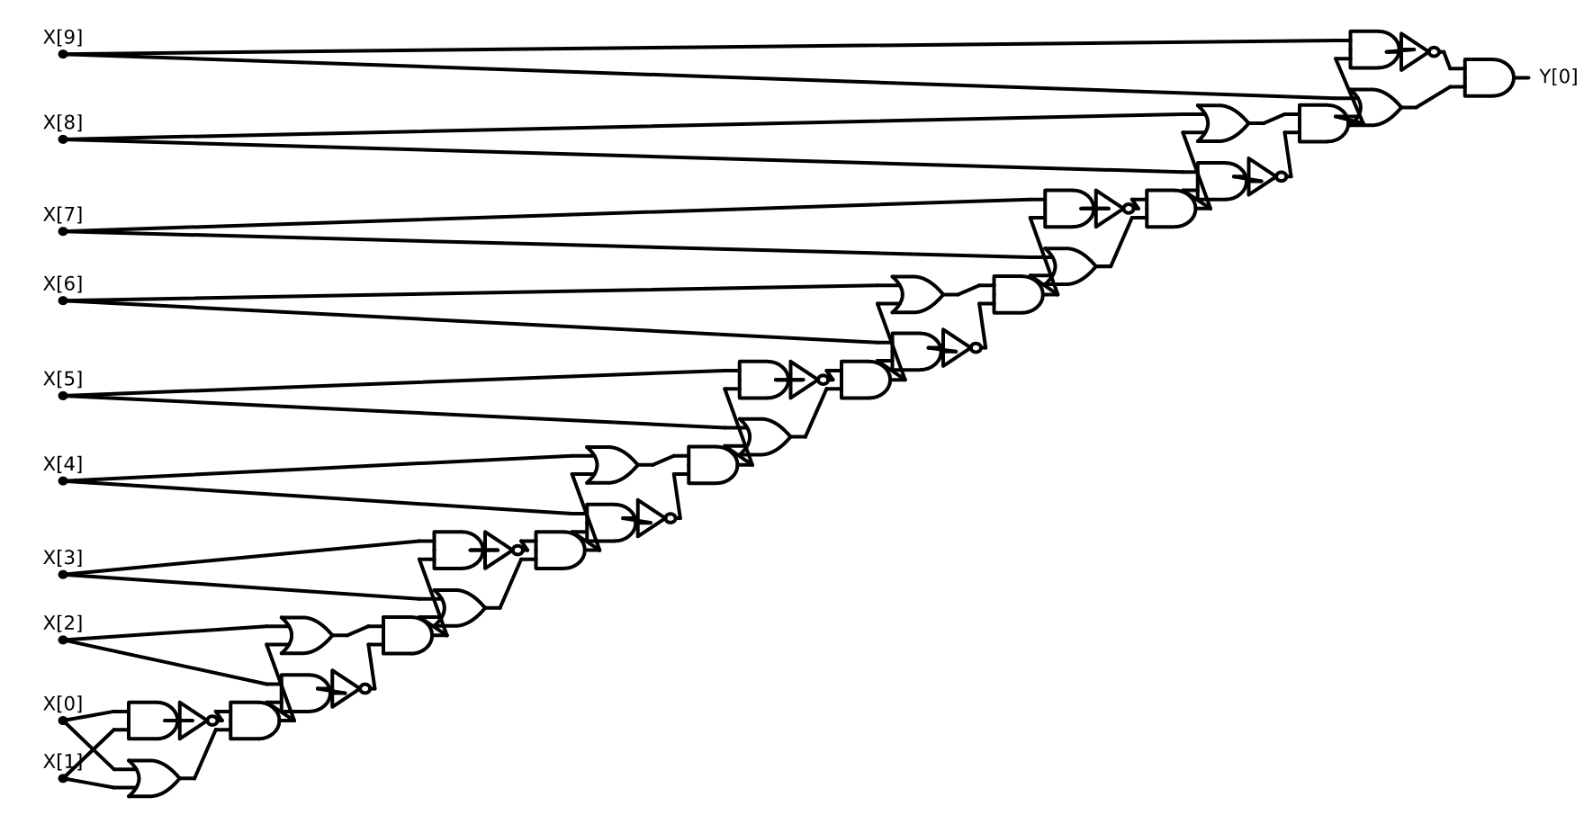
$XOR$ on 10 variables

Slide 13
So far
Have seen Circuits/NAND-CIRC Programs
Compute all finite functions:
Given $f:{\left\{0,1\right\}}^{n}→{\left\{0,1\right\}}^{m},$exists NAND-CIRC $C$, s.t. $∀x∈{\left\{0,1\right\}}^{n}, C\left(x\right)=f\left(x\right)$
Sounds great?
Weakness: Only computes finite functions.
No generalization?
Given circuits for $ADD_{1}, {ADD}_{2}, {ADD}_{3}, …{ADD}_{n}$ - do we know what circuit for $ADD_{n+1}$ looks like?
Our favorite algorithms generalize!!

Slide 14
Today: Algorithms with finite state
What should an algorithm be?
Sequence of simple steps
Different steps for different inputs
Exactly which step to take must be determined (based on input, easily, locally).
Different #steps for different input lengths
When to stop must be determined (based on input, easily, locally).
Finite state algorithms: What step to take, when to stop determined by “finite state” (constant # bits of memory).

Slide 15
Example: Addition as finite state algorithm
Advantage: O(1)-sized description. Tells how to compute an infinite function $ADD:{\left\{0,1\right\}}^{∗}×{\left\{0,1\right\}}^{∗}→{\left\{0,1\right\}}^{∗}$
Can you do anything else?
Multiplication? NO ☹
… but can do modular counting, pattern matching

Slide 16
Boolean functions
From now will focus only on Boolean functions: $G:{\left\{0,1\right\}}^{∗}→\left\{0,1\right\}$
Why?
Given $F:{\left\{0,1\right\}}^{∗}→{\left\{0,1\right\}}^{∗}$, can design $bF:{\left\{0,1\right\}}^{∗}×ℕ→\left\{0,1\right\}$ or
$BF:{\left\{0,1\right\}}^{∗}×ℕ→\left\{0,1\right\}$, that are roughly “equally easy/hard”.
Idea: $BF\left(x,i\right)=F{\left(x\right)}_{i}$
If $F\left(x\right)∈{\left\{0,1\right\}}^{m}$ for some $m$:
Can go from $F\left(x\right)$ to $BF\left(x,i\right)$ (for any single $i$) by erasing other parts of output.
Can go from $BF(x,i)$ to $F(x)$ by $m$ calls to algorithm for $BF(⋅,⋅)$

Slide 17
Exercise Break 1
Booleanize $Mult:{\left\{0,1\right\}}^{∗}×{\left\{0,1\right\}}^{∗}→{\left\{0,1\right\}}^{∗}$, where $Mult$ is the multiplication function for integers (given in “little-endian”).
What is domain of your function?
What is the range?

Slide 18
Deterministic Finite Automata (DFA)
Finite algorithms computing Boolean functions: $f:{\left\{0,1\right\}}^{∗}→\left\{0,1\right\}$
Operation:
Finite number of states: $C$
Starts in state $0$, reads $x_{0}$
At any stage has current state $q$, last read input symbol $σ$
Moves to state $T(q,σ)$; moves to read next input symbol
If input not done, repeat from Step 3.
When done: Accept (output 1) if current state $q∈S$ and reject (output 0) otherwise.
Specification:, $\left(T,S\right)$ where $T:\left[C\right]×\left\{0,1\right\}→[C]$, $S⊆[k]$
(more elaborate spec. in Sipser): $(Q, q_{0},Σ,T,S)$ [$Q=\left[C\right], q_{0}=0, Σ=\{0,1\}$ ]

Slide 19
Example:
$f\left(x\right)=1⇔$ $x$ contains 011 as a subsequence

Slide 20
Exercise Break 2:
Convert the following diagram to transition function:
Describe the function $f$ computed by this DFA.

Slide 23
Regular Expressions
Motivation: DFA detects simple patterns in strings. Can it do more complex ones?
Regular expressions:
A generalization of “Patterns”.
Succinct descriptions of subsets of ${\left\{0,1\right\}}^{∗}$
Definition:
Basic cases:
0 is a regular expression
1 is a regular expression
Compound cases: If $r_{1}, r_{2}$ are regular expressions, then so are:
$r_{1}r_{2}$: “$r_{1}$ followed by $r_{2}$” (or “concatenation”)
($r_{1}| r_{2}$): “$r_{1}$or $r_{2}$”
$r_{1}^{∗}$: “Concatenation of finite number of $r_{1}$’s”
End Cases:
$φ$ (empty set) is regular.
“” (null string) is regular.

Slide 24
Examples:
${\left(0 | 1\right)}^{∗}011{\left(0 | 1\right)}^{∗}$

Slide 25
Regular Expression Matching
Basic
0 matches 0
1 matches 1
“” matches “”
No string matches $φ$
Compound:
$s$ matches $r_{1}r_{2}$ if there exists $s_{1},s_{2}$ such that $s=s_{1}s_{2}$ and $s_{1}$ matches $r_{1}$ and $s_{2}$ matches $s_{2}$
$s$ matches $\left(r_{1}|r_{2}\right)$ if $s$ matches $r_{1}$ or $s$ matches $s_{2}$
$s$ matches $r_{1}^{∗}$ if there exists $s_{1},s_{2},…,s_{ℓ}$ such that $s=s_{1}s_{2}…s_{ℓ}$ and $s_{i}$ matches $r_{1}$ for every $i∈\left[ℓ\right]$

Slide 26
Examples:
${\left(0 | 1\right)}^{∗}1{\left(0 | 1\right)}^{∗}1{\left(0|1\right)}^{∗}1{\left(0 | 1\right)}^{∗}$

Slide 27
Examples:
${\left(0^{∗}{10}^{∗}{10}^{∗}1\right)}^{∗}$

Slide 29
Regular expressions = sets (languages) = functions
Can think of a regular expression as a set or as a Boolean function:
Given regular expression $r$ can look at set (language)
$L\left(r\right)=\left\{x∈{\left\{0,1\right\}}^{∗} \right| x matches r\}$
$f_{r}:{\left\{0,1\right\}}^{∗}→\left\{0,1\right\}$ where $f_{r}\left(x\right)=1⇔x∈L\left(r\right)⇔x matches r$
We prefer the last version

Slide 30
Next two lectures:
Understanding DFA via regular expressions:
For which regular expressions $r$ is $f\left(r\right)$ computable by a DFA
(Note: # states can depend on $r$, but not on $x$ or $|x|$)
What are some functions computable by DFA that are not regular
Limits of DFA
What are some functions that are not computed by DFA?

