Slide 1
CS 121: Lecture 8 Finite Automata and Regular Functions
Adam Hesterberg
https://madhu.seas.Harvard.edu/courses/Fall2020
Book: https://introtcs.org
{
The whole staff (faster response): CS 121 Piazza
How to contact us
Only the course heads (slower): cs121.fall2020.course.heads@gmail.com

Slide 2
Today
Comparison of regular expressions and finite automata
Nondeterministic Finite Automata
Preview of next lecture: non-regular functions

Slide 3
Reminder: Regular Expressions
Defines function $f:{\left\{0,1\right\}}^{∗}→\left\{0,1\right\}$
Definition:
Basic cases:
0, 1, $φ=\{\}$ (empty set), $""=ε$ (null string)
Compound cases: If $r_{1}, r_{2}$ are regular expressions, then so are:
$r_{1}r_{2}$: “$r_{1}$ followed by $r_{2}$” (or “concatenation”)
($r_{1}| r_{2}$): “$r_{1}$or $r_{2}$”
$r_{1}^{∗}$: “Concatenation of nonnegative (finite) number of $r_{1}$’s”
Example:
0|(1(0|1)*0): nonnegative even integers in binary
(deterministic | )finite(-state | state | )automaton

Slide 4
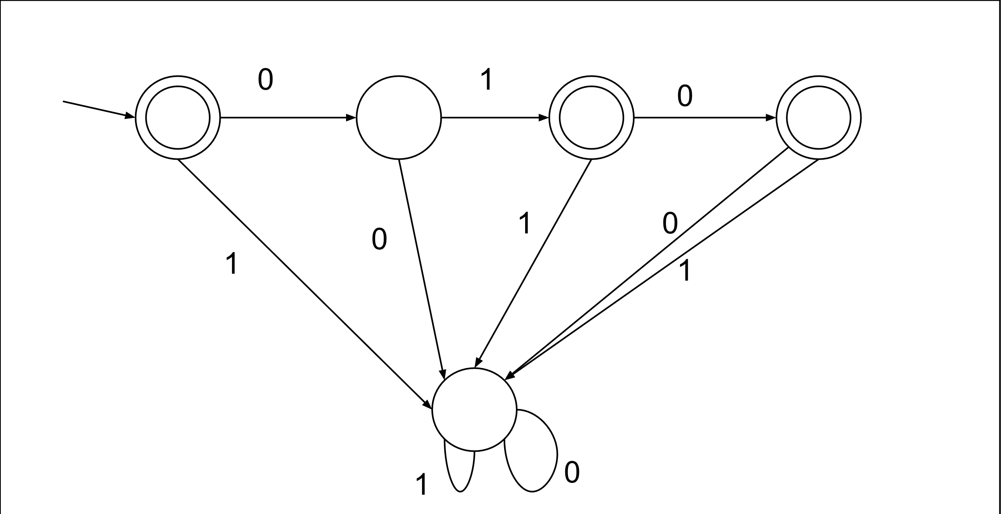
Reminder: Deterministic Finite Automata (DFAs)
Computes function $f:{\left\{0,1\right\}}^{∗}→\left\{0,1\right\}$
Specification:
accept states S (subset of all states, C)
transition function $C×\{0,1\}→C$
Operation:
Starts in state $0$
Read one bit of input $x_{0}$: do the state transition matching current state and just-read input.
Move past just-read input.
If input not done, repeat from Step 2.
When done: Accept (output 1) if the sequence of transitions ends in an accept state $q∈S$ and reject (output 0) otherwise.

Slide 5
Comparison: DFAs and Regular expressions
 | Regular Expressions | DFAs
Define function ${f: \left\{0,1\right\}}^{∗}→\left\{0,1\right\}$
Define set of strings $S \text{⊆ }{\{0,1\}}^{∗}$
One for every finite set
If $S_{1}$ is computed by one, so is $S_{1}^{∗}$
If $f_{1}$ is comp by one, so is $NOT(f_{1}$)
If $f_{1}$ and $f_{2}$ are, so is OR($f_{1},f_{2}$)
If $f_{1}$ and $f_{2}$ are, so is AND($f_{1},f_{2}$)
If $S_{1}$ and $S_{2}$ are, so is $S_{1}S_{2}=$ $\{s: ∃s_{1}∈S_{1}.∃s_{2}∈S_{2}. s=s_{1}s_{2}$}

Slide 6
If $f_{1}$ is the function of some DFA, so is $NOT(f_{1}$)
DFA for the function that’s 1 at
“”, “01”, “010”, and nothing else:
DFA for the function that’s 1 at
everything but “”, “01”, and “010”?

Slide 7
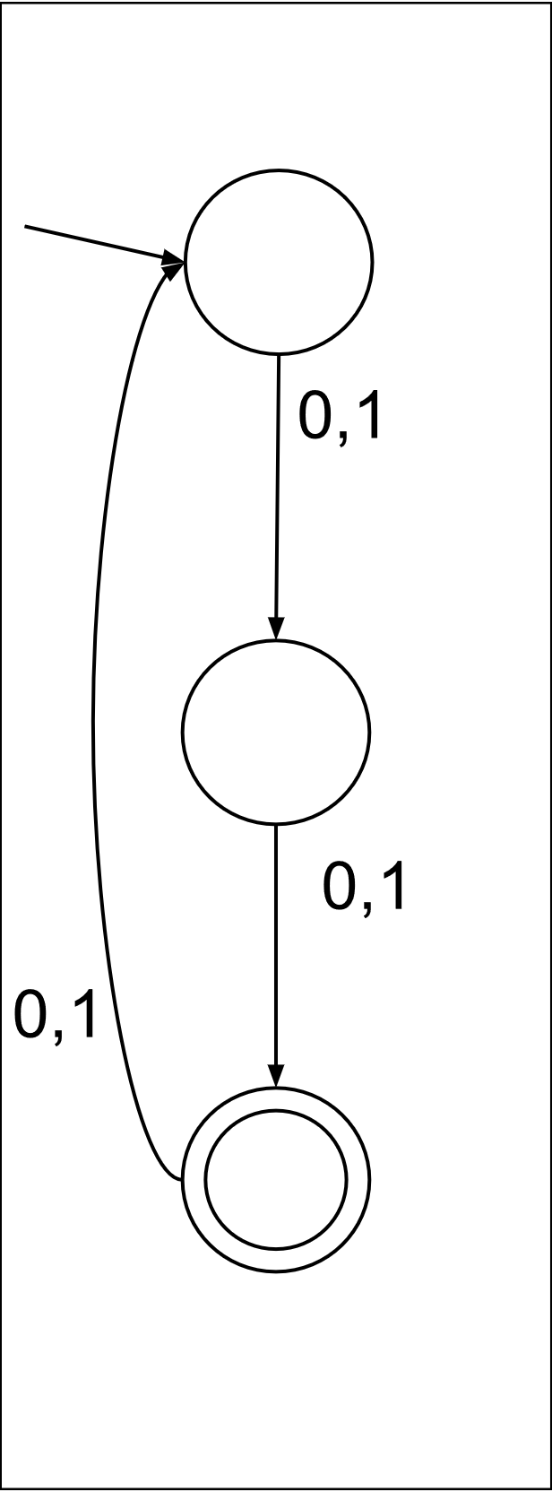
If $f_{1}$ and $f_{2}$ are DFA functions, is AND($f_{1},f_{2}$)?
DFA for multiples
of 2 in binary:
Is there a DFA for multiples of 2 of length 2 mod 3?
DFA for strings
of length 2 mod 3:

Slide 8
Exercise Break 1:
Express “if each of $f_{1}$ and $f_{2}$ is the function computed by some DFA, so is OR($f_{1},f_{2}$)’’ in terms of sets of strings instead of functions.
Prove the above.
Prove that if each of $f_{1}$ and $f_{2}$ is the function computed by some DFA, so is NAND($f_{1},f_{2}$).
True or false: 3) means that every function is the function computed by some DFA.

Slide 9
DFA for each infinite function?
True or false: “if each of $f_{1}$ and $f_{2}$ is the function computed by some DFA, so is NAND($f_{1},f_{2}$)” means that every infinite function is the function computed by some DFA.
If $f_{1}$ and $f_{2}$ are the function of DFAs with $q_{1}$ and $q_{2}$ states, NAND($f_{1},f_{2}$) is the function of some DFA with $q_{1}q_{2}$ states.
NAND of finitely many functions: still function of some DFA.
NAND of infinitely many functions: DFAs aren’t allowed infinitely many states!

Slide 10
Comparison: DFAs and Regular expressions
 | Regular Expressions | DFAs
Define function ${f: \left\{0,1\right\}}^{∗}→\left\{0,1\right\}$ | Yes | Yes
Define set of strings $S \text{⊆ }{\{0,1\}}^{∗}$ | Yes | Yes
One for every finite set | Yes | Yes
If $S_{1}$ is computed by one, so is $S_{1}^{∗}$ | Yes
If $f_{1}$ is comp by one, so is $NOT(f_{1}$) |  | Yes
If $f_{1}$ and $f_{2}$ are, so is OR($f_{1},f_{2}$) | Yes | Yes
If $f_{1}$ and $f_{2}$ are, so is AND($f_{1},f_{2}$) |  | Yes
If $S_{1}$ and $S_{2}$ are, so is $S_{1}S_{2}=$ $\{s: ∃s_{1}∈S_{1}.∃s_{2}∈S_{2}. s=s_{1}s_{2}$} | Yes

Slide 11
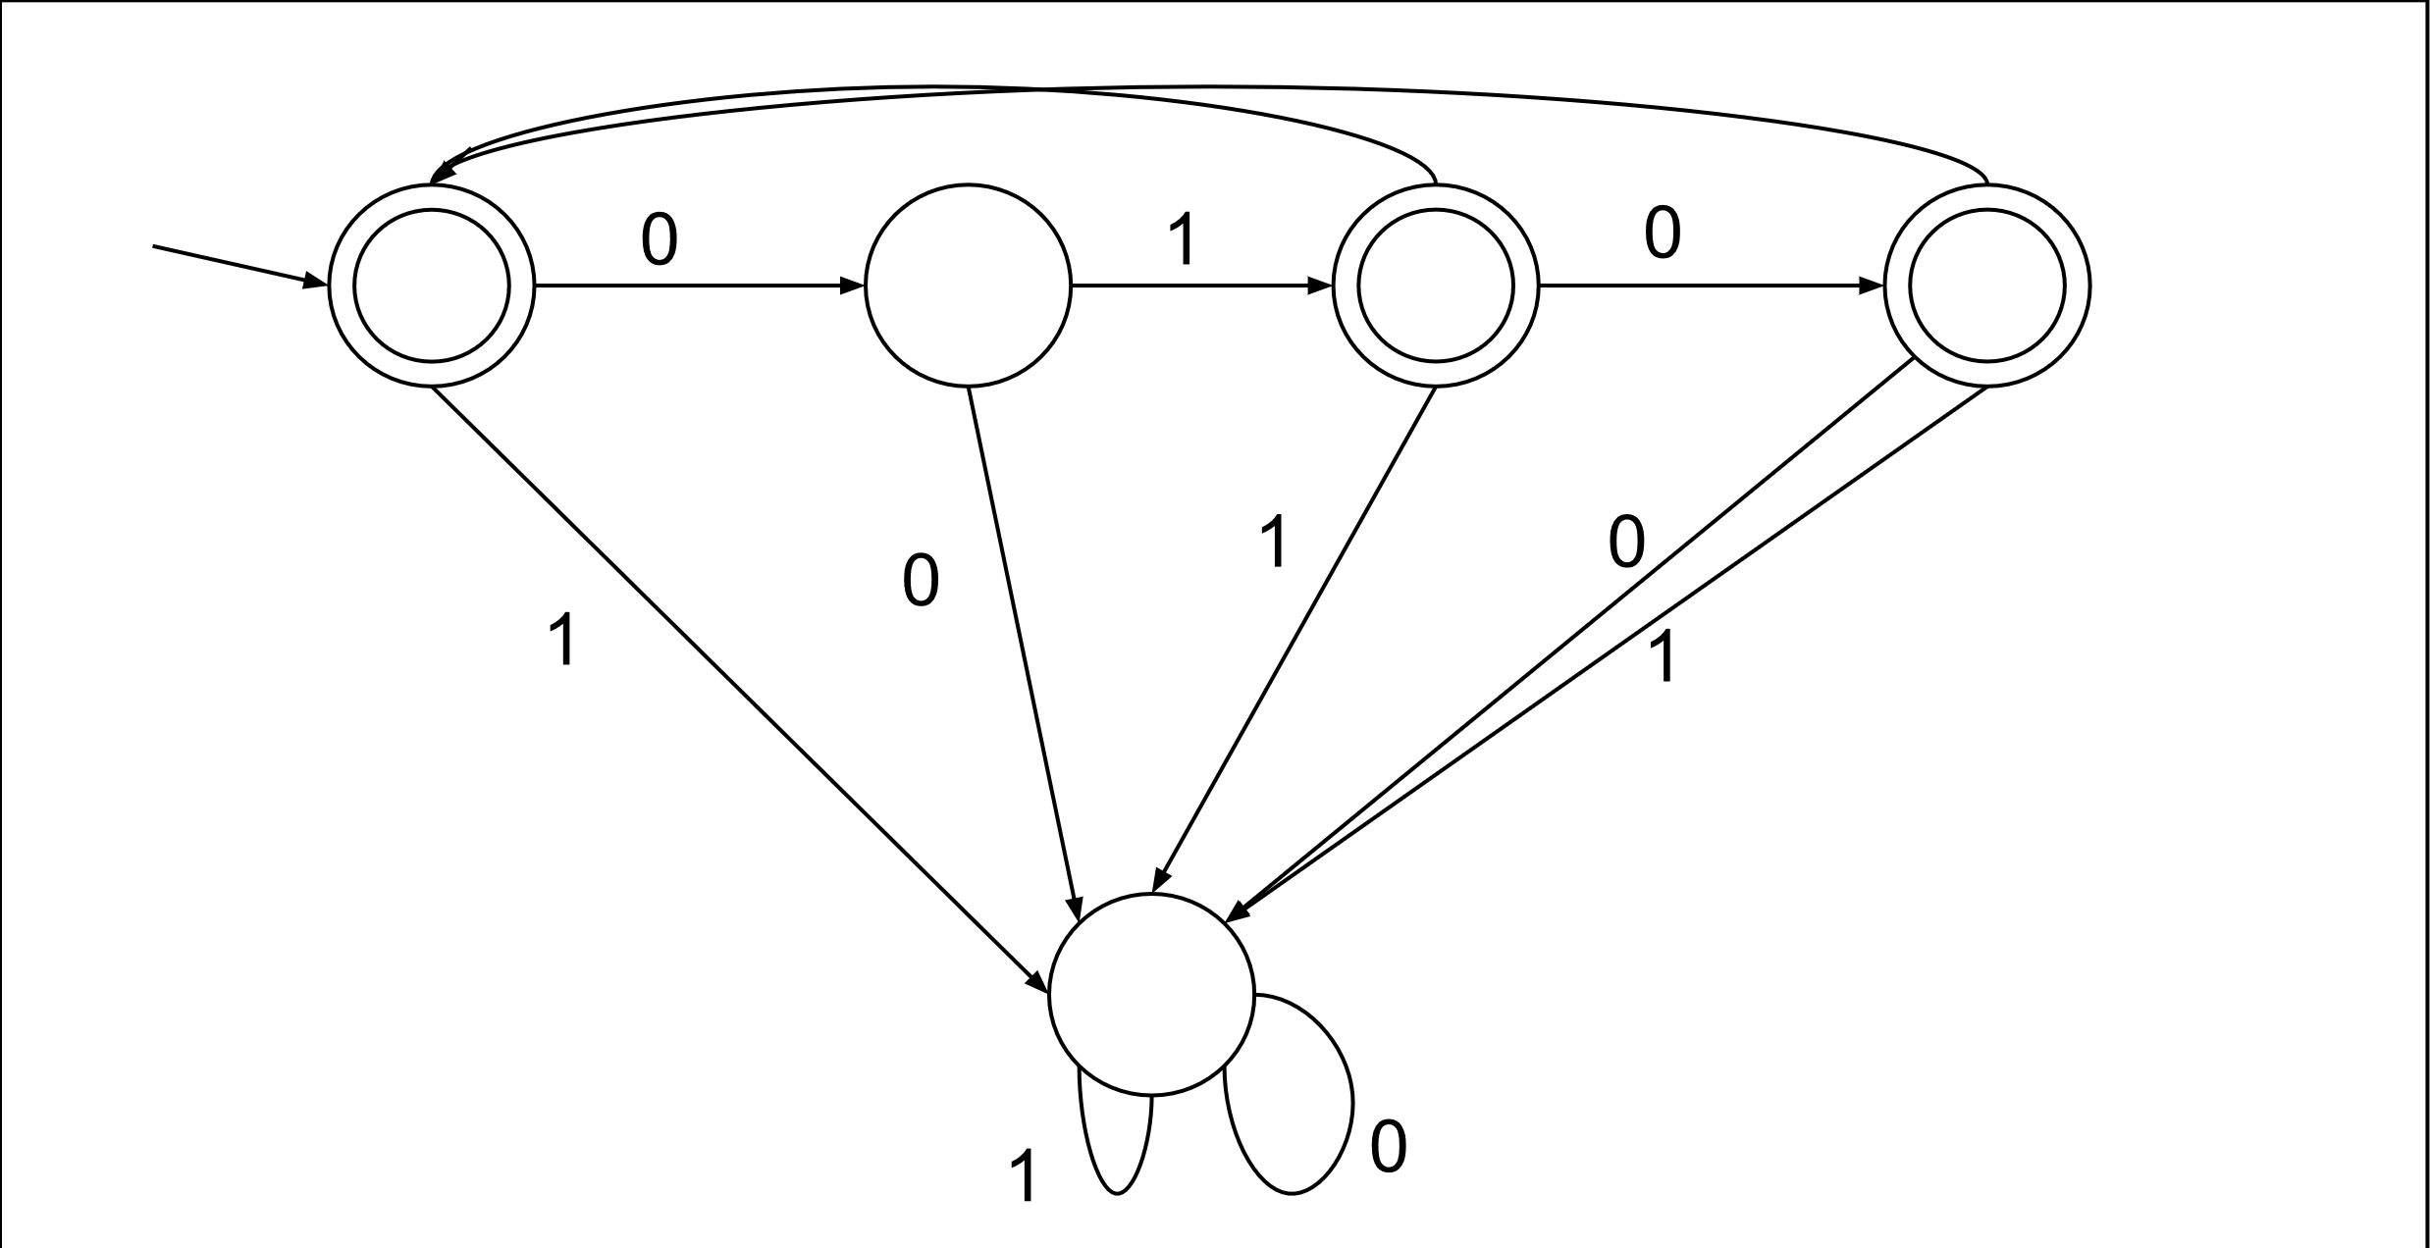
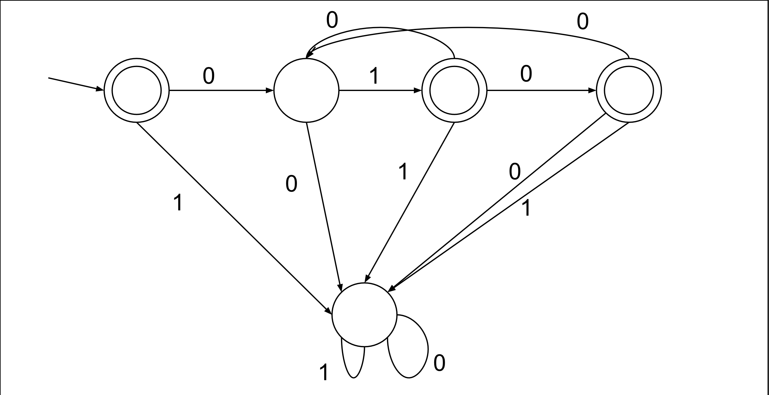
Kleene closure for DFAs?
At right is a DFA that accepts (|01|010):
Which of the bottom two is a DFA that
accepts (|01|010)*?

Slide 12
Non-deterministic Finite Automata (NFAs)
Defines Computes function $f:{\left\{0,1\right\}}^{∗}→\left\{0,1\right\}$
Specification:
accept states S (subset of all states, C)
transition function relation $C×\{0,1,ε=""\}→C$
Operation:
Starts in state $0$
Read up to one bit of input $x_{0}$: do the any state transition matching current state and just-read input.
Move past just-read input.
If input not done, repeat from Step 2.
When done: Accept (output 1) if the any sequence of transitions ends in an accept state $q∈S$ and reject (output 0) otherwise.

Slide 13
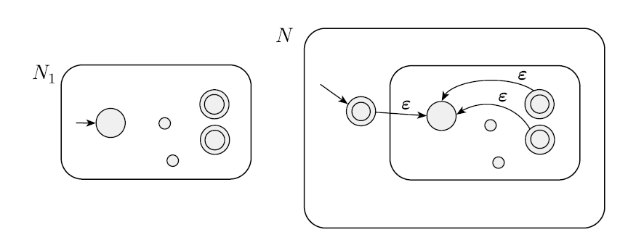
Kleene closure for NFAs?

Slide 14
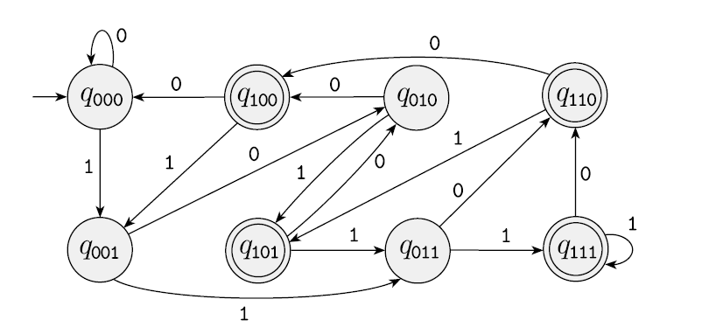
DFA-NFA equivalence
Theorem: For every NFA, there’s a DFA that accepts the same language.
Proof: As an NFA reads its input, at all times, there’s a subset of states it could be in. Make each subset of NFA states a DFA state; define DFA transitions and accept states accordingly.
Example NFA (third-last bit 1): Equivalent DFA:

Slide 15
Kleene closure for DFAs, take 2

Slide 16
Exercise Break 2:
We negated the function computed by a DFA by switching accept and reject states. Switching accept and reject states doesn’t necessarily negate the function defined by an NFA. Why not?
If $S_{1}$ and $S_{2}$ are sets accepted by DFAs $D_{1}$ and $D_{2}$, prove that $S_{1}S_{2}$ (the set of concatenations of a string in $S_{1}$ and a string in $S_{2}$) is the set accepted by some DFA. (Hint: Convert to NFAs, solve the same problem for them, and convert back.)

Slide 17
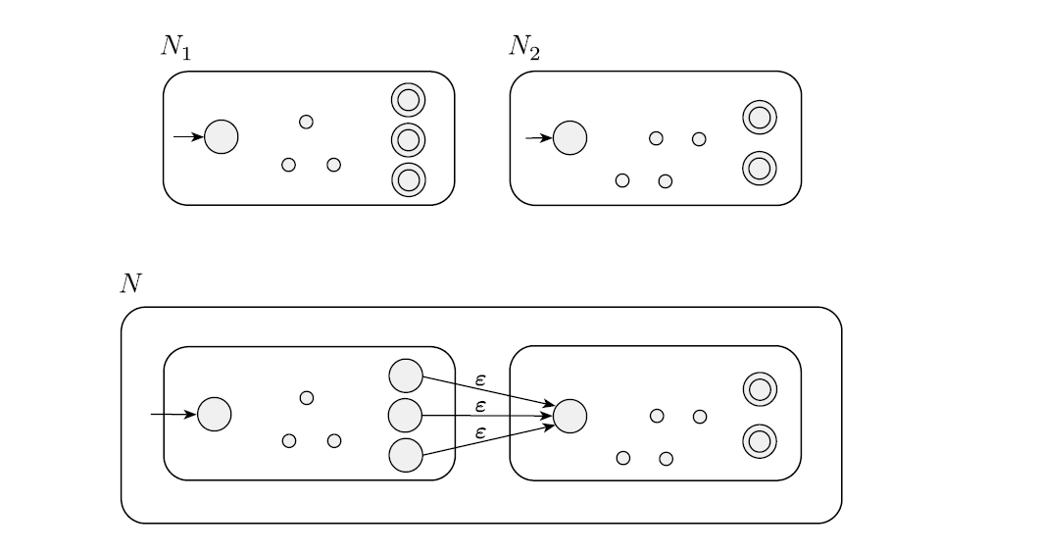
NFA concatenation

Slide 18
Comparison: DFAs and Regular expressions
 | Regular Expressions | DFAs
Define function ${f: \left\{0,1\right\}}^{∗}→\left\{0,1\right\}$ | Yes | Yes
Define set of strings $S \text{⊆ }{\{0,1\}}^{∗}$ | Yes | Yes
One for every finite set | Yes | Yes
If $S_{1}$ is computed by one, so is $S_{1}^{∗}$ | Yes | Yes
If $f_{1}$ is comp by one, so is $NOT(f_{1}$) |  | Yes
If $f_{1}$ and $f_{2}$ are, so is OR($f_{1},f_{2}$) | Yes | Yes
If $f_{1}$ and $f_{2}$ are, so is AND($f_{1},f_{2}$) |  | Yes
If $S_{1}$ and $S_{2}$ are, so is $S_{1}S_{2}=$ $\{s: ∃s_{1}∈S_{1}.∃s_{2}∈S_{2}. s=s_{1}s_{2}$} | Yes | Yes

Slide 19
Summary: regular expressions vs DFAs
Theorem: For every regular expression, there’s an equivalent DFA.
Proof: Regular expressions are built up with *, |, concatenation. Do those with DFAs (possibly via NFAs), as on previous slides.
Theorem: For every DFA, there’s an equivalent regular expression, too!
Proof (optional, skipped slides):
Generalize DFAs/NFAs to allow transitions to be any regular expressions.
For any DFA/NFA/generalized NFA, eliminate states one by one.
If just 1 start state and 1 accept state, can read off a regular expression.

Slide 20
Equivalent: DFAs and Regular expressions
 | Regular Expressions | DFAs
Define function ${f: \left\{0,1\right\}}^{∗}→\left\{0,1\right\}$ | Yes | Yes
Define set of strings $S \text{⊆ }{\{0,1\}}^{∗}$ | Yes | Yes
One for every finite set | Yes | Yes
If $S_{1}$ is computed by one, so is $S_{1}^{∗}$ | Yes | Yes
If $f_{1}$ is comp by one, so is $NOT(f_{1}$) | Yes | Yes
If $f_{1}$ and $f_{2}$ are, so is OR($f_{1},f_{2}$) | Yes | Yes
If $f_{1}$ and $f_{2}$ are, so is AND($f_{1},f_{2}$) | Yes | Yes
If $S_{1}$ and $S_{2}$ are, so is $S_{1}S_{2}=$ $\{s: ∃s_{1}∈S_{1}.∃s_{2}∈S_{2}. s=s_{1}s_{2}$} | Yes | Yes

Slide 21
Generalized Non-deterministic Finite Automata
Defines Computes function $f:{\left\{0,1\right\}}^{∗}→\left\{0,1\right\}$
Specification:
accept states S (subset of all states, C)
transition function relation $C×\{0,1,ε, regular expressions\}→C$
Operation:
Starts in state $0$
Read up to one or more bits of input: do the any state transition matching (as a regular expression) current state and just-read input.
Move past just-read input.
If input not done, repeat from Step 2.
When done: Accept (output 1) if the any sequence of transitions ends in an accept state $q∈S$ and reject (output 0) otherwise.

Slide 22
Eliminating all but one accept state of NFAs
Given an NFA with multiple accept states:
Make a new accept state.
Add a free transition from each old accept state.
Un-accept the old accept states.

Slide 23
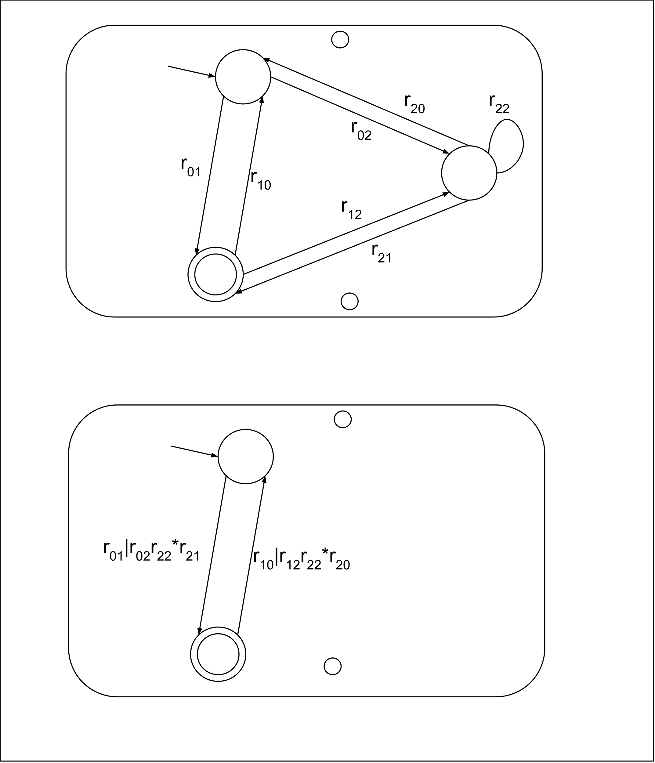
Eliminating non-accept, non-start of gNFAs
Given a gNFA with a non-accept, non-start state c:
Eliminate it.
For each ordered pair (a,b) of other states, if:
$r_{a,b}$ was the regular expression describing transitions from a to b,
$r_{a,c}$, $r_{c,c}$, and $r_{c,a}$ describe transitions from a to c, c to c, and c to a
then replace $r_{a,b}$ by $r_{a,b}|r_{a,c}r_{c,c}^{∗}r_{c,b}$: ways to transition from a to b, possibly through c.

Slide 24
Reading regular expression from 2-state gNFA
Given a gNFA with one start state and one accept state:
A regular expression equivalent to it is:
$$r_{00}^{∗}r_{01}r_{11}^{∗}{(r_{10}r_{00}^{∗}r_{01}r_{11}^{∗})}^{∗}$$
So, every NFA accepts the same set of strings
as some regular expression!

Slide 25
Next lecture:
Recap of DFA-regexp equivalence
Limits of DFA
NAND circuits computed all (finite) functions.
Do DFA compute all (infinite) functions? No.
What are some functions that are not computed by DFA?

