Slide 1
CS 121: Lecture 9 Limits of Finite Automata
Adam Hesterberg
https://madhu.seas.Harvard.edu/courses/Fall2020
Book: https://introtcs.org
{
The whole staff (faster response): CS 121 Piazza
How to contact us
Only the course heads (slower): cs121.fall2020.course.heads@gmail.com

Slide 2
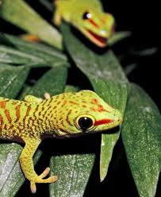
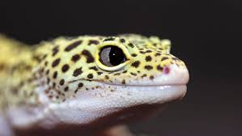
Reminders
121.5 at 4:30: Ben Edelman on Probably Approximately Correct learning
Section 4 cycle begins today
Problem set 2 due tonight (midnight ET)
Problem set 3 out tonight
Midterm on 2020-10-13 (1.5 weeks), covering material through today

Slide 3
Today:
Recap of DFA-regexp equivalence
Break 1: convert a regular expression to a DFA
Limits of DFA
All functions computed by DFAs take O(n) time.
Some functions are not computed by any DFA.
Break 2: Regular or not?
Summary of nonregularity: the “Pumping Lemma”

Slide 4
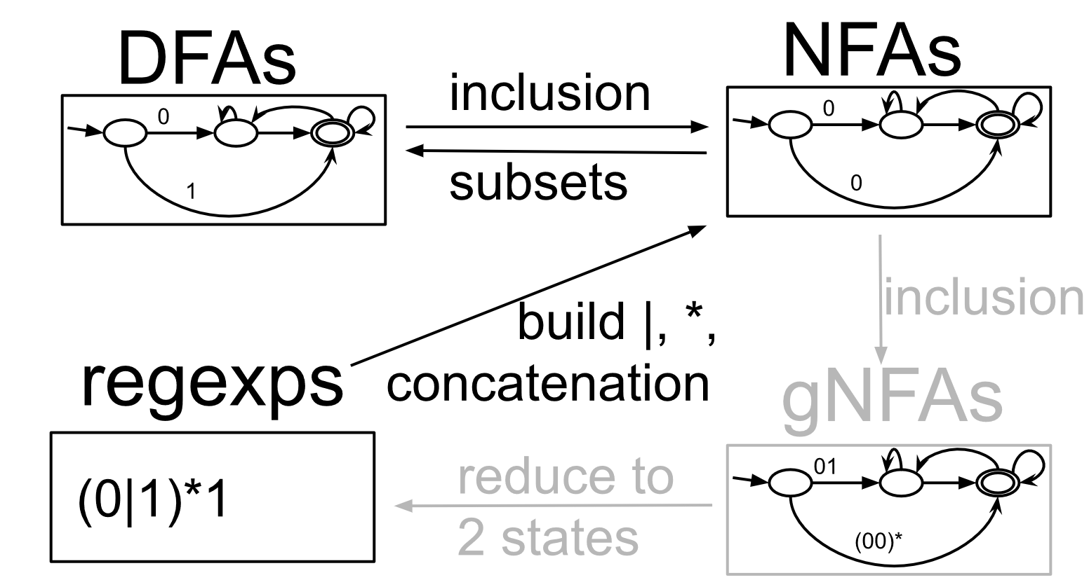
Equivalence of DFAs and regular expressions

Slide 5
Example: (0|1)*1 -> NFA -> DFA

Slide 6
Exercise Break 1:
Find a 2-state DFA for (0|1)*1.
Find a DFA for (0(0|1)*1)|(1(0|1)*0)

Slide 8
A non-regular language: $\{0^{n}10^{n}\}$
Theorem: There‘s no DFA or regular expression that accepts exactly $\left\{0^{n}10^{n}\right\}=\left\{1, 010, 00100, …\right\}$.
Proof 1:
Suppose, for contradiction, that there is such a DFA, say with $q$ states…

Slide 10
A non-regular language: $\{0^{n}10^{n}\}$
Theorem: There‘s no DFA or regular expression that accepts exactly $\left\{0^{n}10^{n}\right\}=\left\{1, 010, 00100, …\right\}$.
Proof 2:
Suppose, for contradiction, that there is such a regexp, say with $q$ characters…

Slide 12
Exercise Break 2:
For each of the following sets of strings, either describe a DFA or regular expression for it or prove that none exists.
Strings with the same number of 0s and 1s
Strings with the same number of 01s and 10s
Strings with at least 4 1s
Strings with at least ¼ 1s

Slide 13
Strings with the same number of 0s and 1s

Slide 14
Strings with the same number of 01s and 10s

Slide 15
Strings with at least 4 1s

Slide 16
Strings with at least ¼ 1s

Slide 17
Pumping Lemma
Proof:

Slide 18
“Is that so? Then what is the number whose existence is guaranteed by the pumping lemma?”

Slide 19
Next lecture:
Turing Machines
Like DFAs, can read and write, and can move right and left over input.
As powerful as any programming language.

