Slide 1
General Strong Polarization
Madhu Sudan
Harvard University
Joint work with Jaroslaw Blasiok (Harvard), Venkatesan Guruswami (CMU), Preetum Nakkiran (Harvard) and Atri Rudra (Buffalo)

Slide 2
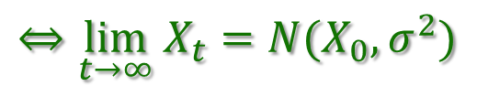
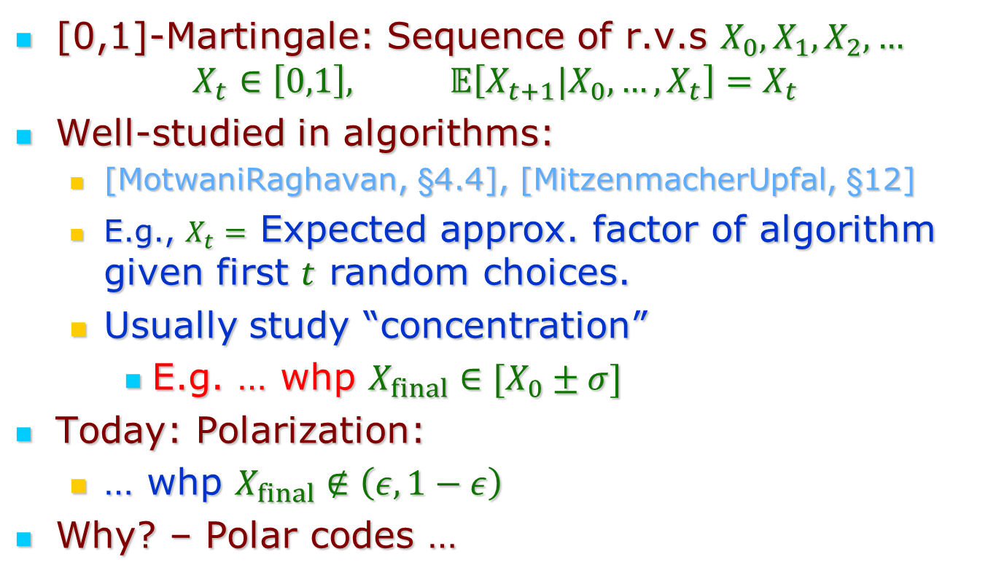
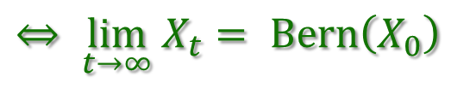
This Talk: Martingales and Polarization
[0,1]-Martingale: Sequence of r.v.s $X_{0},X_{1},X_{2},…$
$$X_{t}∈\left[0,1\right], 𝔼\left[X_{t+1}|X_{0},…,X_{t}\right]=X_{t}$$
Well-studied in algorithms:
  [MotwaniRaghavan, §4.4], [MitzenmacherUpfal, §12]
  E.g., $X_{t}=$ Expected approx. factor of algorithm given first $t$ random choices.
  Usually study “concentration”
    E.g. … whp $X_{final}∈[X_{0}±σ]$
Today: Polarization:
  … whp $X_{final}∉\left(ε,1−ε\right)$
Why? – Polar codes …
$$⇔\lim_{t→∞} X_{t}={N(X}_{0},σ^{2})$$
$$⇔ \lim_{t→∞} X_{t}= Bern\left(X_{0}\right)$$

Slide 3
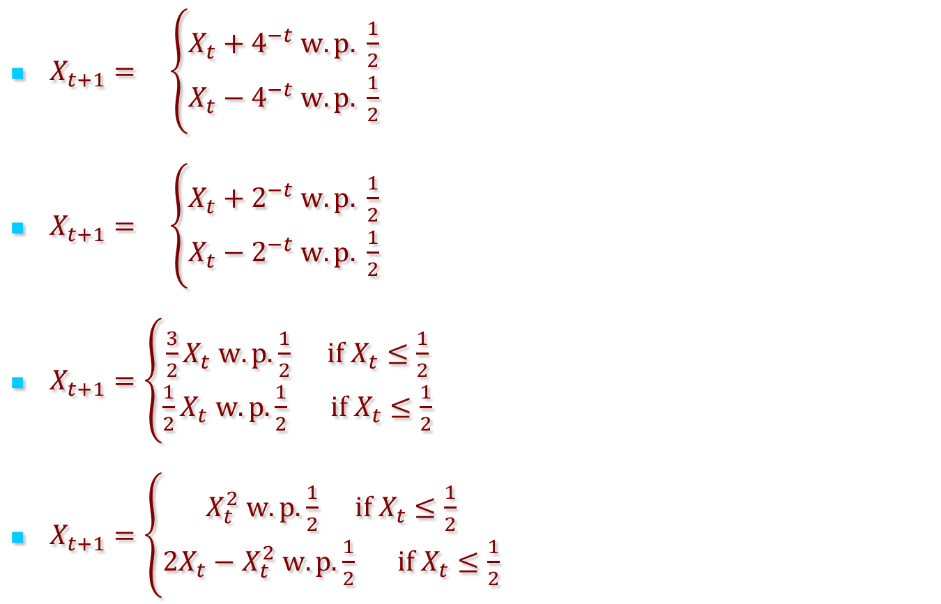
Some examples
$X_{t+1}= \left\{\begin{aligned}X_{t}+4^{−t} w.p. \frac{1}{2} \\ X_{t}−4^{−t} w.p. \frac{1}{2}\end{aligned}\right.$
$X_{t+1}= \left\{\begin{aligned}X_{t}+2^{−t} w.p. \frac{1}{2} \\ X_{t}−2^{−t} w.p. \frac{1}{2}\end{aligned}\right.$
$X_{t+1}=\left\{\begin{aligned}\frac{3}{2}X_{t} w.p.\frac{1}{2} if X_{t}≤\frac{1}{2} \\ \frac{1}{2}X_{t} w.p.\frac{1}{2} if X_{t}≤\frac{1}{2}\end{aligned}\right.$
$X_{t+1}=\left\{\begin{aligned}X_{t}^{2} w.p.\frac{1}{2} if X_{t}≤\frac{1}{2} \\ 2X_{t}−X_{t}^{2} w.p.\frac{1}{2} if X_{t}≤\frac{1}{2}\end{aligned}\right.$
Converges!
Uniform on [0,1]
Polarizes (weakly)!
Polarizes
(strongly)!

Slide 4
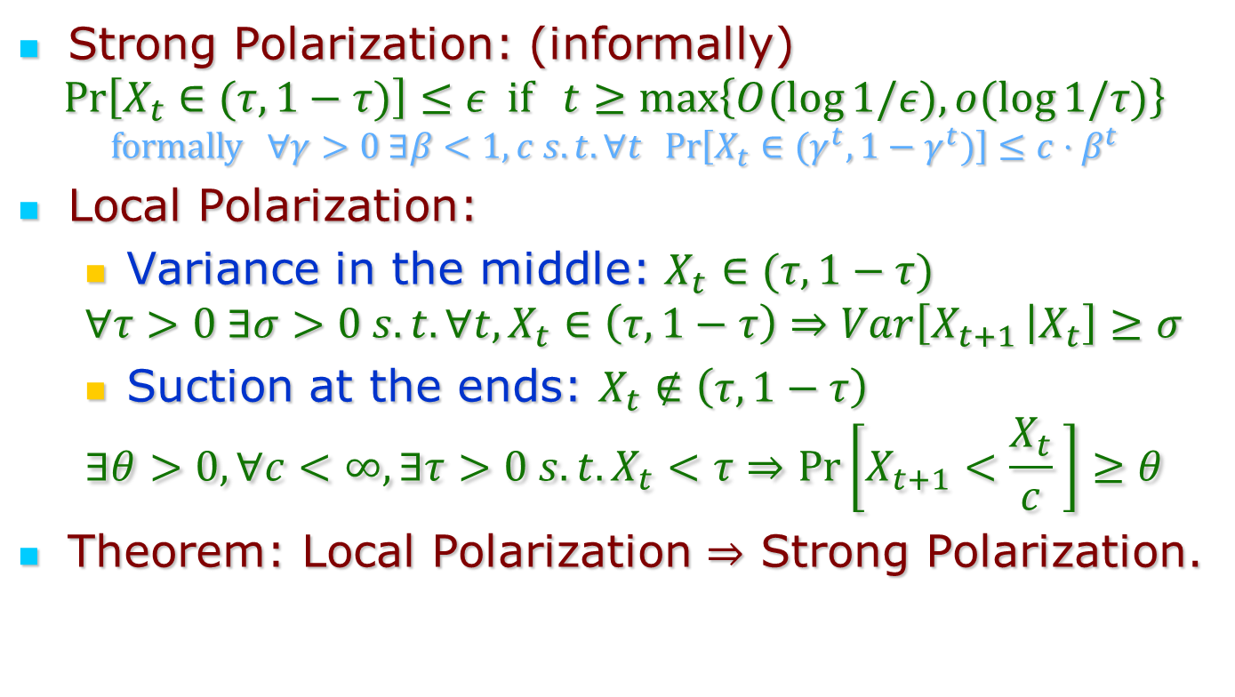
Main Result: Definition and Theorem
Strong Polarization: (informally)
$$\operatorname{Pr}\left[X_{t}∈(τ,1−τ)\right]≤ε if t≥\max\left\{O(\log{1/ε), o(\log{1/τ)}}\right\}$$
$$formally ∀γ>0 ∃β<1,c s.t. ∀t \operatorname{Pr}\left[X_{t}∈(γ^{t},1−γ^{t})\right]≤c⋅β^{t}$$
Local Polarization:
  Variance in the middle: $X_{t}∈(τ,1−τ)$
  $$∀τ>0 ∃σ>0 s.t. ∀t, X_{t}∈\left(τ,1−τ\right)⇒Var\left[X_{t+1 } | X_{t}\right]≥σ$$
  Suction at the ends: $X_{t}∉\left(τ,1−τ\right)$
  $$∃θ>0, ∀c<∞, ∃τ>0 s.t. X_{t}<τ⇒\operatorname{Pr}\left[X_{t+1}<\frac{X_{t}}{c} \right]≥θ$$
Theorem: Local Polarization $⇒$ Strong Polarization.
Both definitions qualitative!
“low end” condition. Similar
condition for high end

Slide 5
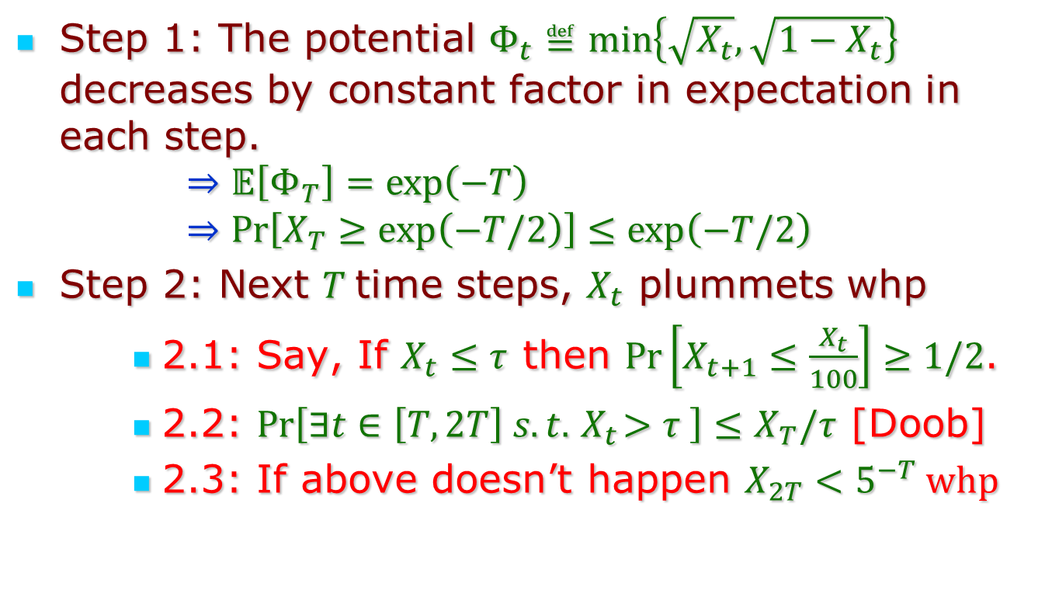
Proof (Idea):
Step 1: The potential $Φ_{t}≝\min\left\{\sqrt{X_{t}}, \sqrt{1−X_{t}}\right\}$ decreases by constant factor in expectation in each step.
  $$⇒𝔼\left[Φ_{T}\right]=\exp\left(−T\right)⇒\operatorname{Pr}\left[X_{T}≥\exp\left(−T/2\right)\right]≤\exp\left(−T/2\right)$$
Step 2: Next $T$time steps, $X_{t}$ plummets whp
    2.1: Say, If $X_{t}≤τ$ then $\operatorname{Pr}\left[X_{t+1}≤\frac{X_{t}}{100}\right]≥1/2$.
    2.2: $\operatorname{Pr}\left[∃t∈\left[T,2T\right] s.t.{ X}_{t}>τ \right]≤X_{T}/τ$ [Doob]
    2.3: If above doesn’t happen $X_{2T}<5^{−T} whp$
QED

Slide 6
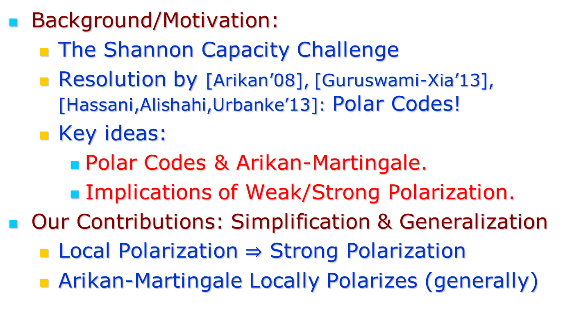
Rest of the talk
Background/Motivation:
  The Shannon Capacity Challenge
  Resolution by [Arikan’08], [Guruswami-Xia’13], [Hassani,Alishahi,Urbanke’13]: Polar Codes!
  Key ideas:
    Polar Codes & Arikan-Martingale.
    Implications of Weak/Strong Polarization.
Our Contributions: Simplification & Generalization
  Local Polarization $⇒$ Strong Polarization
  Arikan-Martingale Locally Polarizes (generally)

Slide 7

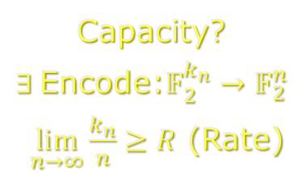
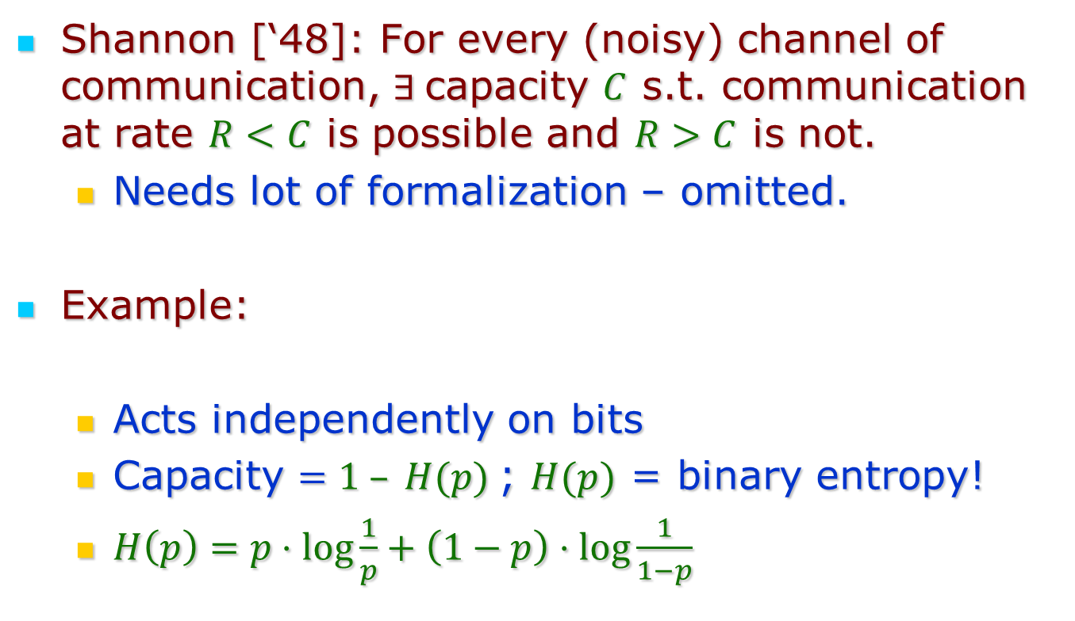



Shannon and Channel Capacity
Shannon [‘48]: For every (noisy) channel of communication, $∃$capacity $C$ s.t. communication at rate $R<C$ is possible and $R>C$ is not.
  Needs lot of formalization – omitted.
Example:
  Acts independently on bits
  Capacity $=1 – H(p)$; $H(p)$ = binary entropy!
  $H\left(p\right)=p⋅\log{\frac{1}{p}}+\left(1−p\right)⋅\log{\frac{1}{1−p}}$
$$X∈𝔽_{2}$$
Capacity?
$∃$Encode:$𝔽_{2}^{k_{n}}→𝔽_{2}^{n}$
$\lim_{n→∞}{\frac{k_{n}}{n}≥R}$ (Rate)
$X$ w.p. $1−p$
$$BSC(p)$$
$1−X$ w.p. $p$

Slide 8
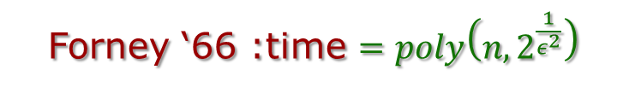
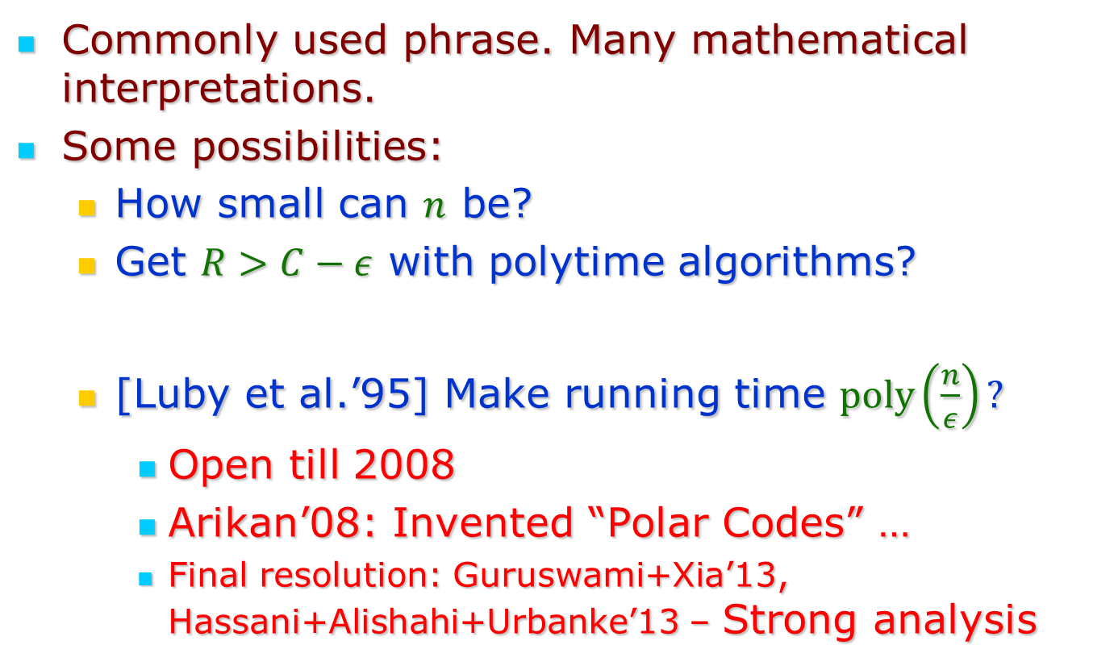

“Achieving” Channel Capacity
Commonly used phrase. Many mathematical interpretations.
Some possibilities:
  How small can $n$ be?
  Get $R>C−ε$ with polytime algorithms?
  [Luby et al.’95] Make running time $poly\left(\frac{n}{ε}\right)?$
    Open till 2008
    Arikan’08: Invented “Polar Codes” …
    Final resolution: Guruswami+Xia’13, Hassani+Alishahi+Urbanke’13 – Strong analysis
Shannon ‘48 : $n=O{\left(C−R\right)}^{−2}$
Forney ‘66 :time $=poly\left(n,2^{\frac{1}{ε^{2}}}\right)$

Slide 9
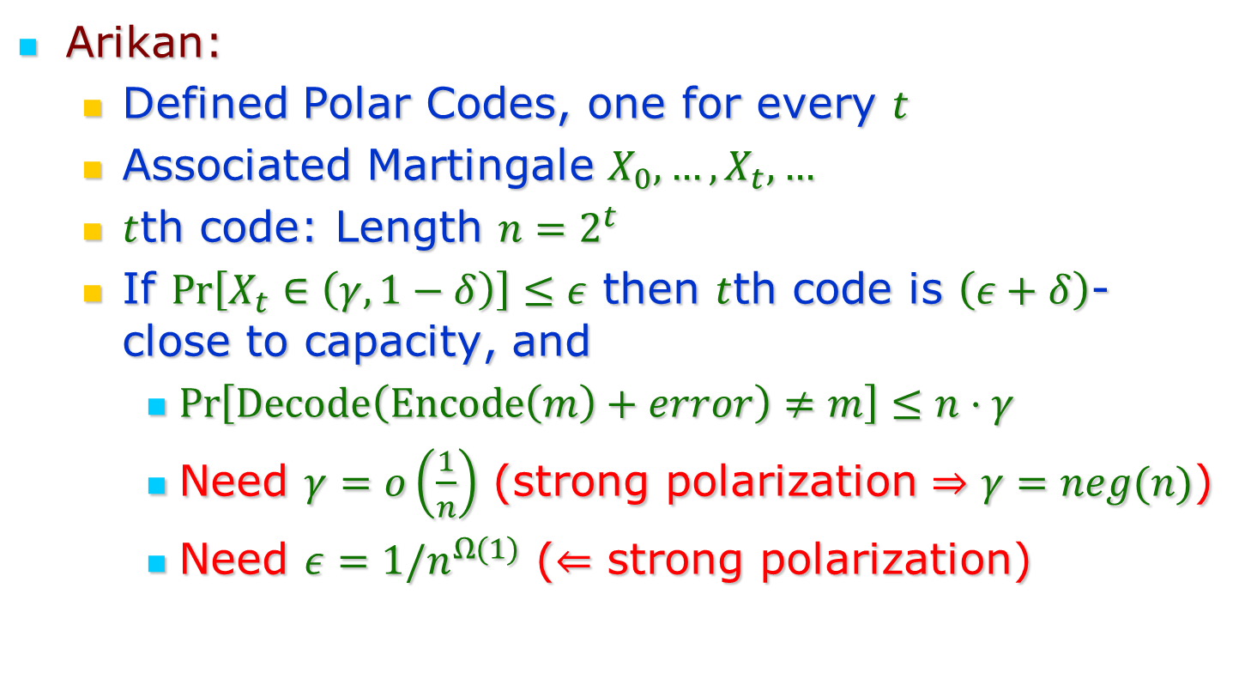
Polar Codes and Polarization
Arikan:
  Defined Polar Codes, one for every $t$
  Associated Martingale $X_{0},…,X_{t},…$
  $t$th code: Length $n=2^{t}$
  If $\operatorname{Pr}\left[X_{t}∈\left(γ,1−δ\right)\right]≤ε$ then $t$th code is $\left(ε+δ\right)$-close to capacity, and
    $\operatorname{Pr}\left[Decode\left(Encode\left(m\right)+error\right)≠m\right]≤n⋅γ$
    Need $γ=o\left(\frac{1}{n}\right)$ (strong polarization $⇒γ=neg(n)$)
    Need $ε=1/n^{Ω(1)}$ ($⇐$ strong polarization)

Slide 10
Context for today’s talk
[Arikan’08]: Martingale associated to general class of codes.
  Martingale polarizes (weakly) implies code achieves capacity (weakly)
  Martingale polarizes weakly for entire class.
[GX’13, HAU’13]: Strong polarization for one specific code.
Why so specific?
  Bottleneck: Strong Polarization
Rest of talk: Polar codes, Martingale and Strong Polarization

Slide 11
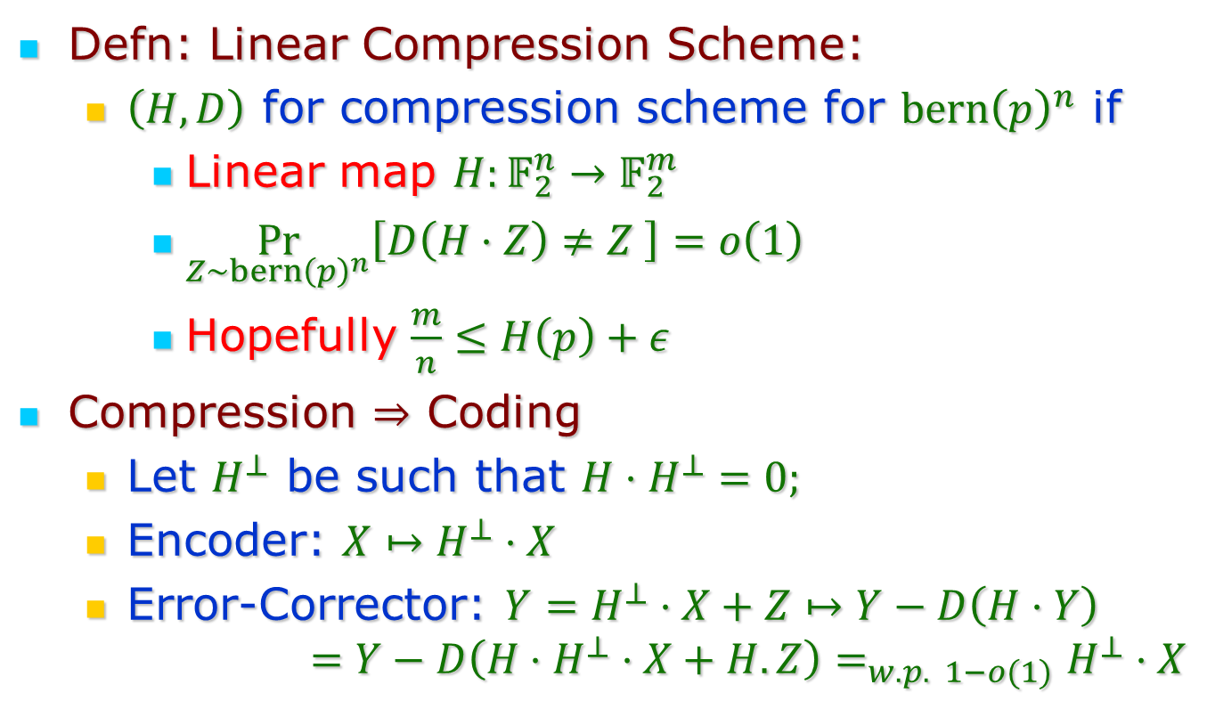
Lesson 0: Compression $⇒$ Coding
Defn: Linear Compression Scheme:
  $\left(H,D\right)$ for compression scheme for $bern{\left(p\right)}^{n}$ if
    Linear map $H:𝔽_{2}^{n}→𝔽_{2}^{m}$
    $\underset{Z∼bern{\left(p\right)}^{n}}{Pr}\left[D\left(H⋅Z\right)≠Z \right]=o\left(1\right)$
    Hopefully $\frac{m}{n}≤H\left(p\right)+ε$
Compression $⇒$ Coding
  Let $H^{⊥}$ be such that ${H⋅H}^{⊥}=0;$
  Encoder: $X↦H^{⊥}⋅X$
  Error-Corrector: $Y=H^{⊥}⋅X+Z↦Y−D\left(H⋅Y\right)$
  $$=Y−D\left(H⋅H^{⊥}⋅X+H.Z\right)=_{w.p. 1−o(1)}H^{⊥}⋅X$$

Slide 12
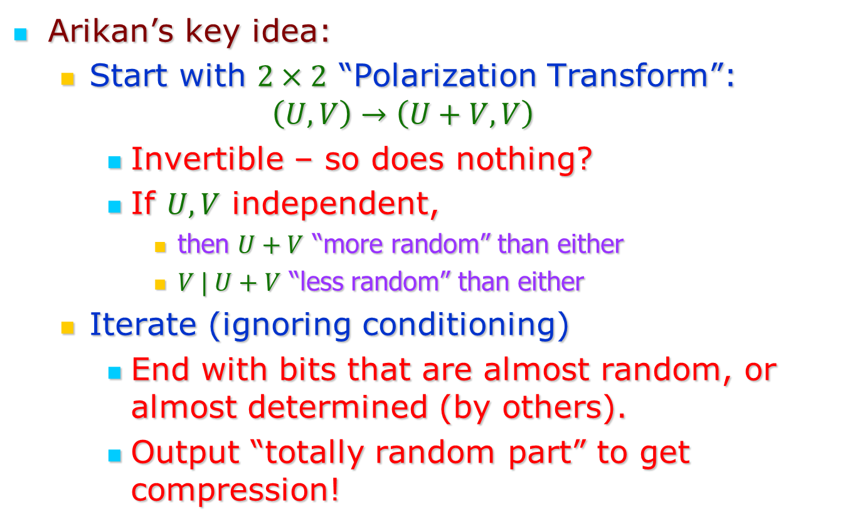
Question: How to compress?
Arikan’s key idea:
  Start with $2×2$ “Polarization Transform”:
  $$\left(U,V\right)→\left(U+V,V\right)$$
    Invertible – so does nothing?
    If $U,V$ independent,
      then $U+V$ “more random” than either
      $V | U+V$ “less random” than either
  Iterate (ignoring conditioning)
    End with bits that are almost random, or almost determined (by others).
    Output “totally random part” to get compression!

Slide 13

Iteration elaborated:
Martingale: $X_{t}≝$conditional entropy of
random output after $t$ iterations
A
A+B
A+B+C+D
B
B
C+D
C
C+D
B+D
D
D
D
E
E+F
E+F+G+H
F
F
G+H
G
G+H
F+H
H
H
H

Slide 14















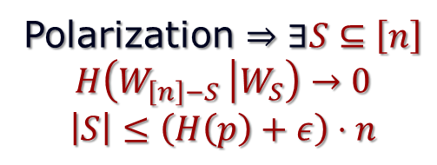


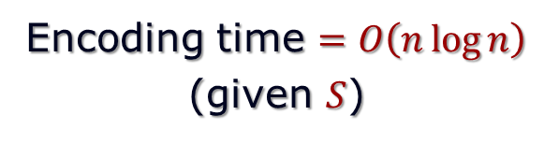





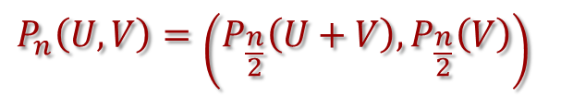
The Polarization Butterfly
$$P_{n}\left(U,V\right)=\left(P_{\frac{n}{2}}\left(U+V\right),P_{\frac{n}{2}}\left(V\right)\right)$$
$$Z_{1}$$
$$Z_{1}+Z_{\frac{n}{2}+1}$$
$$W_{1}$$
Polarization $⇒∃S⊆\left[n\right]$
$$H\left(W_{\left[n\right]−S} | W_{S}\right)→0$$
$$\left|S\right|≤\left(H\left(p\right)+ε\right)⋅n$$
$$Z_{2}$$
$$Z_{2}+Z_{\frac{n}{2}+2}$$
$$W_{2}$$
$$U$$
$$Z_{\frac{n}{2}}$$
$$Z_{\frac{n}{2}}+Z_{n}$$
Compression $E\left(Z\right)=P_{n}{\left(Z\right)}_{S}$
$$W_{\frac{n}{2}}$$
$$Z_{\frac{n}{2}+1}$$
$$Z_{\frac{n}{2}+1}$$
$$W_{\frac{n}{2}+1}$$
Encoding time $=O\left(n\log{n}\right)$
(given $S$)
$$Z_{\frac{n}{2}+2}$$
$$Z_{\frac{n}{2}+2}$$
$$W_{\frac{n}{2}+2}$$
$$V$$
To be shown:
1. Decoding = $O\left(n\log{n }\right)$
2. Polarization!
$$Z_{n}$$
$$Z_{n}$$
$$W_{n}$$

Slide 15


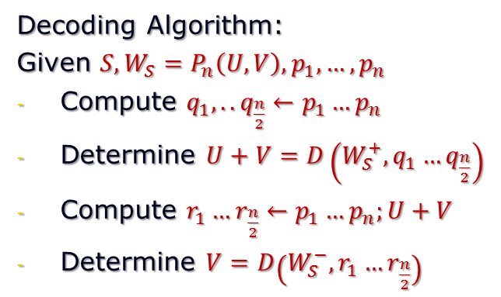






The Polarization Butterfly: Decoding
Decoding idea:
Given $S, W_{S}=P_{n}\left(U,V\right)$
Compute $U+V∼Bern\left(2p−2p^{2}\right)$
Determine $V∼ ?$
$$Z_{1}$$
$$Z_{1}+Z_{\frac{n}{2}+1}$$
$$W_{1}$$
$$Z_{2}$$
$$Z_{2}+Z_{\frac{n}{2}+2}$$
$$W_{2}$$
$V|U+V∼\prod_{i}{Bern(r_{i})}$
$$Z_{\frac{n}{2}}$$
$$Z_{\frac{n}{2}}+Z_{n}$$
$$W_{\frac{n}{2}}$$
Key idea: Stronger induction!
- non-identical product distribution
$$Z_{\frac{n}{2}+1}$$
$$Z_{\frac{n}{2}+1}$$
$$W_{\frac{n}{2}+1}$$
Decoding Algorithm:
Given $S, W_{S}=P_{n}\left(U,V\right),p_{1},…,p_{n}$
Compute $q_{1},..q_{\frac{n}{2}}←p_{1}…p_{n}$
Determine $U+V=D\left(W_{S}^{+}, q_{1}…q_{\frac{n}{2}}\right)$
Compute $r_{1}…r_{\frac{n}{2}}←p_{1}…p_{n};U+V$
Determine $V=D\left(W_{S}^{−}, r_{1}…r_{\frac{n}{2}}\right)$
$$Z_{\frac{n}{2}+2}$$
$$Z_{\frac{n}{2}+2}$$
$$W_{\frac{n}{2}+2}$$
$$Z_{n}$$
$$Z_{n}$$
$$W_{n}$$

Slide 16


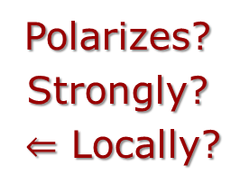

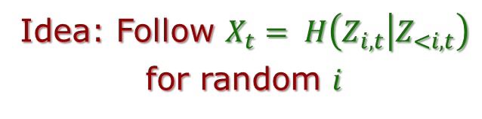
Polarization Martingale
$$Z_{1}$$
$$Z_{1}+Z_{\frac{n}{2}+1}$$
$$W_{1}$$
Idea: Follow $X_{t}= H\left(Z_{i,t} | Z_{<i,t}\right)$
for random $i$
$$Z_{2}$$
$$Z_{2}+Z_{\frac{n}{2}+2}$$
$$W_{2}$$
$$Z_{i,0}$$
$$Z_{i,1}… Z_{i,t}… Z_{i,\log{n }}$$
$$Z_{\frac{n}{2}}$$
$$Z_{\frac{n}{2}}+Z_{n}$$
$$W_{\frac{n}{2}}$$
$$Z_{\frac{n}{2}+1}$$
$$Z_{\frac{n}{2}+1}$$
$$W_{\frac{n}{2}+1}$$
$X_{t}$ Martingale!
$$Z_{\frac{n}{2}+2}$$
$$Z_{\frac{n}{2}+2}$$
$$W_{\frac{n}{2}+2}$$
Polarizes?
Strongly?
$⇐$ Locally?
$$Z_{n}$$
$$Z_{n}$$
$$W_{n}$$

Slide 17
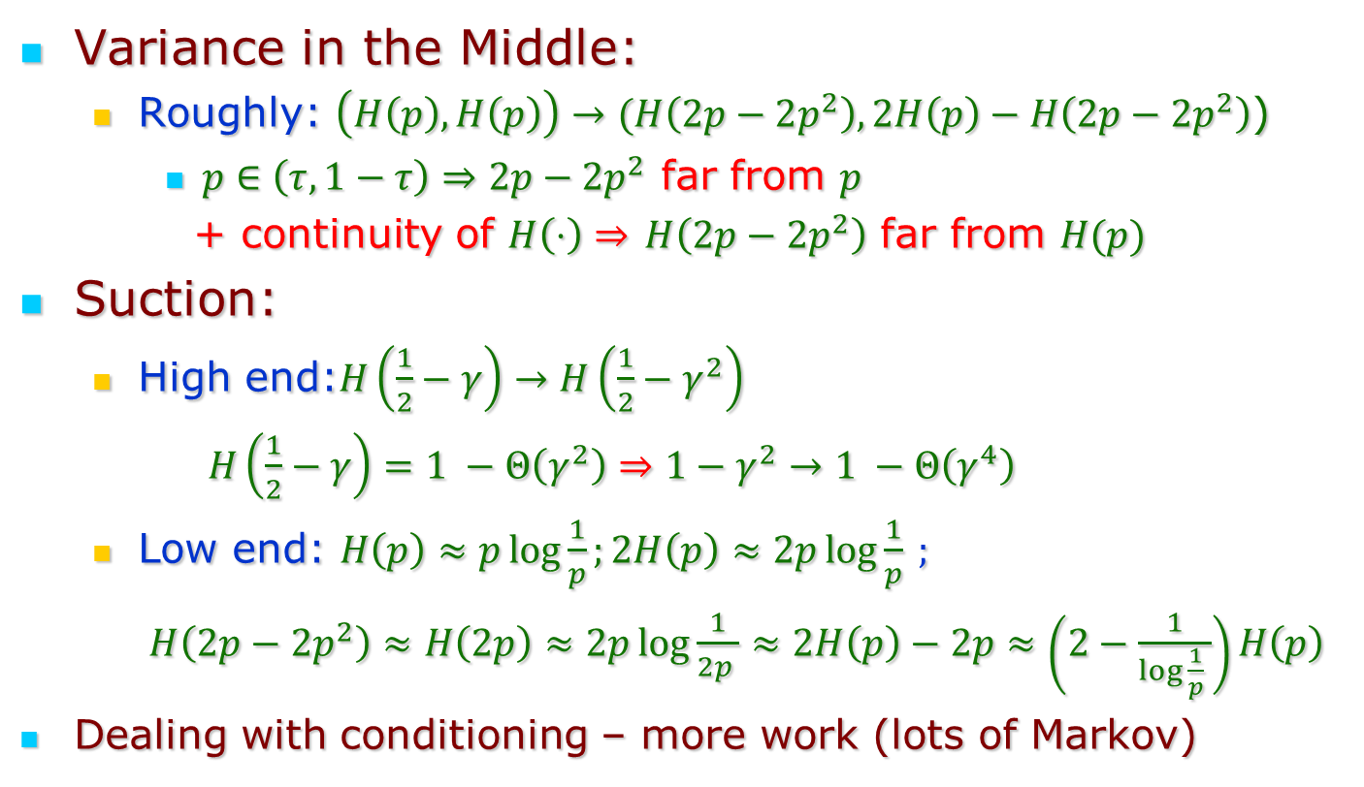
Local Polarization of Arikan Martingale
Variance in the Middle:
  Roughly: $\left(H\left(p\right),H\left(p\right)\right)→(H\left(2p−2p^{2}\right), 2H\left(p\right)−H\left(2p−2p^{2}\right)$)
    $p∈\left(τ,1−τ\right)⇒2p−2p^{2}$ far from $p$
    + continuity of $H\left(⋅\right)⇒$ $H\left(2p−2p^{2}\right)$ far from $H(p)$
Suction:
  High end:$H\left(\frac{1}{2}−γ\right)→H\left(\frac{1}{2}−γ^{2}\right)$
    $H\left(\frac{1}{2}−γ\right)=1 −Θ\left(γ^{2}\right)⇒1−γ^{2}→1 −Θ\left(γ^{4}\right)$
  Low end: $H\left(p\right)≈p\log{\frac{1}{p}};2H\left(p\right)≈2p\log{\frac{1}{p}} ;$
  $H\left(2p−2p^{2}\right)≈H\left(2p\right)≈2p\log{\frac{1}{2p }}≈2H\left(p\right)−2p≈\left(2−\frac{1}{\log{\frac{1}{p} }}\right)H\left(p\right)$
Dealing with conditioning – more work (lots of Markov)

Slide 18
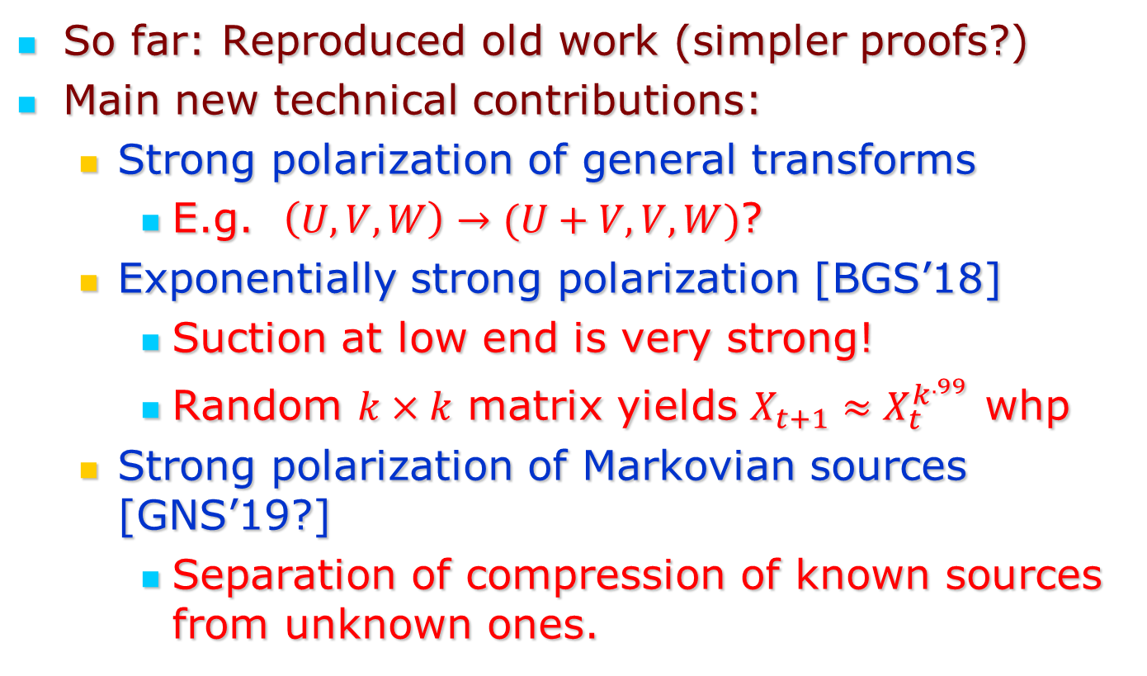
“New contributions”
So far: Reproduced old work (simpler proofs?)
Main new technical contributions:
  Strong polarization of general transforms
    E.g. $\left(U,V,W\right)→(U+V,V,W)$?
  Exponentially strong polarization [BGS’18]
    Suction at low end is very strong!
    Random $k×k$ matrix yields $X_{t+1}≈X_{t}^{k^{.99}}$ whp
  Strong polarization of Markovian sources [GNS’19?]
    Separation of compression of known sources from unknown ones.

Slide 19
Conclusions
Polarization:
  Important phenomenon associated with bounded random variables.
  Not always bad ☹ ☺
  Needs better understanding!
    Recently also used in CS:
      [Lovett Meka] – implicit
      [Chattopadhyay-Hatami-Hosseini-Lovett] - explicit

Slide 20
Thank You!

Slide 21
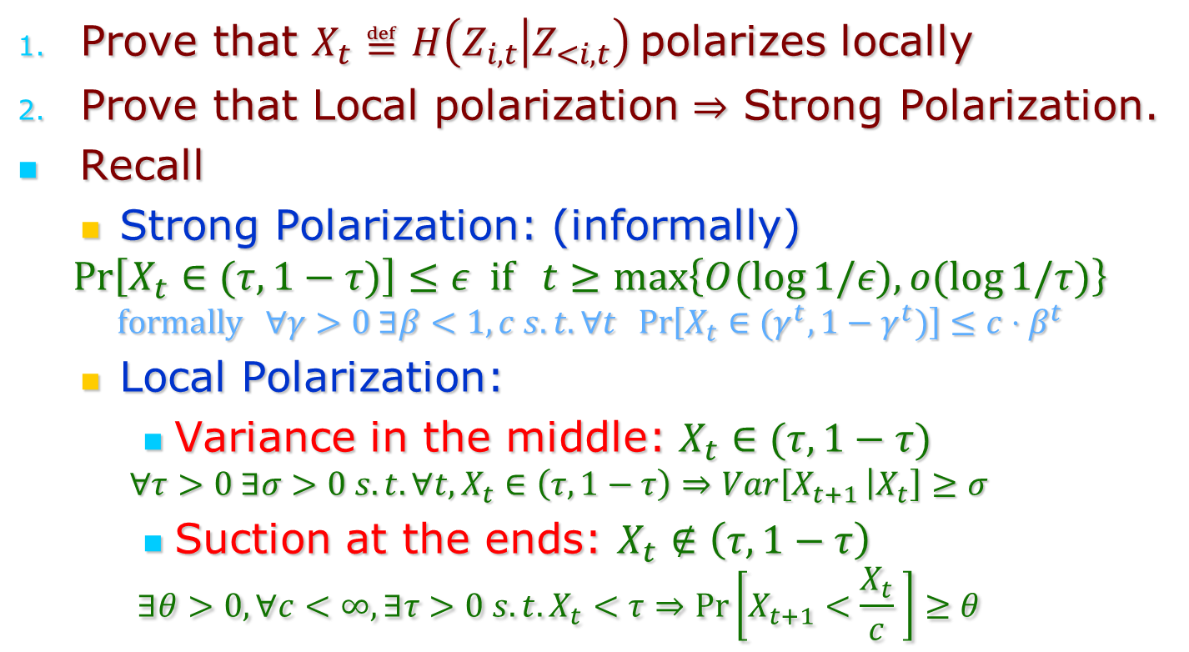
Remaining Tasks:
Prove that $X_{t}≝H\left(Z_{i,t} | Z_{<i,t}\right)$polarizes locally
Prove that Local polarization $⇒$ Strong Polarization.
Recall
  Strong Polarization: (informally)
$$\operatorname{Pr}\left[X_{t}∈(τ,1−τ)\right]≤ε if t≥\max\left\{O(\log{1/ε), o(\log{1/τ)}}\right\}$$
$$formally ∀γ>0 ∃β<1,c s.t. ∀t \operatorname{Pr}\left[X_{t}∈(γ^{t},1−γ^{t})\right]≤c⋅β^{t}$$
  Local Polarization:
    Variance in the middle: $X_{t}∈(τ,1−τ)$
  $$∀τ>0 ∃σ>0 s.t. ∀t, X_{t}∈\left(τ,1−τ\right)⇒Var\left[X_{t+1 } | X_{t}\right]≥σ$$
    Suction at the ends: $X_{t}∉\left(τ,1−τ\right)$
  $$∃θ>0, ∀c<∞, ∃τ>0 s.t. X_{t}<τ⇒\operatorname{Pr}\left[X_{t+1}<\frac{X_{t}}{c} \right]≥θ$$

Slide 22
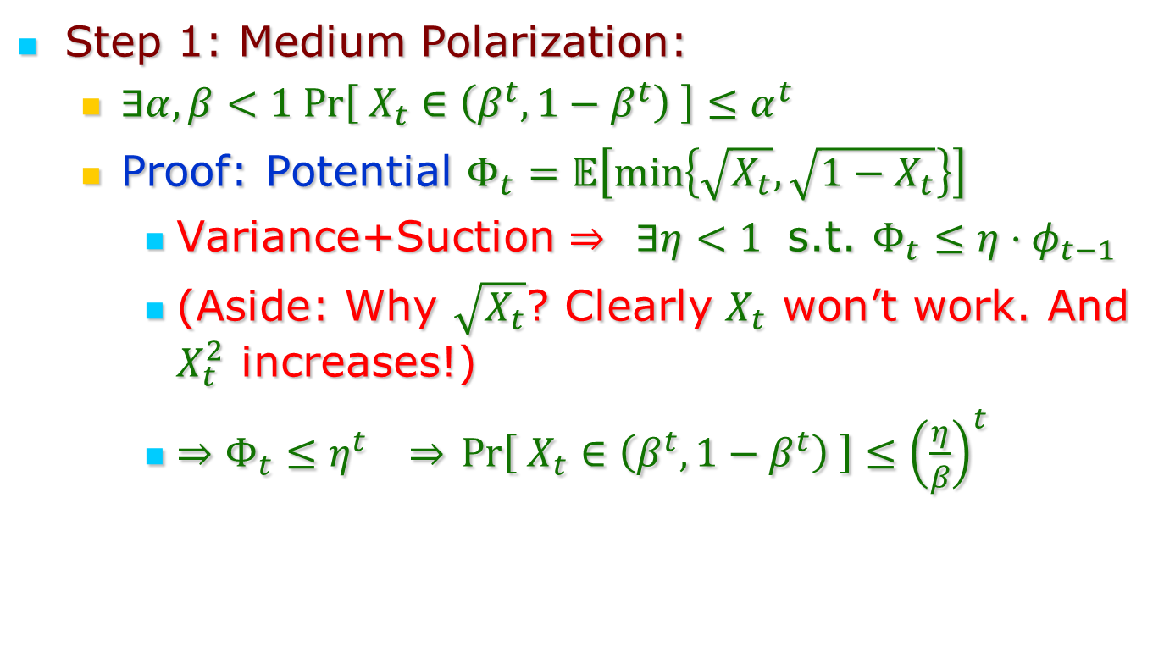
Local $⇒$ (Global) Strong Polarization
Step 1: Medium Polarization:
  $∃α,β<1 Pr\left[ X_{t}∈\left(β^{t},1−β^{t}\right) \right]≤α^{t}$
  Proof: Potential $Φ_{t}=𝔼\left[\min\left\{\sqrt{X_{t}}, \sqrt{1−X_{t}}\right\}\right]$
    Variance+Suction $⇒ ∃η<1$ s.t. $Φ_{t}≤η⋅φ_{t−1}$
    (Aside: Why $\sqrt{X_{t}}$? Clearly $X_{t}$ won’t work. And $X_{t}^{2}$ increases!)
    $⇒Φ_{t}≤η^{t} ⇒$ $Pr\left[ X_{t}∈\left(β^{t},1−β^{t}\right) \right]≤{\left(\frac{η}{β}\right)}^{t}$

Slide 23
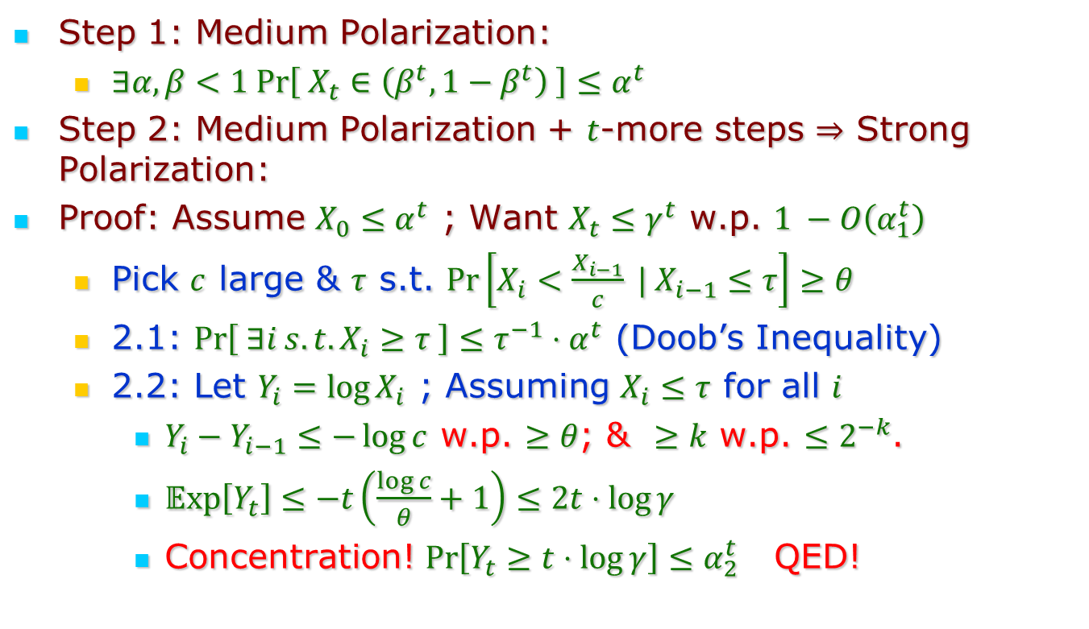
Local $⇒$ (Global) Strong Polarization
Step 1: Medium Polarization:
  $∃α,β<1 Pr\left[ X_{t}∈\left(β^{t},1−β^{t}\right) \right]≤α^{t}$
Step 2: Medium Polarization + $t$-more steps $⇒$ Strong Polarization:
Proof: Assume $X_{0}≤α^{t}$ ; Want $X_{t}≤γ^{t}$ w.p. $1 −O\left(α_{1}^{t}\right)$
  Pick $c$ large & $τ$ s.t. $\operatorname{Pr}\left[X_{i}<\frac{X_{i−1}}{c} | X_{i−1}≤τ\right]≥θ$
  2.1: $\operatorname{Pr}\left[ ∃i s.t. X_{i}≥τ \right]≤τ^{−1}⋅α^{t}$ (Doob’s Inequality)
  2.2: Let $Y_{i}=\log{X_{i}}$ ; Assuming $X_{i}≤τ$ for all $i$
    $Y_{i}−Y_{i−1}≤−\log{c}$ w.p. $≥θ$; & $≥k$ w.p. $≤2^{−k}$.
    $𝔼xp\left[Y_{t}\right]≤−t\left(\frac{\log{c}}{θ}+1\right)≤2t⋅\log{γ}$
    Concentration! $\operatorname{Pr}\left[Y_{t}≥t⋅\log{γ}\right]≤α_{2}^{t}$ QED!

Slide 24
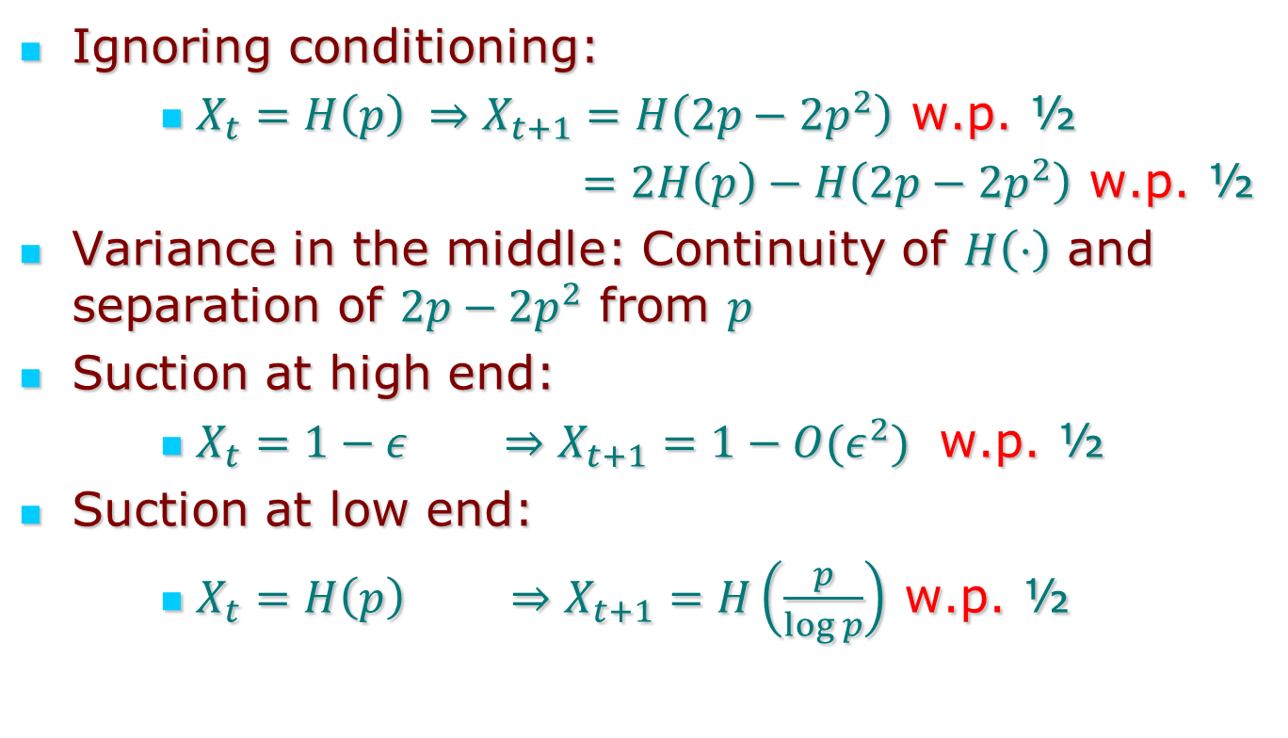
Polarization of Arikan Martingale
Ignoring conditioning:
    $X_{t}=H\left(p\right) ⇒X_{t+1}=H\left(2p−2p^{2}\right)$ w.p. ½
    $=2H\left(p\right)−H\left(2p−2p^{2}\right)$ w.p. ½
Variance in the middle: Continuity of $H\left(⋅\right)$ and separation of $2p−2p^{2}$ from $p$
Suction at high end:
    $X_{t}=1−ε ⇒X_{t+1}=1−{O(ε}^{2})$ w.p. ½
Suction at low end:
    $X_{t}=H\left(p\right) ⇒X_{t+1}=H\left(\frac{p}{\log{p}}\right)$ w.p. ½

Slide 25
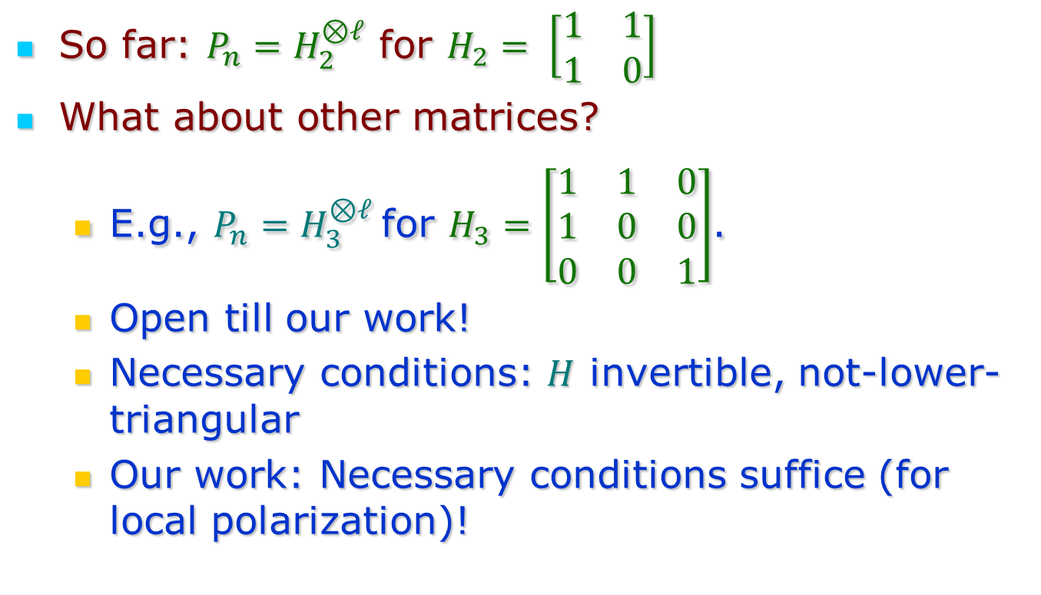
General Strong Polarization?
So far: $P_{n}=H_{2}^{⊗ℓ}$ for $H_{2}= \left[\begin{matrix}1 & 1 \\ 1 & 0\end{matrix}\right]$
What about other matrices?
  E.g., $P_{n}=H_{3}^{⊗ℓ}$for $H_{3}=\left[\begin{matrix}1 & 1 & 0 \\ 1 & 0 & 0 \\ 0 & 0 & 1\end{matrix}\right]$.
  Open till our work!
  Necessary conditions: $H$ invertible, not-lower-triangular
  Our work: Necessary conditions suffice (for local polarization)!

Slide 26
Conclusion
Simple General Analysis of Strong Polarization
But main reason to study general polarization:
  Maybe some matrices polarize even faster!
  This analysis does not get us there.
  But hopefully following the (simpler) steps in specific cases can lead to improvements.

Slide 27
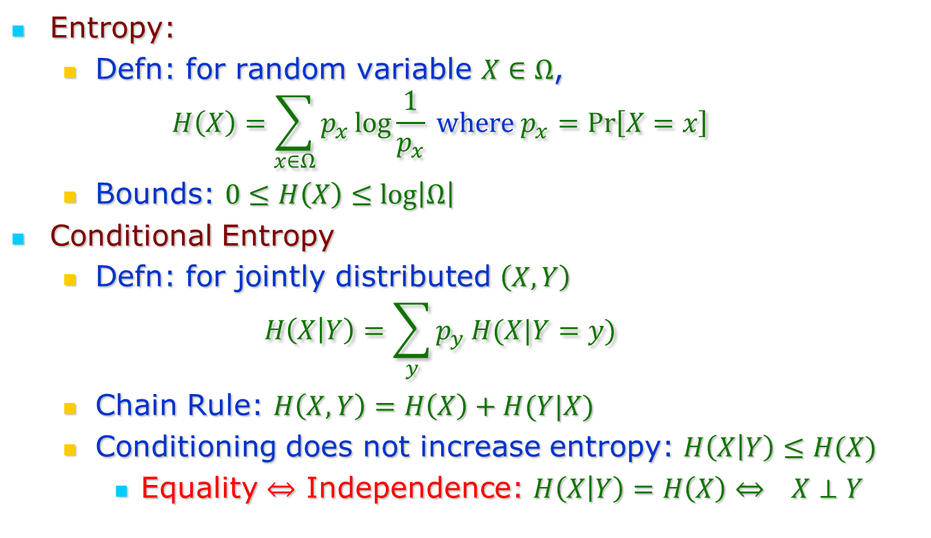
Information Theory Basics
Entropy:
  Defn: for random variable $X∈Ω$,
  $$H\left(X\right)=\sum_{x∈Ω}{p_{x}\log{\frac{1}{p_{x}}}} where p_{x}=\operatorname{Pr}\left[X=x\right]$$
  Bounds: $0≤H\left(X\right)≤\log\left|Ω\right|$
Conditional Entropy
  Defn: for jointly distributed $\left(X,Y\right)$
  $$H\left(X | Y\right)=\sum_{y}{p_{y}}H(X|Y=y)$$
  Chain Rule: $H\left(X,Y\right)=H\left(X\right)+H(Y|X)$
  Conditioning does not increase entropy: $H\left(X | Y\right)≤H(X)$
    Equality $⇔$ Independence: $H\left(X | Y\right)=H\left(X\right)⇔ X⊥Y$

Slide 28







Iteration by Example:
$\left(A,B,C,D\right)→\left(A+B+C+D,B+D,C+D, D\right)$
$\left(E,F,G,H\right)→\left(E+F+G+H,F+H,G+H,H\right)$
$$B+D$$
$$B+D+F+H$$
$$H\left(B+D \right|A+B+C+D)$$
$$H\left(B+D+F+H| \left\{\begin{aligned}A+B+C+D, \\ E+F+G+H\end{aligned}\right\}\right)$$
$$F+H$$
$$F+H$$
$$H\left(F+H \right|E+F+G+H)$$
$$H\left(F+H| \left\{\begin{aligned}A+B+C+D, \\ E+F+G+H, \\ B+D+F+H\end{aligned}\right\}\right)$$

Slide 29




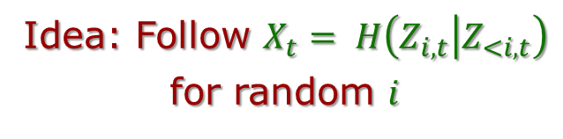
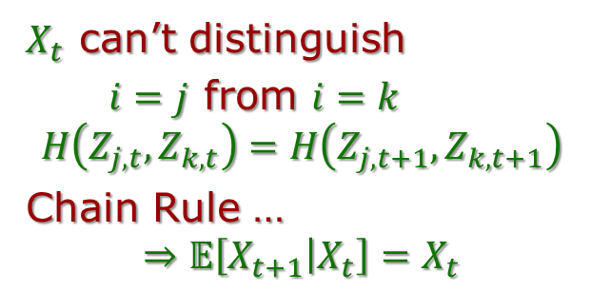
Polarization Martingale
Idea: Follow $X_{t}= H\left(Z_{i,t} | Z_{<i,t}\right)$
for random $i$
$$Z_{1}$$
$$Z_{1}+Z_{\frac{n}{2}+1}$$
$$W_{1}$$
$$Z_{2}$$
$$Z_{2}+Z_{\frac{n}{2}+2}$$
$$W_{2}$$
Martingale?
$$Z_{i,0}$$
$$Z_{i,1}… Z_{i,t}… Z_{i,\log{n }}$$
$$Z_{j,t}$$
$$Z_{j,t+1}$$
$$Z_{\frac{n}{2}}$$
$$Z_{\frac{n}{2}}+Z_{n}$$
$$W_{\frac{n}{2}}$$
$$Z_{k,t}$$
$$Z_{k,t+1}$$
$$Z_{\frac{n}{2}+1}$$
$$Z_{\frac{n}{2}+1}$$
$$W_{\frac{n}{2}+1}$$
$$Z_{\frac{n}{2}+2}$$
$$Z_{\frac{n}{2}+2}$$
$$W_{\frac{n}{2}+2}$$
$X_{t}$ can’t distinguish
$i=j$ from $i=k$
$$H\left(Z_{j,t},Z_{k,t}\right)=H\left(Z_{j,t+1},Z_{k,t+1}\right)$$
Chain Rule …
$$⇒𝔼\left[X_{t+1} | X_{t}\right]=X_{t}$$
$$Z_{n}$$
$$Z_{n}$$
$$W_{n}$$

