Slide 1
What should I talk about?
Aspects of Human Communication
Madhu Sudan
Harvard University
Based on many joint works …

Slide 2
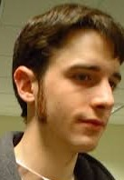
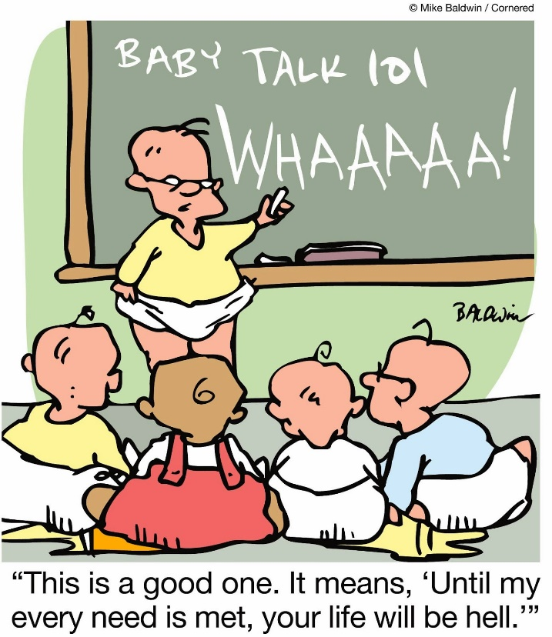
Ingredients in Human Communication
Ability to start with (nearly) zero context and “learning to communicate by communicating”.
Children learn to speak … (not by taking courses)
Focus of works with Juba and Goldreich
“What is possible?” (a la computability)
Ability to leverage large uncertain context.
E.g. … This talk today …
Assumes … English, Math, TCS, Social info, Geography.
Aside … what is “self-contained”?
“How to make communication efficient (using context)?” (a la complexity)

Slide 3
Context in Communication
Empirically, Informally:
Huge piece of information (much larger than “content” of communication)
Not strictly needed for communication …
… But makes communication efficient, when shared by communicating players
… helps even if context not shared perfectly.
Challenge: Formalize?
Work so far … some (toy?) settings

Slide 4
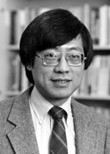
Underlying Model: Communication Complexity
The model
(with shared randomness)
$$x$$
$$y$$
$$f:\left(x,y\right)↦Σ$$
$$R=\$\$\$$$
Usually studied for lower bounds.
This talk: CC as +ve model.
Alice
Bob
$CC\left(f\right)=\#$bits exchanged
by best protocol
$$f(x,y)$$
w.p. 2/3

Slide 5
Aside: Easy CC Problems [Ghazi,Kamath,S’15]
$∃$Problems with large inputs and small communication?
Equality testing:
$EQ\left(x,y\right)=1⇔x=y;$ $CC\left(EQ\right)=O\left(1\right)$
Hamming distance:
$H_{k}\left(x,y\right)=1⇔Δ\left(x,y\right)≤k; CC\left(H_{k}\right)=O(k\log{k})$ [Huang etal.]
Small set intersection:
$∩_{k}\left(x,y\right)=1⇔ wt\left(x\right), wt\left(y\right)≤k \& ∃i s.t. x_{i}=y_{i}=1.$
$CC\left(∩_{k}\right)=O(k)$ [Håstad Wigderson]
Gap (Real) Inner Product:
$x,y∈ℝ^{n};{\left|x\right|}_{2}, {\left|y\right|}_{2}=1;$
$GIP_{c,s}\left(x,y\right)=1 if 〈x,y〉≥c; =0 if 〈x,y〉≤s;$
$CC\left(GIP_{c,s}\right)=O\left(\frac{1}{{\left(c−s\right)}^{2}}\right) ;$[Alon, Matias, Szegedy]
Protocol:
Fix ECC $E:{\left\{0,1\right\}}^{n}→{\left\{0,1\right\}}^{N};$
Shared randomness: $i←\left[N\right];$
Exchange $E{\left(x\right)}_{i}, E{\left(y\right)}_{i};$
Accept iff $E{\left(x\right)}_{i}=E{\left(y\right)}_{i}$.
$poly\left(k\right)$Protocol:
Use common randomness
to hash $\left[n\right]→[k^{2}]$
$$x=(x_{1}, …, x_{n})$$
$$y=\left(y_{1}, …, y_{n}\right)$$
$$〈x,y〉≜\sum_{i}{x_{i}y_{i}}$$
Main Insight:
If $G←N{\left(0,1\right)}^{n}$, then
$𝔼\left[〈G,x〉⋅〈G,y〉\right]=〈x,y〉$
Unstated philosophical contribution of CC a la Yao:
Communication with a focus (“only need to determine $f\left(x,y\right)$”)
can be more effective (shorter than $\left|x\right|,H\left(x\right),H\left(y\right),I(x;y)$… )

Slide 6
Communication & (Uncertain) Context
$${Context}_{Alice}$$
$$=(f,R,P_{XY})$$
$${Context}_{Bob}$$
$$=(f,R,P_{XY})$$
$$=(f^{A},R^{A},P_{XY}^{A})$$
$$=(f^{B},R^{B},P_{XY}^{B})$$
$$x$$
$$y$$
$$f:\left(x,y\right)↦Σ$$
Alice
Bob
$$f(x,y)$$
w.p. 2/3

Slide 7
1. Imperfectly Shared Randomness
$${Context}_{Alice}$$
$$=R$$
$${Context}_{Bob}$$
$$=R$$
$$=R^{A}$$
$$=R^{B}$$
$$x$$
$$y$$
$$f:\left(x,y\right)↦Σ$$
Alice
Bob
$$f(x,y)$$
w.p. 2/3

Slide 8
Imperfectly Shared Randomness (ISR)
Model: $R^{A}∼N_{ρ}\left(R^{B}\right)$ ($ρ$-correlated iid on each coord.)
Thm [Bavarian-Gavinsky-Ito’15]: Equality testing has $O(1)$-comm. comp. with ISR.
Thm [Canonne-Guruswami-Meka-S.’16]: If $f$ has CC $k$ with perfect rand., then it has ISR-CC $O_{ρ}\left(2^{k}\right)$
Thm [CGMS] This is tight (for promise problems).
Complete problem: Estimate $〈x,y〉$ for $x,y∈ℝ^{n}$
$ε$-approximation needs $Θ\left(ε^{−2}\right)$ communication
Hard problem: Sparse inner product – where $x$ is non-zero only $ε$-fraction of the times.

Slide 9
2. Uncertain Functionality
$${Context}_{Alice}$$
$$=(f,R,P_{XY})$$
$${Context}_{Bob}$$
$$=(f,R,P_{XY})$$
$$=(f^{A},R,P_{XY})$$
$$=(f^{B},R,P_{XY})$$
$$x$$
$$y$$
$$f:\left(x,y\right)↦Σ$$
Alice
Bob
$$f(x,y)$$
w.p. 2/3
w.p. 2/3 over $x,y∼P_{XY}$

Slide 10
Definitions and results
Defining problem is non-trivial:
Alice/Bob may not “know” $f$ but protocol might!
Prevent this by considering entire class of function pairs $𝒢=\left\{(f^{A},f^{B})\right\}$ that are admissible.
Complexity = complexity of $𝒢$ !
Theorem[Ghazi,Komargodski,Kothari,S. 16]:
If $P_{XY}$ arbitrary then there exists $𝒢$ s.t. every $f∈𝒢$ has cc = 1, but uncertain-cc$\left(𝒢\right)=Ω\left(\sqrt{n}\right)$
If $P_{XY}=$ uniform and every $f∈𝒢$ has one-way cc $k$, then uncertain-cc$\left(𝒢\right)=O\left(k\right).$
Theorem[Ghazi-S.,18]: Above needs perfect shared randomness.

Slide 11
3. Compression & (Uncertain) Context
$${Context}_{Alice}$$
$$=P_{X}$$
$${Context}_{Bob}$$
$$=P_{X}$$
$$=P_{X}^{A}$$
$$=P_{X}^{B}$$
$$x$$
$$y$$
$$f:\left(x,y\right)↦Σ$$
Alice
Bob
$$f(x,y)$$
$$x$$
w.p. 2/3

Slide 12
3. (Uncertain) Compression
Without context: CC = $log \left|Ω\right|$ (where $x∈Ω$)
With shared context, Expected-CC = $H\left(P_{X}\right)$
With imperfectly shared context, but with shared randomness, Expected-CC = $H\left(P_{X}^{A}\right)+Θ(Δ)$
Where $Δ=\max_{x}\left\{\max\left\{\log{\frac{P^{A}\left(x\right)}{P^{B}\left(x\right)}},\log{\frac{P^{B}\left(x\right)}{P^{A}\left(x\right)}}\right\}\right\}$ [JKKS’11]
Without shared randomness … exact status unknown! Best upper bound ([Haramaty,S’14]):
Expected-CC $=O\left(H\left(P_{X}^{A}\right)+Δ+\log{\log{Ω}}\right)$

Slide 13
Compression as a proxy for language
Information theoretic study of language?
Goal of language: Effective means of expressing information/action.
Implicit objective of language: Make frequent messages short. Compression!
Frequency = Known globally? Learned locally?
If latter – every one can’t possibly agree on it;
Yet need to agree on language (mostly)!
Similar to problem of Uncertain Compression.
Studied formally in [Ghazi,Haramaty,Kamath,S. ITCS 17]

Slide 14
Part II: Proofs

Slide 15
Well understood …
(Goldwasser-Micali-Rackoff, …)
Interactive Proofs
Zero Knowledge Proofs
Multi-Prover Interactive Proofs
PCPs
Interactive Proofs for Muggles
Pseudodeterministic Proofs …
… nevertheless some challenges in understanding communication of proofs …

Slide 16
Standard Assumption
A
T
$$Π$$
Small (Constant) Number of Axioms
$X→Y, Y→Z⇒ X→Z$, Peano, etc.
Medium Sized Theorem:
$∀x,y,z,n∈ℕ, x^{n}+y^{n}=z^{n}→n≤2$ …
Big Proof:
Blah blah blah blah blah blah bla blah blah blah blah blah blah blah blah blah blah blah blah blah blah blah blah blah blah blah blah blah blah blah blah blah blah blah blah blah blah blah blah blah blah blah blah blah blah blah blah blah blah blah blah blah blah blah

Slide 17
The truth
Mathematical proofs assume large context.
“By some estimates a proof that 2+2=4 in ZFC would require about 20000 steps … so we will use a huge set of axioms to shorten our proofs – namely, everything from high-school mathematics”
[Lehman,Leighton,Meyer – Notes for MIT 6.042]
Context (= huge set of axioms) shortens proofs.
But context is uncertain!
What is “high school mathematics”?

Slide 18
Communicating (“speaking of”) Proofs
Ingredients:
Prover:
Axioms $A,$Theorem $T$, Proof $Π$
Communicates $\left(T,Π\right)$ (Claim: $Π$ proves $A→T$)
Verifier:
Complete+sound: $∃Π, V^{A}\left(T, Π\right)=1$ iff $A→T$
Verifier efficient = Poly$(T, Π)$ with oracle access to $A$
Axioms = Context.
A
T
$$Π$$

Slide 19
Uncertainty of Context?
Prover: works with axioms $A_{P},$ generates $Π$ s.t. $V^{A_{P}}\left(T,Π\right)=1$
Verifier: works with axioms $A_{V}$, checks $V^{A_{V}}\left(T,Π\right)=1$
Robust prover/verifier ?
Need measure $δ\left(A_{P},A_{V}\right)$ (not symmetric).
Given $δ$ prover should be able to generate $Π_{δ}$ such that $∀ A_{P}$ s.t. $δ\left(A_{P},A_{V}\right)≤δ, V^{A_{V}}\left(T,Π\right)=1$
$Π_{δ}$ not much larger than $Π=Π_{0}$
$δ\left(.,.\right)$ “reasonable” …
E.g. if $X→Y, Y→Z∈A$ and $A^{′}=A∪\left\{X→Z\right\}$
then $δ\left(A′,A \right)$ tiny.
Open: Does such an efficient verifier exist?

Slide 20
Beyond oracle access: Modelling the mind
Brain (of verifier) does not just store and retrieve axioms.
Can make logical deductions too! But should do so feasibly.
Semi-formally:
Let $A^{t}$ denote the set of axioms “known” to the verifier given $t$ query-proc. time
Want $\left|A^{2t}\right|≫\left|A^{t}\right|$, but storage space $\sim \left|A^{0}\right|$
What is a computational model of the brain that allows this?
Cell-probe – $No^{∗}$. ConsciousTM – Maybe. Etc…

Slide 21
Conclusions
Very poor understanding of “communication of proofs” as we practice it.
Have to rely on verifier’s “knowledge”
But can’t expect to know it exactly
Exposes holes in computational understanding of knowledge-processing.
Can we “verify” more given more time?
Or are we just memorizing?

Slide 22
Thank You!

