Slide 1
Polarization of Bounded Martingales
Madhu Sudan
Harvard University
Joint work with Jaroslaw Blasiok (Harvard), Venkatesan Guruswami (CMU), Preetum Nakkiran (Harvard) and Atri Rudra (Buffalo)

Slide 2
This talk
Martingale: Sequence of random variables $X_{0},…,X_{t}, …$s.t. $𝔼\left[X_{t}| X_{0},…,X_{t−1}\right]=X_{t−1}$
Gambling … randomized algorithms …
Bounded: $∀t X_{t}∈[0,1]$
Polarization: When is $\lim_{t}\left\{X_{t}\right\}∈\{0,1\}$ ?
How fast is the convergence? Tools?
$$X_{t+1}= \left\{\begin{aligned}X_{t}−{\frac{1}{4}.2}^{−t} w.p. .5 \\ X_{t}+{\frac{1}{4}.2}^{−t} w.p. .5\end{aligned}\right.$$
$$Y_{t+1}=\left\{\begin{aligned}Y_{t}^{2} w.p..5 \\ 2Y_{t}−Y_{t}^{2} w.p..5 \end{aligned}\right.$$

Slide 3
Part I: Motivation Achieving Shannon Capacity

Slide 4
Shannon and Channel Capacity
Shannon [‘48]: For every (noisy) channel of communication, $∃$capacity $C$ s.t. communication at rate $R<C$ is possible and $R>C$ is not.
formalization – omitted.
Example:
Acts independently on bits
Capacity $=1 – H(p)$; $H(p)$ = binary entropy!
$H\left(p\right)=p⋅\log{\frac{1}{p}}+\left(1−p\right)⋅\log{\frac{1}{1−p}}$
Capacity?
$$∃ E:𝔽_{2}^{k_{n}}→𝔽_{2}^{n}$$
$D:𝔽_{2}^{n}→𝔽_{2}^{k_{n}}$
w. $\operatorname{Pr}\left[D\left(BSC\left(E\left(m\right)\right)\right)≠m\right]=o(1)$
$\lim_{n→∞}{\frac{k_{n}}{n}≥R}$ (Rate)
$$X∈𝔽_{2}$$
$X$ w.p. $1−p$
$$BSC(p)$$
$1−X$ w.p. $p$

Slide 5
“Achieving” Shannon Capacity
Commonly used phrase. Many mathematical interpretations.
Some possibilities:
How small can $n$ be?
Get $R>C−ε$ with polytime algorithms?
[Luby et al.’95]
running time $poly\left(\frac{n}{ε}\right)?$ (or $n=poly\left(\frac{1}{ε}\right)$?)
Open till 2008
Arikan’08: Invented “Polar Codes” …
Final resolution: Guruswami+Xia’13, Hassani+Alishahi+Urbanke’13 – Strong analysis
Shannon ‘48: $n=O\left(\frac{1}{ε^{2}}\right)$ ; $ε≝C−R$
Forney ‘66 :time $=poly\left(n,2^{\frac{1}{ε^{2}}}\right)$

Slide 6
Polar Codes and Polarization
Arikan:
Defined Polar Codes, one for every integer $t$
Associated martingales $X_{0},…,X_{t},…$ $X_{t}∈[0,1]$
$t$th code: Length $n=2^{t}$
Prove Polarization: $\underset{t→∞}{∀τ>0 lim}{\operatorname{Pr}\left[X_{t}∈\left(τ,1−τ\right)\right]→0}$
If $\operatorname{Pr}\left[X_{t}∈\left(τ_{t},1−δ_{t}\right)\right]≤ε_{t}$ then
$t$th code is $\left(ε_{t}+δ_{t}\right)$-close to capacity, and
$\operatorname{Pr}\left[Decode\left(BSC\left(Encode\left(m\right)\right)\right)≠m\right]≤n⋅τ_{t}$
Need $ε_{t}=\frac{1}{n^{Ω\left(1\right)}}=\exp\left(−t\right)$; ${δ_{t}, τ}_{t}=o\left(\frac{1}{n}\right)=exp\left(−ω\left(t\right)\right)$ (“strong polarization”)
Arikan et al. $τ=neg\left(n\right);ε=o\left(1\right);$[GX13,HAU13] $↑$

Slide 7
Part II: Martingales, Polarization, Strong & Local

Slide 8
Some examples
$X_{t+1}= \left\{\begin{aligned}X_{t}+2^{−t^{2}} w.p. \frac{1}{2} \\ X_{t}−2^{−t^{2}} w.p. \frac{1}{2}\end{aligned}\right.$
$X_{t+1}= \left\{\begin{aligned}X_{t}+2^{−t} w.p. \frac{1}{2} \\ X_{t}−2^{−t} w.p. \frac{1}{2}\end{aligned}\right.$
$X_{t+1}=\left\{\begin{aligned}\frac{3}{2}X_{t} w.p.\frac{1}{2} if X_{t}≤\frac{1}{2} \\ \frac{1}{2}X_{t} w.p.\frac{1}{2} if X_{t}≤\frac{1}{2}\end{aligned}\right.$
$X_{t+1}=\left\{\begin{aligned}X_{t}^{2} w.p.\frac{1}{2} \\ 2X_{t}−X_{t}^{2} w.p.\frac{1}{2} \end{aligned}\right.$
Converges!
Uniform on [0,1]
Polarizes (weakly)!
Polarizes
(strongly)!

Slide 9
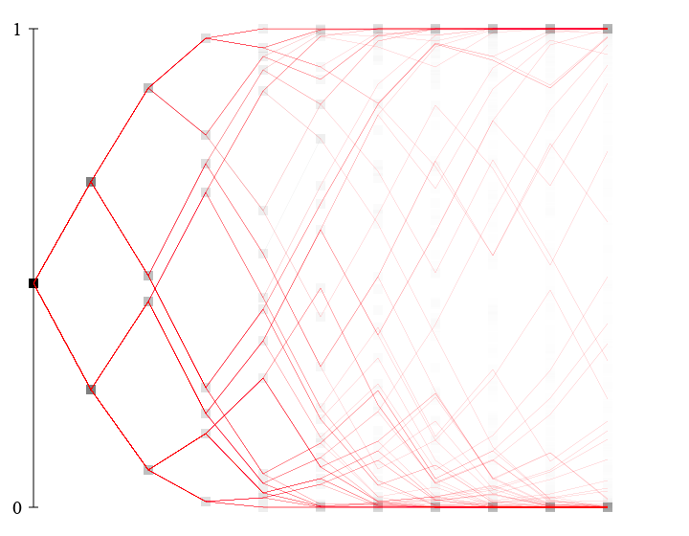
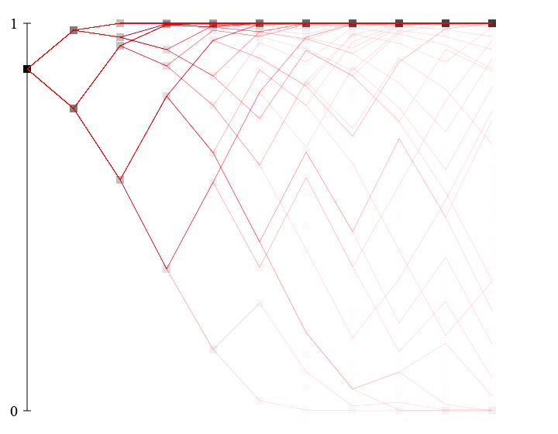
Arikan Martingale
Issues:
Local behavior – well understood
Challenge: Limiting behavior

Slide 10
Main Result: Definition and Theorem
Strong Polarization: (informally)
$$\operatorname{Pr}\left[X_{t}∈(τ,1−τ)\right]≤ε if τ=2^{−ω(t)} and ε=2^{−O(t)}$$
$$formally ∀γ>0 ∃β<1,c s.t. ∀t \operatorname{Pr}\left[X_{t}∈(γ^{t},1−γ^{t})\right]≤c⋅β^{t}$$
Local Polarization:
Variance in the middle: $X_{t}∈(τ,1−τ)$
$$∀τ>0 ∃σ>0 s.t. ∀t, X_{t}∈\left(τ,1−τ\right)⇒Var\left[X_{t+1 } | X_{t}\right]≥σ$$
Suction at the ends: $X_{t}∉\left(τ,1−τ\right)$
$$∃θ>0, ∀c<∞, ∃τ>0 s.t. X_{t}<τ⇒\operatorname{Pr}\left[X_{t+1}<\frac{X_{t}}{c} \right]≥θ$$
Theorem: Local Polarization $⇒$ Strong Polarization.
Both definitions qualitative!
“low end” condition. Similar
condition for high end

Slide 11
Proof (Idea):
Step 1: The potential $Φ_{t}≝\min\left\{\sqrt{X_{t}}, \sqrt{1−X_{t}}\right\}$ decreases by constant factor in expectation in each step.
$$⇒𝔼\left[Φ_{T}\right]=\exp\left(−T\right)⇒\operatorname{Pr}\left[X_{T}≥\exp\left(−T/2\right)\right]≤\exp\left(−T/2\right)$$
Step 2: Next $T$time steps, $X_{t}$ plummets whp
2.1: Say, If $X_{t}≤τ$ then $\operatorname{Pr}\left[X_{t+1}≤\frac{X_{t}}{100}\right]≥1/2$.
2.2: $\operatorname{Pr}\left[∃t∈\left[T,2T\right] s.t.{ X}_{t}>τ \right]≤X_{T}/τ$ [Doob]
2.3: If above doesn’t happen $X_{2T}<5^{−T} whp$
QED

Slide 12
Part III: Polar Codes Encoding, Decoding, Martingale, Polarization

Slide 13
Lesson 0: Compression $⇒$ Coding
Defn: Linear Compression Scheme:
$\left(M,D\right)$ form compression scheme for $bern{\left(p\right)}^{n}$ if
Linear map $M:𝔽_{2}^{n}→𝔽_{2}^{m}$
$\underset{Z∼bern{\left(p\right)}^{n}}{Pr}\left[D\left(M⋅Z\right)≠Z \right]=o\left(1\right)$
Hopefully $\frac{m}{n}≤H\left(p\right)+ε$
Compression $⇒$ Coding
Let $M^{⊥}$ be such that ${M⋅M}^{⊥}=0;$
Encoder: $X↦M^{⊥}⋅X$
Error-Corrector: $Y=M^{⊥}⋅X+Z↦Y−D\left(M⋅Y\right)$
$$=Y−D\left(M⋅M^{⊥}⋅X+M.Z\right)=_{w.p. 1−o(1)}M^{⊥}⋅X$$
$$M$$
$$M^{⊥}$$

Slide 14
Question: How to compress?
Arikan’s key idea:
Start with $2×2$ “Polarization Transform”:
$$\left(U,V\right)→\left(U+V,V\right)$$
Invertible – so does nothing?
If $U,V$ independent,
then $U+V$ “more random” than either
$V | U+V$ “less random” than either
Iterate (ignoring conditioning)
End with bits that are almost random, or almost determined (by others).
Output “totally random part” to get compression!

Slide 15
Iteration elaborated:
Martingale: $X_{t}≝$conditional entropy of
random output after $t$ iterations
A
A+B
A+B+C+D
B
B
C+D
C
C+D
B+D
D
D
D
E
E+F
E+F+G+H
F
F
G+H
G
G+H
F+H
H
H
H

Slide 16
The Polarization Butterfly
$$P_{n}\left(U,V\right)=\left(P_{\frac{n}{2}}\left(U+V\right),P_{\frac{n}{2}}\left(V\right)\right)$$
$$Z_{1}$$
$$Z_{1}+Z_{\frac{n}{2}+1}$$
$$W_{1}$$
Polarization $⇒∃S⊆\left[n\right]$
$$H\left(W_{\left[n\right]−S} | W_{S}\right)→0$$
$$\left|S\right|≤\left(H\left(p\right)+ε\right)⋅n$$
$$Z_{2}$$
$$Z_{2}+Z_{\frac{n}{2}+2}$$
$$W_{2}$$
$$U$$
$$Z_{\frac{n}{2}}$$
$$Z_{\frac{n}{2}}+Z_{n}$$
Compression $E\left(Z\right)=P_{n}{\left(Z\right)}_{S}$
$$W_{\frac{n}{2}}$$
$$Z_{\frac{n}{2}+1}$$
$$Z_{\frac{n}{2}+1}$$
$$W_{\frac{n}{2}+1}$$
Encoding time $=O\left(n\log{n}\right)$
(given $S$)
$$Z_{\frac{n}{2}+2}$$
$$Z_{\frac{n}{2}+2}$$
$$W_{\frac{n}{2}+2}$$
$$V$$
To be shown:
1. Decoding = $O\left(n\log{n }\right)$
2. Polarization!
$$Z_{n}$$
$$Z_{n}$$
$$W_{n}$$

Slide 17
The Polarization Butterfly: Decoding
Decoding idea:
Given $S, W_{S}=P_{n}\left(U,V\right)$
Compute $U+V∼Bern\left(2p−2p^{2}\right)$
Determine $V∼ ?$
$$Z_{1}$$
$$Z_{1}+Z_{\frac{n}{2}+1}$$
$$W_{1}$$
$$Z_{2}$$
$$Z_{2}+Z_{\frac{n}{2}+2}$$
$$W_{2}$$
$V|U+V∼\prod_{i}{Bern(r_{i})}$
$$Z_{\frac{n}{2}}$$
$$Z_{\frac{n}{2}}+Z_{n}$$
$$W_{\frac{n}{2}}$$
Key idea: Stronger induction!
- non-identical product distribution
$$Z_{\frac{n}{2}+1}$$
$$Z_{\frac{n}{2}+1}$$
$$W_{\frac{n}{2}+1}$$
Decoding Algorithm:
Given $S, W_{S}=P_{n}\left(U,V\right),p_{1},…,p_{n}$
Compute $q_{1},..q_{\frac{n}{2}}←p_{1}…p_{n}$
Determine $U+V=D\left(W_{S}^{+}, q_{1}…q_{\frac{n}{2}}\right)$
Compute $r_{1}…r_{\frac{n}{2}}←p_{1}…p_{n};U+V$
Determine $V=D\left(W_{S}^{−}, r_{1}…r_{\frac{n}{2}}\right)$
$$Z_{\frac{n}{2}+2}$$
$$Z_{\frac{n}{2}+2}$$
$$W_{\frac{n}{2}+2}$$
$$Z_{n}$$
$$Z_{n}$$
$$W_{n}$$

Slide 18
Polarization Martingale
$$Z_{1}$$
$$Z_{1}+Z_{\frac{n}{2}+1}$$
$$W_{1}$$
Idea: Follow $X_{t}= H\left(Z_{i,t} | Z_{<i,t}\right)$
for random $i$
$$Z_{2}$$
$$Z_{2}+Z_{\frac{n}{2}+2}$$
$$W_{2}$$
$$Z_{i,0}$$
$$Z_{i,1}… Z_{i,t}… Z_{i,\log{n }}$$
$$Z_{\frac{n}{2}}$$
$$Z_{\frac{n}{2}}+Z_{n}$$
$$W_{\frac{n}{2}}$$
$$Z_{\frac{n}{2}+1}$$
$$Z_{\frac{n}{2}+1}$$
$$W_{\frac{n}{2}+1}$$
$X_{t}$ Martingale!
$$Z_{\frac{n}{2}+2}$$
$$Z_{\frac{n}{2}+2}$$
$$W_{\frac{n}{2}+2}$$
Polarizes?
Strongly?
$⇐$ Locally?
$$Z_{n}$$
$$Z_{n}$$
$$W_{n}$$

Slide 19
Local Polarization of Arikan Martingale
Variance in the Middle:
Roughly: $\left(H\left(p\right),H\left(p\right)\right)→(H\left(2p−2p^{2}\right), 2H\left(p\right)−H\left(2p−2p^{2}\right)$)
$p∈\left(τ,1−τ\right)⇒2p−2p^{2}$ far from $p$
+ continuity of $H\left(⋅\right)⇒$ $H\left(2p−2p^{2}\right)$ far from $H(p)$
Suction:
High end:$H\left(\frac{1}{2}−γ\right)→H\left(\frac{1}{2}−γ^{2}\right)$
$H\left(\frac{1}{2}−γ\right)=1 −Θ\left(γ^{2}\right)⇒1−γ^{2}→1 −Θ\left(γ^{4}\right)$
Low end: $H\left(p\right)≈p\log{\frac{1}{p}};2H\left(p\right)≈2p\log{\frac{1}{p}} ;$
$H\left(2p−2p^{2}\right)≈H\left(2p\right)≈2p\log{\frac{1}{2p }}≈2H\left(p\right)−2p≈\left(2−\frac{1}{\log{\frac{1}{p} }}\right)H\left(p\right)$
Dealing with conditioning – more work (lots of Markov)

Slide 20
“New contributions”
So far: Reproduced old work (simpler proofs?)
Main new technical contributions:
Strong polarization of general transforms
E.g. $\left(U,V,W\right)→(U+V,V,W)$?
Exponentially strong polarization [BGS’18]
Suction at low end is very strong!
Random $k×k$ matrix yields $X_{t+1}≈X_{t}^{k^{.99}}$ whp
Strong polarization of Markovian sources [GNS’19?]
Separation of compression of known sources from unknown ones.

Slide 21
Conclusions
Polarization:
Important phenomenon associated with bounded random variables.
Not always bad ☹ ☺
Needs better understanding!
Recently also used in CS:
[Lovett Meka] – implicit
[Chattopadhyay-Hatami-Hosseini-Lovett] - explicit

Slide 22
Thank You!

