Slide 1

My Interests
Mainly: Reliability (in communication) (in theory)
Some Past Works:
  Error-correcting codes & List decoding
  Local testing/correcting of codes
  Communication with no prior context!
    (Talking to alien, child learning language)
  Communication with lots of (imperfectly shared) context
    This talk?
Other interests:
  Probabilistically Checkable Proofs …
  Any mathematically interesting question

Slide 2
My Interests
Mainly: Reliability (in communication) (in theory)
Some Past Works:
  Error-correcting codes & List decoding
  Local testing/correcting of codes
  Communication with no prior context!
    (Talking to alien, child learning language)
  Communication with lots of (imperfectly shared) context
    This talk?
Other interests:
  Probabilistically Checkable Proofs …
  Any mathematically interesting question
#Errors overwhelm information
Massive data; need to recover 1 bit

Slide 3
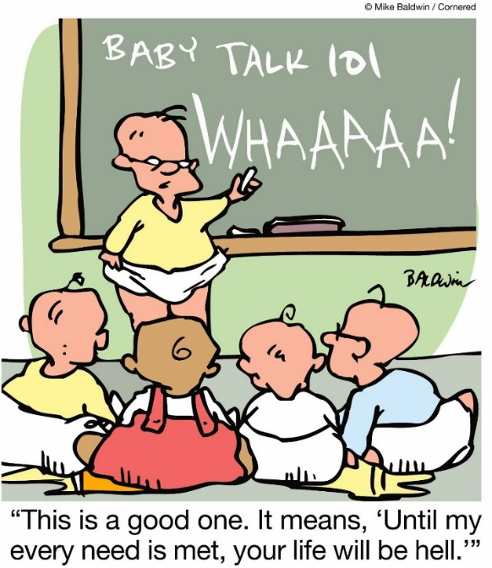
My Interests
Mainly: Reliability (in communication) (in theory)
Some Past Works:
  Error-correcting codes & List decoding
  Local testing/correcting of codes
  Communication with no prior context!
    (Talking to alien, child learning language)
  Communication with lots of (imperfectly shared) context
    This talk?
Other interests:
  Probabilistically Checkable Proofs …
  Any mathematically interesting question
#Errors overwhelm information
Massive data; need to recover 1 bit

Slide 4
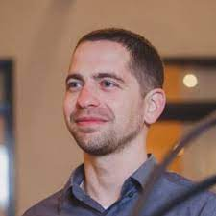
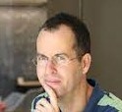
A Current Interest
Aggregation of Information/Errors: [Ben-Eliezer,Mossel,S’21]
  Underlying issue: Knowledge is cumulative … but error-prone.
  How does latter affect former?
  Needs error-correction (else almost everything erroneous).
    Information spread model?
    Errors?
    Correction?

Slide 5

Aside/Poll
What fraction of papers in math journals have an error (in thm/lemma)
  If you think:
    $≤5\%$ : Raise Hand
    $≥30\%$ : Cross Hands (X/No on zoom)

Slide 6
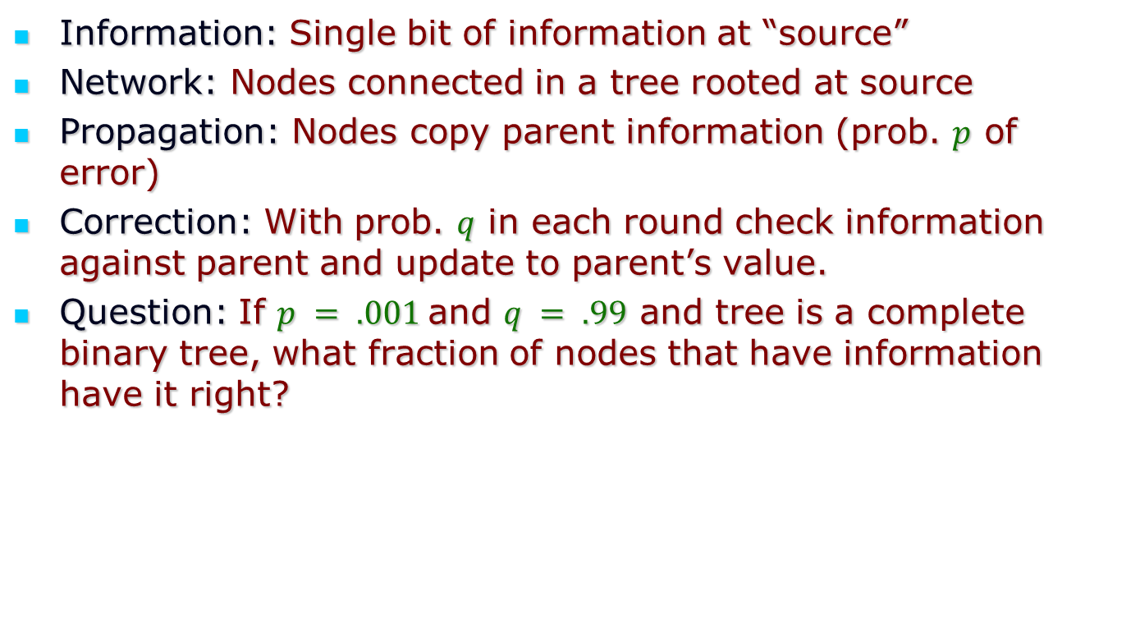
A baby model (Inf. Prop.+Errors)
Information: Single bit of information at “source”
Network: Nodes connected in a tree rooted at source
Propagation: Nodes copy parent information (prob. $p$ of error)
Correction: With prob. $q$ in each round check information against parent and update to parent’s value.
Question: If $p = .001$and $q = .99$ and tree is a complete binary tree, what fraction of nodes that have information have it right?

Slide 7
Some proofs/pictures (TBDrawn)

