Slide 1

Streaming & Sketching CSPs
Madhu Sudan
Harvard University
Based on joint works with Chi-Ning Chou, Alexander Golovnev, Noah Singer, Ameya Velingker and Santhoshini Velusamy.

Slide 2
This Talk
CSPs (& approximation & streaming/sketching)
Our results
Some Proof Ideas

Slide 3
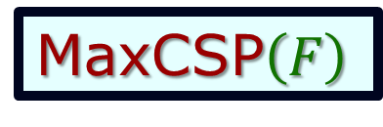
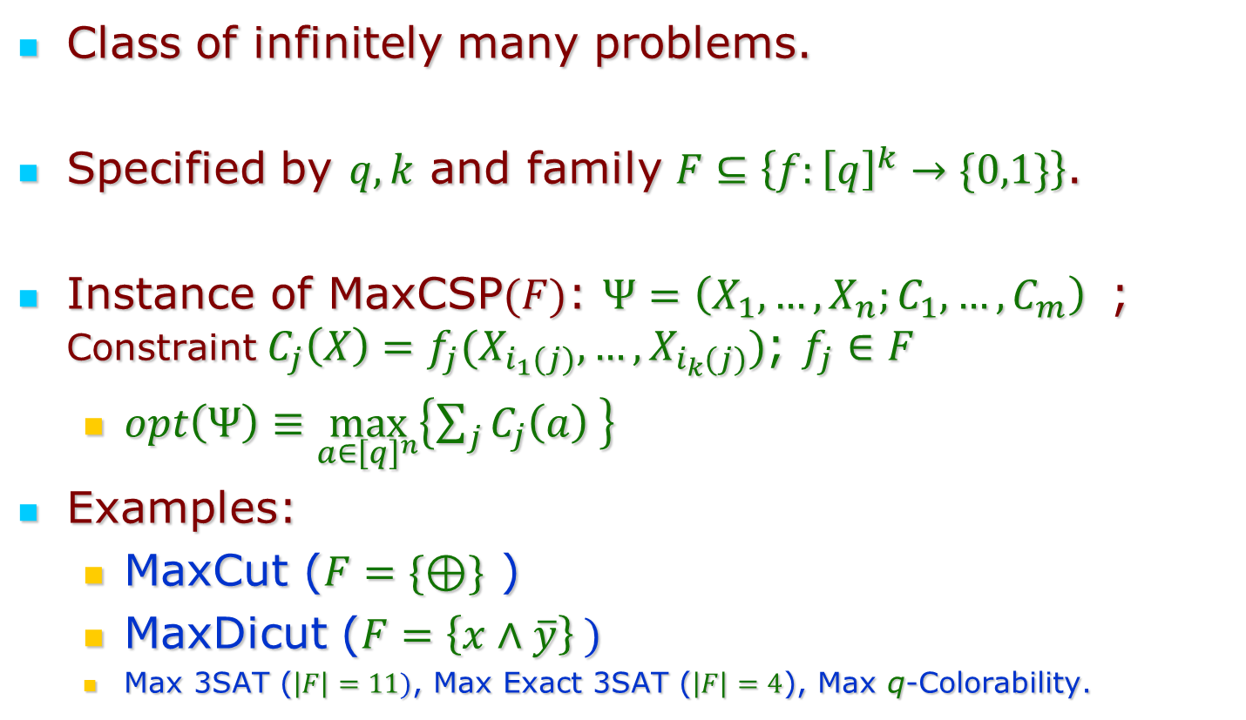
Constraint Satisfaction Problems (CSPs)
MaxCSP$\left(F\right)$
Class of infinitely many problems.
Specified by $q,k$ and family $F⊆\left\{f:{\left[q\right]}^{k}→\{0,1\}\right\}$.
Instance of MaxCSP$(F)$: $Ψ=\left(X_{1},…,X_{n};C_{1},…,C_{m}\right)$ ; Constraint $C_{j}\left(X\right)=f_{j}(X_{i_{1}(j)},…,X_{i_{k}(j)})$; $f_{j}∈F$
  $opt\left(Ψ\right)≡\max_{a∈{\left[q\right]}^{n}}\left\{\sum_{j}{C_{j}\left(a\right) }\right\}$
Examples:
  MaxCut ($F=\{⊕\}$ )
  MaxDicut ($F=\left\{x∧\overline{y}\right\} )$
  Max 3SAT ($\left|F\right|=11)$, Max Exact 3SAT ($\left|F\right|=4$), Max q-Colorability.

Slide 4
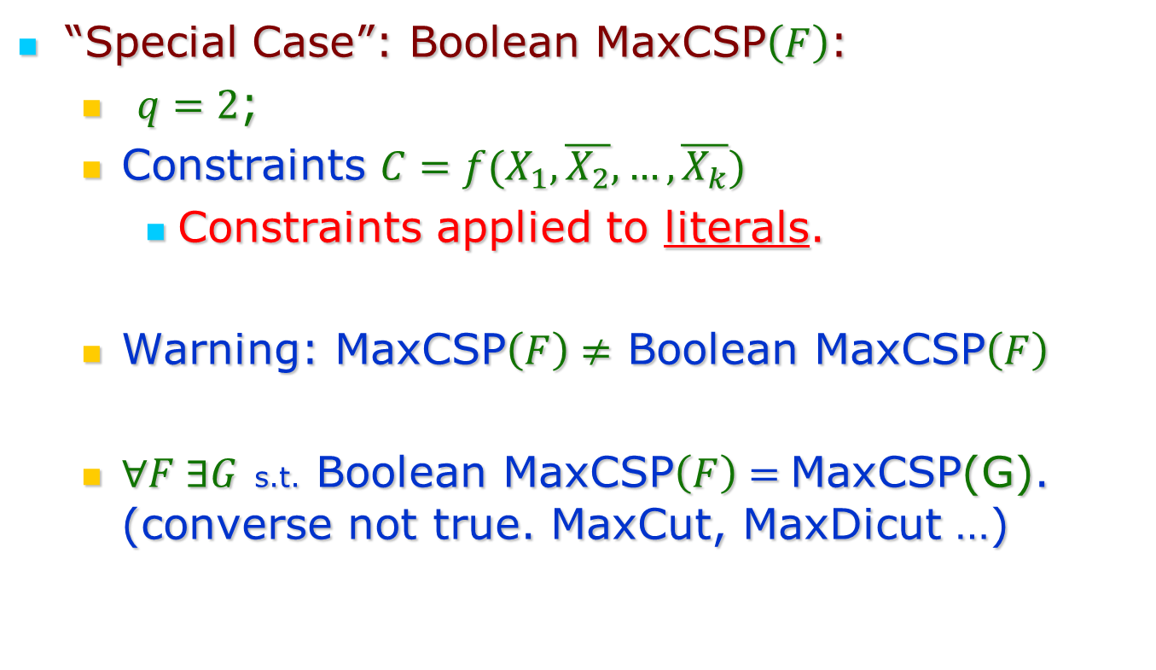
Constraint Satisfaction Problems (CSPs)
“Special Case”: Boolean MaxCSP$\left(F\right)$:
  $q=2$;
  Constraints $C=f(X_{1},\overline{X_{2}},…,\overline{X_{k}})$
    Constraints applied to literals.
  Warning: MaxCSP$\left(F\right)≠$ Boolean MaxCSP$\left(F\right)$
  $∀F ∃G$ s.t. Boolean MaxCSP$\left(F\right)=$MaxCSP(G). (converse not true. MaxCut, MaxDicut …)

Slide 5
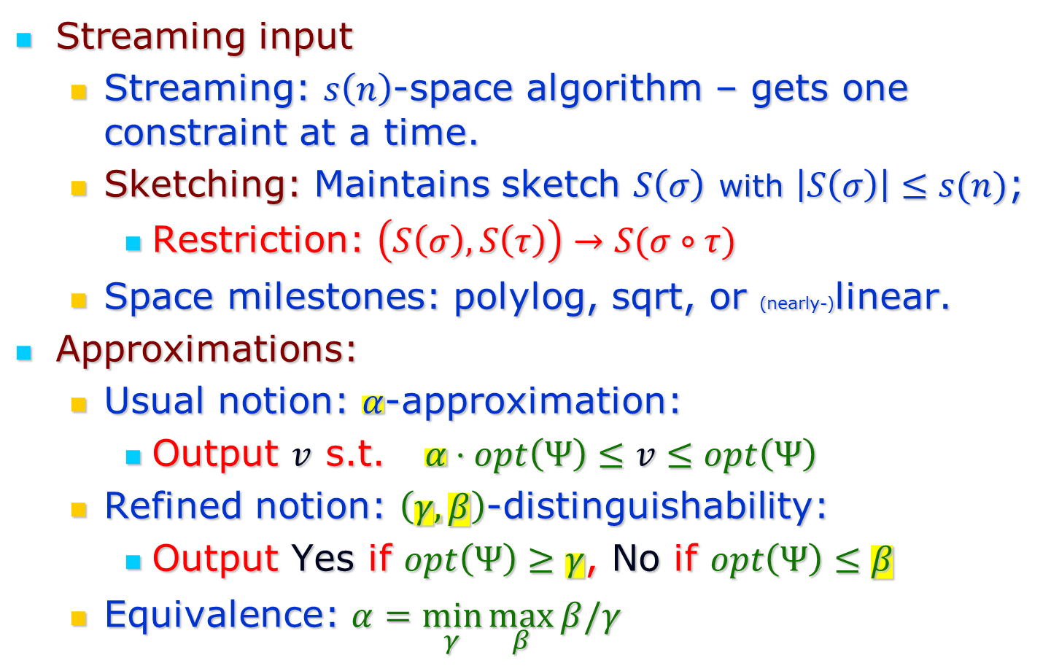
Streaming & Approximation
Streaming input
  Streaming: $s\left(n\right)$-space algorithm – gets one constraint at a time.
  Sketching: Maintains sketch $S\left(σ\right)$ with $\left|S\left(σ\right)\right|≤s(n)$;
    Restriction: $\left(S\left(σ\right), S\left(τ\right)\right)→S(σ∘τ)$
  Space milestones: polylog, sqrt, or (nearly-)linear.
Approximations:
  Usual notion: $α$-approximation:
    Output $v$ s.t. $α⋅opt\left(Ψ\right)≤v≤opt\left(Ψ\right)$
  Refined notion: $\left(γ,β\right)$-distinguishability:
    Output Yes if $opt\left(Ψ\right)≥γ$, No if $opt\left(Ψ\right)≤β$
  Equivalence: $α=\min_{γ}{\max_{β}{β/γ}}$

Slide 6
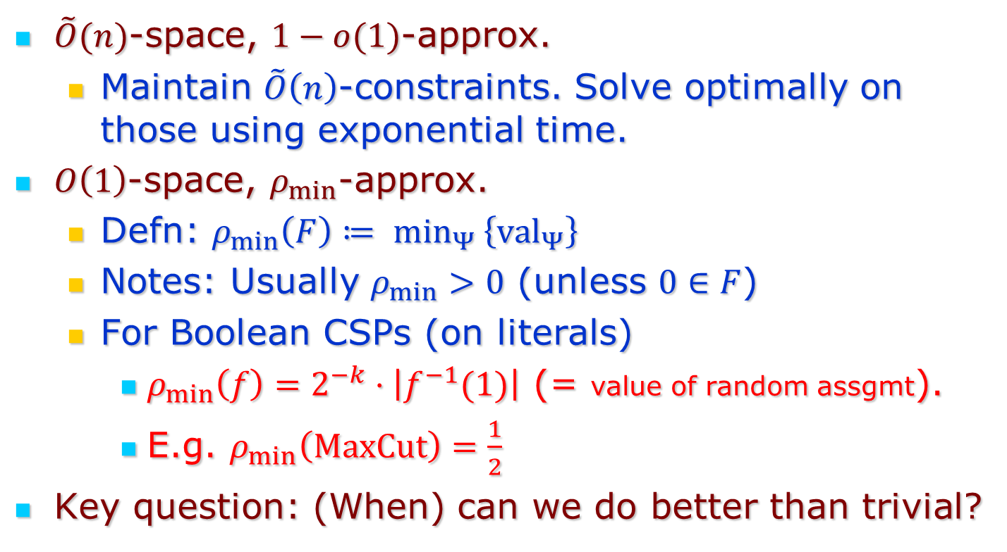
Trivial Approximations:
$\tilde{O}(n)$-space, $1−o(1)$-approx.
  Maintain $\tilde{O}\left(n\right)$-constraints. Solve optimally on those using exponential time.
$O\left(1\right)$-space, $ρ_{min}$-approx.
  Defn: $ρ_{min}\left(F\right)≔ \min_{Ψ}\left\{{val}_{Ψ}\right\}$
  Notes: Usually $ρ_{min}>0$ (unless $0∈F$)
  For Boolean CSPs (on literals)
    $ρ_{min}\left(f\right)=2^{−k}⋅\left|f^{−1}(1)\right|$ (= value of random assgmt).
    E.g. $ρ_{min}\left(MaxCut\right)=\frac{1}{2}$
Key question: (When) can we do better than trivial?

Slide 7
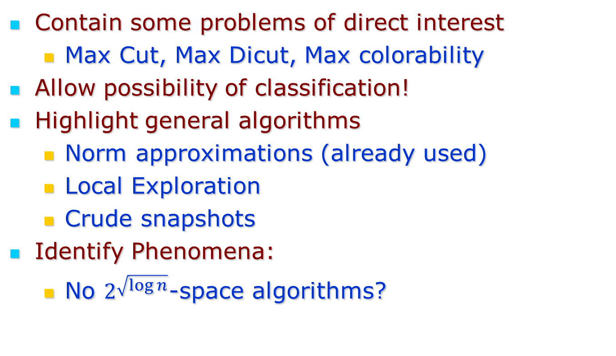
Why study CSPs
Contain some problems of direct interest
  Max Cut, Max Dicut, Max colorability
Allow possibility of classification!
Highlight general algorithms
  Norm approximations (already used)
  Local Exploration
  Crude snapshots
Identify Phenomena:
  No $2^{\sqrt{\log{n}}}$-space algorithms?

Slide 8
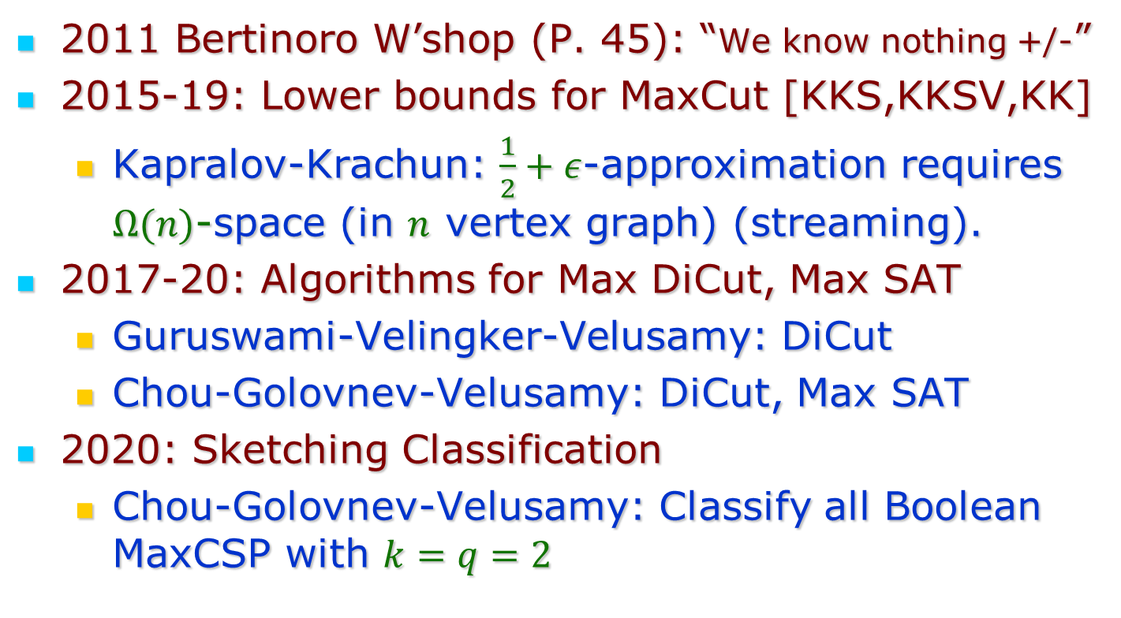
Brief History
2011 Bertinoro W’shop (P. 45): “We know nothing +/-”
2015-19: Lower bounds for MaxCut [KKS,KKSV,KK]
  Kapralov-Krachun: $\frac{1}{2}+ε$-approximation requires $Ω(n)$-space (in $n$ vertex graph) (streaming).
2017-20: Algorithms for Max DiCut, Max SAT
  Guruswami-Velingker-Velusamy: DiCut
  Chou-Golovnev-Velusamy: DiCut, Max SAT
2020: Sketching Classification
  Chou-Golovnev-Velusamy: Classify all Boolean MaxCSP with $k=q=2$

Slide 9
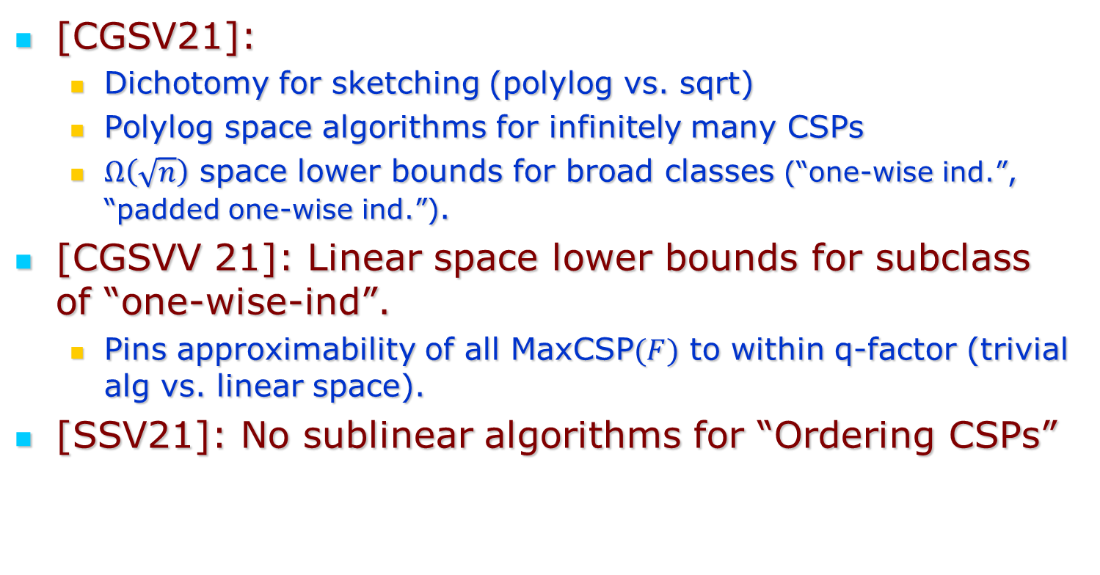
Our Results
[CGSV21]:
  Dichotomy for sketching (polylog vs. sqrt)
  Polylog space algorithms for infinitely many CSPs
  $Ω\left(\sqrt{n}\right)$ space lower bounds for broad classes (“one-wise ind.”, “padded one-wise ind.”).
[CGSVV 21]: Linear space lower bounds for subclass of “one-wise-ind”.
  Pins approximability of all MaxCSP$(F)$ to within q-factor (trivial alg vs. linear space).
[SSV21]: No sublinear algorithms for “Ordering CSPs”

Slide 10
Proof Ideas

Slide 11
Streaming MaxCut

Slide 12
Streaming MaxCut

Slide 13
Streaming MaxCut

Slide 14
Streaming MaxCut

Slide 15
Streaming MaxCut

Slide 16
Streaming MaxCut

Slide 17
Streaming MaxCut

Slide 18
Streaming MaxCut

Slide 19
Streaming MaxCut

Slide 20
Streaming MaxCut

Slide 21
Streaming MaxCut

Slide 22
Streaming MaxCut

Slide 23
Streaming MaxCut

Slide 24
Streaming MaxCut

Slide 25
Streaming MaxCut

Slide 26
Streaming MaxCut

Slide 27
Streaming MaxCut

Slide 28
Streaming MaxCut

Slide 29
Streaming MaxCut

Slide 30
Streaming MaxCut

Slide 31
Streaming MaxCut

Slide 32
Streaming MaxCut

Slide 33
Streaming MaxCut

Slide 34
Streaming MaxCut

Slide 35
Streaming MaxCut

Slide 36
Streaming MaxCut

Slide 37
Streaming MaxCut

Slide 38
Streaming MaxCut

Slide 39
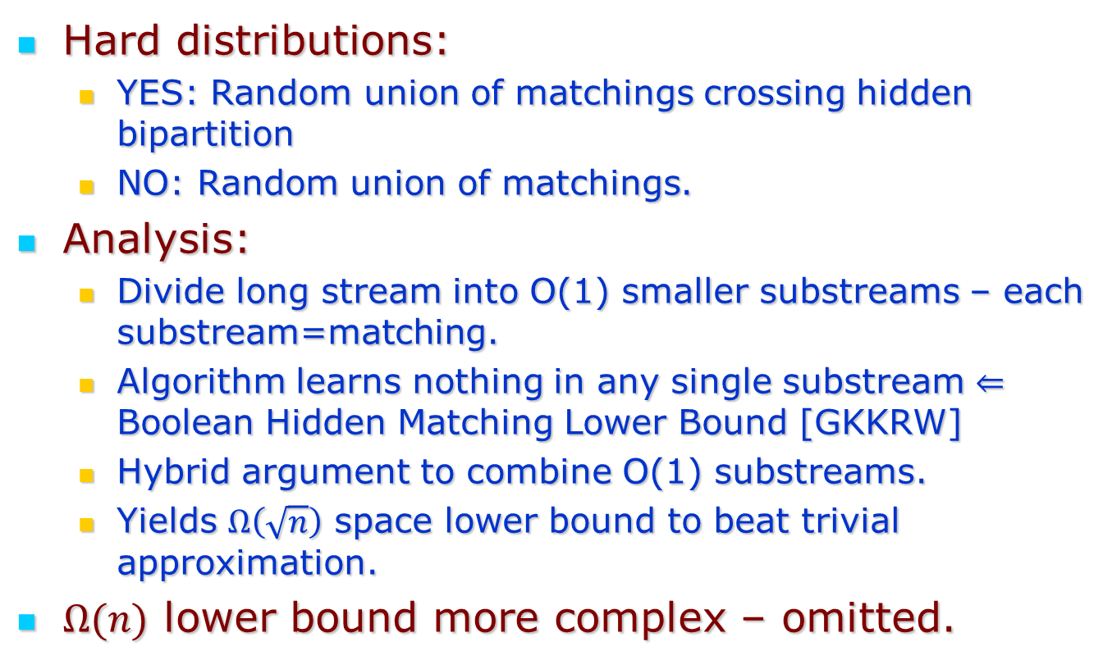
Max Cut Lower Bound
Hard distributions:
  YES: Random union of matchings crossing hidden bipartition
  NO: Random union of matchings.
Analysis:
  Divide long stream into O(1) smaller substreams – each substream=matching.
  Algorithm learns nothing in any single substream $⇐$ Boolean Hidden Matching Lower Bound [GKKRW]
  Hybrid argument to combine O(1) substreams.
  Yields $Ω\left(\sqrt{n}\right)$ space lower bound to beat trivial approximation.
$Ω(n)$ lower bound more complex – omitted.

Slide 40
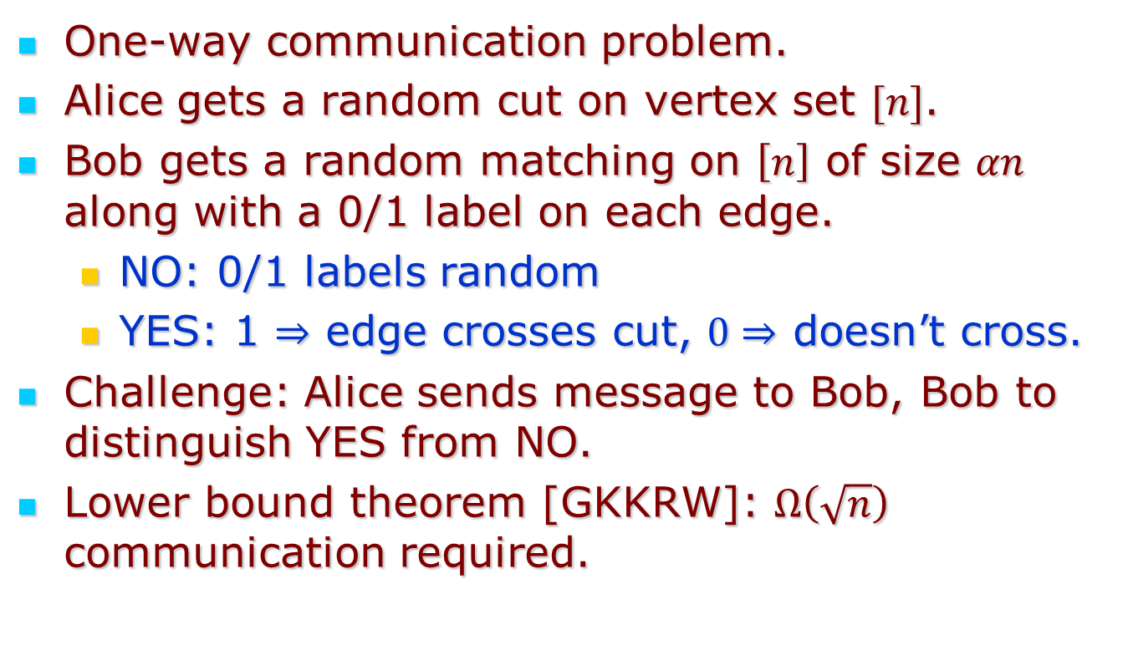
Boolean Hidden Matching Problem
One-way communication problem.
Alice gets a random cut on vertex set $[n]$.
Bob gets a random matching on $\left[n\right]$ of size $αn$ along with a 0/1 label on each edge.
  NO: 0/1 labels random
  YES: 1 $⇒$ edge crosses cut, $0⇒$ doesn’t cross.
Challenge: Alice sends message to Bob, Bob to distinguish YES from NO.
Lower bound theorem [GKKRW]: $Ω\left(\sqrt{n}\right)$ communication required.

Slide 41
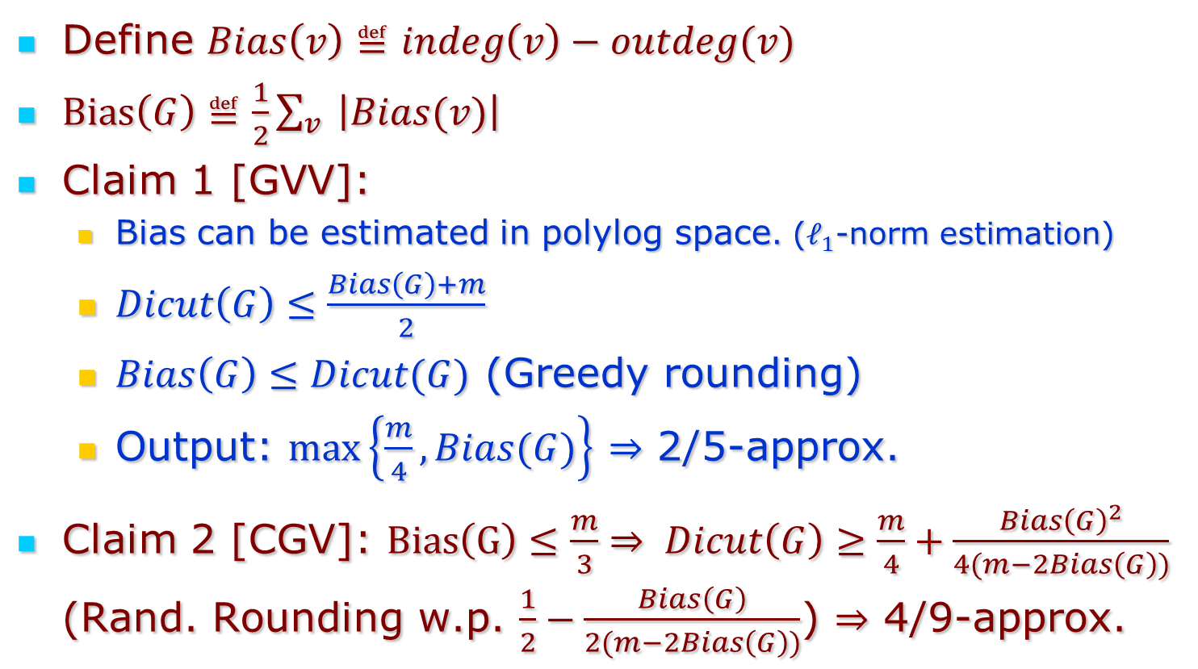
GVV+CGV Algorithms for Max DiCut
Define $Bias\left(v\right)≝indeg\left(v\right)−outdeg(v)$
$Bias\left(G\right)≝\frac{1}{2}\sum_{v}{ \left|Bias(v)\right|}$
Claim 1 [GVV]:
  Bias can be estimated in polylog space. ($ℓ_{1}$-norm estimation)
  $Dicut\left(G\right)≤\frac{Bias\left(G\right)+m}{2}$
  $Bias\left(G\right)≤Dicut(G)$ (Greedy rounding)
  Output: $\max\left\{\frac{m}{4},Bias(G)\right\}$ $⇒$ 2/5-approx.
Claim 2 [CGV]: $Bias\left(G\right)≤\frac{m}{3}⇒ Dicut\left(G\right)≥\frac{m}{4}+\frac{Bias{\left(G\right)}^{2}}{4(m−2Bias\left(G\right))}$ (Rand. Rounding w.p. $\frac{1}{2}−\frac{Bias\left(G\right)}{2(m−2Bias\left(G\right))}$) $⇒$ 4/9-approx.

Slide 42
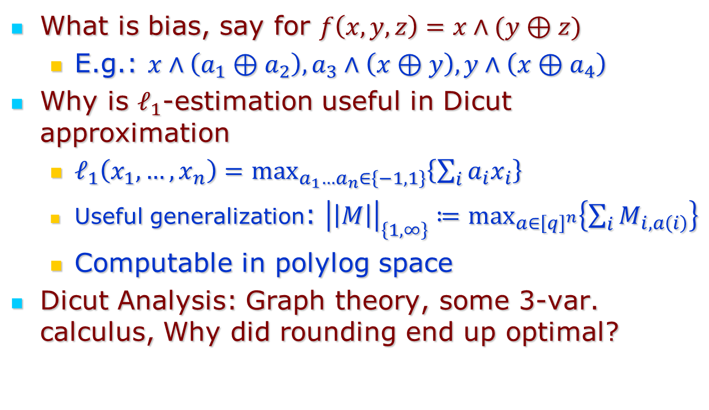
Generalizing to other CSPs: Challenges
What is bias, say for $f\left(x,y,z\right)=x∧(y⊕z)$
  E.g.: $x∧\left(a_{1}⊕a_{2}\right), a_{3}∧\left(x⊕y\right), y∧\left(x⊕a_{4}\right)$
Why is $ℓ_{1}$-estimation useful in Dicut approximation
  $ℓ_{1}\left(x_{1},…,x_{n}\right)=\max_{a_{1}…a_{n}∈\left\{−1,1\right\}}\left\{\sum_{i}{a_{i}x_{i}}\right\}$
  Useful generalization: ${\left|\left|M\right|\right|}_{\left\{1,∞\right\}}≔\max_{a∈{\left[q\right]}^{n}}\left\{\sum_{i}{M_{i,a\left(i\right)}}\right\}$
  Computable in polylog space
Dicut Analysis: Graph theory, some 3-var. calculus, Why did rounding end up optimal?

Slide 43
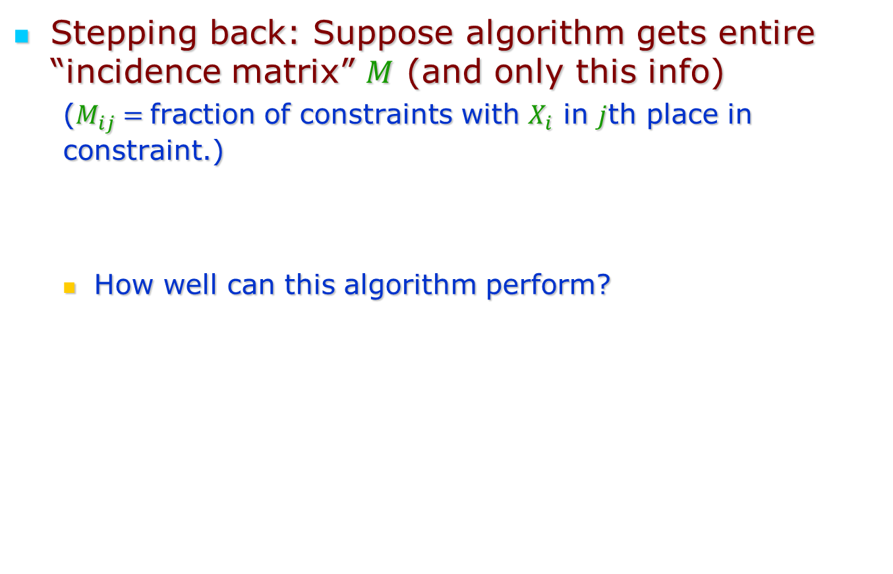
Dichotomy for Sketching
Stepping back: Suppose algorithm gets entire “incidence matrix” $M$ (and only this info)
  ($M_{ij}=$fraction of constraints with $X_{i}$ in $j$th place in constraint.)
  How well can this algorithm perform?

Slide 44
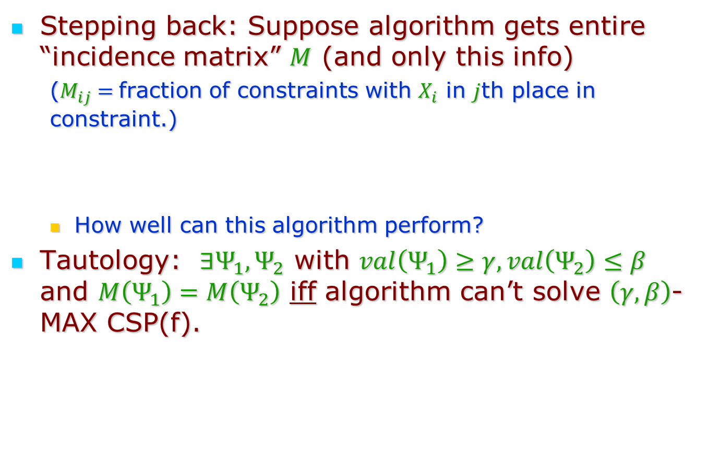
Dichotomy for Sketching
Stepping back: Suppose algorithm gets entire “incidence matrix” $M$ (and only this info)
  ($M_{ij}=$fraction of constraints with $X_{i}$ in $j$th place in constraint.)
  How well can this algorithm perform?
Tautology: $∃Ψ_{1},Ψ_{2}$ with $val\left(Ψ_{1}\right)≥γ, val\left(Ψ_{2}\right)≤β$ and $M\left(Ψ_{1}\right)=M\left(Ψ_{2}\right)$ iff algorithm can’t solve $\left(γ,β\right)$-MAX CSP(f).

Slide 45
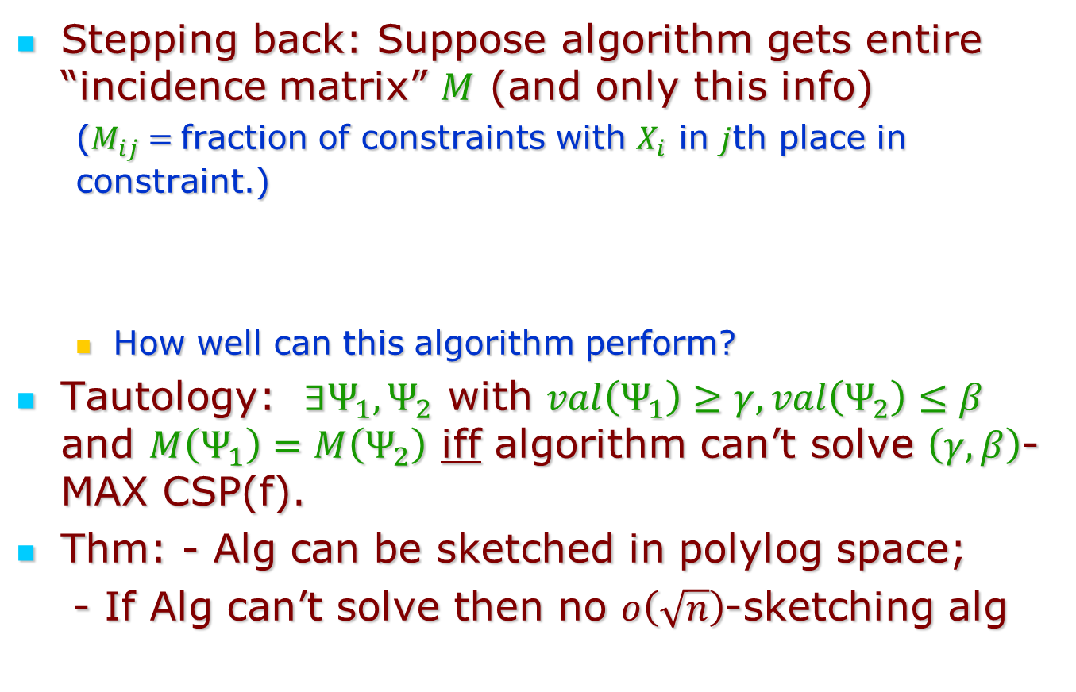
Dichotomy for Sketching
Stepping back: Suppose algorithm gets entire “incidence matrix” $M$ (and only this info)
  ($M_{ij}=$fraction of constraints with $X_{i}$ in $j$th place in constraint.)
  How well can this algorithm perform?
Tautology: $∃Ψ_{1},Ψ_{2}$ with $val\left(Ψ_{1}\right)≥γ, val\left(Ψ_{2}\right)≤β$ and $M\left(Ψ_{1}\right)=M\left(Ψ_{2}\right)$ iff algorithm can’t solve $\left(γ,β\right)$-MAX CSP(f).
Thm: - Alg can be sketched in polylog space;
- If Alg can’t solve then no $o\left(\sqrt{n}\right)$-sketching alg

Slide 46
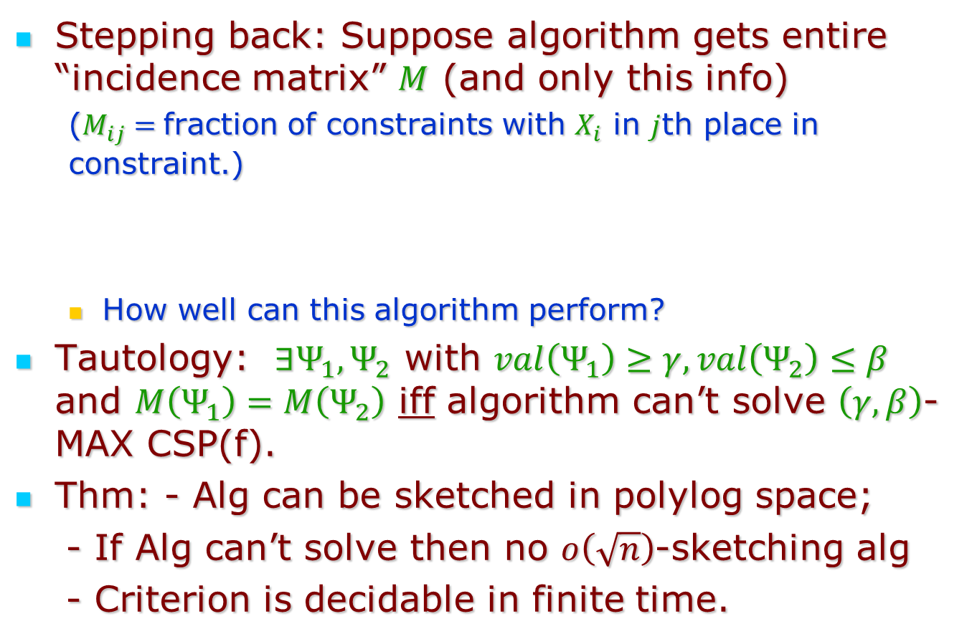
Dichotomy for Sketching
Stepping back: Suppose algorithm gets entire “incidence matrix” $M$ (and only this info)
  ($M_{ij}=$fraction of constraints with $X_{i}$ in $j$th place in constraint.)
  How well can this algorithm perform?
Tautology: $∃Ψ_{1},Ψ_{2}$ with $val\left(Ψ_{1}\right)≥γ, val\left(Ψ_{2}\right)≤β$ and $M\left(Ψ_{1}\right)=M\left(Ψ_{2}\right)$ iff algorithm can’t solve $\left(γ,β\right)$-MAX CSP(f).
Thm: - Alg can be sketched in polylog space;
- If Alg can’t solve then no $o\left(\sqrt{n}\right)$-sketching alg
- Criterion is decidable in finite time.

Slide 47
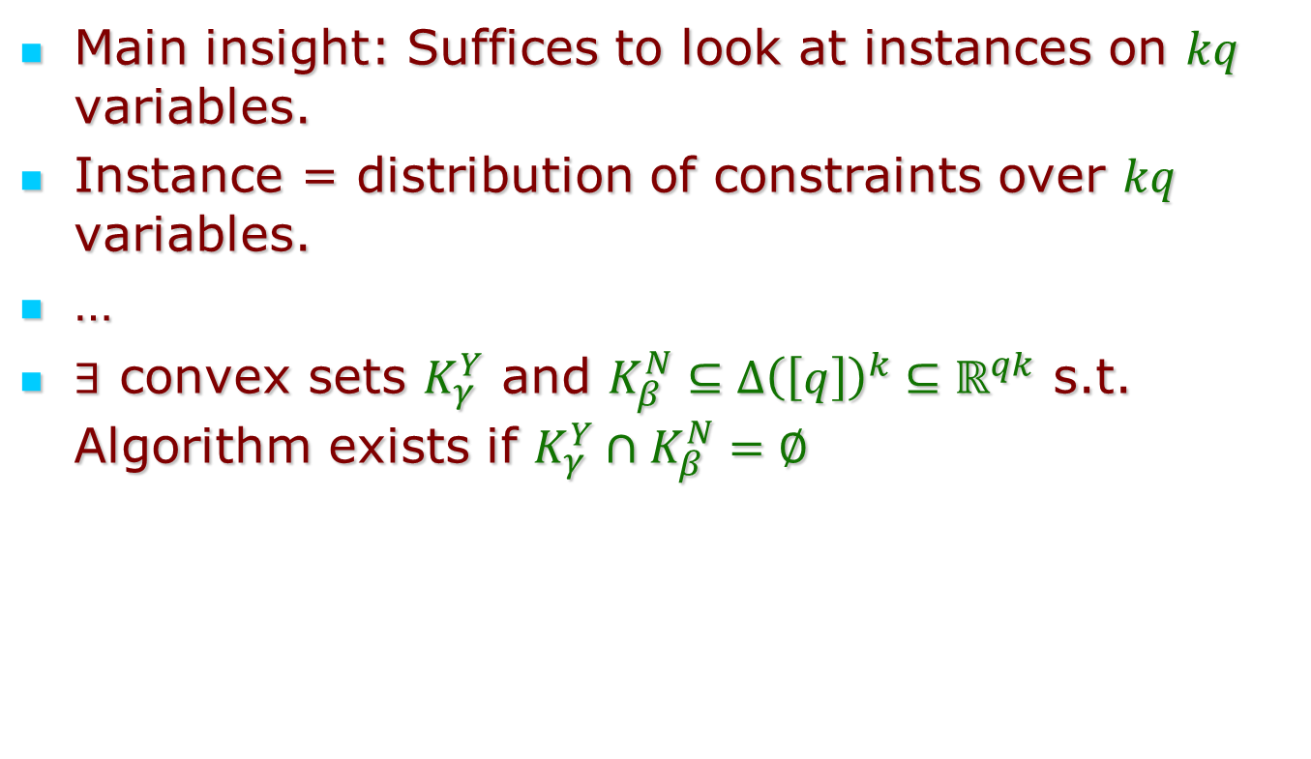
Decidability & Criterion
Main insight: Suffices to look at instances on $kq$ variables.
Instance = distribution of constraints over $kq$ variables.
…
$∃$ convex sets $K_{γ}^{Y}$ and $K_{β}^{N}⊆Δ{\left(\left[q\right]\right)}^{k}⊆ℝ^{qk}$ s.t. Algorithm exists if $K_{γ}^{Y}∩K_{β}^{N}=∅$

Slide 48

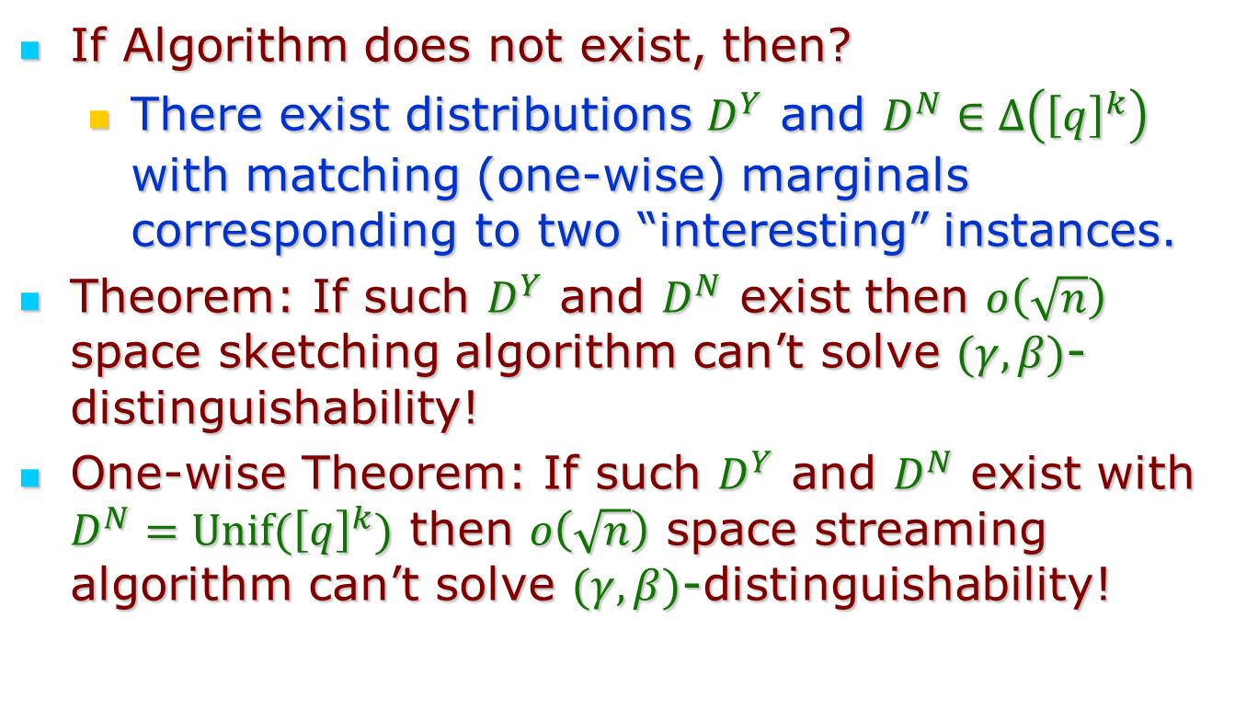
Complexity?
If Algorithm does not exist, then?
  There exist distributions $D^{Y}$ and $D^{N}∈Δ\left({\left[q\right]}^{k}\right)$ with matching (one-wise) marginals corresponding to two “interesting” instances.
Theorem: If such $D^{Y}$ and $D^{N}$ exist then $o\left(\sqrt{n}\right)$ space sketching algorithm can’t solve $(γ,β)$-distinguishability!
One-wise Theorem: If such $D^{Y}$ and $D^{N}$ exist with $D^{N}=Unif({\left[q\right]}^{k})$ then $o\left(\sqrt{n}\right)$ space streaming algorithm can’t solve $(γ,β)$-distinguishability!
Extends to Padded One Wise (k=q=2):
$D^{Y}=τD_{0}+{\left(1−τ\right)D}_{1};D^{N}=τD_{0}+\left(1−τ\right)Unif({\left[q\right]}^{k})$

Slide 49
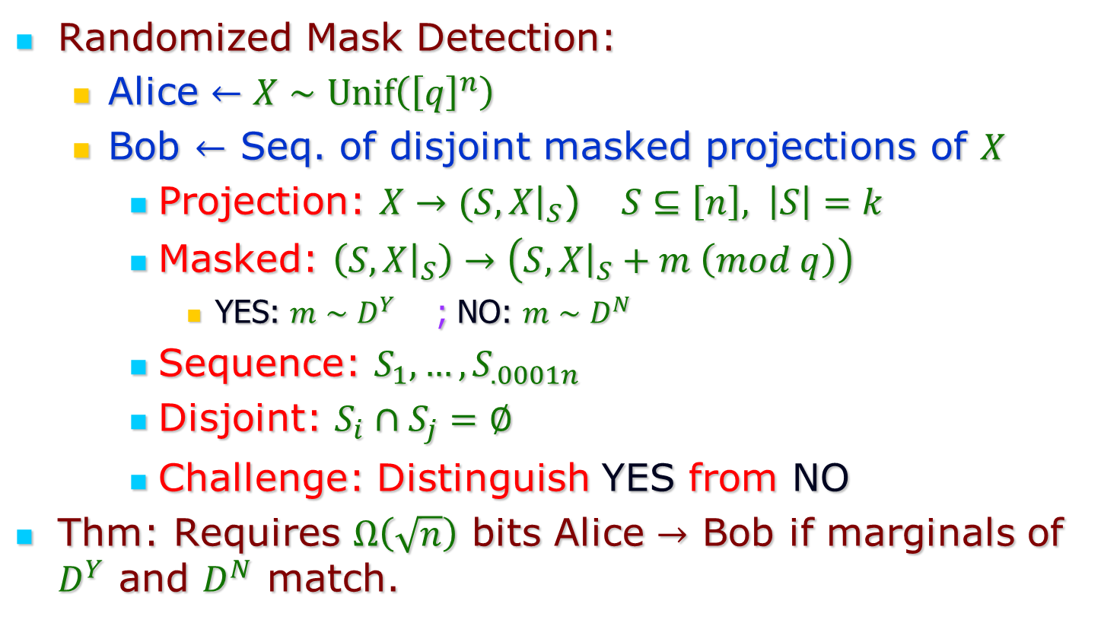
Underlying Communication Problem
Randomized Mask Detection:
  Alice $←X∼Unif\left({\left[q\right]}^{n}\right)$
  Bob $←$ Seq. of disjoint masked projections of $X$
    Projection: $X→(S,X{\left.​\right|}_{S}$) $S⊆\left[n\right], \left|S\right|=k$
    Masked: $\left(S,X{\left.​\right|}_{S}\right)→\left(S, X{\left.​\right|}_{S}+m \left(mod q\right)\right)$
      YES: $m∼D^{Y}$ ; NO: $m∼D^{N}$
    Sequence: $S_{1},…,S_{.0001n}$
    Disjoint: $S_{i}∩S_{j}=∅$
    Challenge: Distinguish YES from NO
Thm: Requires $Ω\left(\sqrt{n}\right)$ bits Alice $→$ Bob if marginals of $D^{Y}$ and $D^{N}$ match.

Slide 50
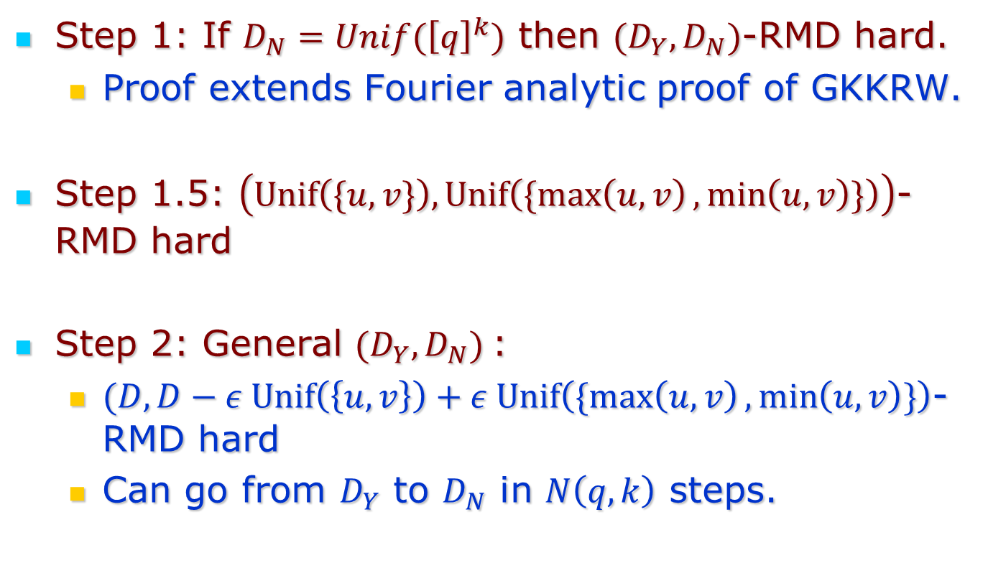
Proof ingredients
Step 1: If $D_{N}=Unif({\left[q\right]}^{k})$ then $(D_{Y},D_{N})$-RMD hard.
  Proof extends Fourier analytic proof of GKKRW.
Step 1.5: $\left(Unif\left(\{u,v\}\right), Unif\left(\{\max\left(u,v\right),\min\left(u,v\right)\}\right)\right)$-RMD hard
Step 2: General ${(D_{Y},D}_{N})$:
  $(D,D−ε Unif\left(\left\{u,v\right\}\right)+ε Unif\left(\{\max\left(u,v\right),\min\left(u,v\right)\}\right)$-RMD hard
  Can go from $D_{Y}$ to $D_{N}$ in $N\left(q,k\right)$ steps.

Slide 51
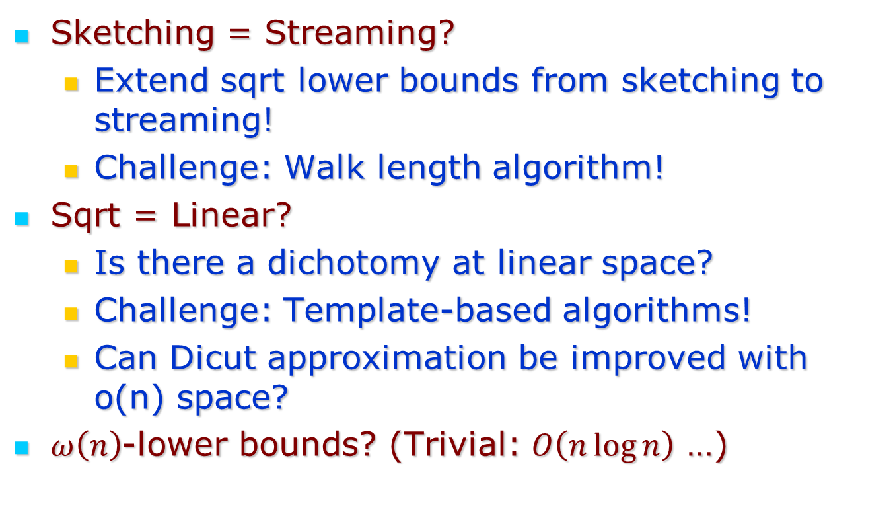
Open Questions
Sketching = Streaming?
  Extend sqrt lower bounds from sketching to streaming!
  Challenge: Walk length algorithm!
Sqrt = Linear?
  Is there a dichotomy at linear space?
  Challenge: Template-based algorithms!
  Can Dicut approximation be improved with o(n) space?
$ω\left(n\right)$-lower bounds? (Trivial: $O\left(n\log{n}\right)$ …)

Slide 52
Thank You!

Slide 53
Additional Slides

Slide 54
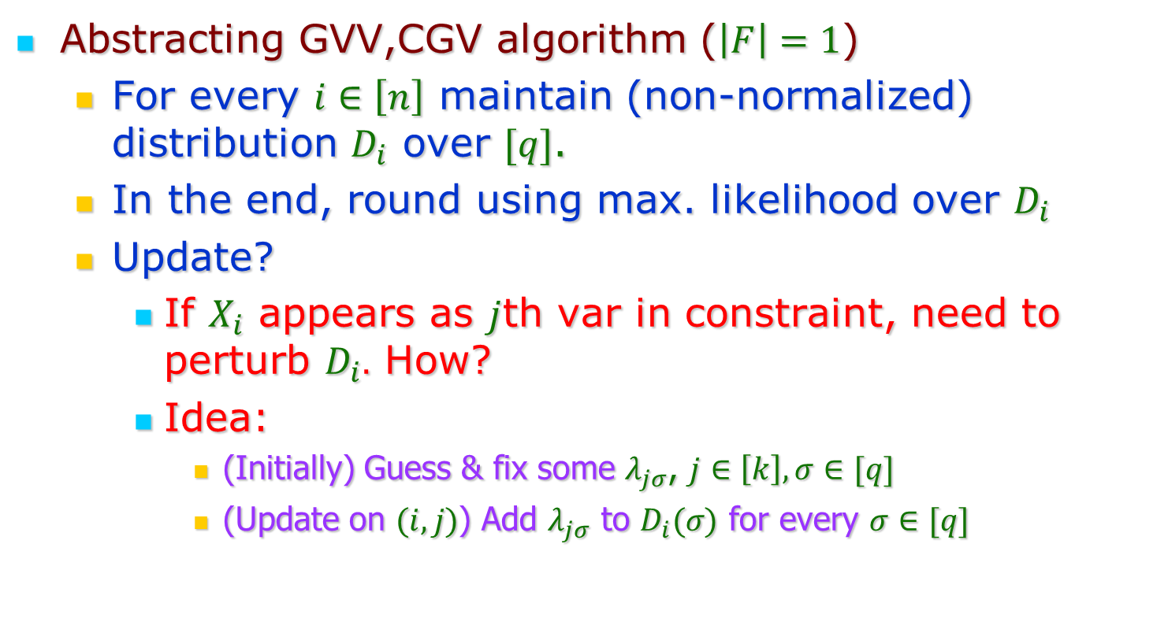
Algorithms - 1
Abstracting GVV,CGV algorithm ($\left|F\right|=1$)
  For every $i∈\left[n\right]$ maintain (non-normalized) distribution $D_{i}$ over $[q]$.
  In the end, round using max. likelihood over $D_{i}$
  Update?
    If $X_{i}$ appears as $j$th var in constraint, need to perturb $D_{i}.$ How?
    Idea:
      (Initially) Guess & fix some $λ_{jσ}$, $j∈\left[k\right], σ∈[q]$
      (Update on $(i,j)$) Add $λ_{jσ}$ to $D_{i}(σ)$ for every $σ∈[q]$

Slide 55
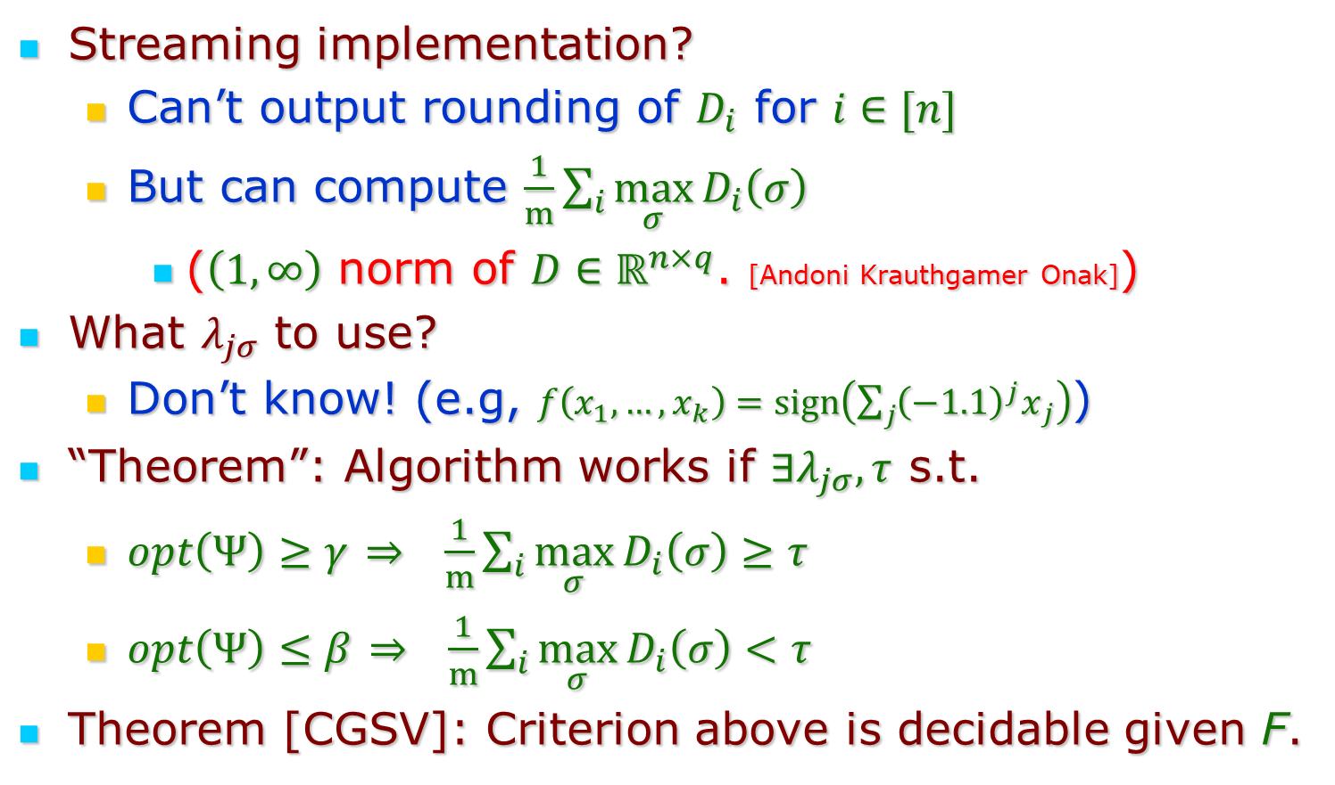
Algorithms - 2
Streaming implementation?
  Can’t output rounding of $D_{i}$ for $i∈[n]$
  But can compute $\frac{1}{m}\sum_{i}{\max_{σ}{D_{i}\left(σ\right)}}$
    ($\left(1,∞\right)$ norm of $D∈ℝ^{n×q}$. [Andoni Krauthgamer Onak])
What $λ_{jσ}$ to use?
  Don’t know! (e.g, $f\left(x_{1},…,x_{k}\right)=sign\left(\sum_{j}{{{\left(−1.1\right)}^{j}x}_{j}}\right)$)
“Theorem”: Algorithm works if $∃λ_{jσ}, τ$ s.t.
  $opt\left(Ψ\right)≥γ$ $⇒$ $\frac{1}{m}\sum_{i}{\max_{σ}{D_{i}\left(σ\right)}≥τ}$
  $opt\left(Ψ\right)≤β$ $⇒$ $\frac{1}{m}\sum_{i}{\max_{σ}{D_{i}\left(σ\right)}<τ}$
Theorem [CGSV]: Criterion above is decidable given F.

Slide 56

Open Questions
Sketching = Streaming in sqrt setting?
  Extend sqrt lower bounds from sketching to streaming!
  Challenge: Walk length algorithm!
(Suggested by Saxena et al.)
Walk length algorithm:
For every pattern $→←←…→$
Pick $S⊂\left[n\right], \left|S\right|=polylog(n)$
Follow patterned path from $S$ till
we run out of stream.
Look at the distribution of path
lengths when we stop.
Different for $opt≥γ$ vs. $opt≤β$?

Slide 57
Open Questions
Sketching = Streaming in sqrt setting?
  Extend sqrt lower bounds from sketching to streaming!
  Challenge: Walk length algorithm!
Sqrt = Linear?
  Is there a dichotomy at linear space?
  Challenge: Template-based algorithms!
  Can Dicut approximation be improved with o(n) space?

Slide 58
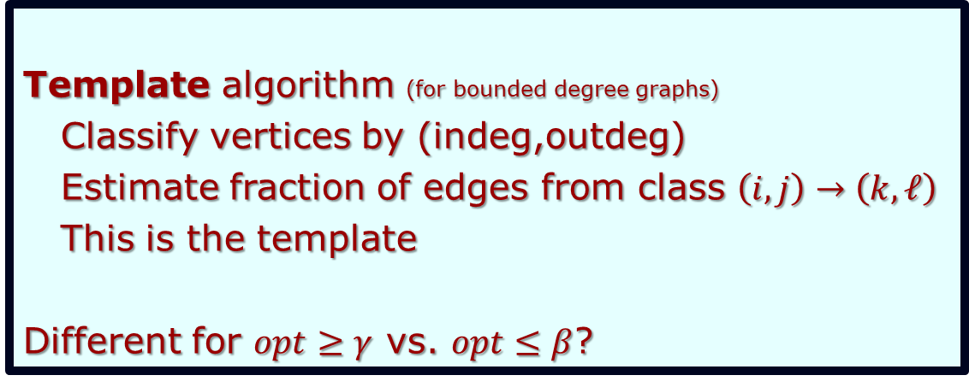
Open Questions
Sketching = Streaming?
  Extend sqrt lower bounds from sketching to streaming!
  Challenge: Walk length algorithm!
Sqrt = Linear?
  Is there a dichotomy at linear space?
  Challenge: Template-based algorithms!
  Can Dicut approximation be improved with o(n) space?
Template algorithm (for bounded degree graphs)
Classify vertices by (indeg,outdeg)
Estimate fraction of edges from class $\left(i,j\right)→\left(k,ℓ\right)$
This is the template
Different for $opt≥γ$ vs. $opt≤β$?

Slide 59
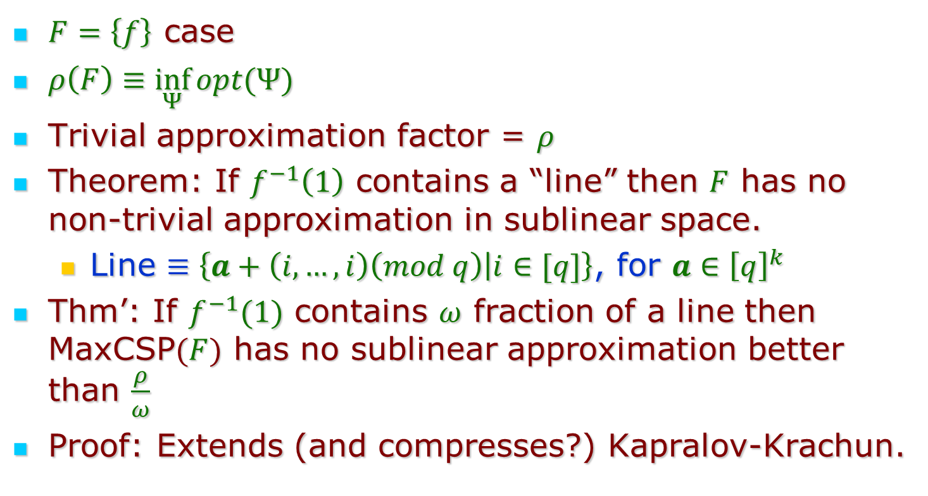
Linear Space Lower Bounds
$F=\left\{f\right\}$ case
$ρ\left(F\right)≡\inf_{Ψ}{opt(Ψ)}$
Trivial approximation factor = $ρ$
Theorem: If $f^{−1}\left(1\right)$ contains a “line” then $F$ has no non-trivial approximation in sublinear space.
  Line $≡\left\{a+\left(i,…,i\right)\left(mod q\right) | i∈[q]\right\}$, for $a∈{\left[q\right]}^{k}$
Thm’: If $f^{−1}(1)$ contains $ω$ fraction of a line then MaxCSP$(F)$ has no sublinear approximation better than $\frac{ρ}{ω}$
Proof: Extends (and compresses?) Kapralov-Krachun.

Slide 60
Streaming MaxCut

Slide 61
Streaming MaxCut

Slide 62
Constraint Satisfaction Problems (CSPs)
Class of infinitely many problems.

Slide 63
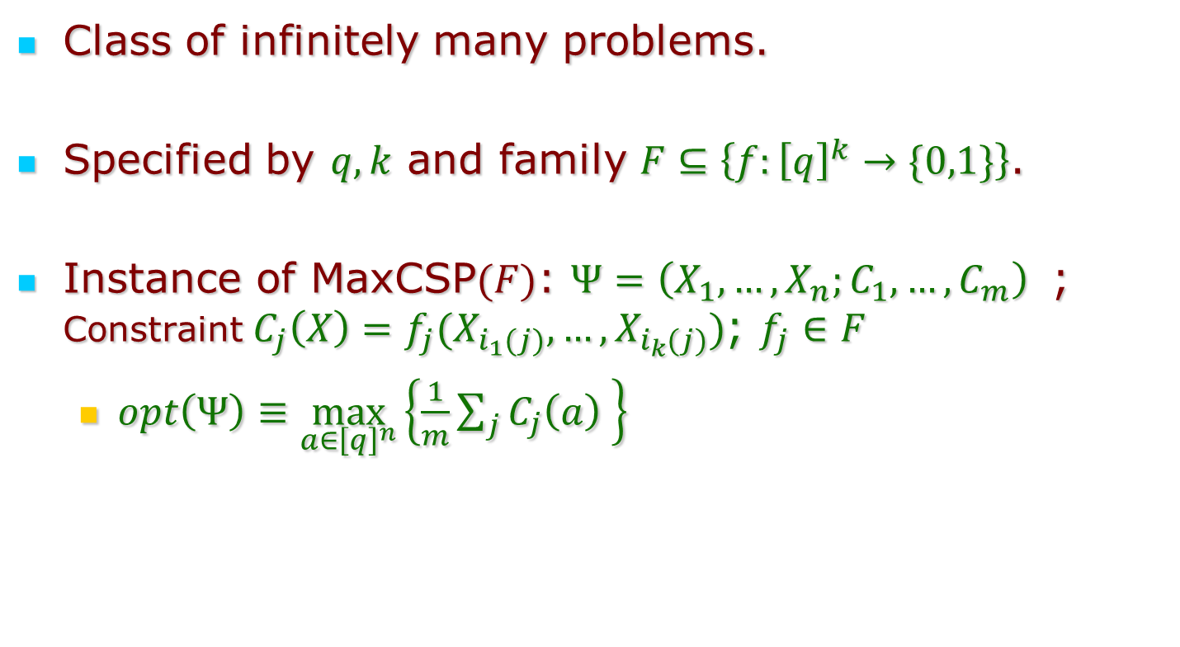
Constraint Satisfaction Problems (CSPs)
MaxCSP$\left(F\right)$
Class of infinitely many problems.
Specified by $q,k$ and family $F⊆\left\{f:{\left[q\right]}^{k}→\{0,1\}\right\}$.
Instance of MaxCSP$(F)$: $Ψ=\left(X_{1},…,X_{n};C_{1},…,C_{m}\right)$ ; Constraint $C_{j}\left(X\right)=f_{j}(X_{i_{1}(j)},…,X_{i_{k}(j)})$; $f_{j}∈F$
  $opt\left(Ψ\right)≡\max_{a∈{\left[q\right]}^{n}}\left\{\frac{1}{m}\sum_{j}{C_{j}\left(a\right) }\right\}$

