Slide 1
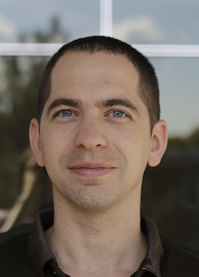
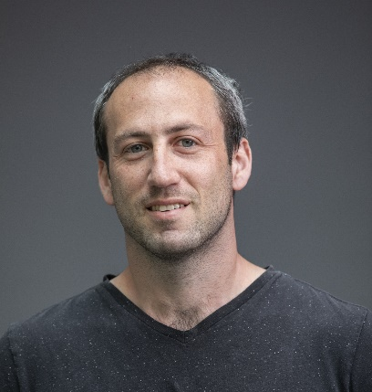
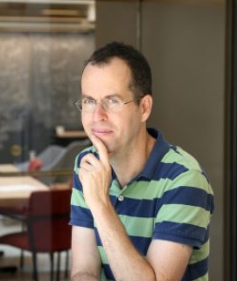
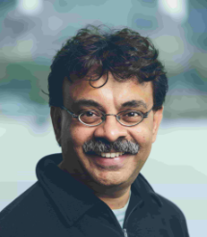
Is this correct? Let’s Check!
Omri Ben-Eliezer
Dan Mikulincer
Elchanan Mossel
Madhu Sudan

Slide 2
Is societal knowledge robust?
Why ask this question?
Builds on error-prone processes
Collecting Data
Analyzing it
Combining results
Last is especially problematic/interesting: Knowledge is cumulative!!
Accumulation can be very bad for errors!!!!!
There must exist error-correcting processes
What are they? How do they work? How well do they work?

Slide 3
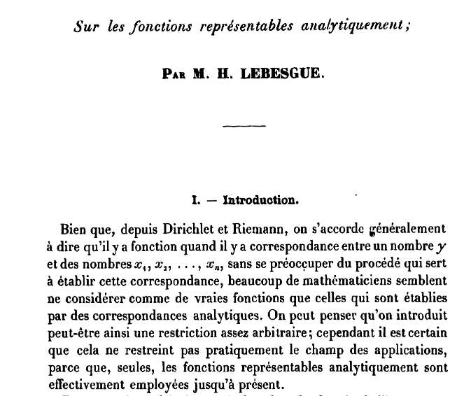
Lebesgue’s Mistake
In 1904 Lebesgue proved the following theorem:
“A projection of a measurable set is measurable”

Slide 4
Lebesgue’s Mistake
In 1904 Lebesgue proved the following theorem:
“A projection of a measurable set is measurable”
According to Google Scholar the paper has 303 citations.
Some citations prior to 1917.

Slide 5
Lebesgue’s Mistake
In 1904 Lebesgue proved the following theorem:
“A projection of a measurable set is measurable”
According to Google Scholar the paper has 303 citations.
Some citations prior to 1917.
In 1917 Suslin discovered a counterexample:
“There exists a projection of measurable set which is not mesurable”
Happy ending: The field of “Descriptive set theory” was born.
Did the mistake propagate?

Slide 6
Another Example
Dietary fats, carbohydrates and atherosclerotic vascular disease
RB McGandy, DM Hegsted… - New England Journal of …, 1967 - Mass Medical Soc
THERE is considerable evidence relating nutrition, presumably through its influence on the levels of circulating lipids, to the relentless progression of atherosclerotic vascular disease …
Save Cite Cited by 180 Related articles
E.G:
Dietary Fats, Carbohydrates and Atherosclerotic Vascular Disease
List of authors.Robert B. McGandy, M.D.†,
D.M. Hegsted, Ph.D.‡,
and F. J. Stare, M.D.§
¹⁹⁶⁷
Epidemiology as a guide to clinical decisions
SB Hulley, RH Rosenman, RD Bawol, RJ Brand - Nutrition Today, 1980 - journals.lww.com
Epidemiology Page 1 Epidemiology aS a Guide tO Clinical Decisions The association between Triglyceride and coronary heart disease is discussed in this report of work supported by a …
Save Cite Cited by 965 Related articles All 13 versions
In the 1960s, the sugar industry funded research that downplayed the risks of
sugar and highlighted the hazards of fat,
according to a newly published article in JAMA Internal Medicine.
Special Communication
November 2016
Sugar Industry and Coronary Heart Disease ResearchA Historical Analysis of Internal Industry Documents
Cristin E. Kearns, DDS, MBA^{1,2}; Laura A. Schmidt, PhD, MSW, MPH^{1,3,4}; Stanton A. Glantz, PhD^{1,5,6,7,8}

Slide 7
Today
Question
Can we guarantee that the effects caused by a single error do not propagate?

Slide 8
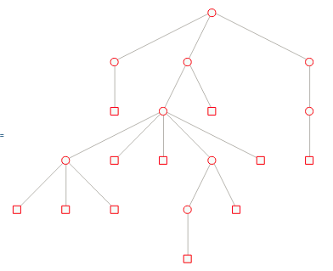
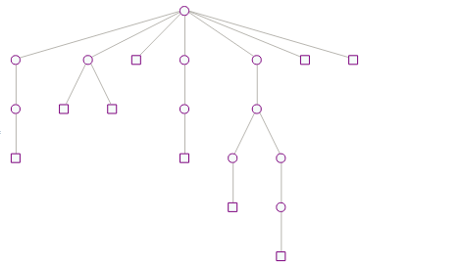
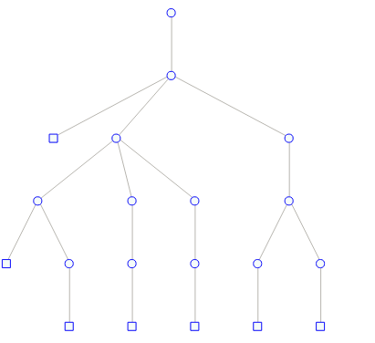
Cumulative Knowledge Process
In the paper we model the process of accumulating knowledge.
Main properties:
New “units of knowledge” build upon previous units.
Errors are sometimes introduced and may propagate forward.
Errors can be checked and removed from the process.
We study structural properties of the process.

Slide 9
The Model

Slide 10
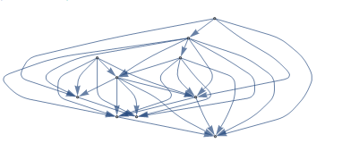
Representation of Knowledge
Ideally: Knowledge is stored as Directed Acyclic Graph (DAG).
Vertices represent units of knowledge
Edges represent dependence or “inherited knowledge”.
E.g. a paper cites several papers.

Slide 11
Representation of Knowledge
Ideally: Knowledge is stored as Directed Acyclic Graph (DAG).
Vertices represent units of knowledge
Edges represent dependence or “inherited knowledge”.
E.g. a paper cites several papers.
Citation correlation? Would require a proper model of knowledge clustering.
Simplified notion: Knowledge is represented as a tree.

Slide 12
The Model
The Knowledge DAG Tree: In the Cumulative Knowledge Process (CKP) knowledge units are modeled as a tree.
A node represents a single “unit of knowledge” and edges represent the relation of “building upon existing knowledge”
Each node has:
A hidden state conditionally true(CT)/conditionally false(CF)
A public state proclaimed true(PT)/proclaimed false(PF)
A node is considered to hold true knowledge
if all ancestors are CT
CT
CT
CF
CT
CF
CT
CT
CT
CF
CT

Slide 13
Accumulating Knowledge
At each time $t≥0$, we have a knowledge tree $T_{t}$ with associated labels.
At time $t+1$ a new node is added to the tree, by choosing a random proclaimed true (PT) parent.
Parents are chosen according to the preferential attachment model.
The more PT children a node has the more likely it is to generate new knowledge.
A new node is always proclaimed true
PT
PT
PF
PT
PT
PT
New knowledge
PT
PT
PT
PF
PT
PF
PF
PF
PF
PF

Slide 14
Injection of Errors
Recall: nodes also have hidden states.
The hidden label of a new node is determined randomly:
Parameter $ε:$ with probability $ε$ the new node is CF and otherwise CT.
CT
?
CF
CT
CF
CT
CF
CT
CT
CF
CT
CF
CF
CF
CF
CF

Slide 15
Aside: Probabilistic Models
Quote from unknown sourc$e^{∗}$
“All models are wrong. Some are useful”
Obviously today’s model is too simple to model the complex phenomena
Question (for you) to ponder : Is it useful?

Slide 16
Checking for Errors
Checks may be performed whenever a new node is added.
Parameter $p:$ a node preformed a check with probability $p.$
Checks are performed by ascending the tree.
Parameter $k:$ the number of levels to be checked.
This node is CF
PT
PT
PF
PT
PF
PT
$$k=2$$
PT
PT
PT
PT
PF
PT
PF
PF
PF
PF
PF
New node
PT

Slide 17
Checking for Errors
Checks may be performed whenever a new node is added.
Parameter $p:$ a node preformed a check with probability $p.$
Checks are performed by ascending the tree.
Parameter $k:$ the number of levels to be checked.
If a CF or PF node is encountered, the public state of the entire path changes to proclaimed false.
This node is CF
PT
PF
PF
PT
PF
PT
$$k=2$$
PF
PT
PT
PT
PF
PT
PF
PF
PF
PF
PF
New node
PF

Slide 18
The Model - Summary
Knowledge: represented by a tree.
Growth: by preferential attachment; nodes of high degree are more influential.
Errors: introduced (sometimes) when new knowledge is created
Checks: Performed when new knowledge is introduced, with some probability in locality of new knowledge.
Error correction: when a node is verified to be faulty, the error is announced and the node is effectively eliminated.
With the parameters $ε, p, and k$ the model is called the $\left(ε,p,k\right)−CKP$.

Slide 19
Phenomena

Slide 20
Error Effects
Question
Can we guarantee that the effects caused by a single error do not propagate?
Effects caused by a single error: subtree rooted at a CF node.
Observation: if, at some time, all nodes in a subtree are marked PF, the subtree is effectively eliminated for all future.
Error effect elimination: If this happens w.p. 1
Error effect survives: If this happens w.p. $<1$
This node is CF
PF
PF
PF
PF
PF
PF
PF
PF
PF
PF
PF
PF
PF
PF
PF

Slide 21
Error Effects
Question
Can we guarantee that the effects caused by a single error do not propagate?
Definition
If every subtree rooted at a CF node is eliminated with probability 1, we say that the error effects are completely eliminated.
Otherwise, the error effects survive with positive probability.
This node is CF
PF
PF
PF
PF
PF
PF
PF
PF
PF
PF
PF
PF
PF
PF
PF

Slide 22
Phenomena of interest
Do error effects survive? Or get eliminated?
When the error effect survives:
How large are false components (compared to true ones)?
When the error effect is completely eliminated:
How large are the “temporary error effects”?

Slide 23
Results

Slide 24
First Result – Depth Matters
Theorem 1
If $k=2$, then for any $p<1,$the error effects in the $\left(ε, p,2\right)−CKP$ survives with positive probability.

Slide 25
Second Result– Checking Matters
Theorem 2
For every $k≥4$, a$nd ε<1,$there exists $p_{0}∈\left[\frac{1}{4},1\right)$ such that:
If $p>p_{0}$ the error effects in the $\left(ε, p,k\right)−CKP$ are completely eliminated.
If $p<p_{0}$ the error effects in the $\left(ε, p,k\right)−CKP$ survive with positive probability.

Slide 26
Further Results
With a refined analysis we also consider other structural properties.
When the error effect survives:
Identify parameters which ensure that false components are sublinear.
Also control the size of the components.
When the error effect is completely eliminated:
Identify parameters which also ensure that proportion of false nodes in the tree is always at the noise level.

Slide 27
Proofs?
On board

Slide 28
Future Directions
The mysterious case of $k=3$:
Can the error effect be eliminated when only performing depth 3 checks?
Phase transitions:
Determine the value of the critical probability $p_{0}$.
More general models:
Can similar results be obtained for DAGS, instead of tree?
Will require to define an appropriate preferential attachment model on DAGs, which allows “similar knowledge” units to cluster.

Slide 29
Thank you!

Slide 30
First Result – Depth Matters
Theorem 1
If $k=2$, then for any $p<1,$the error effects in the $\left(ε, p,2\right)−CKP$ survives with positive probability.
Main idea: couple the CKP with a branching process.
PT
This node is False
PT
PT
PT

Slide 31
First Result – Depth Matters
Theorem 1
If $k=2$, then for any $p<1,$the error effects in the $\left(ε, p,2\right)−CKP$ survive with positive probability.
Main idea: couple the CKP with a branching process.
We show that when $k=2$, by the time an erroneous node is proclaimed false it will effectively create many new components.
PF
PT
PT
PT

Slide 32
First Result – Depth Matters
Theorem 1
If $k=2$, then for any $p<1,$the error effects in the $\left(ε, p,2\right)−CKP$ survive with positive probability.
Conclusion:
To guarantee that error effects are completely eliminated shallow checks are not enough!

Slide 33
Second Result– Main Ideas
Proof of Theorem 2 is based on a (sub\super-)martingale analysis.
We consider some observables in the process and identify regimes in which they increase or decrease in expectation.
Examples:
Number of proclaimed true leaves in the tree.
Distribution of depths in proclaimed true subtree.
PT
PT
PT
PT
PT
PT
PT
PT
PT
PT
PT

