Slide 1
Proofs and Computation
Madhu Sudan
Harvard

Slide 2
In this talk: Proofs and Computation
“Computer Assisted Proofs ?”
[Appel-Haken] – 4-color theorem
[Hales] – Kepler Conjecture
[Petkovsky,Wilf,Zeilberger] – “A=B”
No!
Mathematics
Proofs
Computing

Slide 3
Outline of this talk
I. Prehistoric stuff $(−∞$ to 1950)
Logic & (Theory of) Computing
II. Ancient history (1950-1980)
P, NP, and Optimization
III. Recent history (1980-2010)
Interaction, Randomness
Connections to approximate optimization
IV. Current themes:
Unique games conjecture + progress
Proving Quantum Behavior
V. Future?

Slide 4
I. Prehistory Provable statements

Slide 5
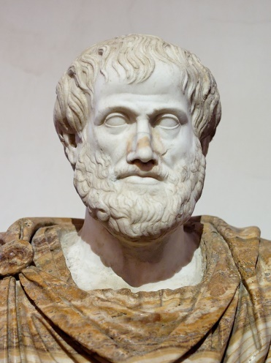
Formal Logic
Attempts to convert reasoning to symbolic manipulation.
Remarkably powerful.
Originated independently, and with different levels of impact, in different civilizations …
Mathematics
Proofs
"Aristotle Altemps Inv8575" by Copy of Lysippus - Jastrow (2006). Licensed under Public Domain via Commons - https://commons.wikimedia.org/wiki/File:Aristotle_Altemps_Inv8575.jpg#/media/File:Aristotle_Altemps_Inv8575.jpg

Slide 6
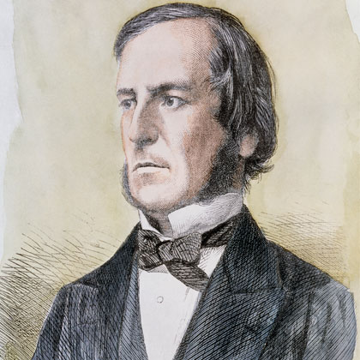
George Boole (1815-1864)
Mathematics
Proofs
The strange math of $(\left\{0,1\right\}; ∨,∧, ¬)$
Typical Derivation:
Axiom: Repetition does not add knowledge
Formally: $xx=x$
Example: Object is Good and Good $≡$ Object is Good
Consequence: Principle of Contradiction
“… it is impossible for any being to possess a quality and at the same time to not possess it.”
Proof: $x^{2}=x⇒x^{2}−x=0⇒x\left(x−1\right)=0$
$⇒x=0$ or $¬x≝1−x=0$
$⇒x$ or $¬x$ does not hold
(page 34)

Slide 7
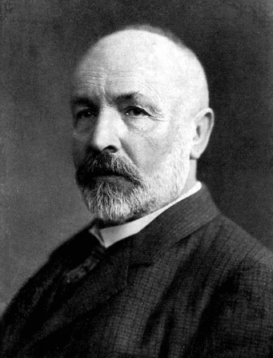
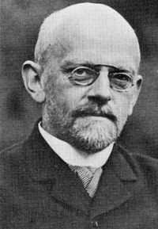
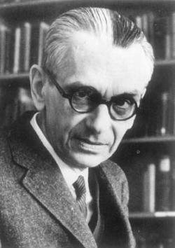
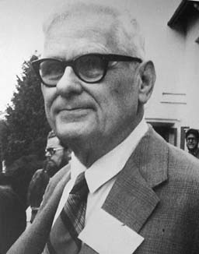
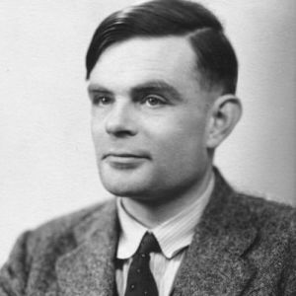
Whither Computing?
How well does the logic capture mathematics?
Cantor‘1890: Logic may face some problems?
Hilbert ‘1900:
Should capture everything!
Godel ‘1920s:
Incompleteness
Church-Turing 1930s: Incompleteness holds for any effective reasoning procedure.
This statement
is not
true
provable

Slide 8
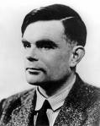
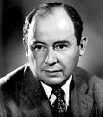
Turing’s Machine
Mathematics
Proofs
Computing
Model of computer
Encodings of other machines
- Universal!
→ von Neumann architecture
Finite
State
Control
RAM
CPU
R/W
Universal
Machine
One machine to rule them all!

Slide 9
Proofs: Story so far
Proof: Has to be mechanically verifiable.
Theorem: Statement with a proof.
Incompleteness: There exist statements consistent with the system of logic that do not admit a proof.
Unaddressed: What difference does proof make?
Theorem: $T$
Proof: $Π_{1}$
$$⇒Π_{2}$$
$$⇒Π_{3}$$
$$⇒Π_{4}$$
$$…$$
$$⇒Π_{ℓ}=T$$
Theorem: $T$
Proof:
Has $ℓ$ lines
Both mechanically verifiable!
#steps $\sim ℓ$
$\sim 2^{ℓ}$

Slide 10
II. Ancient History Efficient Verification

Slide 11
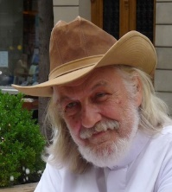
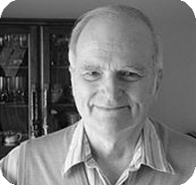
Origins of Modern Complexity
[Gödel 1956] in letter to von Neumann: “Is there a more “effective” procedure to find proof of length $ℓ$ if one exists?” (in $ℓ^{2}$ steps? $ℓ^{3}+10ℓ^{2}$?)
[Cobham, Edmonds, Hartmanis, Stearns – 60s]:
Time Complexity is a (coarse) measure. $10ℓ^{2}=5ℓ^{2} !$ But $ℓ^{2}>ℓ^{1.9}$.
$P≝$ problems solvable in time $ℓ^{c}$ for constant $c$
Edmonds Conjecture: Travelling Salesman Problem is not solvable in $P$

Slide 12
Proofs, Complexity & Optimization!
[Cook ’71]
Complexity of
Theorem Proving
[Levin ’73]
Universal Search problems
Formalized Edmond’s Conjecture:
$NP=$ Problems w. efficiently verifiable solutions
$NP$-complete = Hardest problem in NP
Theorem-Proving NP-Complete
SAT (simple format of proofs) NP-complete
Domino tiling NP-Complete
Godel’s question $≡$ “Is $NP=P$?”

Slide 13
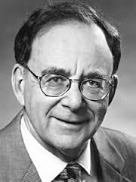
Proofs, Complexity & Optimization - 2
[Karp ‘72] Reducibility among
combinatorial optimization problems
Showed central importance of $NP$.
Nineteen problems $NP$-Complete!
Cover optimization, logic, combinatorics, graph theory, chip design.

Slide 14
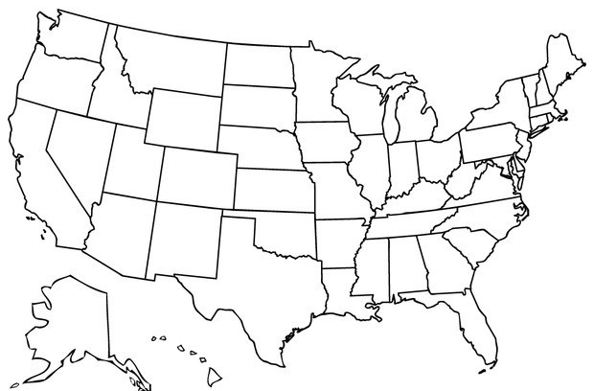
Some NP-complete Problems
Map Coloring: Can you color a given map with 3-colors, s.t. bordering states have diff. colors?

Slide 15
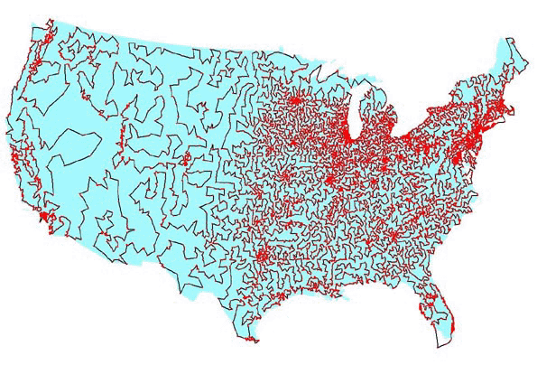
Some NP-Complete Problems
Travelling Salesman Problem: (TSP) – Find tour of minimum length visiting given set of cities.
Image due to [Applegate, Bixby, Chvatal, Cook].
Optimal TSP visiting ~13000 most populated cities in US.

Slide 16
Some NP-Complete Problems
Biology: Fold DNA sequence so as to minimize energy.
Economics: Finding optimal portfolio of stocks subject to budget constraint.
Industrial Engineering: Schedule tasks subject to precedence constraints to minimize completion time.
…

Slide 17
Consequences to Proof Checking
NP-Complete problem $≡$ Format for proofs.
3-coloring is NP-complete $⇒$ exists function $f$
$f\left(T,ℓ\right)=$ Map with $ℓ^{c}$ regions s.t.
$T$ has proof of length $ℓ$ $⇒$ Map is 3-colorable
$…$ no proofs of length $ℓ$ $⇒$ Map not 3-colorable
Format?
Rather than conventional proof, can simply give coloring of map!
Advantage: Error is local (two improperly colored regions)
Verifier computes $f(T,ℓ)$ and
verifies coloring is good

Slide 18
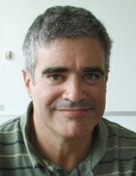
Is P=NP?
Don’t know …
If P=NP …
Cryptography might well be impossible (current systems all broken simultaneously)
All optimization problems become “easy”
… You get whatever you wish … if you can verify satisfaction.
Mathematicians replaced by computers.
If P≠NP …
… Consistent with current thinking, so no radical changes.
Proof would be very educational.
Might provide sound cryptosystems.
Independent of Peano’s axioms, Choice …?
“Of all the Clay Problems, this might be the one to find the shortest solution, by an amateur mathematician.”
- Devlin, The Millenium Problems (Possibly thinking P=NP)
“If someone shows P=NP, then they prove any theorem they wish. So they would walk away not just with $1M, but $6M by solving all the Clay Problems!”
- Lance Fortnow, Complexity Blog
“P = NP?” is Mathematics-Complete !!

Slide 19
III. Recent History Proofs and Randomness

Slide 20
Randomness & Modern Complexity
Emphasis on Randomness.
Randomness can potentially speed up algorithms.
Essential for
Equilibrium behavior
Coordination among multiple players
Cryptography
But it probably can’t help with Logic – right?
Actually – it does!!

Slide 21
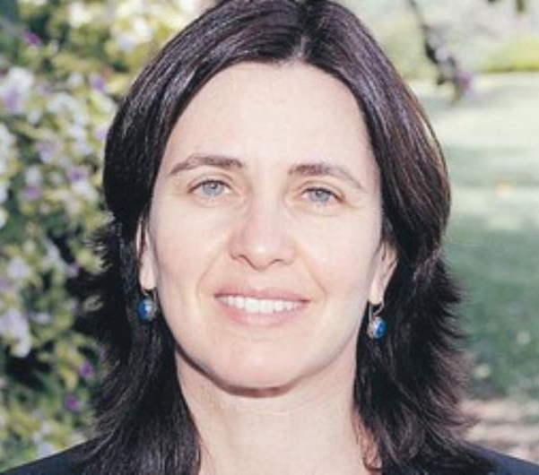
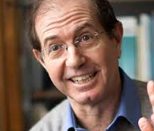
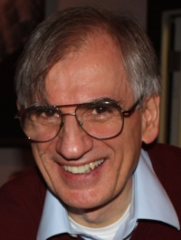
Interactive Proofs
[Goldwasser, Micali, Rackoff], [Babai] ~1985
Verifier asks questions and Prover responds:
Space of questions exponentially large in the length!
Prover has to be ready for all!
Many striking examples:
Pepsi $≠$ Coke! (“Graphs not isomorphic”)
Can prove “theorem has no short proof”.
“IP = PSPACE” [LFKN, Shamir]
“Zero Knowledge Protocols” – Foundations of Secure communication

Slide 22
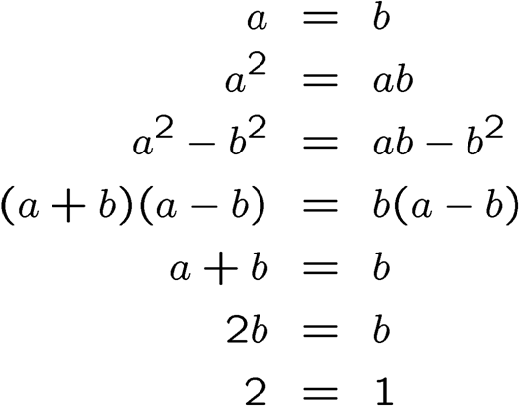
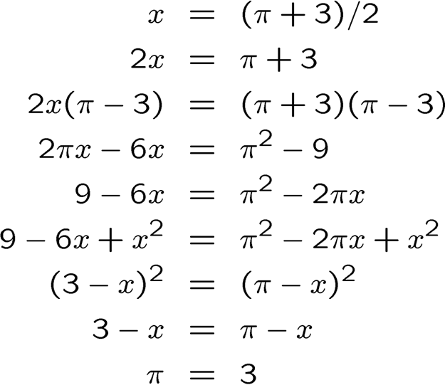
Probabilistically Checkable Proofs
Do proofs have to be read in entirety to verify?

Slide 23
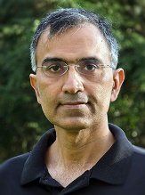
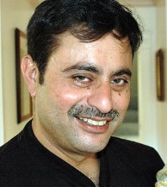
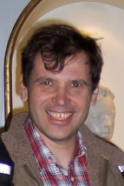
Probabilistically Checkable Proofs
Do proofs have to be read in entirety to verify?
Conventional formats for proofs – YES!
But we can change the format!
Format $≡$ Verification Algorithm
Any verifier is ok, provided:
If $T$ has proof of length $ℓ$ in standard system, then $V$ should accept some proof of length poly$(ℓ)$
If $T$ has no proofs, then $V$ should not accept any proof
PCP Theorem [Arora, Lund, Motwani, Safra, Sudan, Szegedy ‘92]:
A format exists where V reads only
constant number of bits of proof!
with probability $≥\frac{1}{2}$
X $.001$

Slide 24
An Analogy
Inspecting a building:
“Building $= O(n)$atoms”
“Building $= O(1)$rooms $= O(1)$walls”
Former view:
Verifying stability takes $Ω\left(n\right)$-checks.
Latter view:
Verifying stability takes $O\left(1\right)$-checks +
$O(1)$-”stability of wall-checks”.
Polynomials $≡$ Walls!
… OR

Slide 25
$10^{6}$-mile view of PCPs: Polynomials
A (NP-)complete statement:
Graph $G∈{\left\{0,1\right\}}^{n×n}$ is $3$-colorable.
Proof: Coloring ($Θ(n)$-bits).
Verification: Read entire coloring.
PCP Idea: Glue $n$ bits using polynomials (deg. $n$)
Key fact: Non-zero polynomial usually non-zero.
Equivalent (NP-)complete statement:
Given: $Φ$ local map from poly’s to poly’s
$∃$ poly’s $A,B,C,D$ s.t. $Φ\left(A,B,C,D\right)≡0$
Verification:
Step 1: Test $A,B,C,D$ are polynomials
Step 2: Verify $Φ\left(A,B,C,D\right)\left[r\right]=0$ for random $r.$

Slide 26
Polynomials = Wall - II
Reduction from $3$-coloring to polynomial satisfiability [Ben-Sasson-S.’04]
$Φ\left(A,B,C,D\right)\left[x_{0},x,y\right]=Φ_{E}\left(A,B,C,D\right)[x_{0},x,y]$
$=(A\left[x\right]\left(A\left[x\right]−1\right)\left(A\left[x\right]−2\right) −B\left[x\right]Π_{v∈V}\left(x−v\right)$)
${ + x}_{0}⋅(E\left(x,y\right)⋅Π_{i∈\left\{−2,−1,1,2\right\}}\left(A\left[x\right]−A\left[y\right]−i\right)$
$− C\left[x,y\right]Π_{v∈V}\left(x−v\right)−D\left(x,y\right)Π_{v∈V}\left(y−v\right))$

Slide 27
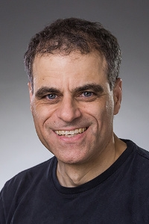
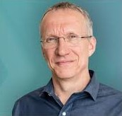
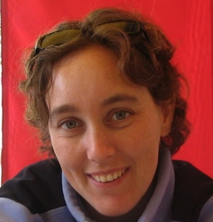
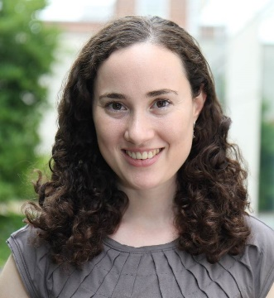
Improved (Optimal) PCPs
[Raz’94, Hastad‘97, Dinur’06, Moshkovitz-Raz’08]: Series of remarkable improvements: Reduced error, reduced #queried bits, Reduced size of PCP:
Current: For barely super-linear blowup in size, PCP can be verified reading 3 bits to get error ½.
Ingredients: Fourier analysis, Expander graphs, Error-correcting codes, Information Theory

Slide 28
PCPs and Approximate Optimization
Classical connection: [Cook $→$ Karp]:
Solving optimization problems $≡$ finding proofs
New Connection: [Feige et al., Arora et al.]
Solving optimization problems approximately $≡$ finding nearly valid proofs.
Existence of nearly valid proofs $≡$ Existence of perfectly valid proofs (due to PCPs)!
Conclude: Solving (some/many) optimizations approximately is as hard as solving them exactly!
1992-today: PCP-induced revolution in understanding approximability!!

Slide 29
IV. Current Directions

Slide 30
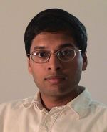
Unique Games and a Conjecture
Given linear equations $Ax=b (mod p)$, distinguish:
$1 −ε$ fraction of equations satisfiable.
$\frac{1}{p}+ε$ fraction of equations satisfiable.
Thm [Hastad ’97]: NP-hard even if each equation has only 3 variables.
Unique Game setting: 2 variables/equation
Conjecture [Khot]: Still NP-hard …
Implications: Many!
Roughly – for very broad class of optimization problems, a natural “convex relaxation and rounding” is best possible.

Slide 31
Unique? Game?
Inspires “2-prover proof system” (game):
$$P_{1}$$
$$P_{2}$$
$$q1(i)$$
$$q2(i)$$
$$α$$
$$β$$
$$Ax=b⇔{\left\{a_{i}⋅x=b_{i}\right\}}_{i}$$
[Khot,Minzer,Safra’17]:
Proof of analogous
conjecture for system of
quadratic equations
V
Pick random $i$
$a_{i}⋅x=b_{i}$ : $x_{q1\left(i\right)}+x_{q2\left(i\right)}=b_{i}$
Accept iff $α+β=b_{i}$
UGC $⇒$ Perfect+Sound Proof system with negligible error
Unique? Condition on answer of $P_{1}$ answer to $P_{2}$ unique + vice versa!

Slide 32
Proofs & Quantumness
CHSH game: Proving laws of quantum mechanics to a skeptic.
$V→A :x ; V→B:y$
$A→V :a ; B→V:b$
Accept iff $x∧y=a⊕b$
Classical strategy wins w.p. ¾
Quantum strategy (A & B share entanglement) wins w.p. ~.85
Modern “extensions”:
[Mahadev]: Classical verification of quantum computation.
[Ji,Natarajan,Vidick,Wright,Yuen]: Interactive verification of all computable functions.
Ingredient: Alice and Bob can prove to V that they have $n$ qubits of entanglement by consuming tiny number of qubits. (e.g, $\log{\log{\log{\log{\log{n}}}}}$ qubits)

Slide 33
V. Future

Slide 34
Some context
PCPs as method to understand (in)approximability: HUGELY successful
PCPs as a positive method:
Make verification easier …
… much more limited
(Actually used in blockchain/cryptocurrencies)
Why so limited?
(from Yael Kalai: “Evolution of Proofs”)

Slide 35
Proofs: Standard Assumption
A
T
$$Π$$
Small (Constant) Number of Axioms
$X→Y, Y→Z⇒ X→Z$, Peano, etc.
Medium Sized Theorem:
$∀x,y,z,n∈ℕ, x^{n}+y^{n}=z^{n}→n≤2$ …
Big Proof:
Blah blah blah blah blah blah bla blah blah blah blah blah blah blah blah blah blah blah blah blah blah blah blah blah blah blah blah blah blah blah blah blah blah blah blah blah blah blah blah blah blah blah blah blah blah blah blah blah blah blah blah blah blah blah

Slide 36
The truth
Mathematical proofs assume large context.
“By some estimates a proof that 2+2=4 in ZFC would require about 20000 steps … so we will use a huge set of axioms to shorten our proofs – namely, everything from high-school mathematics”
[Lehman,Leighton,Meyer – Notes for MIT 6.042]
Context (= huge set of axioms) shortens proofs.
But context is uncertain!
What is “high school mathematics”?
Need to understand how this works?
Context, uncertainty, communication
Mind, reasoning, knowledge

Slide 37
Summary and Conclusions
Computing as a science:
Goes to the very heart of scientific inquiry.
What big implications follow from local steps?
Search for proofs captures essence of all search and optimization.
“Is P=NP?” Central mathematical question.
Still open.
What are proofs?
Many implications of randomness & interaction
Not yet totally understood … ☹
☺ … Up to us to define and design!

Slide 38
Thank You!

