Slide 1

Jaikumar Radhakrishnan
&
The Entropy Method in Combinatorics
Madhu Sudan
Harvard University

Slide 2
The key paper:
Jaikumar Radhakrishnan, “Entropy and Counting”
  Proc. IIT Kgp. Golden Jubilee Volume on Computational Mathematics, Modelling and Algorithms … 2001.

Slide 3
This talk:
Three results
Shearer’s Lemma (from the key paper)
Homomorphism Counting [Kopparty-Rossman]
Union-closed conjecture [Gilmer]

Slide 4

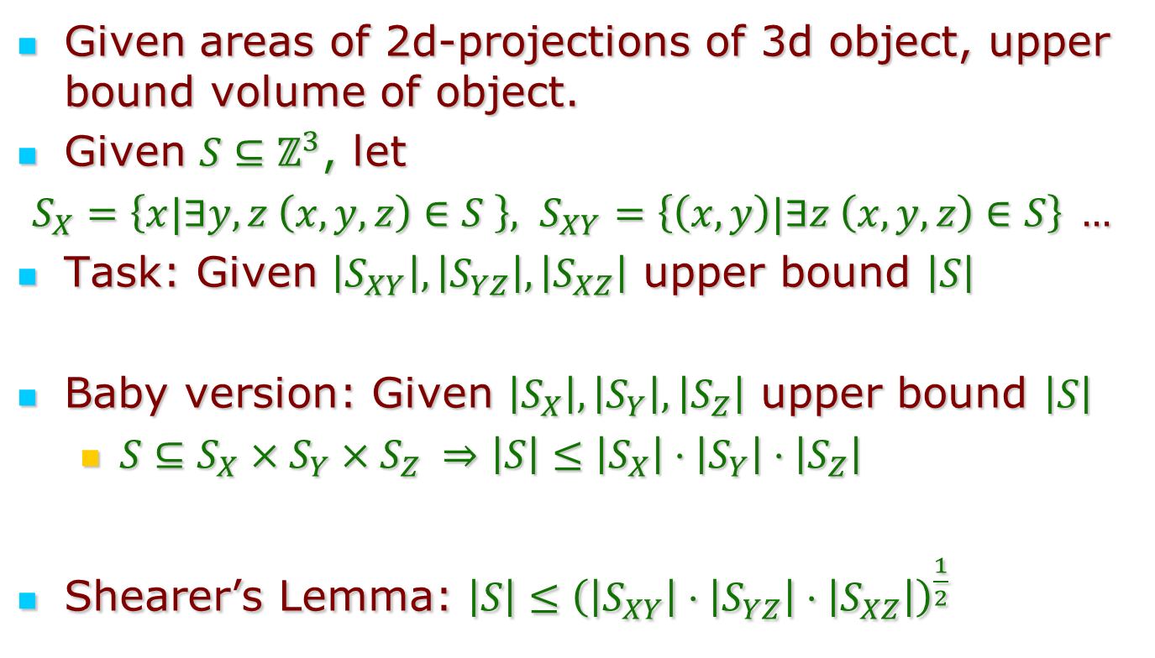
Shearer’s Lemma (in 3d)
Given areas of 2d-projections of 3d object, upper bound volume of object.
Given $S⊆ℤ^{3}$, let
$S_{X}=\left\{x|∃y,z \left(x,y,z\right)∈S \right\}, S_{XY}=\left\{\left(x,y\right)|∃z \left(x,y,z\right)∈S\right\} …$
Task: Given $\left|S_{XY}\right|, \left|S_{YZ}\right|, \left|S_{XZ}\right|$ upper bound $\left|S\right|$
Baby version: Given $\left|S_{X}\right|, \left|S_{Y}\right|, \left|S_{Z}\right|$ upper bound $\left|S\right|$
  $S⊆S_{X}×S_{Y}×S_{Z} ⇒\left|S\right|≤\left|S_{X}\right|⋅\left|S_{Y}\right|⋅\left|S_{Z}\right|$
Shearer’s Lemma: $\left|S\right|≤{\left(\left|S_{XY}\right|⋅\left|S_{YZ}\right|⋅\left|S_{XZ}\right|\right)}^{\frac{1}{2}}$

Slide 5
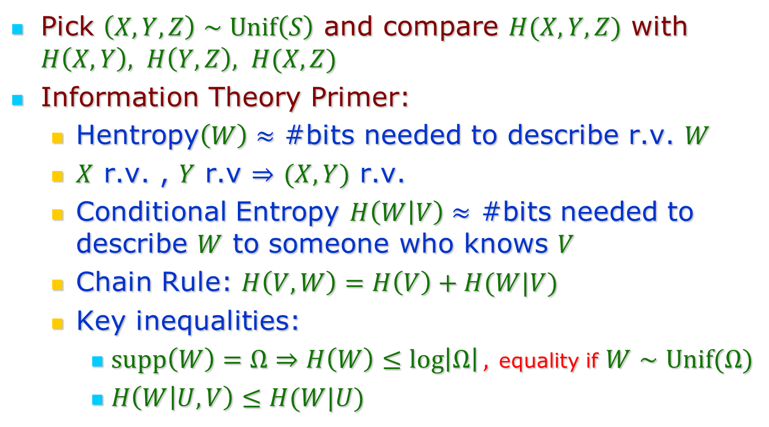
The Jaikumar Proof
Pick $\left(X,Y,Z\right)∼Unif\left(S\right)$ and compare $H(X,Y,Z)$ with $H\left(X,Y\right), H\left(Y,Z\right), H(X,Z)$
Information Theory Primer:
  Hentropy$\left(W\right)≈$ #bits needed to describe r.v. $W$
  $X$ r.v. , $Y$ r.v $⇒$ $(X,Y)$ r.v.
  Conditional Entropy $H\left(W | V\right)≈$ #bits needed to describe $W$ to someone who knows $V$
  Chain Rule: $H\left(V,W\right)=H\left(V\right)+H(W|V)$
  Key inequalities:
    $supp\left(W\right)=Ω⇒H\left(W\right)≤\log\left|Ω\right|,$ equality if $W∼Unif(Ω)$
    $H\left(W | U,V\right)≤H(W|U)$

Slide 6
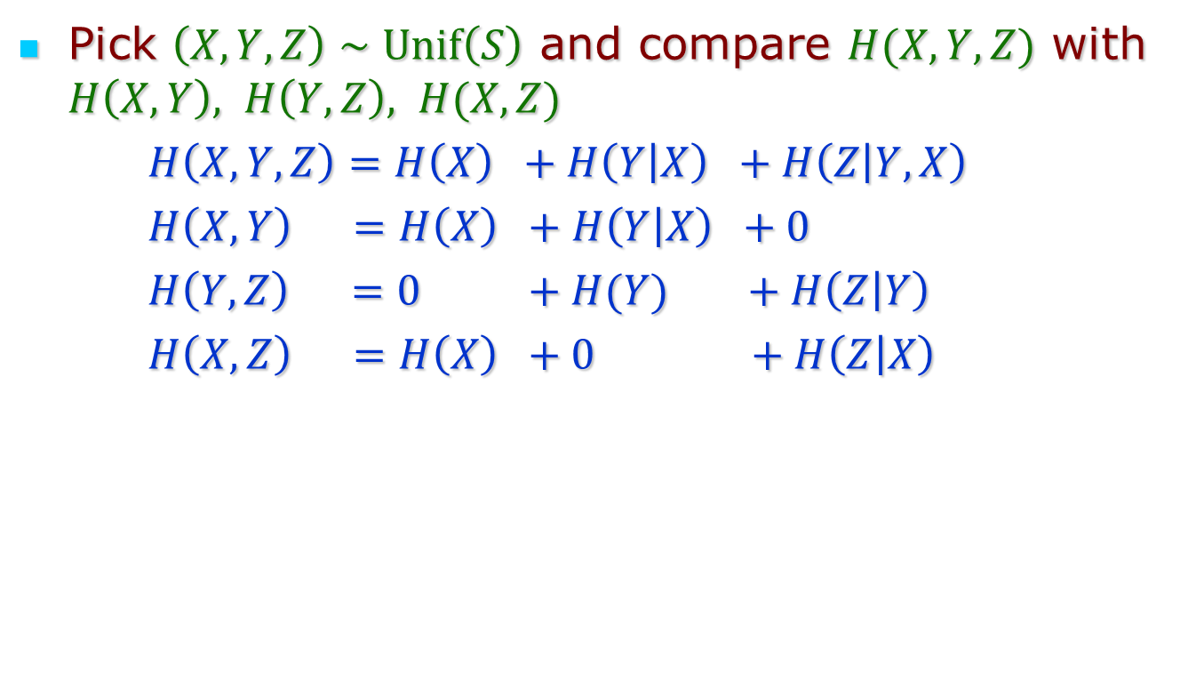
The Jaikumar Proof
Pick $\left(X,Y,Z\right)∼Unif\left(S\right)$ and compare $H(X,Y,Z)$ with $H\left(X,Y\right), H\left(Y,Z\right), H(X,Z)$
  $H\left(X,Y,Z\right)=H\left(X\right) +H\left(Y | X\right) +H\left(Z | Y,X\right)$
  $H\left(X,Y\right) =H\left(X\right) +H\left(Y | X\right) +0$
  $H\left(Y,Z\right) =0 +H(Y) +H\left(Z | Y\right)$
  $H\left(X,Z\right) =H\left(X\right) +0 +H\left(Z | X\right)$

Slide 7
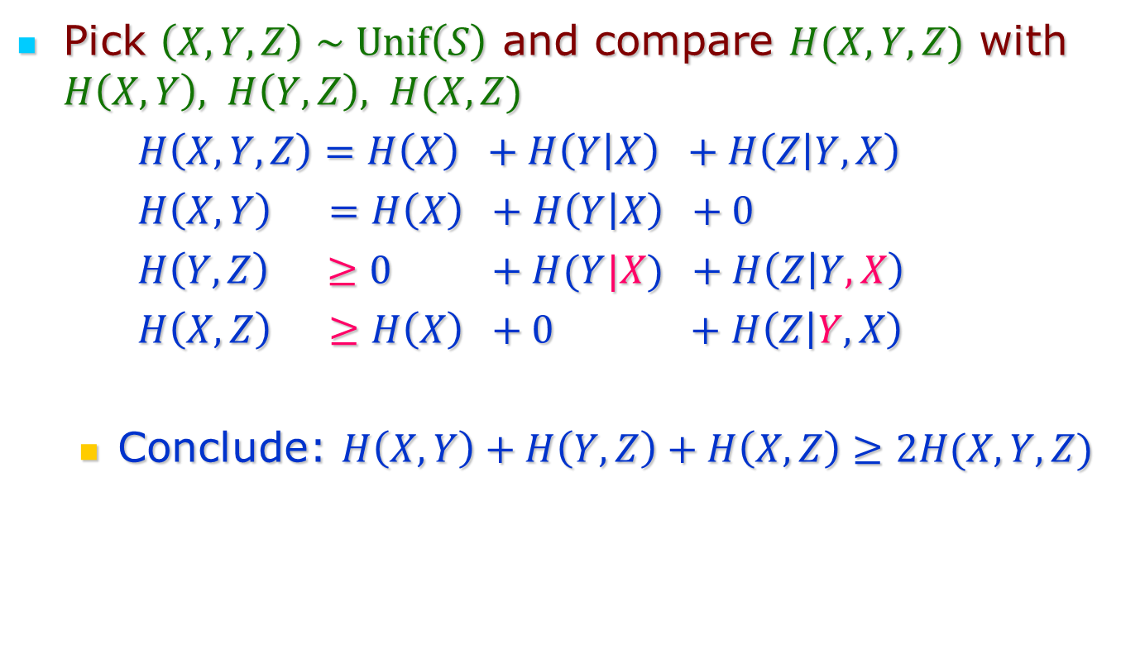
The Jaikumar Proof
Pick $\left(X,Y,Z\right)∼Unif\left(S\right)$ and compare $H(X,Y,Z)$ with $H\left(X,Y\right), H\left(Y,Z\right), H(X,Z)$
  $H\left(X,Y,Z\right)=H\left(X\right) +H\left(Y | X\right) +H\left(Z | Y,X\right)$
  $H\left(X,Y\right) =H\left(X\right) +H\left(Y | X\right) +0$
  $H\left(Y,Z\right) ≥0 +H(Y|X) +H\left(Z | Y,X\right)$
  $H\left(X,Z\right) ≥H\left(X\right) +0 +H\left(Z | Y,X\right)$
  Conclude: $H\left(X,Y\right)+H\left(Y,Z\right)+H\left(X,Z\right)≥2H(X,Y,Z)$

Slide 8

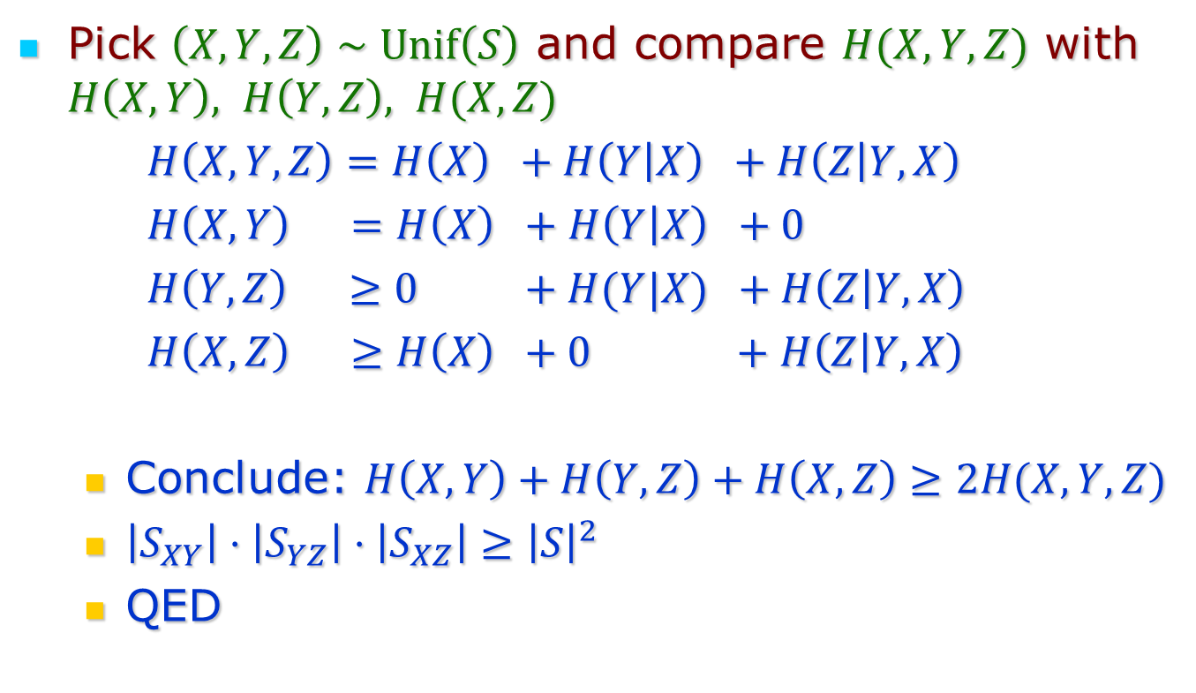



The Jaikumar Proof
Pick $\left(X,Y,Z\right)∼Unif\left(S\right)$ and compare $H(X,Y,Z)$ with $H\left(X,Y\right), H\left(Y,Z\right), H(X,Z)$
  $H\left(X,Y,Z\right)=H\left(X\right) +H\left(Y | X\right) +H\left(Z | Y,X\right)$
  $H\left(X,Y\right) =H\left(X\right) +H\left(Y | X\right) +0$
  $H\left(Y,Z\right) ≥0 +H(Y|X) +H\left(Z | Y,X\right)$
  $H\left(X,Z\right) ≥H\left(X\right) +0 +H\left(Z | Y,X\right)$
  Conclude: $H\left(X,Y\right)+H\left(Y,Z\right)+H\left(X,Z\right)≥2H(X,Y,Z)$
  $\left|S_{XY}\right|⋅\left|S_{YZ}\right|⋅\left|S_{XZ}\right|≥{\left|S\right|}^{2}$
  QED
$$\log{ \left|S\right|}=$$
$$\log{ \left|S_{XY}\right|}≥$$
$$\log{ \left|S_{YZ}\right|}≥$$
$$\log{ \left|S_{XZ}\right|}≥$$

Slide 9
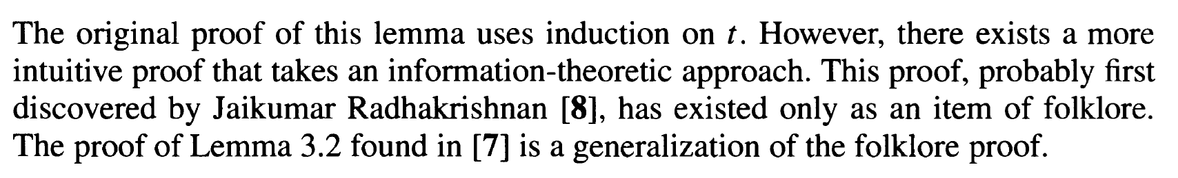
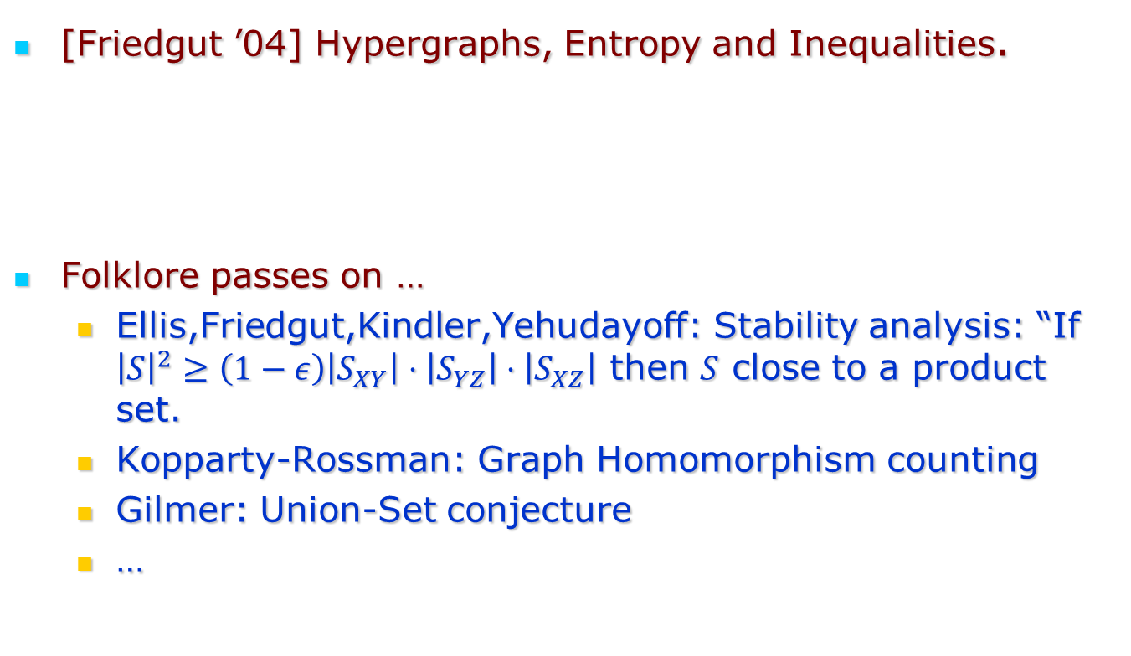
Impact of the Jaikumar Proof
[Friedgut ’04] Hypergraphs, Entropy and Inequalities.
Folklore passes on …
  Ellis,Friedgut,Kindler,Yehudayoff: Stability analysis: “If ${\left|S\right|}^{2}≥\left(1−ε\right)\left|S_{XY}\right|⋅\left|S_{YZ}\right|⋅\left|S_{XZ}\right|$ then $S$ close to a product set.
  Kopparty-Rossman: Graph Homomorphism counting
  Gilmer: Union-Set conjecture
  …

Slide 10
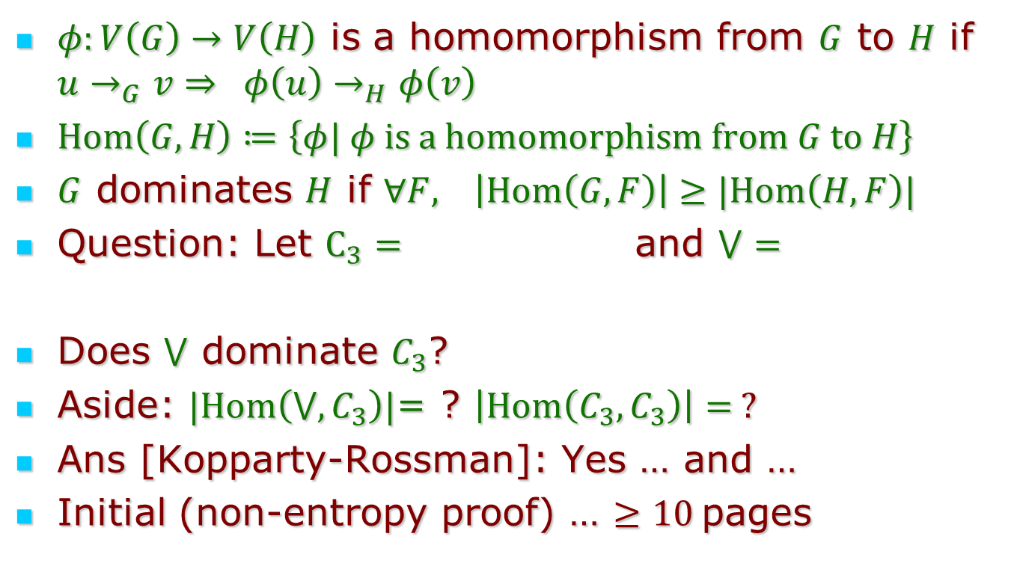
Part 2: Homomorphism Counting
$φ:V\left(G\right)→V\left(H\right)$ is a homomorphism from $G$ to $H$ if $u→_{G}v⇒ φ\left(u\right)→_{H}φ\left(v\right)$
$Hom\left(G,H\right)≔\left\{φ| φ is a homomorphism from G to H\right\}$
$G$ dominates $H$ if $∀F, \left|Hom\left(G,F\right)\right|≥|Hom\left(H,F\right)|$
Question: Let $C_{3}=$ and $⋁=$
Does $⋁$ dominate $C_{3}$?
Aside: $|Hom\left(⋁,C_{3}\right)|$= ? $\left|Hom\left(C_{3},C_{3}\right)\right|= ?$
Ans [Kopparty-Rossman]: Yes … and …
Initial (non-entropy proof) … $≥10$pages

Slide 11
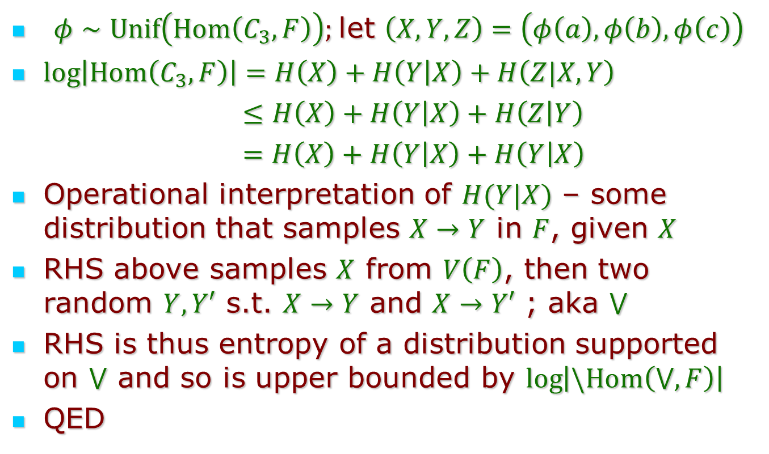
The entropy proof
$φ∼Unif\left(Hom\left(C_{3},F\right)\right);$let $\left(X,Y,Z\right)=\left(φ\left(a\right),φ\left(b\right),φ\left(c\right)\right)$
$\log\left|Hom\left(C_{3},F\right)\right|=H\left(X\right)+H\left(Y | X\right)+H\left(Z|X,Y\right)$
$≤H\left(X\right)+H\left(Y | X\right)+H\left(Z | Y\right)$
$=H\left(X\right)+H\left(Y | X\right)+H\left(Y | X\right)$
Operational interpretation of $H(Y|X)$ – some distribution that samples $X→Y$ in $F$, given $X$
RHS above samples $X$ from $V\left(F\right)$, then two random $Y, Y′$ s.t. $X→Y$ and $X→Y′$ ; aka $⋁$
RHS is thus entropy of a distribution supported on $⋁$ and so is upper bounded by $\log\left|\backslash Hom\left(⋁,F\right)\right|$
QED

Slide 12
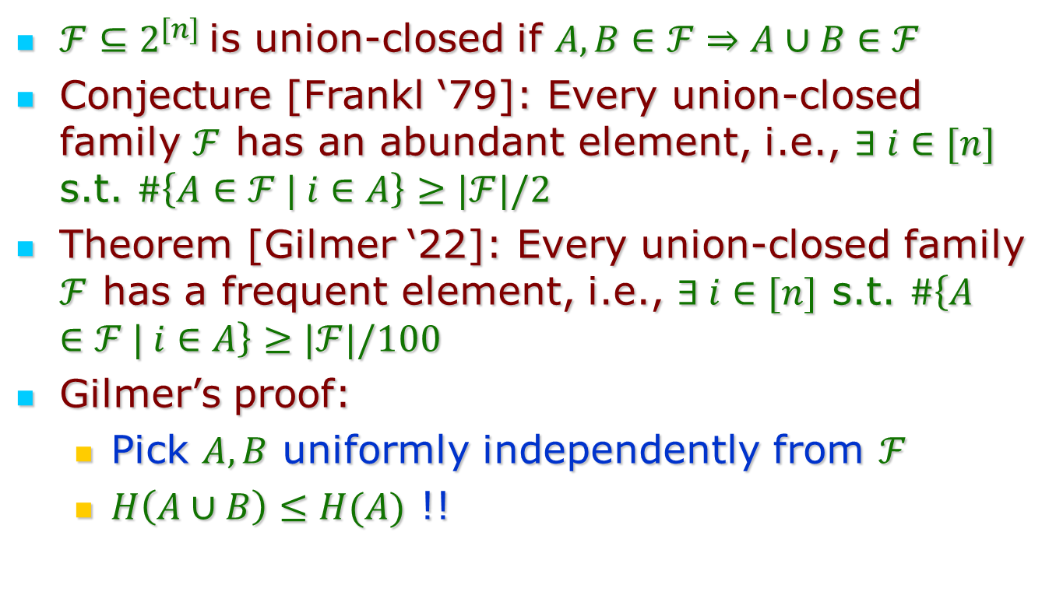
Part 3: Union-closed families
$ℱ⊆2^{[n]}$is union-closed if $A,B∈ℱ⇒A∪B∈ℱ$
Conjecture [Frankl ‘79]: Every union-closed family $ℱ$ has an abundant element, i.e., $∃ i∈[n]$ s.t. $\#\left\{A∈ℱ | i∈A\right\}≥|ℱ|/2$
Theorem [Gilmer ‘22]: Every union-closed family $ℱ$ has a frequent element, i.e., $∃ i∈[n]$ s.t. $\#\left\{A∈ℱ | i∈A\right\}≥|ℱ|/100$
Gilmer’s proof:
  Pick $A,B$ uniformly independently from $ℱ$
  $H\left(A∪B\right)≤H(A)$ !!

Slide 13
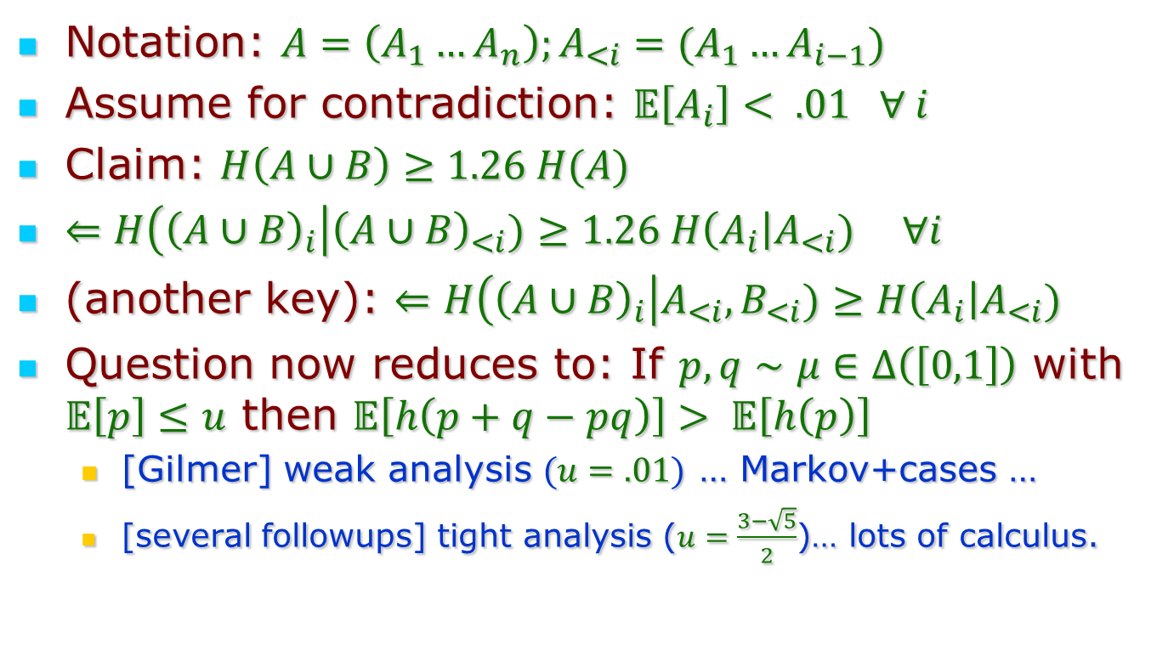
Union-Closed Families (contd.)
Notation: $A=\left(A_{1}…A_{n}\right);A_{<i}=(A_{1}…A_{i−1})$
Assume for contradiction: $𝔼\left[A_{i}\right]< .01 ∀ i$
Claim: $H\left(A∪B\right)≥1.26 H(A)$
$⇐H\left({\left(A∪B\right)}_{i}\right|{\left(A∪B\right)}_{<i})≥1.26 H\left(A_{i}\right|A_{<i}) ∀i$
(another key): $⇐H\left({\left(A∪B\right)}_{i}\right|A_{<i},B_{<i})≥H\left(A_{i}\right|A_{<i})$
Question now reduces to: If $p,q∼μ∈Δ\left(\left[0,1\right]\right)$ with $𝔼\left[p\right]≤u$ then $𝔼\left[h\left(p+q−pq\right)\right]> 𝔼\left[h\left(p\right)\right]$
  [Gilmer] weak analysis $(u=.01)$ … Markov+cases …
  [several followups] tight analysis ($u=\frac{3−\sqrt{5}}{2}$)… lots of calculus.

Slide 14
Conclusion
Entropy method …
… lots of successes in many unexpected ways.
Kudos to Jaikumar
  For recognizing its potential early
  … and teaching/preaching it.

Slide 15
Thank You!

