Slide 1

Low Degree Testing
Madhu Sudan
Harvard University

Slide 2
This talk
Mostly … historical tour of the low-degree testing problem: Results, motivations, some proof insights

Slide 3
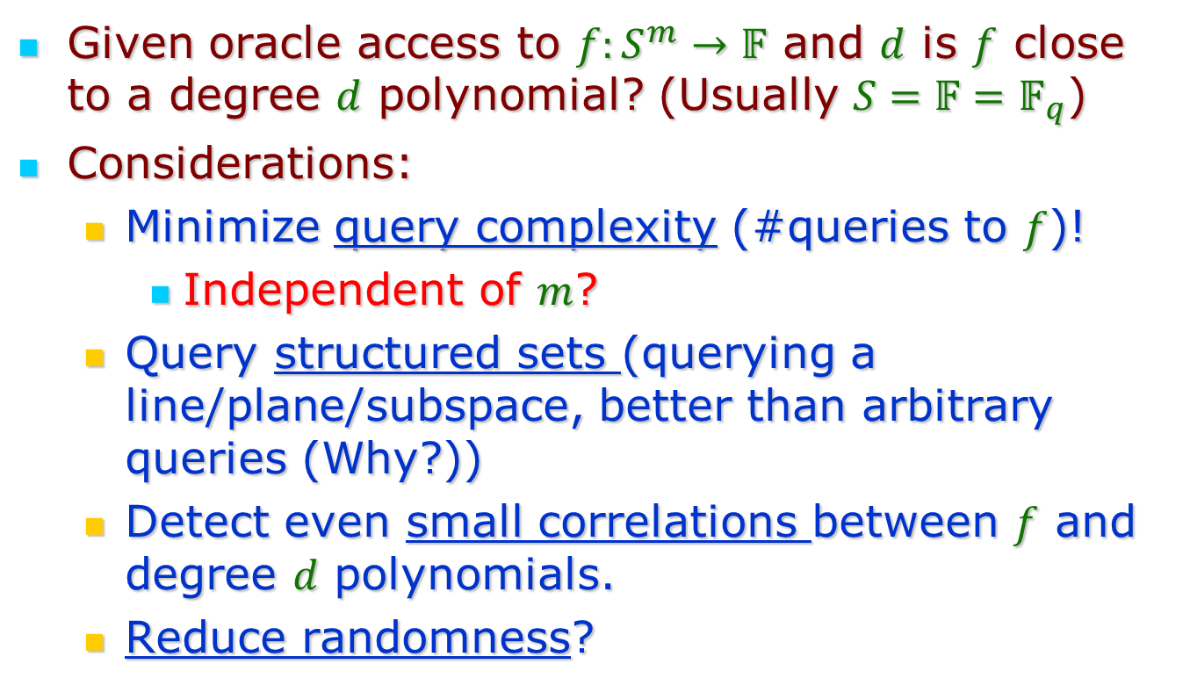
Problem Definition
Given oracle access to $f:S^{m}→𝔽$ and $d$ is $f$ close to a degree $d$ polynomial? (Usually $S=𝔽=𝔽_{q}$)
Considerations:
  Minimize query complexity (#queries to $f$)!
    Independent of $m$?
  Query structured sets (querying a line/plane/subspace, better than arbitrary queries (Why?))
  Detect even small correlations between $f$ and degree $d$ polynomials.
  Reduce randomness?

Slide 4
Why study this question?
Historically:
  Mathematical curiosity … natural question!
  Has applications …
    To PCPs
    (un-)Bias amplification
    Explicit small set expanders …

Slide 5
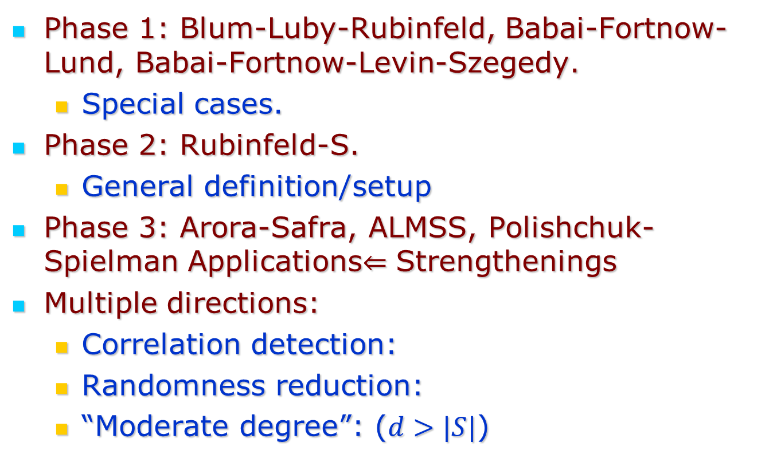
Brief History
Phase 1: Blum-Luby-Rubinfeld, Babai-Fortnow-Lund, Babai-Fortnow-Levin-Szegedy.
  Special cases.
Phase 2: Rubinfeld-S.
  General definition/setup
Phase 3: Arora-Safra, ALMSS, Polishchuk-Spielman Applications$⇐$ Strengthenings
Multiple directions:
  Correlation detection:
  Randomness reduction:
  “Moderate degree”: ($d>|S|$)

Slide 6
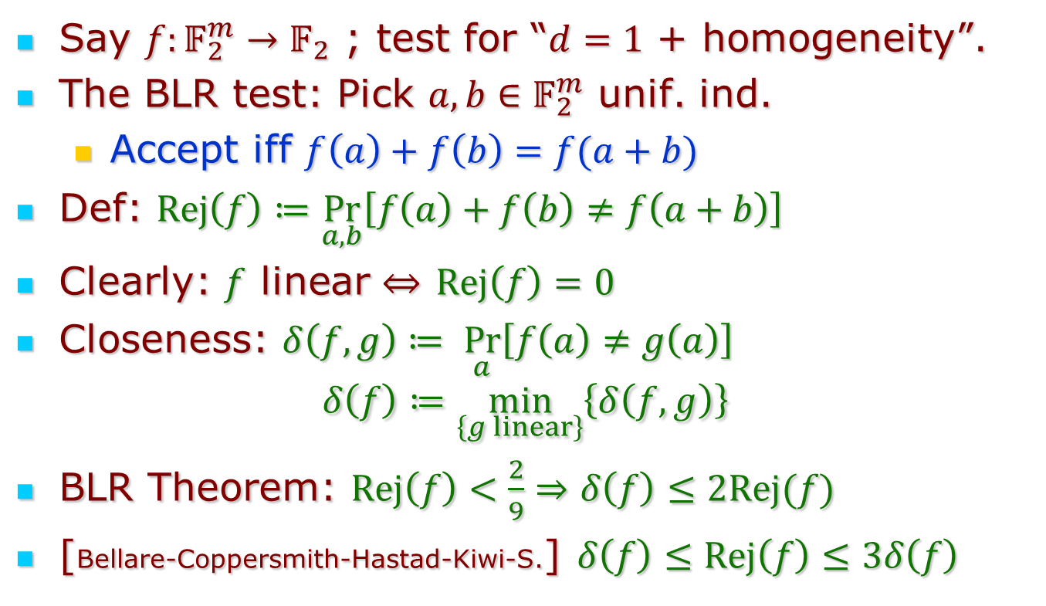
Linearity Testing
Say $f:𝔽_{2}^{m}→𝔽_{2}$ ; test for “$d=1$ + homogeneity”.
The BLR test: Pick $a,b∈𝔽_{2}^{m}$ unif. ind.
  Accept iff $f\left(a\right)+f\left(b\right)=f(a+b)$
Def: $Rej\left(f\right)≔\underset{a,b}{Pr}\left[f\left(a\right)+f\left(b\right)≠f\left(a+b\right)\right]$
Clearly: $f$ linear $⇔$ $Rej\left(f\right)=0$
Closeness: $δ\left(f,g\right)≔ \underset{a}{Pr}\left[f\left(a\right)≠g\left(a\right)\right]$
$$δ\left(f\right)≔\min_{\left\{g linear\right\}}\left\{δ\left(f,g\right)\right\}$$
BLR Theorem: $Rej\left(f\right)<\frac{2}{9}⇒δ\left(f\right)≤2Rej(f)$
[Bellare-Coppersmith-Hastad-Kiwi-S.] $δ\left(f\right)≤Rej\left(f\right)≤3δ\left(f\right)$

Slide 7
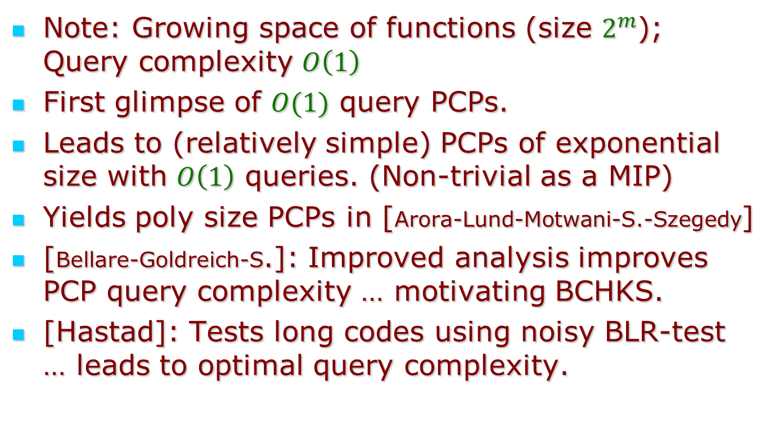
Role of the Linearity Test in PCPs
Note: Growing space of functions (size $2^{m}$); Query complexity $O\left(1\right)$
First glimpse of $O(1)$ query PCPs.
Leads to (relatively simple) PCPs of exponential size with $O\left(1\right)$ queries. (Non-trivial as a MIP)
Yields poly size PCPs in [Arora-Lund-Motwani-S.-Szegedy]
[Bellare-Goldreich-S.]: Improved analysis improves PCP query complexity … motivating BCHKS.
[Hastad]: Tests long codes using noisy BLR-test … leads to optimal query complexity.

Slide 8
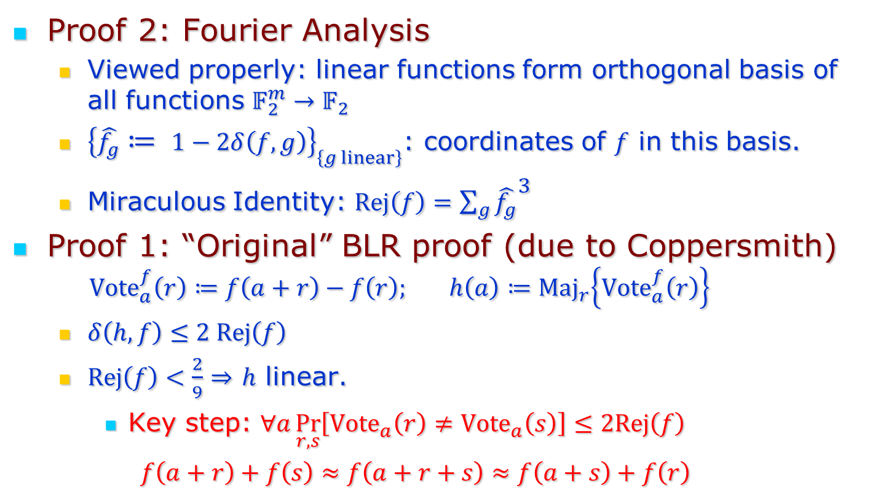
Proof Ideas
Proof 2: Fourier Analysis
  Viewed properly: linear functions form orthogonal basis of all functions $𝔽_{2}^{m}→𝔽_{2}$
  ${\left\{\hat{f_{g}}≔ 1−2δ\left(f,g\right)\right\}}_{\left\{g linear\right\}}$: coordinates of $f$ in this basis.
  Miraculous Identity: $Rej\left(f\right)=\sum_{g}{{\hat{f_{g}}}^{3}}$
Proof 1: “Original” BLR proof (due to Coppersmith)
  $${Vote}_{a}^{f}\left(r\right)≔f\left(a+r\right)−f\left(r\right); h\left(a\right)≔{Maj}_{r}\left\{{Vote}_{a}^{f}\left(r\right)\right\}$$
  $δ\left(h,f\right)≤2 Rej\left(f\right)$
  $Rej\left(f\right)<\frac{2}{9}⇒$ $h$ linear.
    Key step: $∀a\underset{r,s}{Pr}\left[{Vote}_{a}\left(r\right)≠{Vote}_{a}\left(s\right)\right]≤2Rej\left(f\right)$
    $f\left(a+r\right)+f\left(s\right)≈f\left(a+r+s\right)≈f\left(a+s\right)+f\left(r\right)$

Slide 9
Beyond linearity?
Proof 2?
  No luck in this direction … orthogonality is very special
  Nearest attempts to extend:
    [Kiwi] (other fields)
    [Kaufman-Litsyn], [Kaufman-S.]: any sparse high dist. linear code … use MacWilliams Identity, Krawtchouk …
    [Kopparty-Saraf]: Above reduces to linearity test.

Slide 10

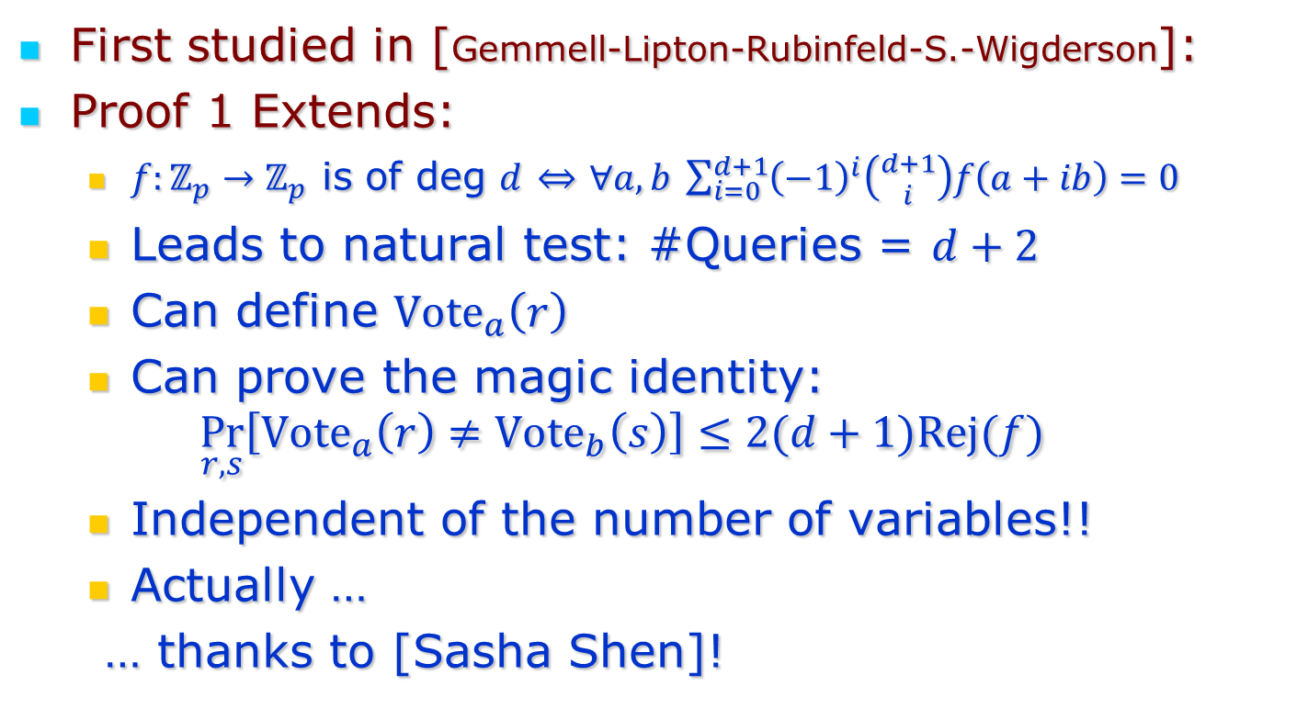
Beyond Linearity
First studied in [Gemmell-Lipton-Rubinfeld-S.-Wigderson]:
Proof 1 Extends:
  $f:ℤ_{p}→ℤ_{p}$ is of deg $d$ $⇔$ $∀a,b \sum_{i=0}^{d+1}{{\left(−1\right)}^{i}\left({d+1 \atop i}\right)f\left(a+ib\right)}=0$
  Leads to natural test: #Queries = $d+2$
  Can define ${Vote}_{a}\left(r\right)$
  Can prove the magic identity:
  $$\underset{r,s}{Pr}\left[{Vote}_{a}\left(r\right)≠{Vote}_{b}\left(s\right)\right]≤2(d+1)Rej(f)$$
  Independent of the number of variables!!
  Actually …
  … thanks to [Sasha Shen]!
$$m$$

Slide 11
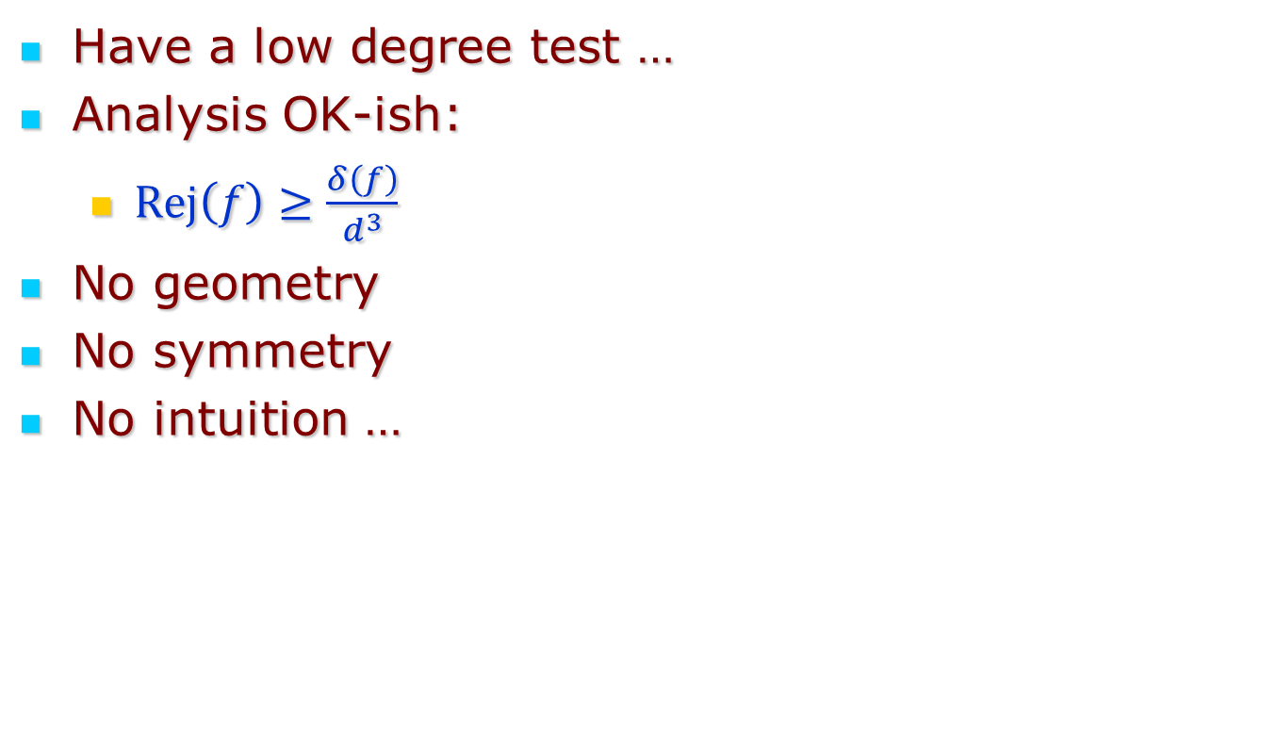
Summary of State of Knowledge in ‘91
Have a low degree test …
Analysis OK-ish:
  $Rej\left(f\right)≥\frac{δ\left(f\right)}{d^{3}}$
No geometry
No symmetry
No intuition …

Slide 12
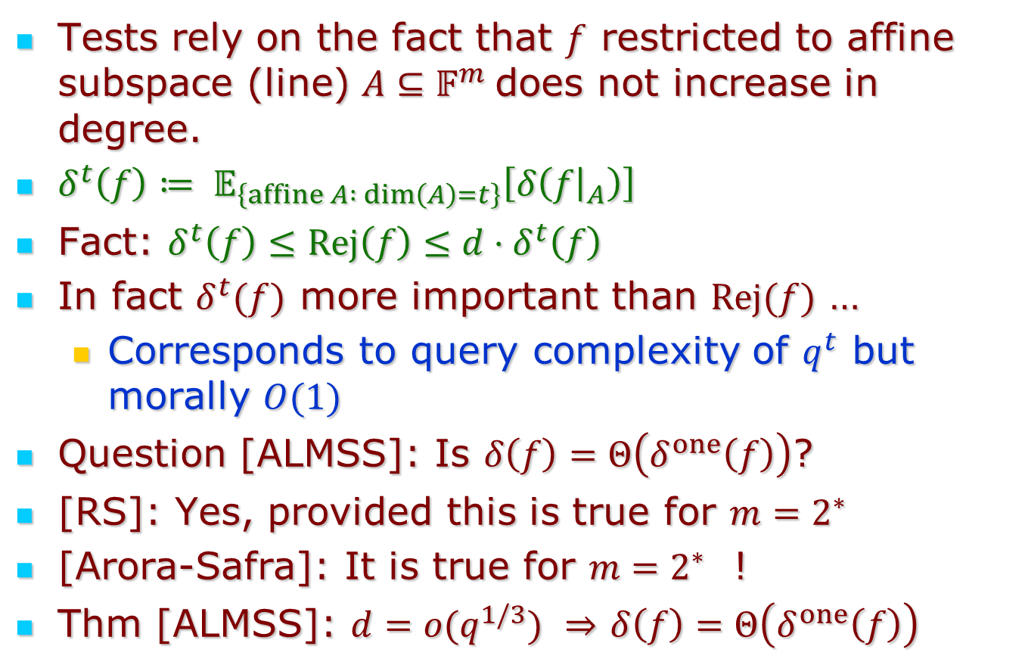
‘91-’92: Rubinfeld-S, ALMSS
Tests rely on the fact that $f$ restricted to affine subspace (line) $A⊆𝔽^{m}$ does not increase in degree.
$δ^{t}\left(f\right)≔ 𝔼_{\left\{affine A : dim\left(A\right)=t\right\}}\left[δ\left(f{\left.​\right|}_{A}\right)\right]$
Fact: $δ^{t}\left(f\right)≤Rej\left(f\right)≤{d⋅δ}^{t}\left(f\right)$
In fact $δ^{t}(f)$ more important than $Rej(f)$ …
  Corresponds to query complexity of $q^{t}$ but morally $O(1)$
Question [ALMSS]: Is $δ\left(f\right)=Θ\left(δ^{one}\left(f\right)\right)$?
[RS]: Yes, provided this is true for $m=2^{∗}$
[Arora-Safra]: It is true for $m=2^{∗}$ !
Thm [ALMSS]: $d={o(q}^{1/3})$ $⇒$ $δ\left(f\right)=Θ\left(δ^{one}\left(f\right)\right)$

Slide 13
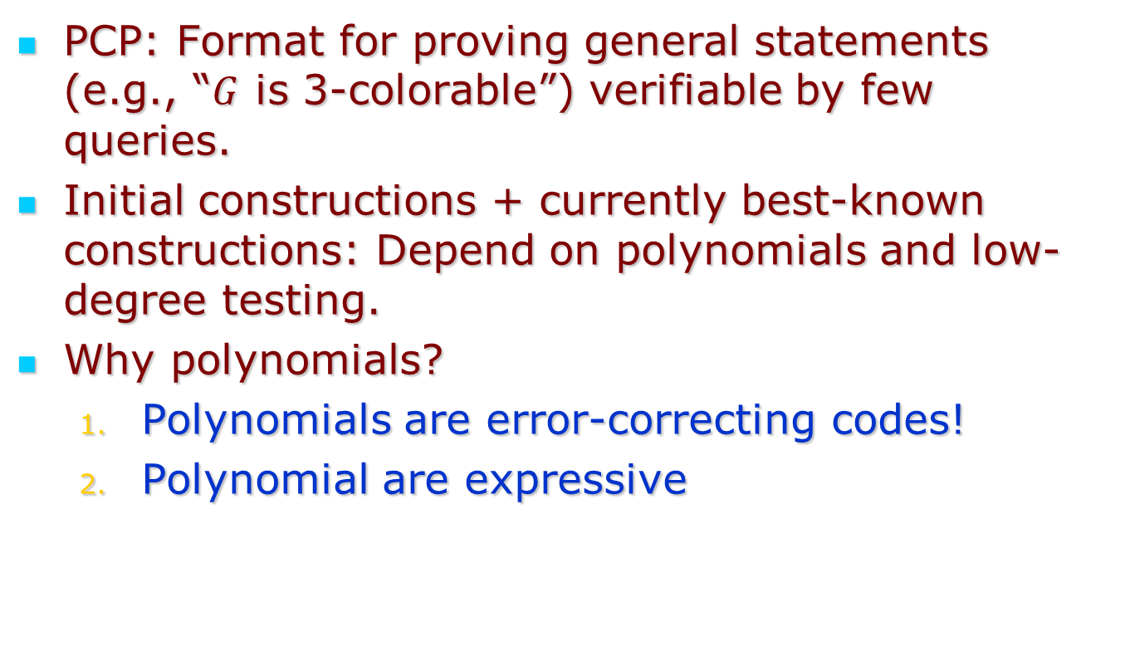
Polynomials and PCPs
PCP: Format for proving general statements (e.g., “$G$ is 3-colorable”) verifiable by few queries.
Initial constructions + currently best-known constructions: Depend on polynomials and low-degree testing.
Why polynomials?
  Polynomials are error-correcting codes!
  Polynomial are expressive

Slide 14
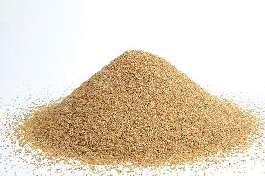
Polynomials = Walls
Data/Proof = zillions of bits … each bit acting independently

Slide 15

Polynomials = walls
Proof = zillions of bits … each bit acting independently
Polynomial = glue that binds them together.

Slide 16
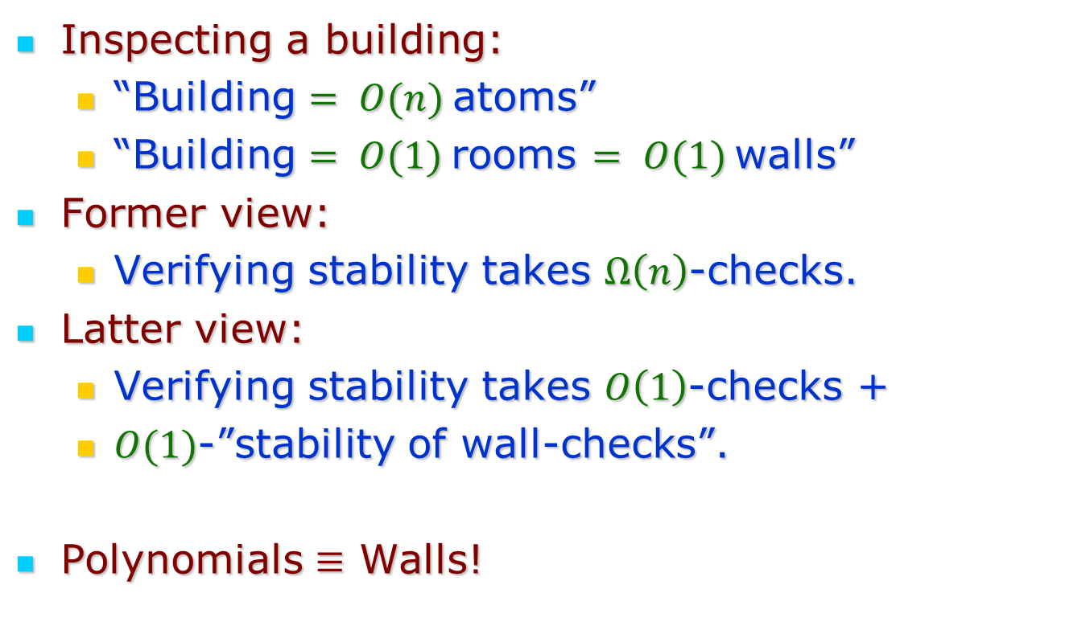
An Analogy
Inspecting a building:
  “Building $= O(n)$atoms”
  “Building $= O(1)$rooms $= O(1)$walls”
Former view:
  Verifying stability takes $Ω\left(n\right)$-checks.
Latter view:
  Verifying stability takes $O\left(1\right)$-checks +
  $O(1)$-”stability of wall-checks”.
Polynomials $≡$ Walls!
  … OR

Slide 17
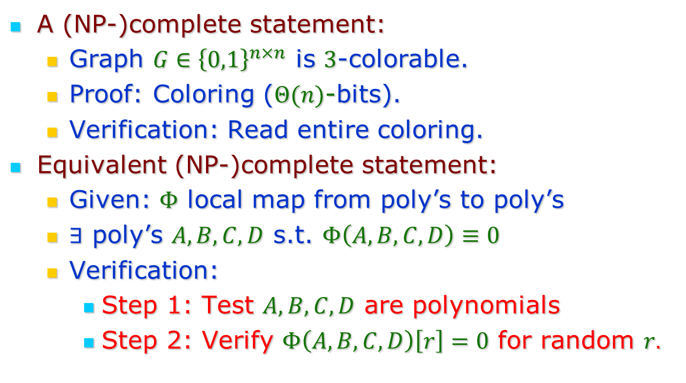
Polynomials = Walls?
A (NP-)complete statement:
  Graph $G∈{\left\{0,1\right\}}^{n×n}$ is $3$-colorable.
  Proof: Coloring ($Θ(n)$-bits).
  Verification: Read entire coloring.
Equivalent (NP-)complete statement:
  Given: $Φ$ local map from poly’s to poly’s
  $∃$ poly’s $A,B,C,D$ s.t. $Φ\left(A,B,C,D\right)≡0$
  Verification:
    Step 1: Test $A,B,C,D$ are polynomials
    Step 2: Verify $Φ\left(A,B,C,D\right)\left[r\right]=0$ for random $r.$

Slide 18
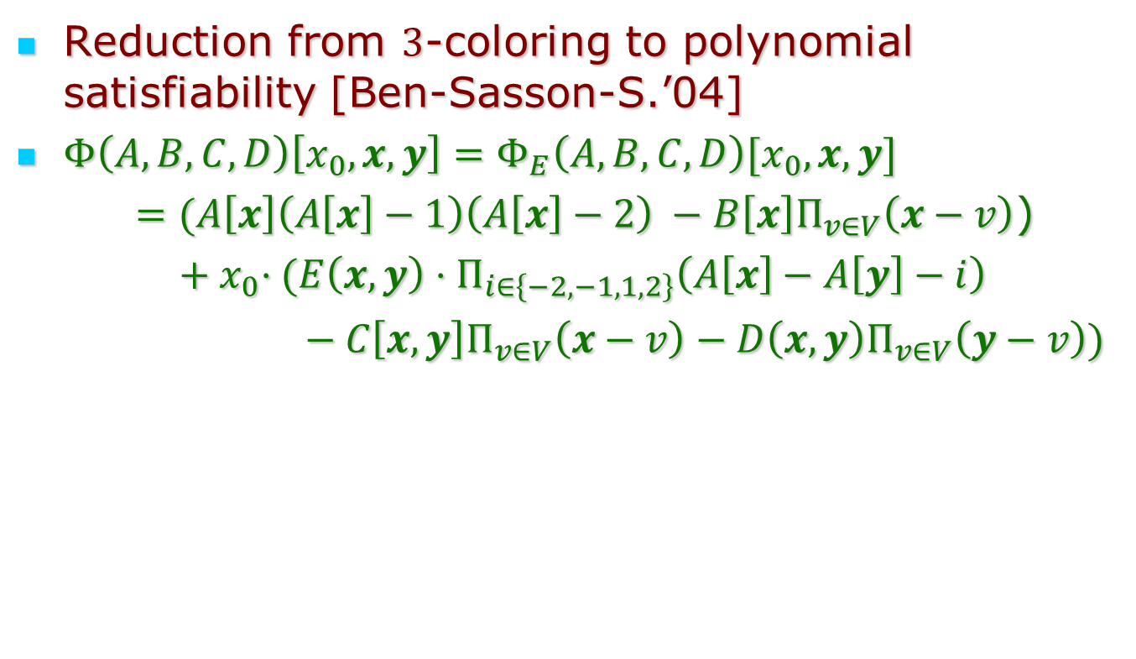
Polynomials = Wall - II
Reduction from $3$-coloring to polynomial satisfiability [Ben-Sasson-S.’04]
$Φ\left(A,B,C,D\right)\left[x_{0},x,y\right]=Φ_{E}\left(A,B,C,D\right)[x_{0},x,y]$
$=(A\left[x\right]\left(A\left[x\right]−1\right)\left(A\left[x\right]−2\right) −B\left[x\right]Π_{v∈V}\left(x−v\right)$)
${ + x}_{0}⋅(E\left(x,y\right)⋅Π_{i∈\left\{−2,−1,1,2\right\}}\left(A\left[x\right]−A\left[y\right]−i\right)$
$− C\left[x,y\right]Π_{v∈V}\left(x−v\right)−D\left(x,y\right)Π_{v∈V}\left(y−v\right))$

Slide 19
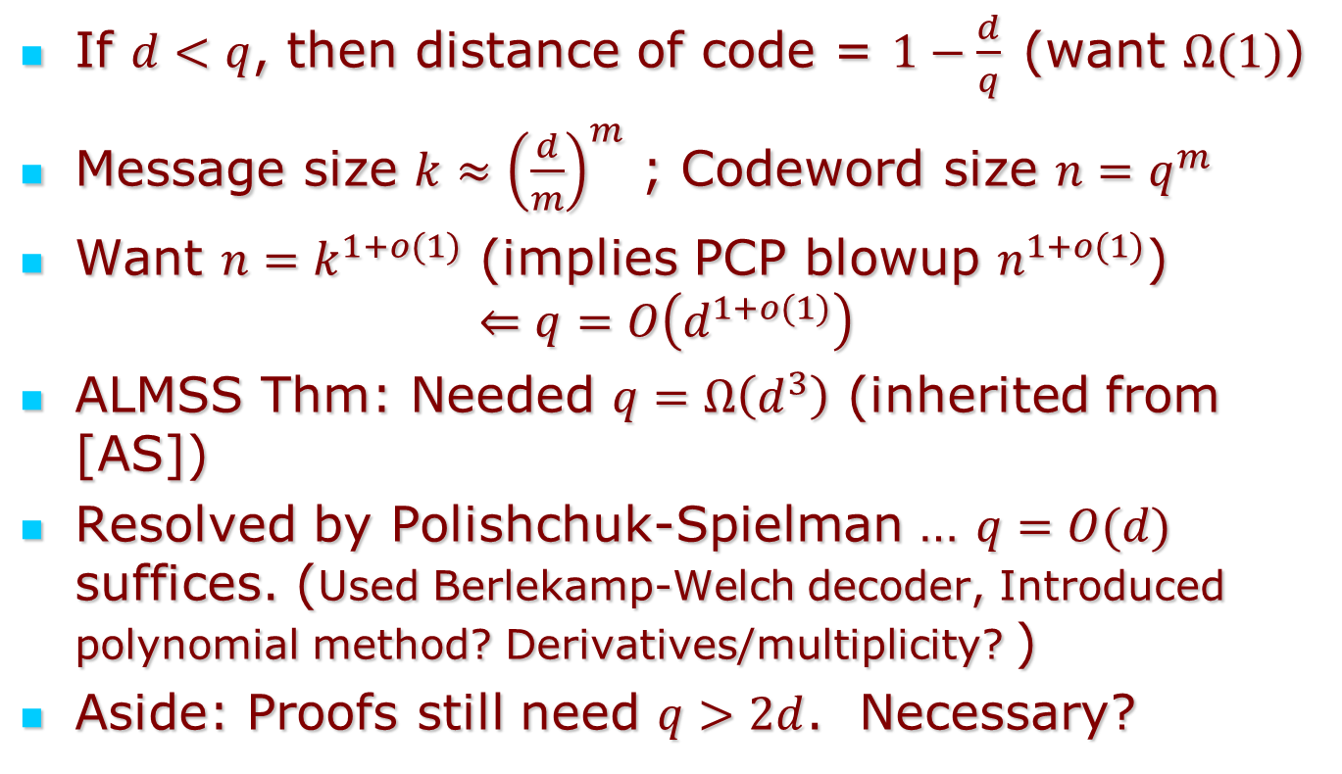
Finer questions: Degree vs. Field Size
If $d<q$, then distance of code = $1−\frac{d}{q}$(want $Ω(1)$)
Message size $k≈{\left(\frac{d}{m}\right)}^{m}$ ; Codeword size $n=q^{m}$
Want $n=k^{1+o(1)}$ (implies PCP blowup $n^{1+o(1)}$)
$$⇐q=O\left(d^{1+o(1)}\right)$$
ALMSS Thm: Needed $q=Ω\left(d^{3}\right)$ (inherited from [AS])
Resolved by Polishchuk-Spielman … $q=O(d)$ suffices. (Used Berlekamp-Welch decoder, Introduced polynomial method? Derivatives/multiplicity? )
Aside: Proofs still need $q>2d$. Necessary?

Slide 20
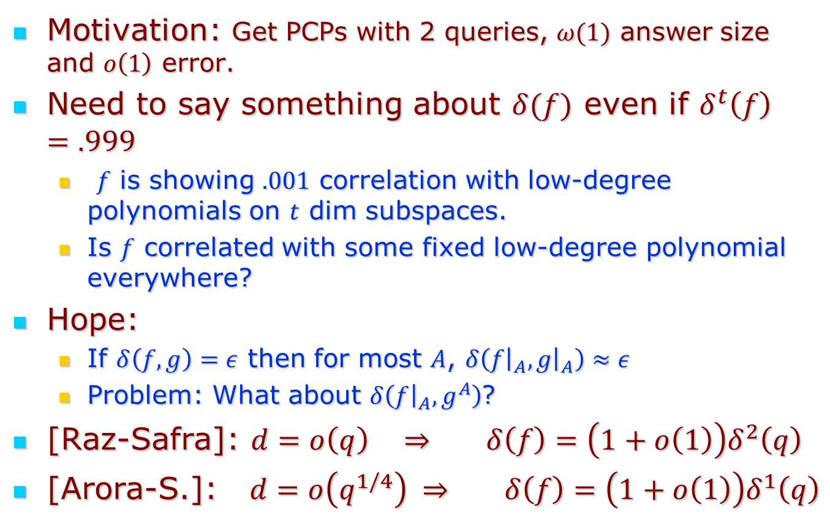
Small Correlations
Motivation: Get PCPs with 2 queries, $ω(1)$ answer size and $o\left(1\right)$ error.
Need to say something about $δ(f)$ even if $δ^{t}\left(f\right)=.999$
  $f$ is showing $.001$ correlation with low-degree polynomials on $t$ dim subspaces.
  Is $f$ correlated with some fixed low-degree polynomial everywhere?
Hope:
  If $δ\left(f,g\right)=ε$ then for most $A$, $δ\left(f{\left.​\right|}_{A},g{\left.​\right|}_{A}\right)≈ε$
  Problem: What about $δ\left(f{\left.​\right|}_{A},g^{A}\right)$?
[Raz-Safra]: $d=o\left(q\right) ⇒ {δ\left(f\right)=\left(1+o\left(1\right)\right)δ}^{2}\left(q\right)$
[Arora-S.]: $d=o\left(q^{1/4}\right) ⇒ δ\left(f\right)=\left(1+o\left(1\right)\right)δ^{1}\left(q\right)$

Slide 21
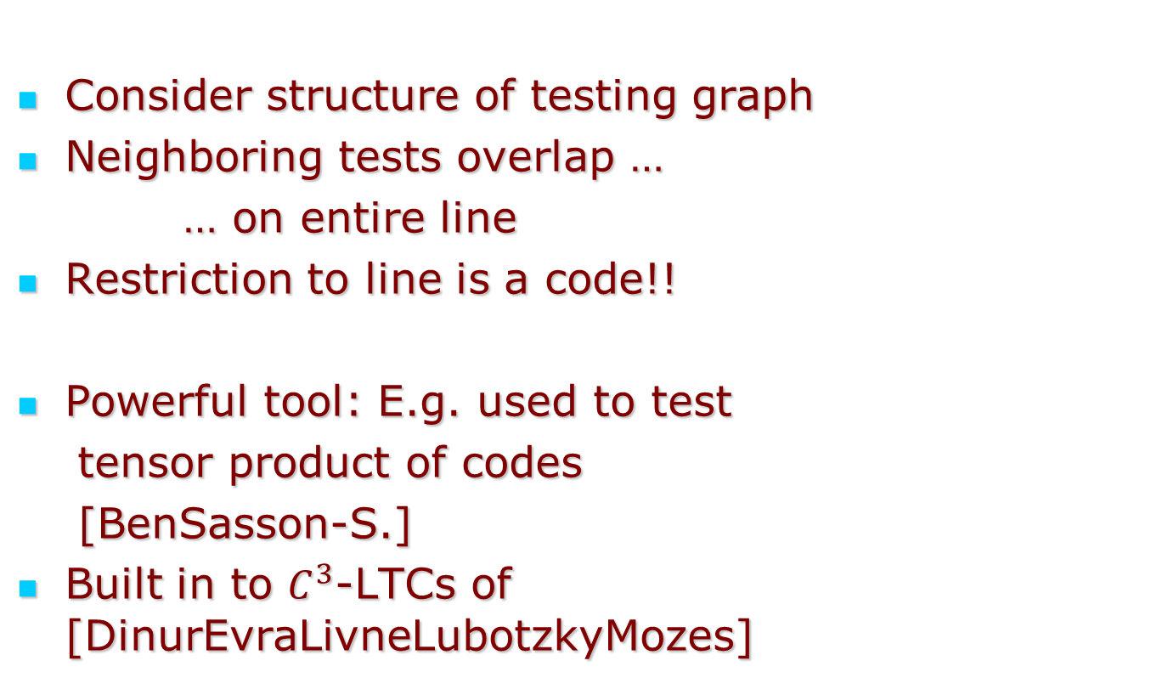
Key insights [RazSafra]
Tests=2-dim. planes
Code
Coordinates
Consider structure of testing graph
Neighboring tests overlap …
… on entire line
Restriction to line is a code!!
Powerful tool: E.g. used to test
tensor product of codes
[BenSasson-S.]
Built in to $C^{3}$-LTCs of [DinurEvraLivneLubotzkyMozes]

Slide 22

Key insights [Arora-S.]
Two steps:
  General reduction from $m$ dim. to 3-dim.
  3-dim. extension of Polishchuk-Spielman replacing [Berlekamp-Welch] with list-decoder.

Slide 23
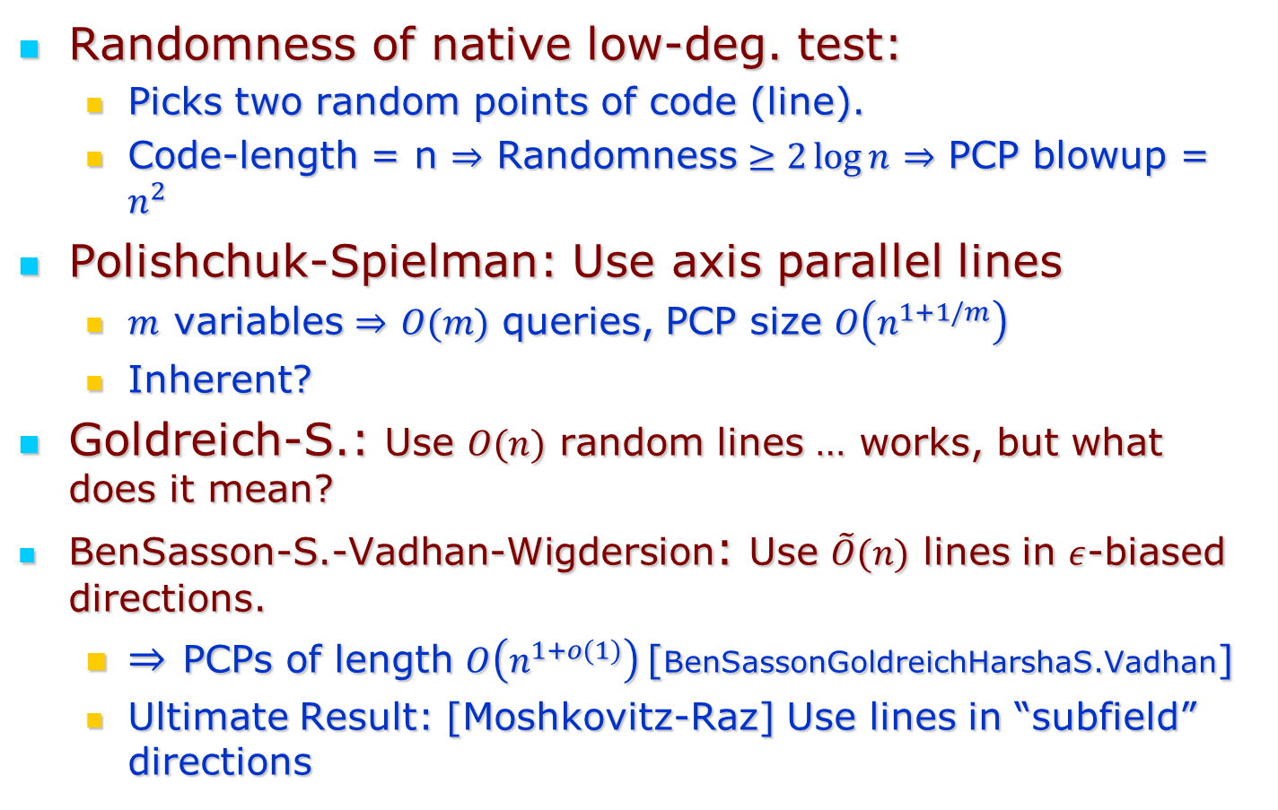
Reducing Randomness
Randomness of native low-deg. test:
  Picks two random points of code (line).
  Code-length = n $⇒$ Randomness $≥2\log{n}$ $⇒$ PCP blowup = $n^{2}$
Polishchuk-Spielman: Use axis parallel lines
  $m$ variables $⇒$ $O(m)$ queries, PCP size $O\left(n^{1+1/m}\right)$
  Inherent?
Goldreich-S.: Use $O(n)$ random lines … works, but what does it mean?
BenSasson-S.-Vadhan-Wigdersion: Use $\tilde{O}(n)$ lines in $ε$-biased directions.
  $⇒$ PCPs of length $O\left(n^{1+o(1)}\right)$[BenSassonGoldreichHarshaS.Vadhan]
  Ultimate Result: [Moshkovitz-Raz] Use lines in “subfield” directions

Slide 24
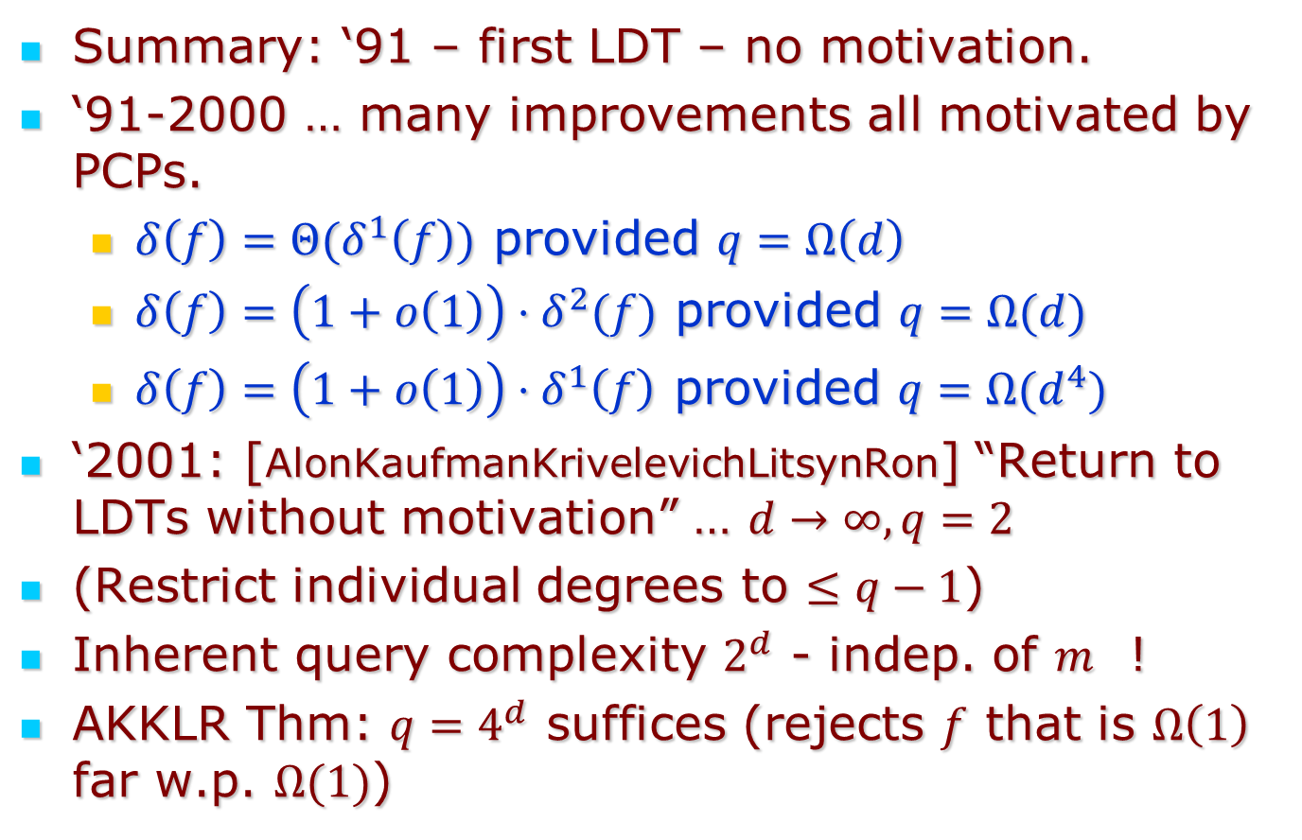
$d≥q$
Summary: ‘91 – first LDT – no motivation.
‘91-2000 … many improvements all motivated by PCPs.
  $δ\left(f\right)=Θ(δ^{1}\left(f\right))$ provided $q=Ω\left(d\right)$
  $δ\left(f\right)=\left(1+o\left(1\right)\right)⋅δ^{2}(f)$ provided $q=Ω(d)$
  $δ\left(f\right)=\left(1+o\left(1\right)\right)⋅δ^{1}\left(f\right)$ provided $q=Ω(d^{4})$
‘2001: [AlonKaufmanKrivelevichLitsynRon] “Return to LDTs without motivation” … $d→∞, q=2$
(Restrict individual degrees to $≤q−1$)
Inherent query complexity $2^{d}$ - indep. of $m$ !
AKKLR Thm: $q=4^{d}$ suffices (rejects $f$ that is $Ω\left(1\right)$ far w.p. $Ω(1)$)

Slide 25
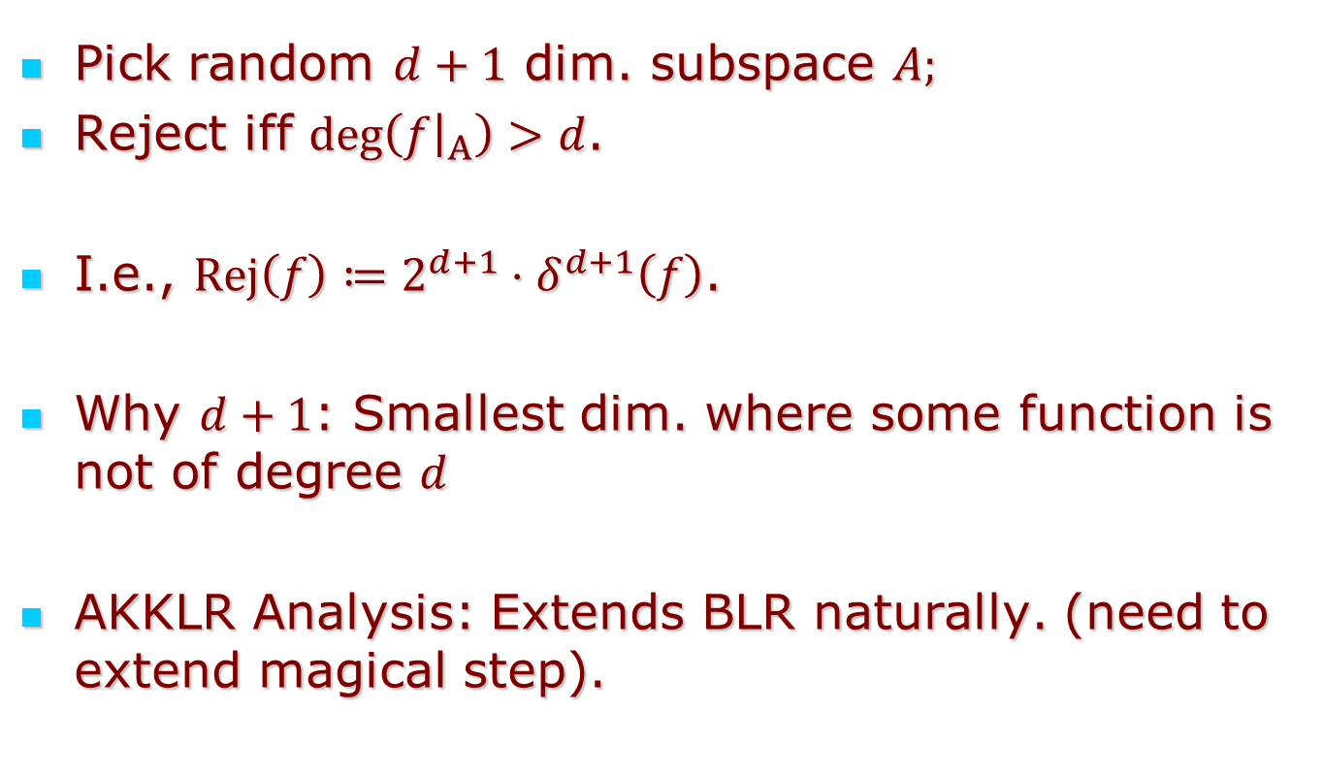
AKKLR Test
Pick random $d+1$ dim. subspace $A;$
Reject iff $\deg\left(f{\left.​\right|}_{A}\right)>d$.
I.e., $Rej\left(f\right)≔2^{d+1}⋅δ^{d+1}\left(f\right)$.
Why $d+1$: Smallest dim. where some function is not of degree $d$
AKKLR Analysis: Extends BLR naturally. (need to extend magical step).

Slide 26
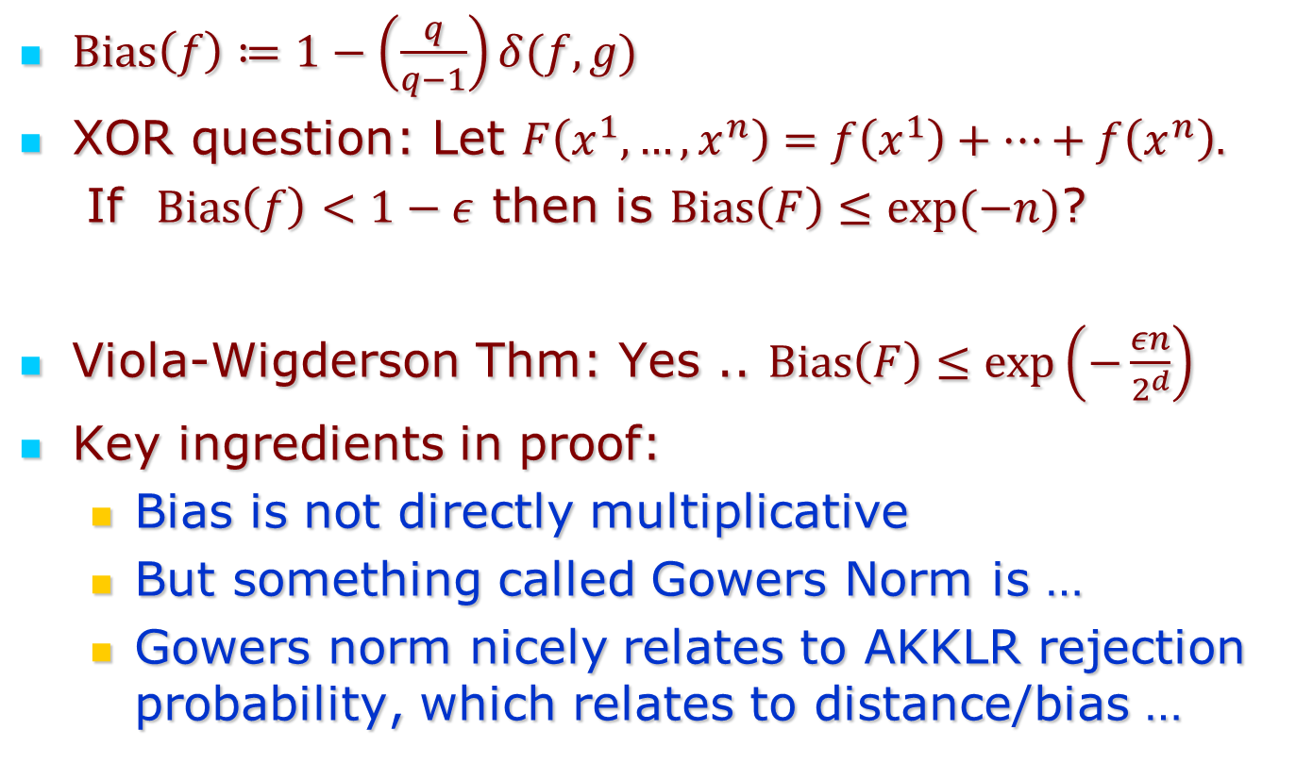
XOR Lemma for Bias of Polynomials
$Bias\left(f\right)≔1−\left(\frac{q}{q−1}\right)δ(f,g)$
XOR question: Let $F\left(x^{1},…,x^{n}\right)=f\left(x^{1}\right)+⋯+f\left(x^{n}\right).$
If $Bias\left(f\right)<1−ε$ then is $Bias\left(F\right)≤exp(−n)$?
Viola-Wigderson Thm: Yes .. $Bias\left(F\right)≤exp\left(−\frac{εn}{2^{d}}\right)$
Key ingredients in proof:
  Bias is not directly multiplicative
  But something called Gowers Norm is …
  Gowers norm nicely relates to AKKLR rejection probability, which relates to distance/bias …

Slide 27
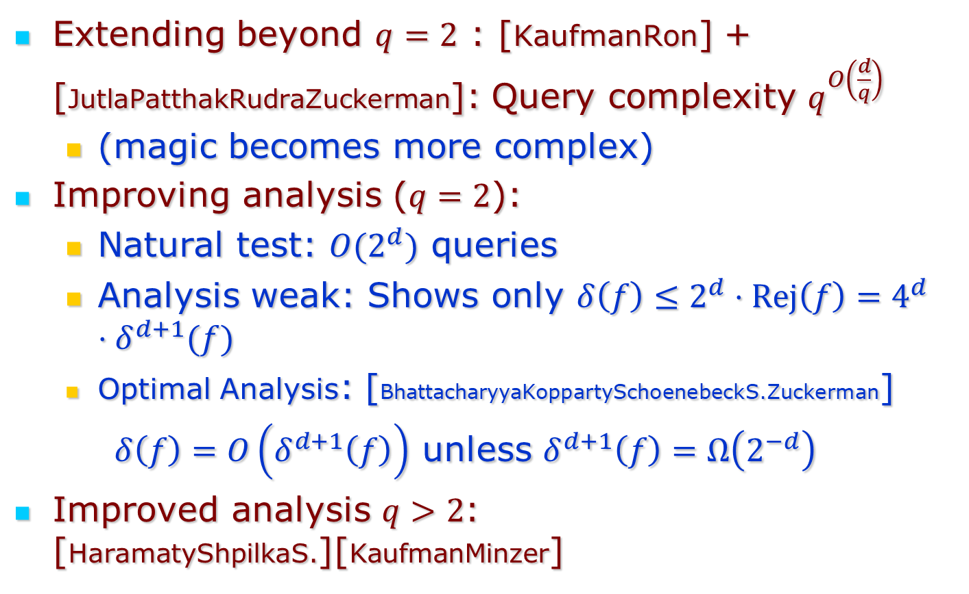
Extending + improving AKKLR
Extending beyond $q=2$ : [KaufmanRon] + [JutlaPatthakRudraZuckerman]: Query complexity $q^{O\left(\frac{d}{q}\right)}$
  (magic becomes more complex)
Improving analysis ($q=2$):
  Natural test: ${O(2}^{d})$ queries
  Analysis weak: Shows only $δ\left(f\right)≤2^{d}⋅Rej\left(f\right)=4^{d}⋅δ^{d+1}(f)$
  Optimal Analysis: [BhattacharyyaKoppartySchoenebeckS.Zuckerman]
  $δ\left(f\right)=O\left(δ^{d+1}\left(f\right)\right)$ unless $δ^{d+1}\left(f\right)=Ω\left(2^{−d}\right)$
Improved analysis $q>2$: [HaramatyShpilkaS.][KaufmanMinzer]

Slide 28
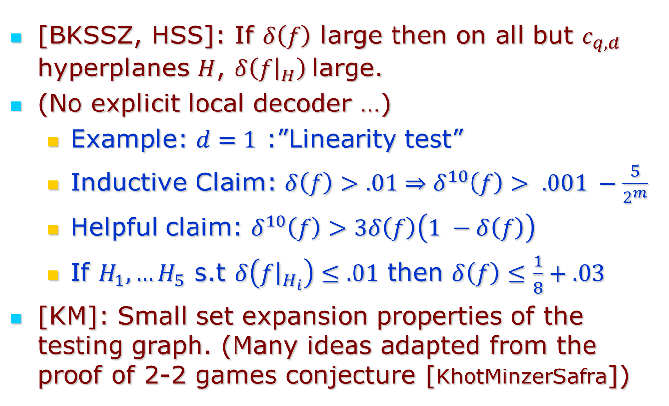
Main Insight
[BKSSZ, HSS]: If $δ\left(f\right)$ large then on all but $c_{q,d}$ hyperplanes $H$, $δ\left(f{\left.​\right|}_{H}\right)$large.
(No explicit local decoder …)
  Example: $d=1$ :”Linearity test”
  Inductive Claim: $δ\left(f\right)>.01⇒δ^{10}\left(f\right)> .001 −\frac{5}{2^{m}}$
  Helpful claim: $δ^{10}\left(f\right)>3δ\left(f\right)\left(1 −δ\left(f\right)\right)$
  If $H_{1},…H_{5}$ s.t $δ\left(f{\left.​\right|}_{H_{i}}\right)≤.01$ then $δ\left(f\right)≤\frac{1}{8}+.03$
[KM]: Small set expansion properties of the testing graph. (Many ideas adapted from the proof of 2-2 games conjecture [KhotMinzerSafra])

Slide 29
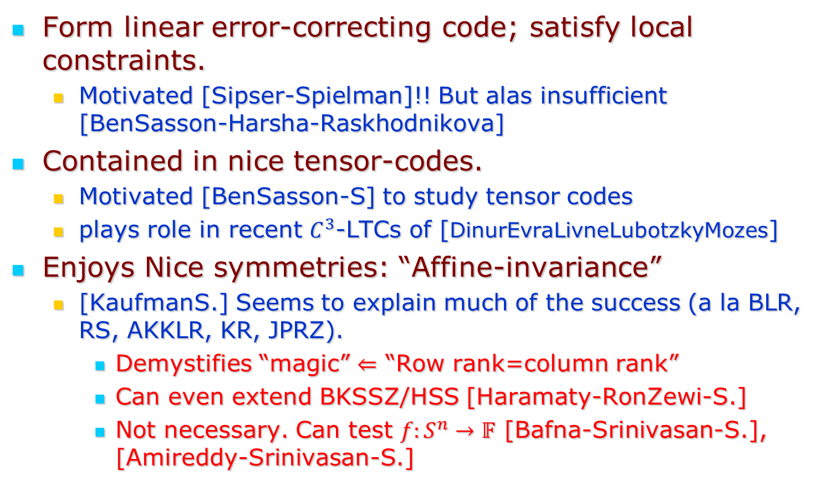
Some introspection:
What made polys testable?
Form linear error-correcting code; satisfy local constraints.
  Motivated [Sipser-Spielman]!! But alas insufficient [BenSasson-Harsha-Raskhodnikova]
Contained in nice tensor-codes.
  Motivated [BenSasson-S] to study tensor codes
  plays role in recent $C^{3}$-LTCs of [DinurEvraLivneLubotzkyMozes]
Enjoys Nice symmetries: “Affine-invariance”
  [KaufmanS.] Seems to explain much of the success (a la BLR, RS, AKKLR, KR, JPRZ).
    Demystifies “magic” $⇐$ “Row rank=column rank”
    Can even extend BKSSZ/HSS [Haramaty-RonZewi-S.]
    Not necessary. Can test $f:S^{n}→𝔽$ [Bafna-Srinivasan-S.], [Amireddy-Srinivasan-S.]

Slide 30
Summary/Future questions
Over three decades … have developed a deep understanding of the local-global structure of polynomials
Some future directions:
  Explain everything in terms of affine-invariance?
  Generalize to product property codes
  LTCs to PCPs … abstract expressivity?

Slide 31
Thank You!

