Slide 1

$≈$ 50 years of approximability
Madhu Sudan
Harvard University

Slide 2
Phases in the Study of Approximability
Phase 0 (‘72): Discovery of NP-Completeness
Phase 1: (‘73-’88): Sporadic discovery of approximation algorithms and the fragility of reductions.
Phase 2: (‘88-’91): MaxSNP, L-reductions, and a theory!!
Phase 3: (’91-’95): PCPs, SDPs and a coarse picture.
Phase 4: (’96-’02): Fourier analysis and some optimal results.
Phase 5: (’02-08): UGC, SOS and a tight picture.

Slide 3

Phase 1: (Lack of) Awareness

Slide 4
Phase 1 Understanding of Approximability
Broad overview:
  Some experts knew the issue was subtle (varied from problem to problem).
  Most of the community:
  “Why is one hardness result not sufficient?”
“What is approximation?”
“Is that like Approximate counting?”

Slide 5
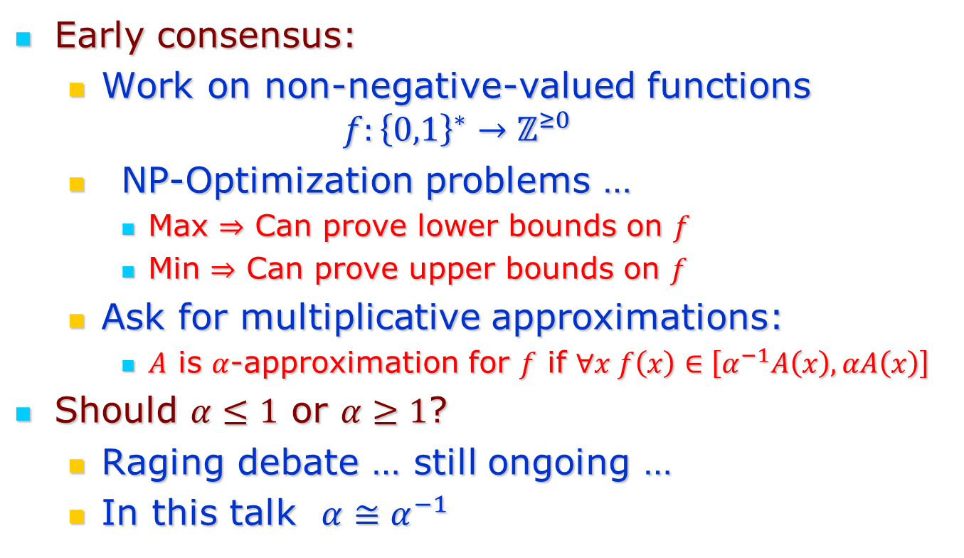
Definition of Approximation
Early consensus:
  Work on non-negative-valued functions
  $$f:{\left\{0,1\right\}}^{∗}→ℤ^{≥0}$$
  NP-Optimization problems …
    Max $⇒$ Can prove lower bounds on $f$
    Min $⇒$ Can prove upper bounds on $f$
  Ask for multiplicative approximations:
    $A$ is $α$-approximation for $f$ if $∀x f\left(x\right)∈\left[α^{−1}A\left(x\right), αA\left(x\right)\right]$
Should $α≤1$ or $α≥1$?
  Raging debate … still ongoing …
  In this talk $α≅α^{−1}$

Slide 6
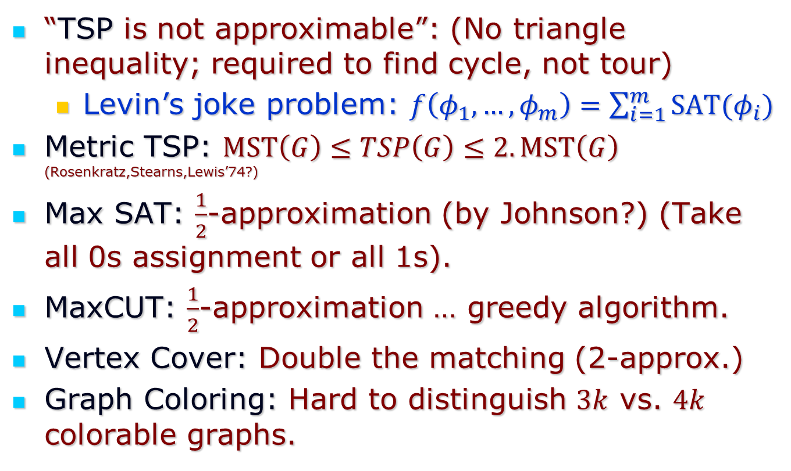
Some notable Problems/Algorithms
“TSP is not approximable”: (No triangle inequality; required to find cycle, not tour)
  Levin’s joke problem: $f\left(φ_{1},…,φ_{m}\right)=\sum_{i=1}^{m}{SAT(φ_{i})}$
Metric TSP: $MST\left(G\right)≤TSP\left(G\right)≤2.MST\left(G\right)$ (Rosenkratz,Stearns,Lewis’74?)
Max SAT: $\frac{1}{2}$-approximation (by Johnson?) (Take all 0s assignment or all 1s).
MaxCUT: $\frac{1}{2}$-approximation … greedy algorithm.
Vertex Cover: Double the matching (2-approx.)
Graph Coloring: Hard to distinguish $3k$ vs. $4k$ colorable graphs.

Slide 7
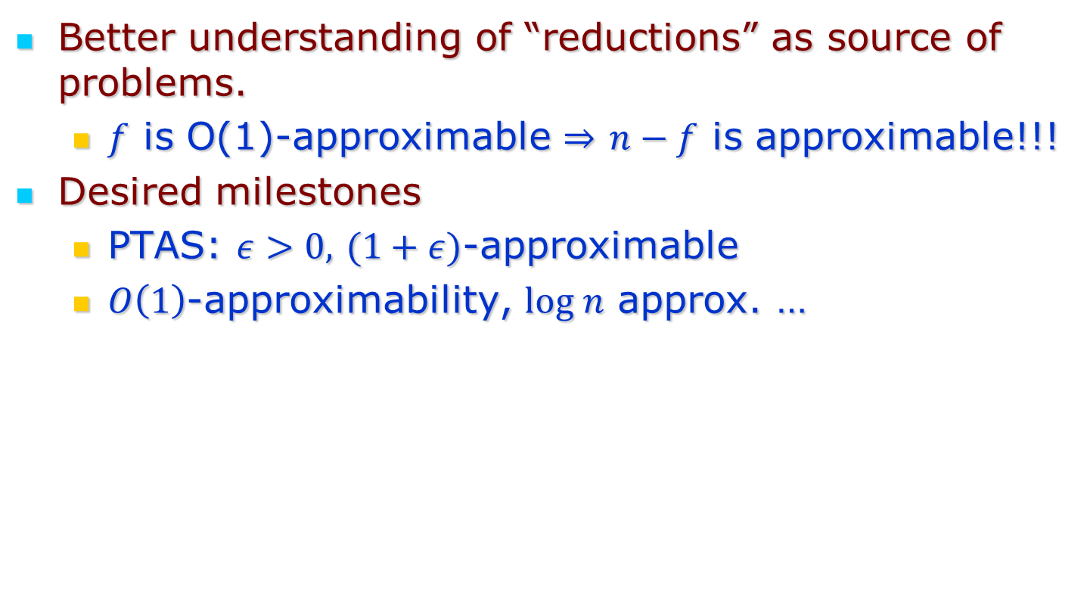
Increasing awareness
Better understanding of “reductions” as source of problems.
  $f$ is O(1)-approximable $⇒$ $n−f$ is approximable!!!
Desired milestones
  PTAS: $ε>0,$ $(1+ε)$-approximable
  $O\left(1\right)$-approximability, $log n$ approx. …

Slide 8
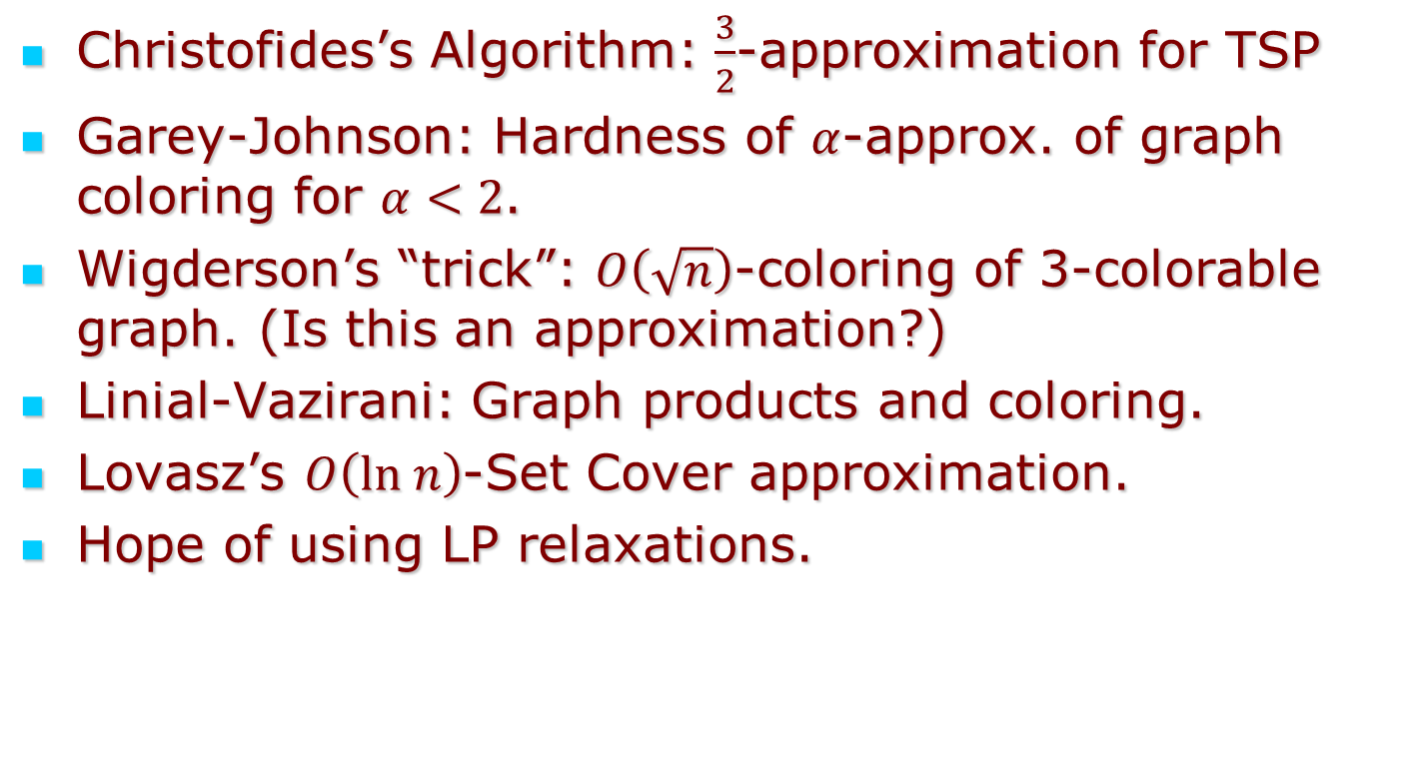
Increasing sophistication
Christofides’s Algorithm: $\frac{3}{2}$-approximation for TSP
Garey-Johnson: Hardness of $α$-approx. of graph coloring for $α<2$.
Wigderson’s “trick”: $O\left(\sqrt{n}\right)$-coloring of 3-colorable graph. (Is this an approximation?)
Linial-Vazirani: Graph products and coloring.
Lovasz’s $O\left(ln n\right)$-Set Cover approximation.
Hope of using LP relaxations.

Slide 9
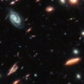



Phase 2: A New Hope

Slide 10
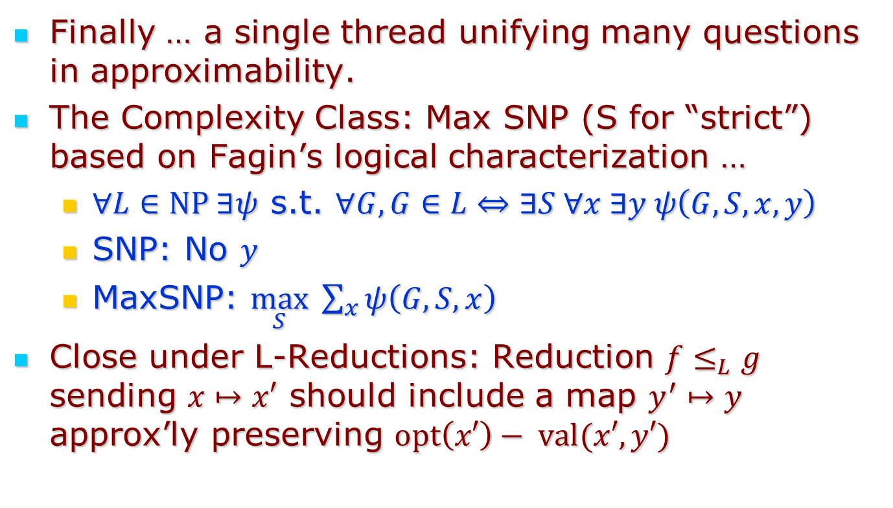
“Optimization, Approximation & Complexity Classes” – P+Y ‘88
Finally … a single thread unifying many questions in approximability.
The Complexity Class: Max SNP (S for “strict”) based on Fagin’s logical characterization …
  $∀L∈NP ∃ψ$ s.t. $∀G, G∈L⇔∃S ∀x ∃y ψ\left(G,S,x,y\right)$
  SNP: No $y$
  MaxSNP: $\max_{S} \sum_{x}{ψ\left(G,S,x\right)}$
Close under L-Reductions: Reduction $f≤_{L}g$ sending $x↦x′$ should include a map $y^{′}↦y$ approx’ly preserving $opt\left(x′\right)− val(x′,y′)$

Slide 11
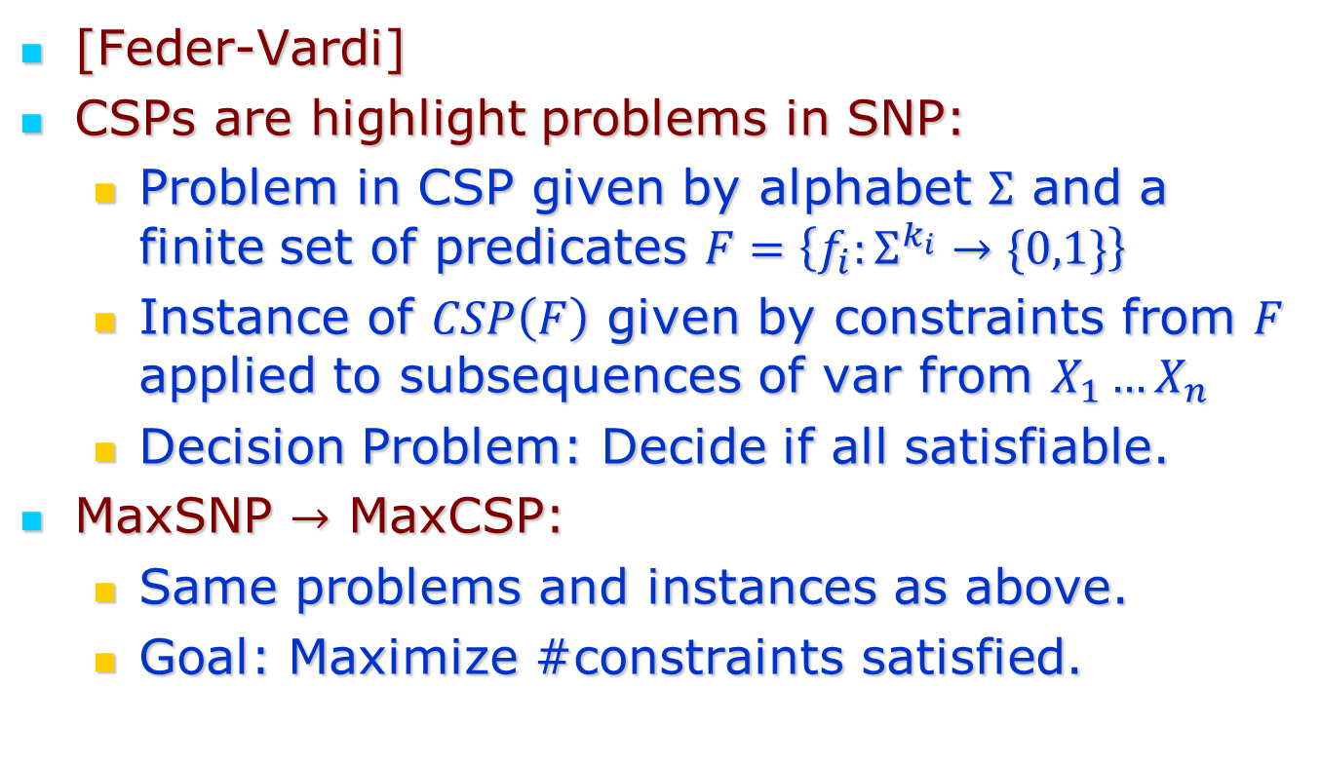
SNP vs. CSP
[Feder-Vardi]
CSPs are highlight problems in SNP:
  Problem in CSP given by alphabet $Σ$ and a finite set of predicates $F=\left\{f_{i}:Σ^{k_{i}}→\{0,1\}\right\}$
  Instance of $CSP\left(F\right)$ given by constraints from $F$ applied to subsequences of var from $X_{1}…X_{n}$
  Decision Problem: Decide if all satisfiable.
MaxSNP $→$ MaxCSP:
  Same problems and instances as above.
  Goal: Maximize #constraints satisfied.

Slide 12
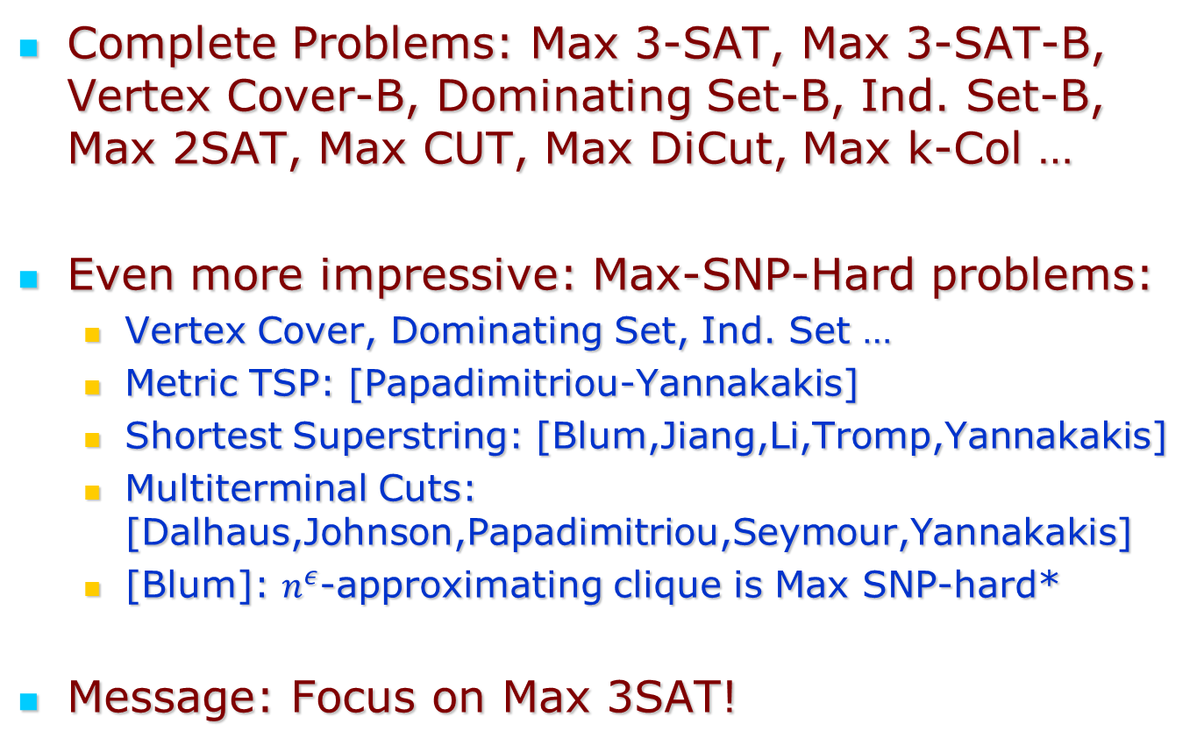
“Optimization, Approximation & Complexity Classes” – P+Y ‘88
Complete Problems: Max 3-SAT, Max 3-SAT-B, Vertex Cover-B, Dominating Set-B, Ind. Set-B, Max 2SAT, Max CUT, Max DiCut, Max k-Col …
Even more impressive: Max-SNP-Hard problems:
  Vertex Cover, Dominating Set, Ind. Set …
  Metric TSP: [Papadimitriou-Yannakakis]
  Shortest Superstring: [Blum,Jiang,Li,Tromp,Yannakakis]
  Multiterminal Cuts: [Dalhaus,Johnson,Papadimitriou,Seymour,Yannakakis]
  [Blum]: $n^{ε}$-approximating clique is Max SNP-hard*
Message: Focus on Max 3SAT!

Slide 13
Some quotes from the paper
How/why we define classes
“In complexity, when we are faced with such a situation, in which a family of problems cannot be identified with the known complexity classes (P and NP in our case), one suspects that a new complexity class may be manifesting itself.”
(Pursued in papers on … Limited Non-Det, Local Search, PPAD, FIXP)
Identifying what was missing: gap creating reduction
“Intuitively, the difficulty lies in that our main technique for showing negative approximability results is the creation of a gap in the cost function.”
“There seems to be no notion of “approximately correct computation””

Slide 14
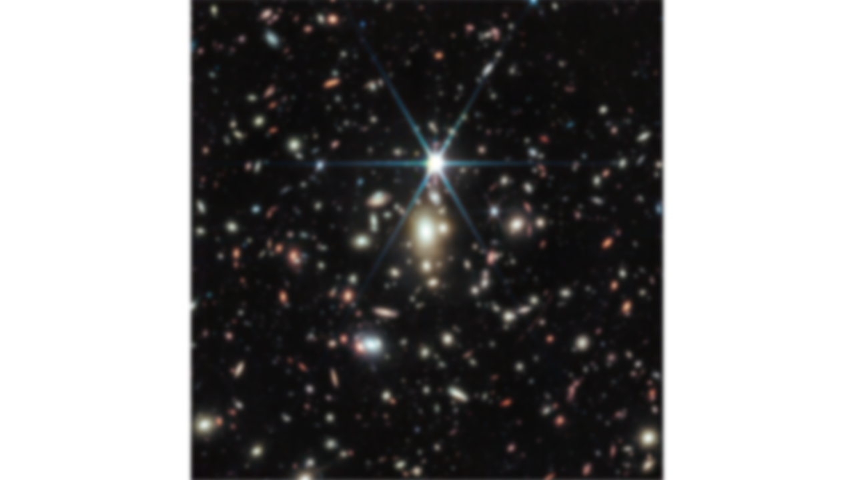
Phase 3: PCPs and SDPs

Slide 15
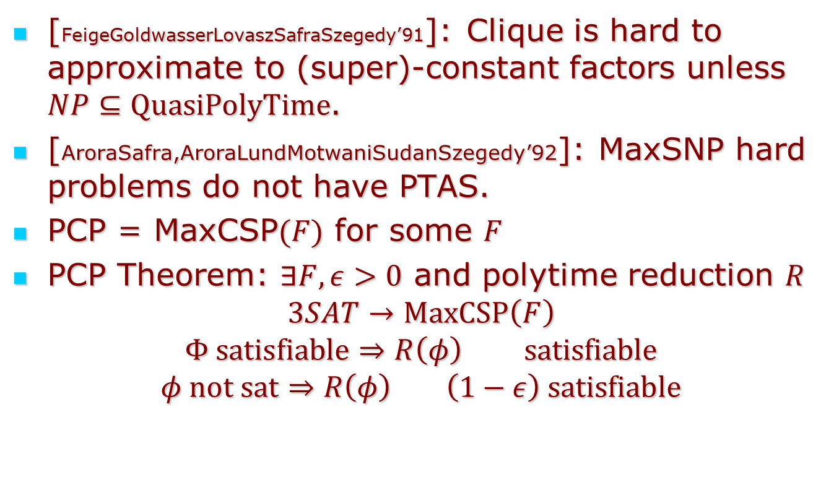
The PCP Connection
[FeigeGoldwasserLovaszSafraSzegedy’91]: Clique is hard to approximate to (super)-constant factors unless $NP⊆QuasiPolyTime$.
[AroraSafra,AroraLundMotwaniSudanSzegedy’92]: MaxSNP hard problems do not have PTAS.
PCP = MaxCSP$(F)$ for some $F$
PCP Theorem: $∃F,ε>0$ and polytime reduction $R$
$$3SAT→MaxCSP\left(F\right)$$
$$Φ satisfiable⇒R\left(φ\right) satisfiable$$
$$φ not sat⇒R\left(φ\right) \left(1−ε\right) satisfiable$$
“Intuitively, the difficulty lies in that our main technique for showing negative approximability results is the creation of a gap in the cost function.”

Slide 16
Aside: Soda ‘92
Personally Significant Moment:
  Mihalis’s talk on ¾ - approximating Max SAT
Led to realization “approximately correct computation” and PCP and Max SNP …
Mihalis brought ALMSS authors together …

Slide 17
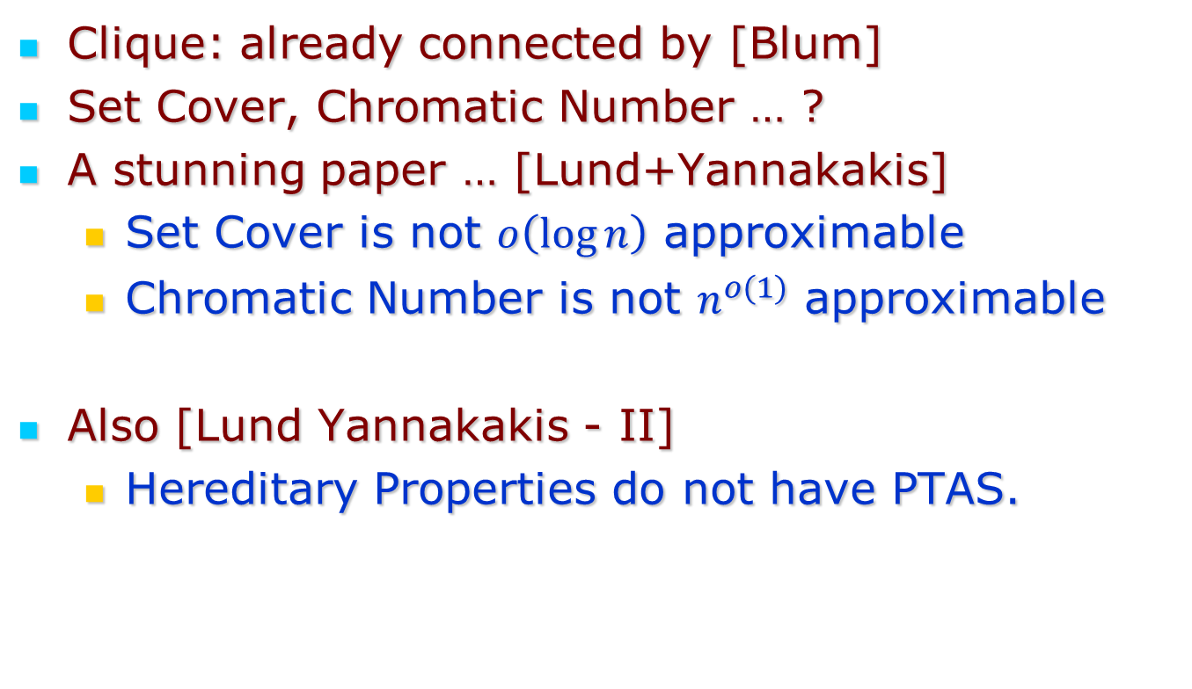
Extensions beyond MaxSNP
Clique: already connected by [Blum]
Set Cover, Chromatic Number … ?
A stunning paper … [Lund+Yannakakis]
  Set Cover is not $o\left(\log{n}\right)$ approximable
  Chromatic Number is not $n^{o(1)}$ approximable
Also [Lund Yannakakis - II]
  Hereditary Properties do not have PTAS.

Slide 18
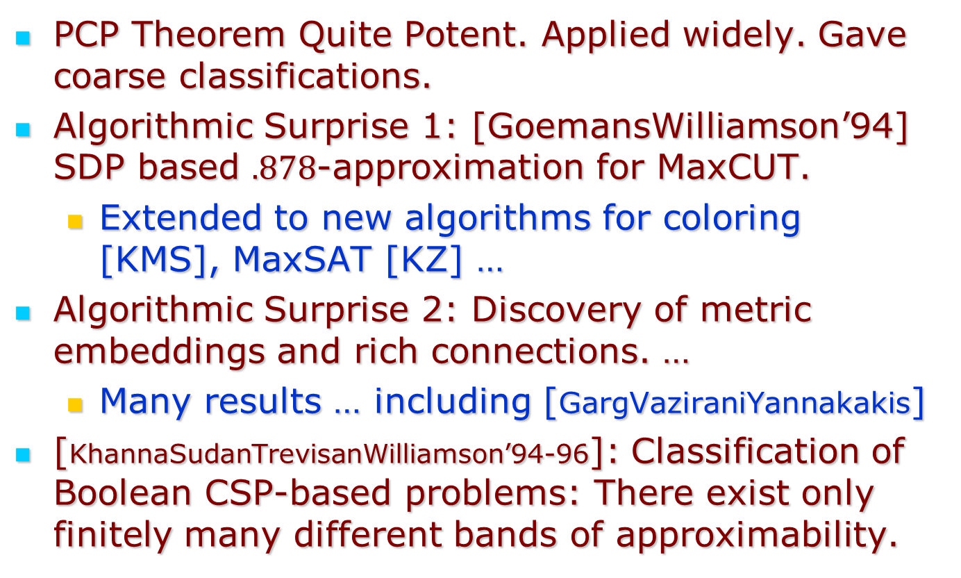
End of Algorithmica?
PCP Theorem Quite Potent. Applied widely. Gave coarse classifications.
Algorithmic Surprise 1: [GoemansWilliamson’94] SDP based $.878$-approximation for MaxCUT.
  Extended to new algorithms for coloring [KMS], MaxSAT [KZ] …
Algorithmic Surprise 2: Discovery of metric embeddings and rich connections. …
  Many results … including [GargVaziraniYannakakis]
[KhannaSudanTrevisanWilliamson’94-96]: Classification of Boolean CSP-based problems: There exist only finitely many different bands of approximability.

Slide 19
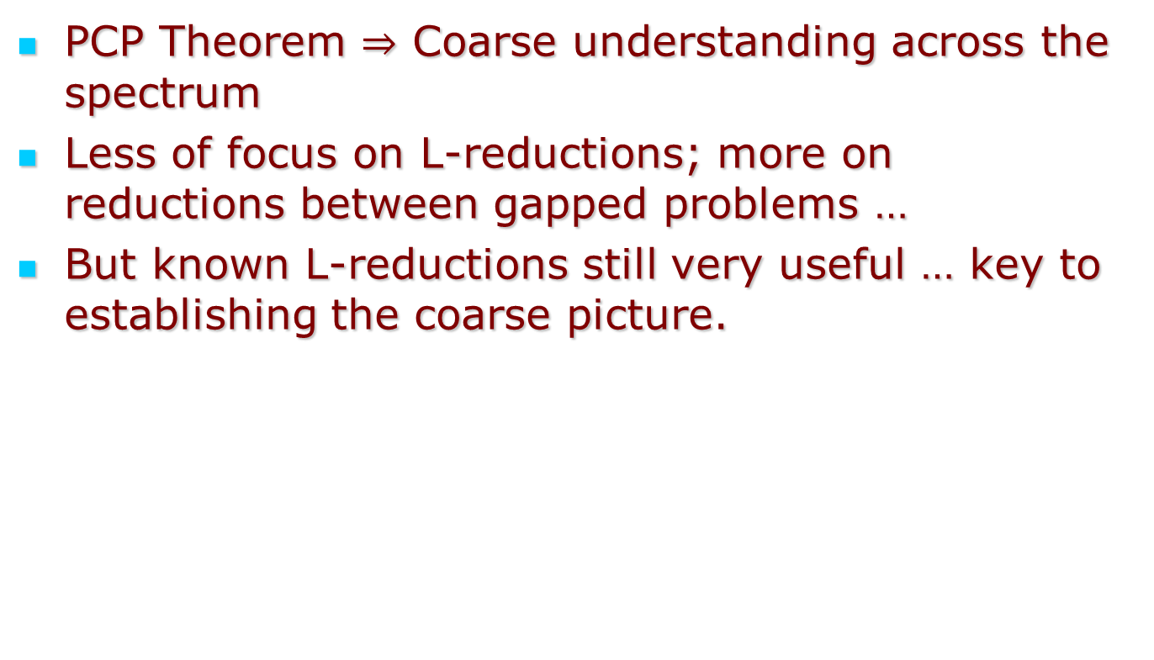
Summary of Phase 3
PCP Theorem $⇒$ Coarse understanding across the spectrum
Less of focus on L-reductions; more on reductions between gapped problems …
But known L-reductions still very useful … key to establishing the coarse picture.

Slide 20
Phase 4: Some Optimal Results

Slide 21
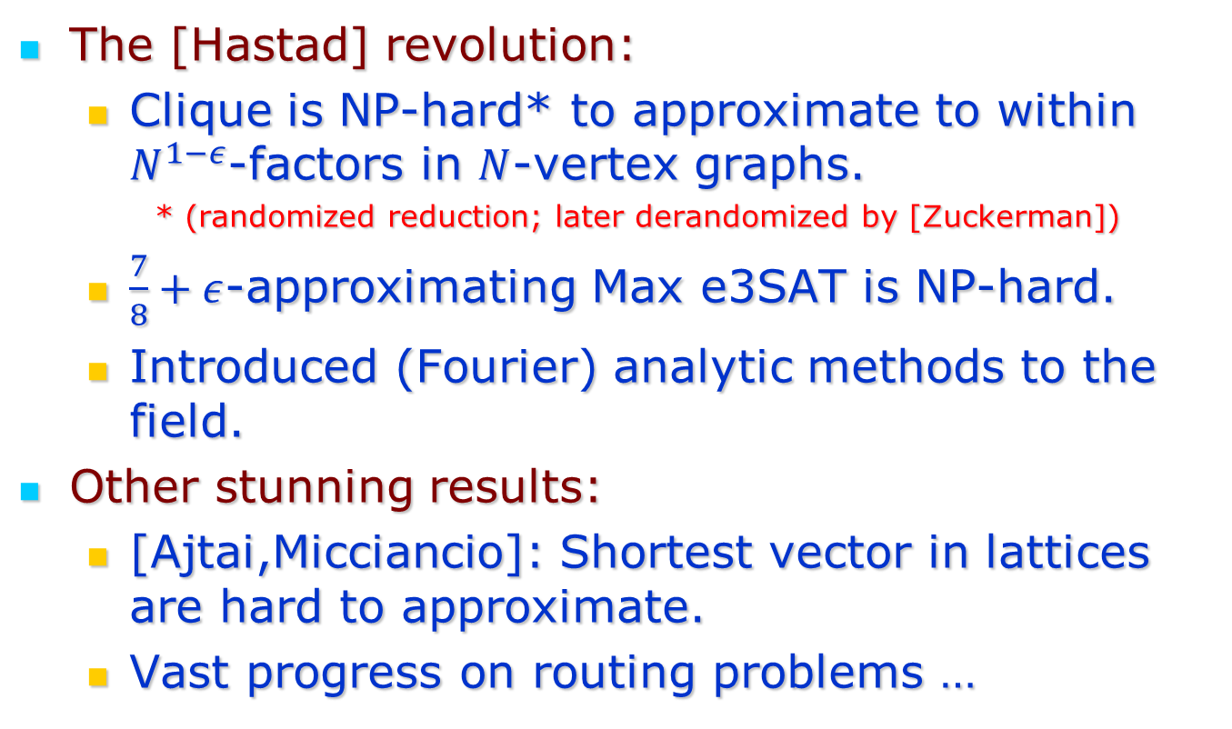
‘96-98
The [Hastad] revolution:
  Clique is NP-hard* to approximate to within $N^{1−ε}$-factors in $N$-vertex graphs.
    * (randomized reduction; later derandomized by [Zuckerman])
  $\frac{7}{8}+ε$-approximating Max e3SAT is NP-hard.
  Introduced (Fourier) analytic methods to the field.
Other stunning results:
  [Ajtai,Micciancio]: Shortest vector in lattices are hard to approximate.
  Vast progress on routing problems …

Slide 22
Not all negative news
Absence of hardness results now was a signal:
  [Arora, Michell] TSP in Euclidean spaces.
  [Chuzhoy, Li] Approximation for edge-disjoint paths
Still gaps existed. Many “2-variable problems”
  Vertex Cover?
  Max Cut
  Max 2SAT

Slide 23
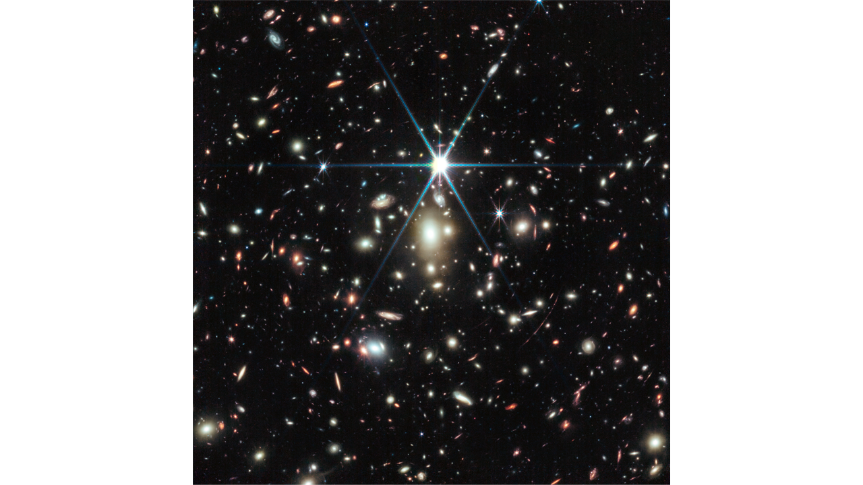
Phase 5: Conditional Clarity
Almost Everywhere

Slide 24
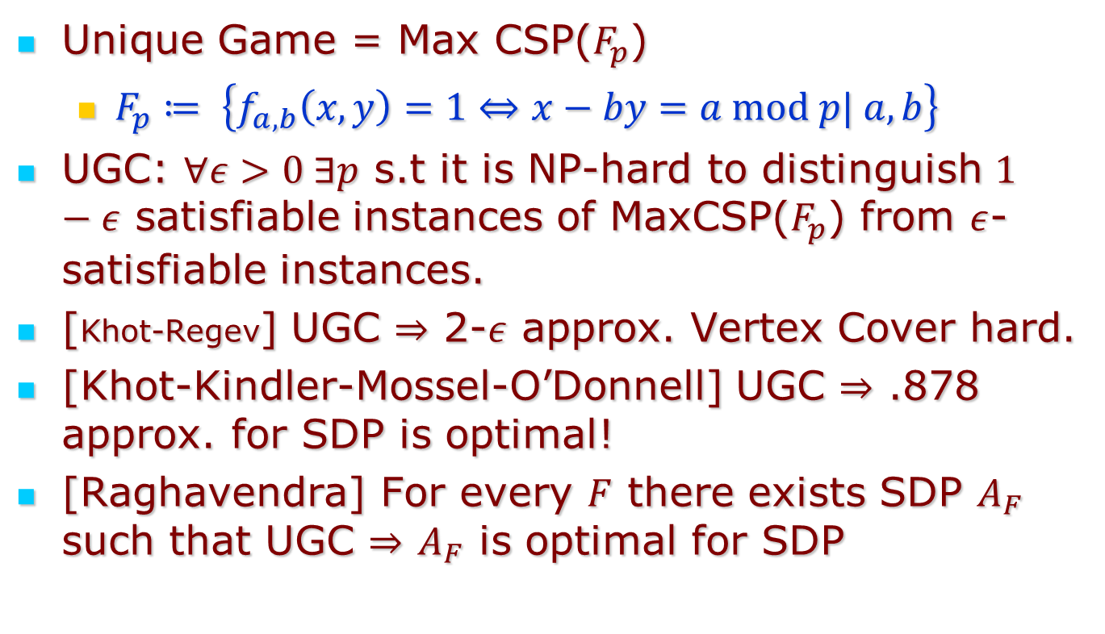
Khot’s UGC
Unique Game = Max CSP($F_{p}$)
  $F_{p}≔ \left\{f_{a,b}\left(x,y\right)=1⇔x−by=a mod p| a,b\right\}$
UGC: $∀ε>0 ∃p$ s.t it is NP-hard to distinguish $1−ε$ satisfiable instances of MaxCSP($F_{p}$) from $ε$-satisfiable instances.
[Khot-Regev] UGC $⇒$ 2-$ε$ approx. Vertex Cover hard.
[Khot-Kindler-Mossel-O’Donnell] UGC $⇒$ .878 approx. for SDP is optimal!
[Raghavendra] For every $F$ there exists SDP $A_{F}$ such that UGC $⇒$ $A_{F}$ is optimal for SDP

Slide 25
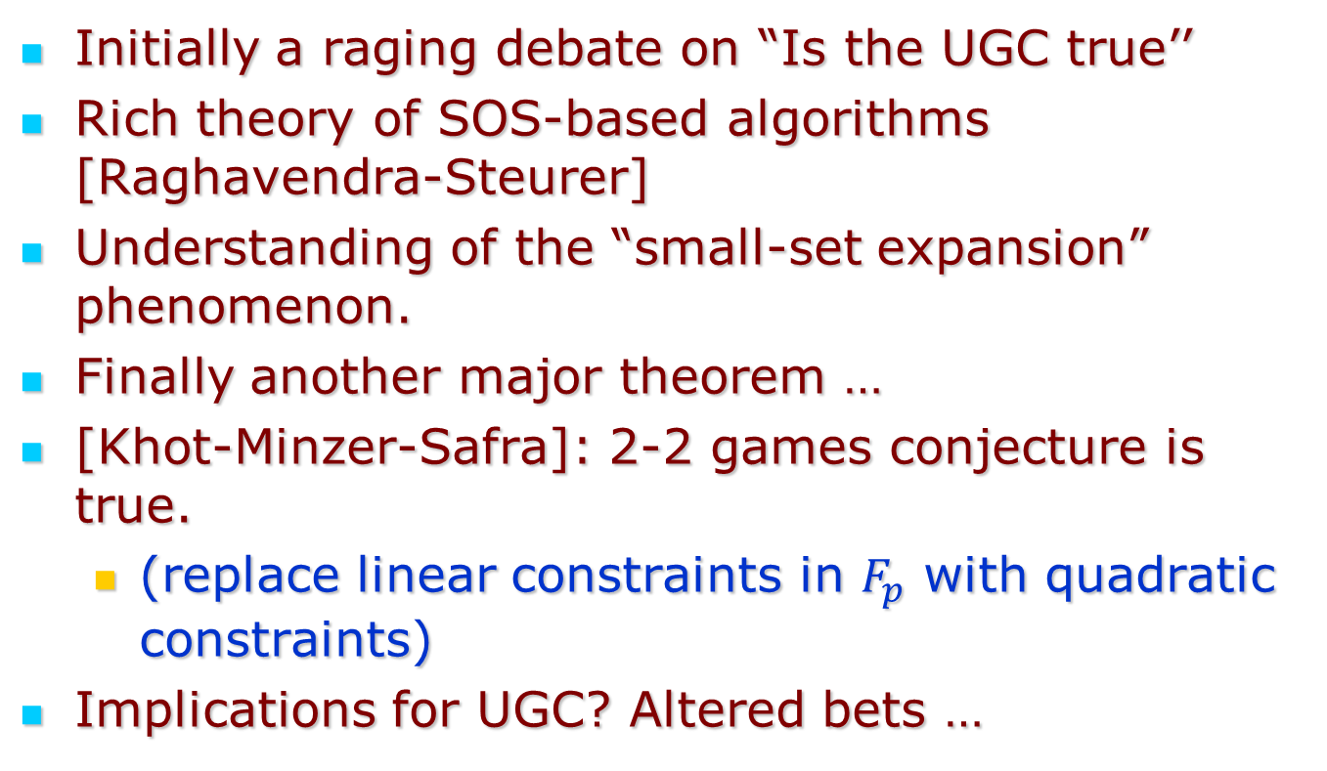
Last decade or so …
Initially a raging debate on “Is the UGC true’’
Rich theory of SOS-based algorithms [Raghavendra-Steurer]
Understanding of the “small-set expansion” phenomenon.
Finally another major theorem …
[Khot-Minzer-Safra]: 2-2 games conjecture is true.
  (replace linear constraints in $F_{p}$ with quadratic constraints)
Implications for UGC? Altered bets …

Slide 26
Conclusions & the Future
’73-’23: From complete darkness to near total clarity.
Some big remaining issues:
  Settle the UGC
  Settle d-to-1 conjecture with satisfiable instances
  Resolve hardness of 3-coloring.

Slide 27
Thank You!

