Slide 1
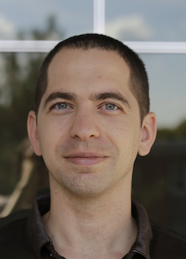
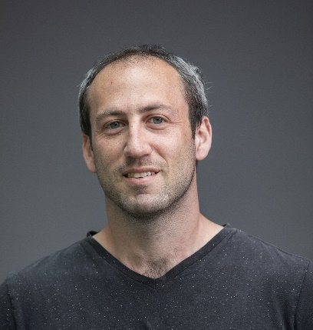
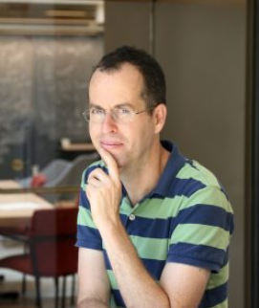
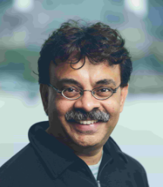
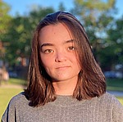

$$Errors and Correction in Cumulative Knowledge$$
Omri Ben-Eliezer
Dan Mikulincer
Elchanan Mossel
Madhu Sudan
Anna Brandenberger
Cassandra Marcussen

Slide 2
Is Societal Knowledge Robust?
Why ask this question?
  Builds on Error-prone processes
    Collecting Data
    Analyzing it
    Merging conclusions with prior knowledge
Last is especially problematic/interesting: Knowledge is cumulative!
  Accumulation can propagate errors!!
There must exist (natural) error-correcting processes
  What are they? How do they work? Are they all equally effective?

Slide 3
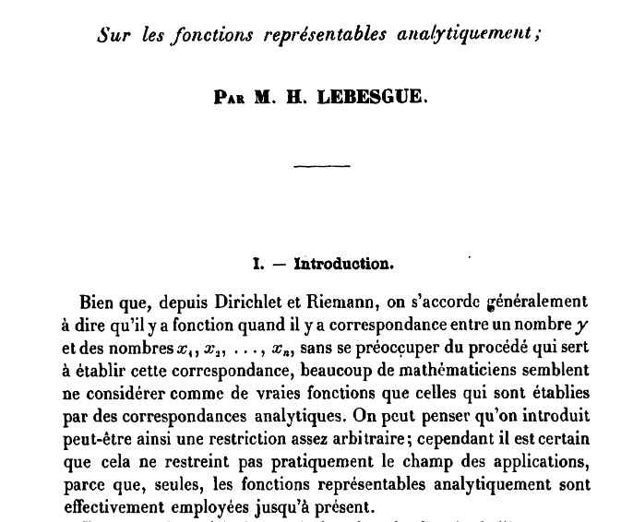
Lebesgue’s Mistake
In 1904 Lebesgue proved:
  “A projection of a measurable set is measurable”

Slide 4
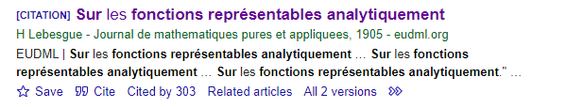
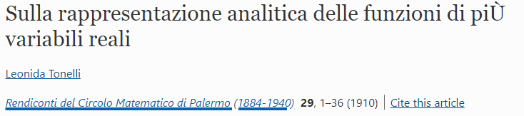
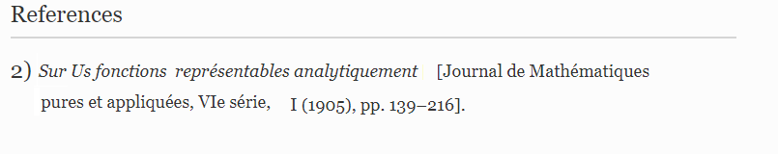
Lebesgue’s Mistake
In 1904 Lebesgue proved:
  “A projection of a measurable set is measurable”
303 Citations per Google Scholar, several prior to 1917.

Slide 5
Lebesgue’s Mistake
In 1904 Lebesgue proved:
  “A projection of a measurable set is measurable”
303 Citations per Google Scholar, several prior to 1917.
Suslin 1917: “There exists a projection of a measurable set that is not measurable.”
  (Aside: The error and correction led to rich developments “Descriptive Set Theory”.)
Our concern: Did the mistake propagate?

Slide 6
Accumulation of Societal Knowledge
Knowledge aggregates slowly, cumulatively

Slide 7
Accumulation of Societal Knowledge
Atomic
Interactions
Knowledge aggregates slowly, cumulatively
Calculus
Of
Variations
Cell
Biology
Protein
Folding
Drug
Design

Slide 8
Accumulation of Societal Knowledge
Parseval’s
Inequality
Knowledge aggregates slowly, cumulatively
Cauchy’s
Interlace
Theorem
Nisan
Szegedy
Degree
Bound
Gotsman
Linial
Equivalence
Sensitivity
Conjecture

Slide 9
Accumulation of Societal Knowledge
Knowledge aggregates slowly, cumulatively
Error: Ingredients can be erroneous. Impact can be widespread.

Slide 10
Accumulation of Societal Knowledge
Knowledge aggregates slowly, cumulatively
Error: Ingredients can be erroneous. Impact can be widespread.

Slide 11
Accumulation of Societal Knowledge
Knowledge aggregates slowly, cumulatively
Error: Ingredients can be erroneous. Impact can be widespread.
Questions:
  How should we check so that we eliminate/minimize the effect of errors?

Slide 12
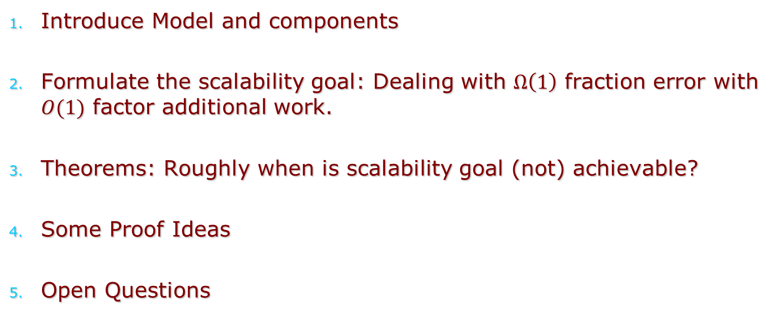
Rest of the talk
Introduce Model and components
Formulate the scalability goal: Dealing with $Ω\left(1\right)$ fraction error with $O(1)$ factor additional work.
Theorems: Roughly when is scalability goal (not) achievable?
Some Proof Ideas
Open Questions

Slide 13
Part 1: The Model

Slide 14
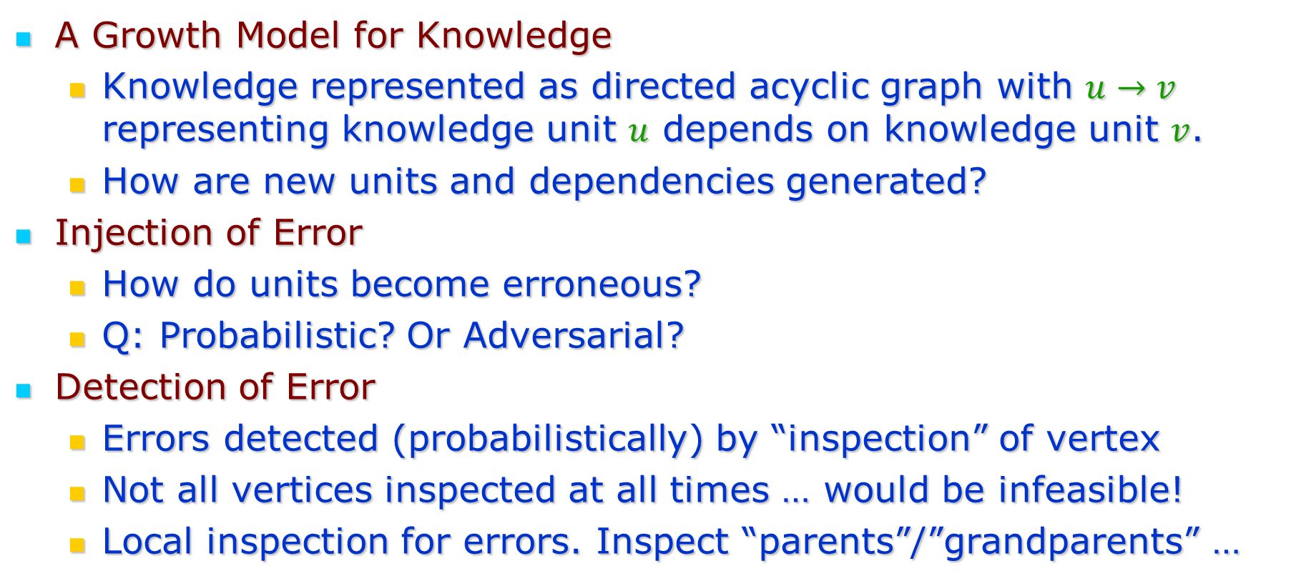
Ingredients in the Model
A Growth Model for Knowledge
  Knowledge represented as directed acyclic graph with $u→v$ representing knowledge unit $u$ depends on knowledge unit $v$.
  How are new units and dependencies generated?
Injection of Error
  How do units become erroneous?
  Q: Probabilistic? Or Adversarial?
Detection of Error
  Errors detected (probabilistically) by “inspection” of vertex
  Not all vertices inspected at all times … would be infeasible!
  Local inspection for errors. Inspect “parents”/”grandparents” …

Slide 15
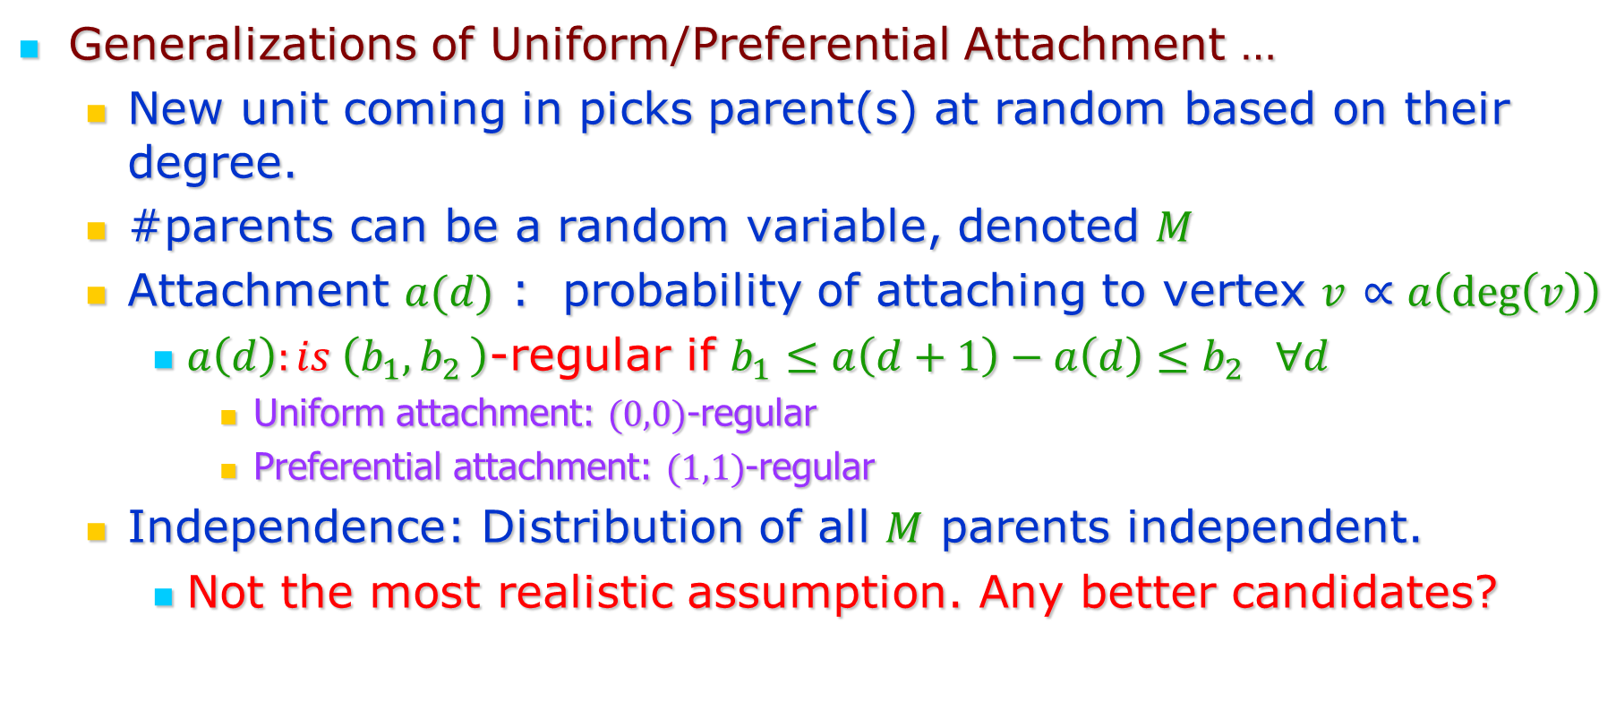
Growth Models
Generalizations of Uniform/Preferential Attachment …
  New unit coming in picks parent(s) at random based on their degree.
  #parents can be a random variable, denoted $M$
  Attachment $a(d)$ : probability of attaching to vertex $v$ $∝a\left(\deg\left(v\right)\right)$
    $a\left(d\right):is \left(b_{1}{,b}_{2}\right)$-regular if $b_{1}≤a\left(d+1\right)−a\left(d\right)≤b_{2} ∀d$
      Uniform attachment: $(0,0)$-regular
      Preferential attachment: $(1,1)$-regular
  Independence: Distribution of all $M$ parents independent.
    Not the most realistic assumption. Any better candidates?

Slide 16
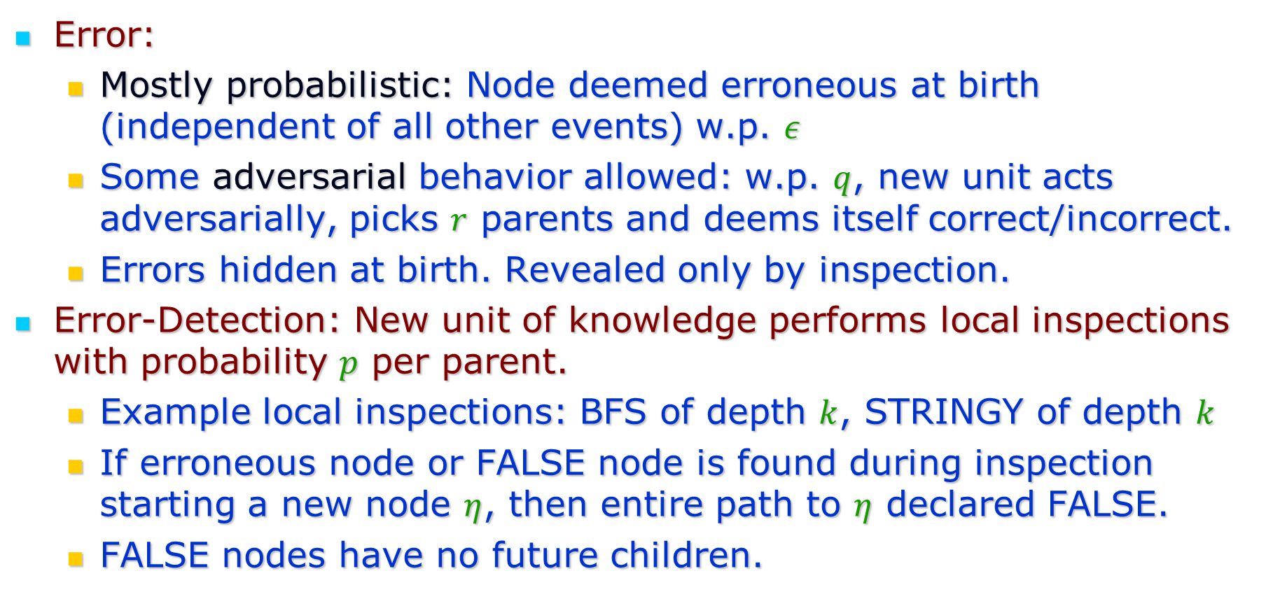
Errors and Detection
Error:
  Mostly probabilistic: Node deemed erroneous at birth (independent of all other events) w.p. $ε$
  Some adversarial behavior allowed: w.p. $q$, new unit acts adversarially, picks $r$ parents and deems itself correct/incorrect.
  Errors hidden at birth. Revealed only by inspection.
Error-Detection: New unit of knowledge performs local inspections with probability $p$ per parent.
  Example local inspections: BFS of depth $k$, STRINGY of depth $k$
  If erroneous node or FALSE node is found during inspection starting a new node $η$, then entire path to $η$ declared FALSE.
  FALSE nodes have no future children.

Slide 17
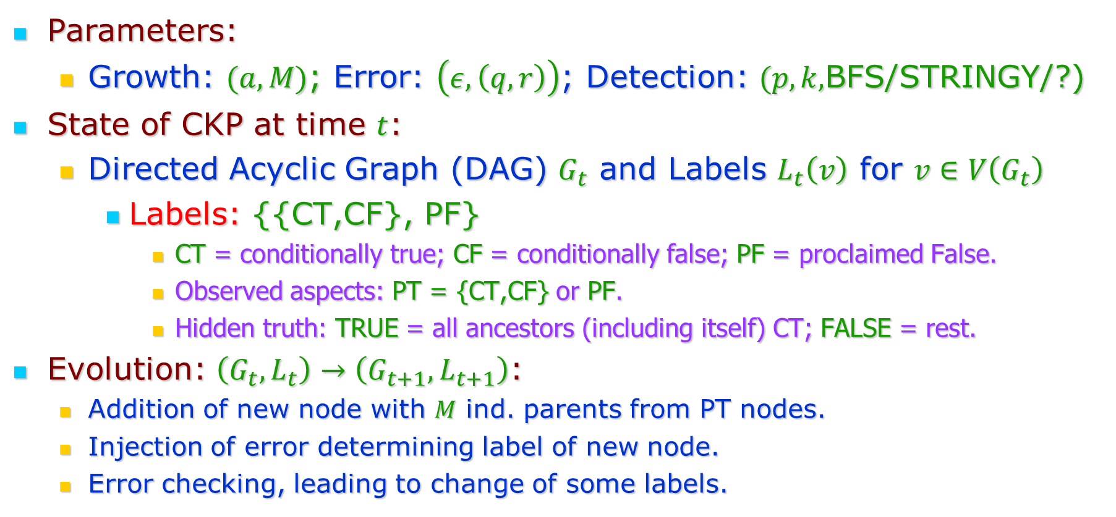
The combined model
Parameters:
  Growth: $(a,M)$; Error: $\left(ε, \left(q,r\right)\right)$; Detection: $(p,k,$BFS/STRINGY/?)
State of CKP at time $t$:
  Directed Acyclic Graph (DAG) $G_{t}$ and Labels $L_{t}\left(v\right)$ for $v∈V\left(G_{t}\right)$
    Labels: {{CT,CF}, PF}
      CT = conditionally true; CF = conditionally false; PF = proclaimed False.
      Observed aspects: PT = {CT,CF} or PF.
      Hidden truth: TRUE = all ancestors (including itself) CT; FALSE = rest.
Evolution: $\left(G_{t},L_{t}\right)→\left(G_{t+1},L_{t+1}\right)$:
  Addition of new node with $M$ ind. parents from PT nodes.
  Injection of error determining label of new node.
  Error checking, leading to change of some labels.

Slide 18
Part 2: The Goal

Slide 19
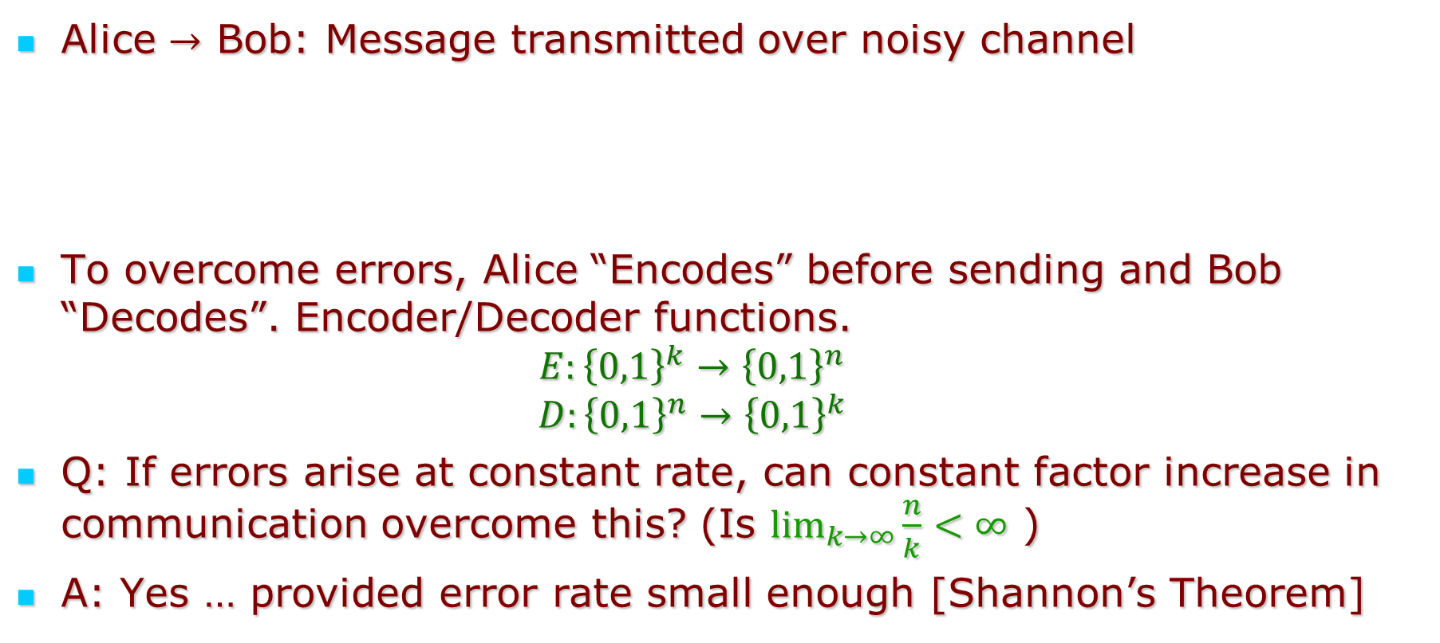
Analogy with Information Theory
Alice $→$ Bob: Message transmitted over noisy channel
To overcome errors, Alice “Encodes” before sending and Bob “Decodes”. Encoder/Decoder functions.
  $$E:{\left\{0,1\right\}}^{k}→{\left\{0,1\right\}}^{n}$$
  $$D:{\left\{0,1\right\}}^{n}→{\left\{0,1\right\}}^{k}$$
Q: If errors arise at constant rate, can constant factor increase in communication overcome this? (Is $\lim_{k→∞}{\frac{n}{k}}<∞$ )
A: Yes … provided error rate small enough [Shannon’s Theorem]
Alice
Encoder
Decoder
Bob

Slide 20
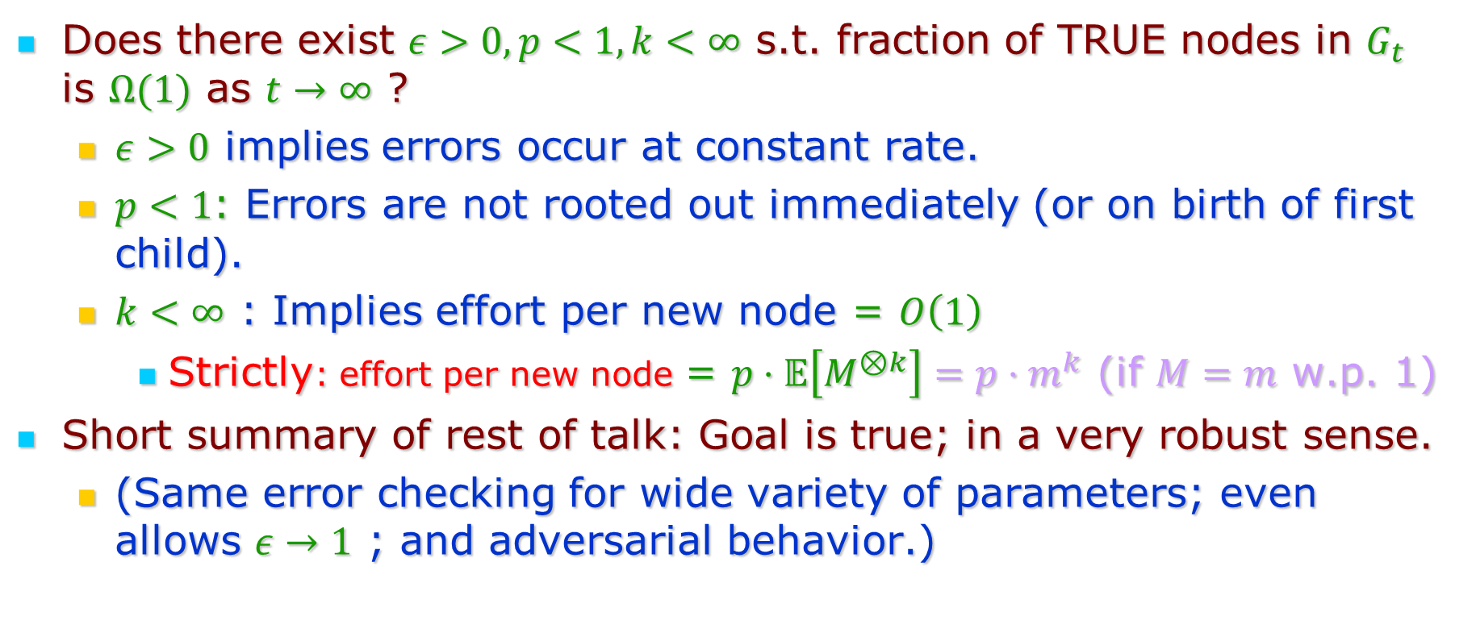
Analogous question for Cumulative Knowledge
Does there exist $ε>0, p<1, k<∞$ s.t. fraction of TRUE nodes in $G_{t}$ is $Ω(1)$ as $t→∞$ ?
  $ε>0$ implies errors occur at constant rate.
  $p<1$: Errors are not rooted out immediately (or on birth of first child).
  $k<∞$ : Implies effort per new node = $O\left(1\right)$
    Strictly: effort per new node = $p⋅𝔼\left[M^{⊗k}\right]=p⋅m^{k}$ (if $M=m$ w.p. 1)
Short summary of rest of talk: Goal is true; in a very robust sense.
  (Same error checking for wide variety of parameters; even allows $ε→1$ ; and adversarial behavior.)

Slide 21
Part 3: The Results

Slide 22
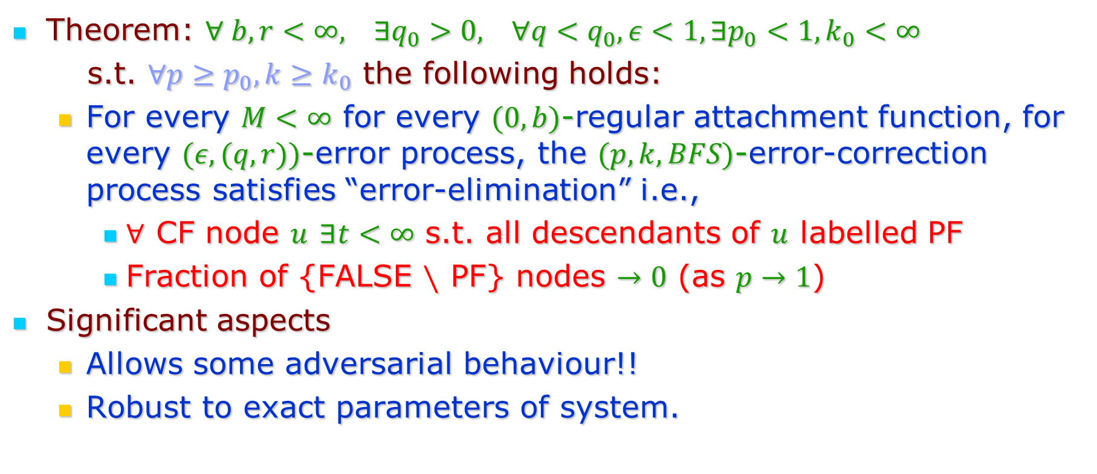
The Good News
Theorem: $∀ b,r<∞, ∃q_{0}>0, ∀q<q_{0}, ε<1, ∃p_{0}<1, k_{0}<∞$
s.t. $∀p≥p_{0}, k≥k_{0}$ the following holds:
  For every $M<∞$ for every $(0,b)$-regular attachment function, for every $(ε,(q,r))$-error process, the $(p,k,BFS)$-error-correction process satisfies “error-elimination” i.e.,
    $∀$ CF node $u$ $∃t<∞$ s.t. all descendants of $u$ labelled PF
    Fraction of {FALSE $∖$ PF} nodes $→0$ (as $p→1$)
Significant aspects
  Allows some adversarial behaviour!!
  Robust to exact parameters of system.

Slide 23
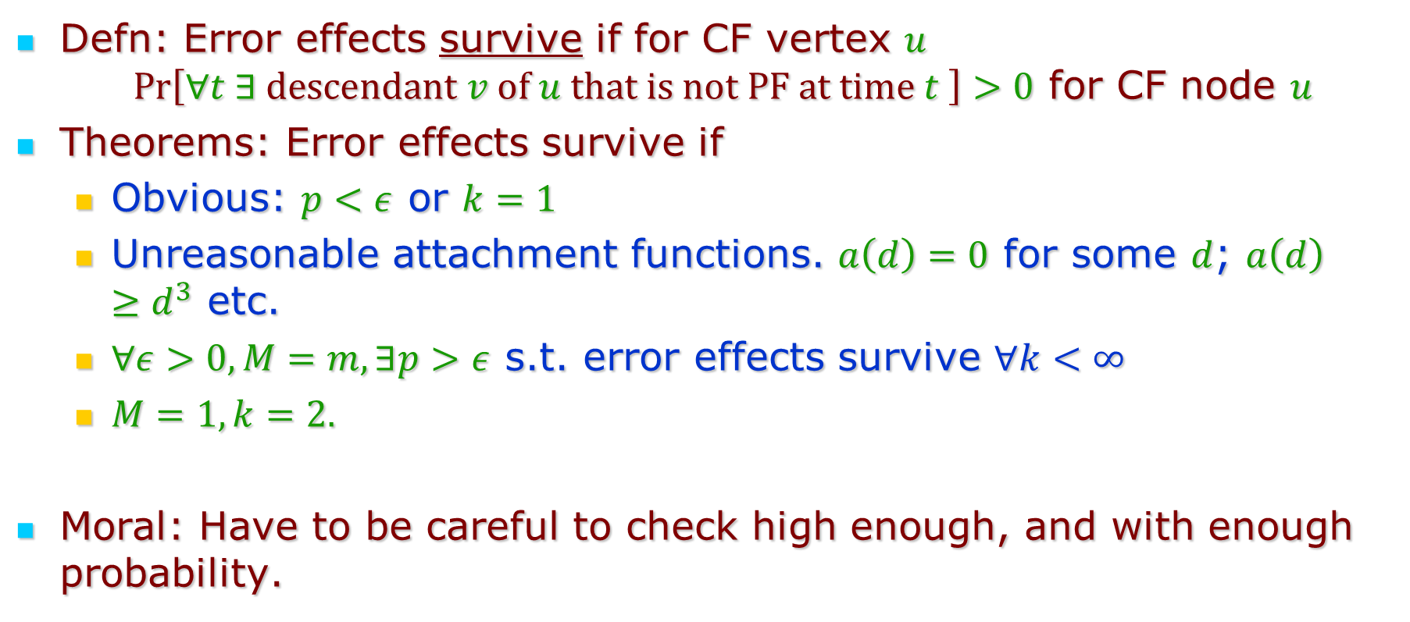
Bad News(es)
Defn: Error effects survive if for CF vertex $u$ $\operatorname{Pr}\left[∀t ∃ descendant v of u that is not PF at time t \right]>0$ for CF node $u$
Theorems: Error effects survive if
  Obvious: $p<ε$ or $k=1$
  Unreasonable attachment functions. $a\left(d\right)=0$ for some $d$; $a\left(d\right)≥d^{3}$ etc.
  $∀ε>0, M=m, ∃p>ε$ s.t. error effects survive $∀k<∞$
  $M=1, k=2.$
Moral: Have to be careful to check high enough, and with enough probability.

Slide 24
Part 4: Proof Ideas

Slide 25
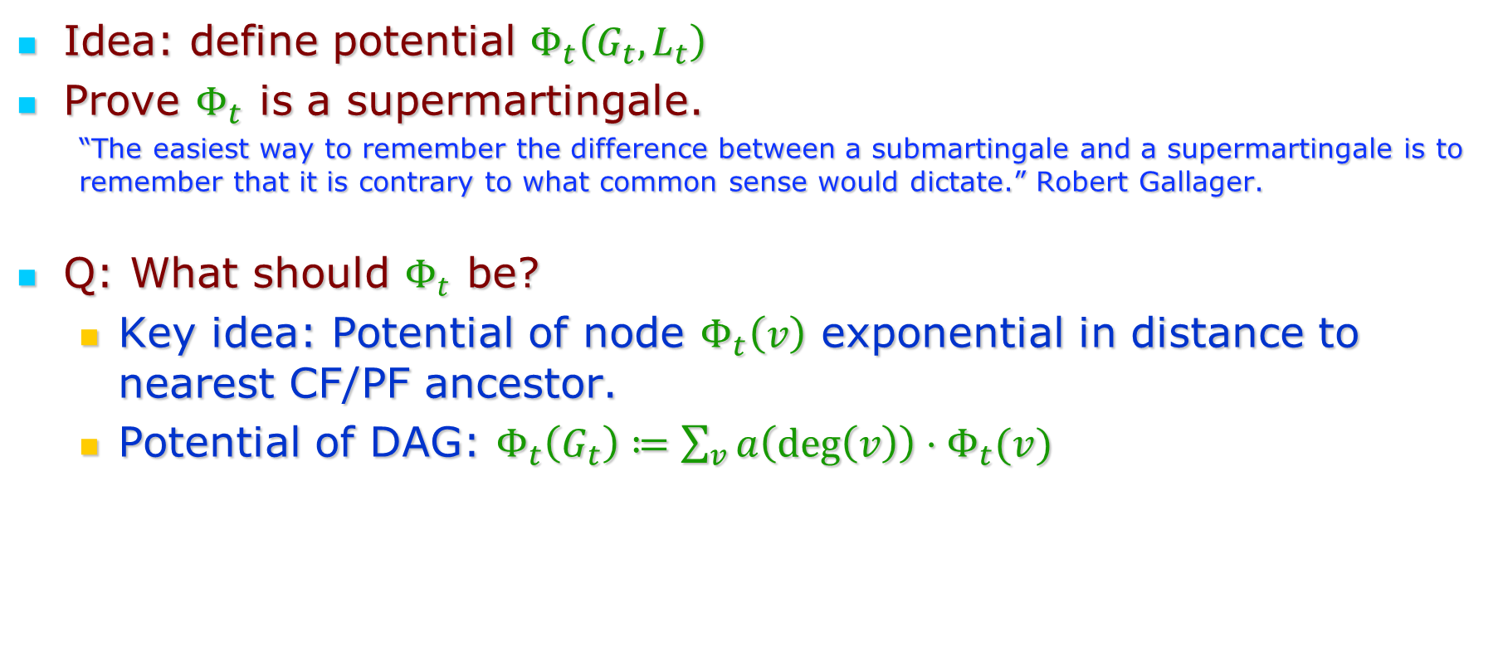
Error elimination
Idea: define potential $Φ_{t}\left(G_{t},L_{t}\right)$
Prove $Φ_{t}$ is a supermartingale.
  “The easiest way to remember the difference between a submartingale and a supermartingale is to re­member that it is contrary to what common sense would dictate.” Robert Gallager.
Q: What should $Φ_{t}$ be?
  Key idea: Potential of node $Φ_{t}\left(v\right)$ exponential in distance to nearest CF/PF ancestor.
  Potential of DAG: $Φ_{t}\left(G_{t}\right)≔\sum_{v}{a\left(\deg\left(v\right)\right)⋅Φ_{t}(v)}$

Slide 26
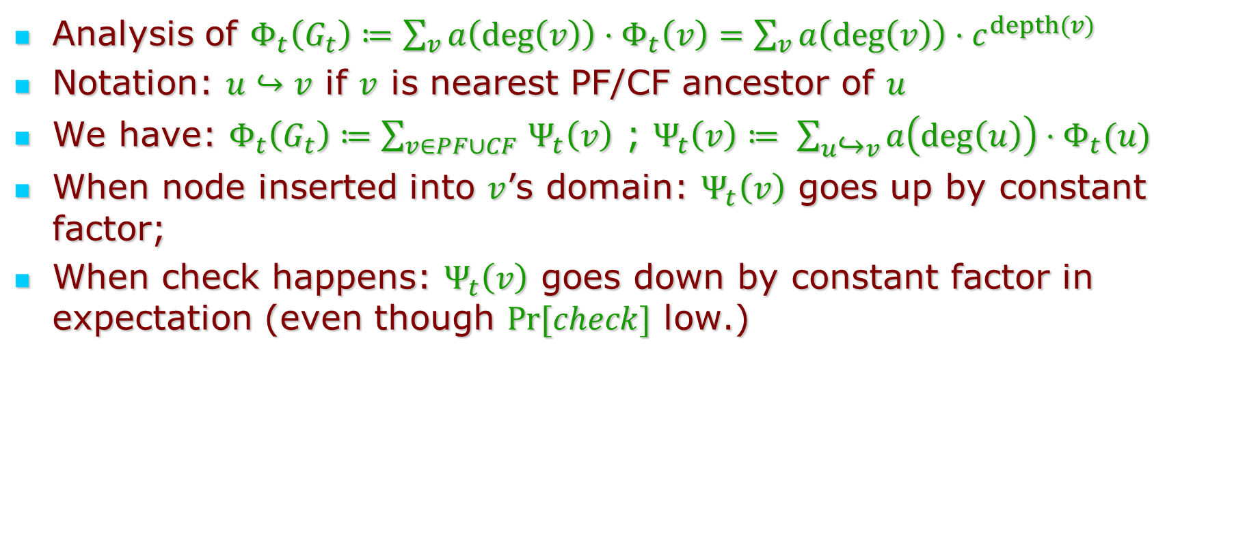
Error elimination (contd.)
Analysis of $Φ_{t}\left(G_{t}\right)≔\sum_{v}{a\left(\deg\left(v\right)\right)⋅Φ_{t}\left(v\right)}=\sum_{v}{a\left(\deg\left(v\right)\right)⋅c^{depth(v)}}$
Notation: $u↪v$ if $v$ is nearest PF/CF ancestor of $u$
We have: $Φ_{t}\left(G_{t}\right)≔\sum_{v∈PF∪CF }{Ψ_{t}\left(v\right)}$ ; $Ψ_{t}\left(v\right)≔ \sum_{u↪v}{{a\left(deg\left(u\right)\right)⋅Φ}_{t}(u) }$
When node inserted into $v$’s domain: $Ψ_{t}\left(v\right)$ goes up by constant factor;
When check happens: $Ψ_{t}\left(v\right)$ goes down by constant factor in expectation (even though $Pr⁡[check]$ low.)

Slide 27

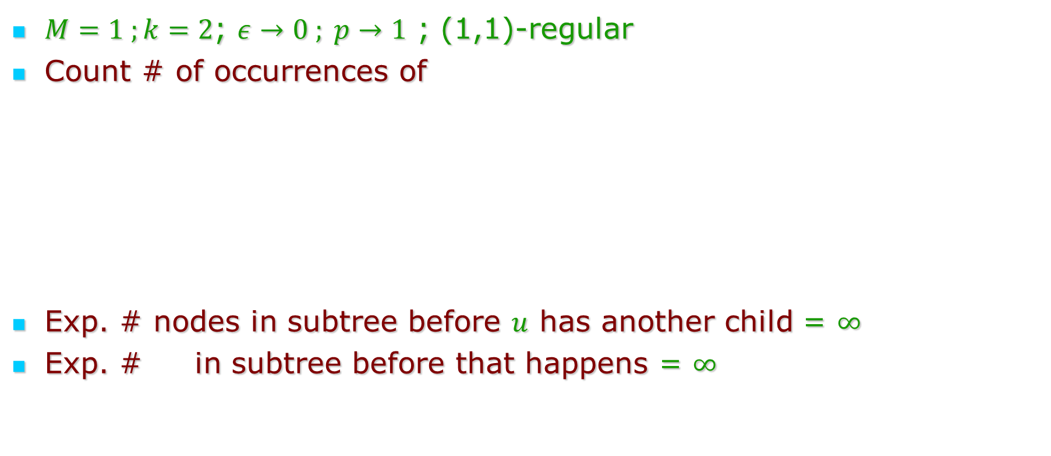
Error survival proof example
PF
$M=1 ;k=2$; $ε→0 ; p→1$ ; (1,1)-regular
Count # of occurrences of
Exp. # nodes in subtree before $u$ has another child = $∞$
Exp. # in subtree before that happens = $∞$
CT
$$u$$
CT

Slide 28
Part 5: Open Problems + Conclusions

Slide 29
Conclusions
Introduced Cumulative Knowledge Processes (models knowledge + error + detection)
Studied: What makes them stable?
  Positive result: Can make them stable with reasonable checking.
  Negative results: Can’t be too casual about checking.

Slide 30
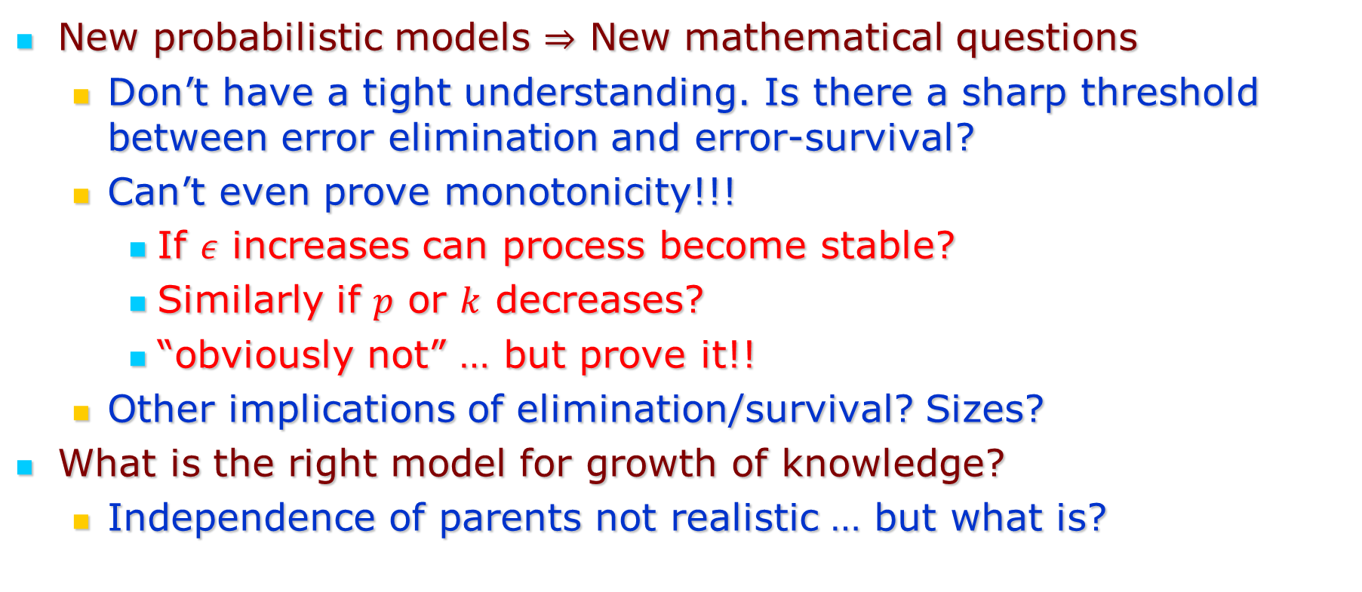
Open Problems
New probabilistic models $⇒$ New mathematical questions
  Don’t have a tight understanding. Is there a sharp threshold between error elimination and error-survival?
  Can’t even prove monotonicity!!!
    If $ε$ increases can process become stable?
    Similarly if $p$ or $k$ decreases?
    “obviously not” … but prove it!!
  Other implications of elimination/survival? Sizes?
What is the right model for growth of knowledge?
  Independence of parents not realistic … but what is?

Slide 31
Thank you!

