Slide 1
Mathematical Theories of Communication:
Old and New
Madhu Sudan
Harvard University

Slide 2
Communication = What?
Today: Digital Communication
i.e., Communicating bits/bytes/data …
As opposed to “radio waves for sound”
Challenge? Communication can be …
… expensive: (e.g., satellite with bounded energy to communicate)
… noisy: (bits flipped, DVD scratched)
… interactive: (complicates above further)
… contextual (assumes you are running Android/iOS/Linux, …IPv4/Ipv10/…)

Slide 3
Theory = Why?
Why build theory and not just use whatever works?
Ad-hoc solutions work today …
… but will they work tomorrow?
Formulating problem allows comparison of solutions!
And some creative solutions might be surprisingly better than naïve!
Understanding of limits.
What can not be achieved …

Slide 4
Old? New?
Why new theories? Were old ones not good enough?
Quite the opposite: Old ones were too good.
They provided right framework and took us from ground level to “orbit”!
And now we can explore all of “space”
… new possibilities lead to new challenges.

Slide 5
Reliable Communication?
Problem from the 1940s: Advent of digital age.
Communication media are always noisy
But digital information less tolerant to noise!
We are not ready
We are now ready
Alice
Bob

Slide 6
Reliability by Repetition
Can repeat (every letter of) message to improve reliability:
WWW EEE AAA RRR EEE NNN OOO WWW …
WXW EEA ARA SSR EEE NMN OOP WWW …
Elementary Reasoning:
$↑$ repetitions $⇒$ $↓$ Prob. decoding error; but still +ve
$↑$ length of transmission $⇒$ $↑$ expected # errors.
Combining above: Rate of repetition coding $→0$ as length of transmission increases.
Belief (pre1940):
Rate of any scheme $→0$as length $→∞$

Slide 7
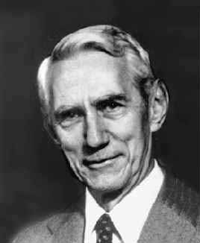
Shannon’s Theory [1948]
Sender “Encodes” before transmitting
Receiver “Decodes” after receiving
Encoder/Decoder arbitrary functions.
$$E:{\left\{0,1\right\}}^{k}→{\left\{0,1\right\}}^{n}$$
$$D:{\left\{0,1\right\}}^{n}→{\left\{0,1\right\}}^{k}$$
Rate = $\frac{k}{n};$
Requirement: $m=D(E\left(m\right)+error)$ w. high prob.
What are the best $E,D$ (with highest Rate)?
Alice
Encoder
Decoder
Bob

Slide 8
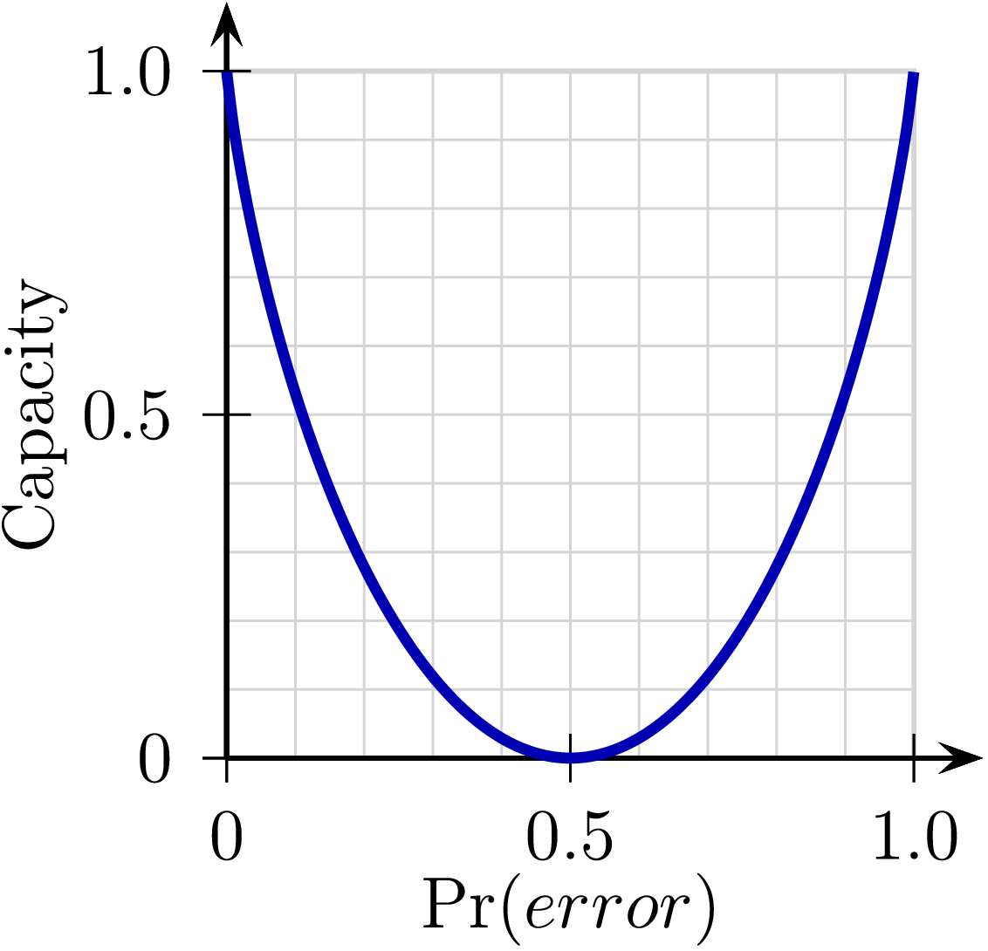
Shannon’s Theorem
If every bit is flipped with probability $p$
Rate $→1−H(p)$ can be achieved.
$H\left(p\right)≜p\log_{2}{\frac{1}{p}}+\left(1−p\right)\log_{2}{\frac{1}{1−p}}$
This is best possible.
Examples:
$p=0⇒Rate=1$
$p=\frac{1}{2}⇒Rate=0$
Monotone decreasing for $p∈(0,\frac{1}{2} )$
Positive rate for $p=0.4999$ ; even if $k→∞$
Creative
solution!
Limit!

Slide 9
Shannon’s contributions
Far-reaching architecture:
Profound analysis:
Independent discovery of probabilistic method?
Deep Mathematical Discoveries:
Entropy, Information
Initial theory: highly non-constructive.
’50s-now: Constructive, algorithmic …
Modern Tools: Algebra, Algebraic-geometry, Graph theory, Information theory, Algorithms,
Alice
Encoder
Decoder
Bob

Slide 10
Aside: “Series of approx. to English”
“We can also approximate to a natural language by means of a series of simple artificial languages.”
$i^{th}$ order approx.: Given $i−1$ symbols, choose $i^{th}$according to the empirical distribution of the language conditioned on the $i−1$ length prefix.
3-order (letter) approximation
“IN NO IST LAT WHEY CRATICT FROURE BIRS GROCID PONDENOME OF DEMONSTURES OF THE REPTAGIN IS REGOACTIONA OF CRE.”
Second-order word approximation
“THE HEAD AND IN FRONTAL ATTACK ON AN ENGLISH WRITER THAT THE CHARACTER OF THIS POINT IS THEREFORE ANOTHER METHOD FOR THE LETTERS THAT THE TIME OF WHO EVER TOLD THE PROBLEM FOR AN UNEXPECTED.”
“$i^{th}$ order approx. produces plausible
sequences of length $2i$”

Slide 11
Modern Theories:
Communication is interactive
E.g., “distributed file sharing/editing”,
“buying airline ticket online”
How/when to correct errors?
Involve large inputs from either side:
Travel agent = vast portfolio of airlines+flights
Traveler = complex collection of constraints and preferences.
Best protocol $≠$ Travel agent sends brochure.
$≠$ Traveller sends entire list of constraints.
How to model? How well should context be shared?

Slide 12
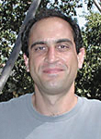
Interaction + Errors: Schulman ‘92
Consider distributed update of shared document.
What if there are errors in interaction?
Error must be corrected immediately?
Or else all future communication wasted.
But too early correction might lead to errors in correction!
Alice
Server
Bob
Typical interaction:
Server $→$ User: Current state of document
User $→$ Server: Update

Slide 13
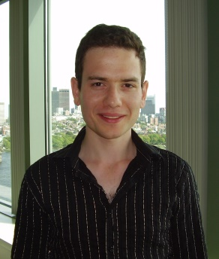
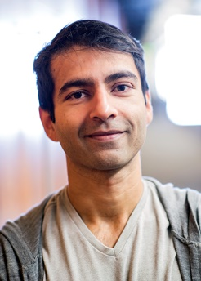
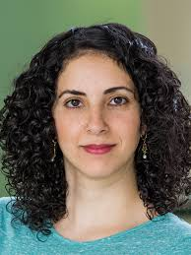
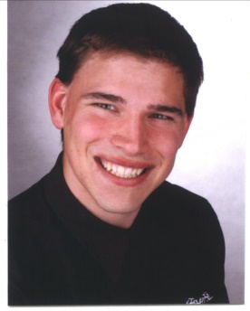
Interactive Coding Schemes
If bits are flipped with probability $p$ what is the rate of communication?
Limits still not precisely determined! But linear for $p≤\frac{1}{8}$ (scales more like $1 −\sqrt{H\left(p\right)}$)
Non-trivial mathematics! Some elements still not fully constructive
… surprising even given Shannon theory!
Schulman
Braverman-Rao
Kol-Raz
Haeupler

Slide 14
Modern Theories:
Communication is interactive
E.g., “distributed file sharing/editing”,
“buying airline ticket online”
How/when to correct errors?
Involve large inputs from either side:
Travel agent = vast portfolio of airlines+flights
Traveler = complex collection of constraints and preferences.
Best protocol $≠$ Travel agent sends brochure.
$≠$ Traveller sends entire list of constraints.
How to model? How well should context be shared?

Slide 15
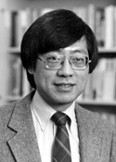
Communication Complexity: Yao
The model
(with shared randomness)
$$x$$
$$y$$
$$f:\left(x,y\right)↦Σ$$
$$R=\$\$\$$$
Usually studied for lower bounds.
This talk: CC as +ve model.
Alice
Bob
$CC\left(f\right)=\#$bits exchanged
by best protocol
$$f(x,y)$$
w.p. 2/3

Slide 16
Some short protocols!
Problem 1: Alice $←x_{1},…,x_{n}$ ; Bob $←y_{1},…,y_{n}$;
Want to know: $\left(x_{1}−y_{1}\right)+⋯+\left(x_{n}−y_{n}\right)$
Solution: Alice $→$ Bob: ${S≝x}_{1}+⋯{+ x}_{n}$
Bob $→$ Alice: $S−\left(y_{1}+⋯+y_{n}\right)$
Problem 2: Alice $←x_{1},…,x_{n}$ ; Bob $←y_{1},…,y_{n}$;
Want to know: ${\left(x_{1}−y_{1}\right)}^{2}+⋯+{\left(x_{n}−y_{n}\right)}^{2}$
Solution?
Deterministically: Needs $n$ bits of communication.
Randomized: Alice+Bob $←r_{1},r_{2},…, r_{n}∈\left\{−1,+1\right\}$ random.
Alice$→$Bob: $S_{1}=x_{1}^{2}+⋯+x_{n}^{2};{ S}_{2}=r_{1}x_{1}+⋯+r_{n}x_{n}$
Bob$→$Alice: $T_{1}=y_{1}^{2}+⋯+y_{n}^{2};{ T}_{2}=r_{1}y_{1}+⋯+r_{n}y_{n}$
Thm: $𝔼_{r_{1}…r_{n}}\left[S_{1}+T_{1}−2S_{2}T_{2}\right]= {\left(x_{1}−y_{1}\right)}^{2}+⋯+{\left(x_{n}−y_{n}\right)}^{2}$

Slide 17
Aside: Easy CC Problems [Ghazi,Kamath,S’15]
$∃$Problems with large inputs and small communication?
Equality testing:
$EQ\left(x,y\right)=1⇔x=y;$ $CC\left(EQ\right)=O\left(1\right)$
Hamming distance:
$H_{k}\left(x,y\right)=1⇔Δ\left(x,y\right)≤k; CC\left(H_{k}\right)=O(k\log{k})$ [Huang etal.]
Small set intersection:
$∩_{k}\left(x,y\right)=1⇔ wt\left(x\right), wt\left(y\right)≤k \& ∃i s.t. x_{i}=y_{i}=1.$
$CC\left(∩_{k}\right)=O(k)$ [Håstad Wigderson]
Gap (Real) Inner Product:
$x,y∈ℝ^{n};{\left|x\right|}_{2}, {\left|y\right|}_{2}=1;$
$GIP_{c,s}\left(x,y\right)=1 if 〈x,y〉≥c; =0 if 〈x,y〉≤s;$
$CC\left(GIP_{c,s}\right)=O\left(\frac{1}{{\left(c−s\right)}^{2}}\right) ;$[Alon, Matias, Szegedy]
Protocol:
Fix ECC $E:{\left\{0,1\right\}}^{n}→{\left\{0,1\right\}}^{N};$
Shared randomness: $i←\left[N\right];$
Exchange $E{\left(x\right)}_{i}, E{\left(y\right)}_{i};$
Accept iff $E{\left(x\right)}_{i}=E{\left(y\right)}_{i}$.
$poly\left(k\right)$Protocol:
Use common randomness
to hash $\left[n\right]→[k^{2}]$
$$x=(x_{1}, …, x_{n})$$
$$y=\left(y_{1}, …, y_{n}\right)$$
$$〈x,y〉≜\sum_{i}{x_{i}y_{i}}$$
Main Insight:
If $G←N{\left(0,1\right)}^{n}$, then
$𝔼\left[〈G,x〉⋅〈G,y〉\right]=〈x,y〉$
Unstated philosophical contribution of CC a la Yao:
Communication with a focus (“only need to determine $f\left(x,y\right)$”)
can be more effective (shorter than $\left|x\right|,H\left(x\right),H\left(y\right),I(x;y)$… )

Slide 18
Application to Buying Air Tickets?
If we can express every flight and every user’s preference as $n$ numbers
(commonly done in Machine Learning)
Then #bits communicated $≈2.$description of final itinerary.
Only two rounds of communication!
Challenge: Express user preferences as numbers!
Not yet there … but soon your cellphones will do it!

Slide 19
Communication vs. Computation
Shannon-theory (and successors):
Assumes sender+receiver perfectly coordinated.
Does not model:
Human communication
Programmable devices
Questions it does not tackle:
Can we learn to communicate by communicating?
How does context improve/hurt communication?
E.g., this talk impossible without assumption that you speak English, know math etc.
Can I write down exactly what subset is needed?

Slide 20
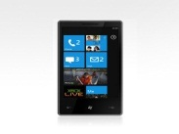
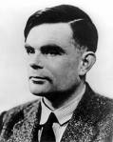
Aside: Communication vs. Computing
Interdependent technologies: Neither can exist without other
Technologies/Products/Commerce developed (mostly) independently.
Early products based on clean abstractions of the other.
Later versions added other capability as afterthought.
Today products … deeply integrated.
Deep theories:
Well separated … and have stayed that way
Shannon ‘48
Turing ‘36
Programmable ……. NOT!

Slide 21
Semantic/Goal-oriented Communication
Fundamental question: Can we learn to communicate (meaningfully?) by communicating?
Humans do it? Phones don’t! Computers = ?
Can intelligence/computational power be leveraged to learn to communicate (as opposed to being suppressed so someone else tells us how to communicate)?
[Juba, S.], [Goldreich, Juba, S.]: “Can learn to communicate from scratch, provided communication is verifiably useful!”

Slide 22
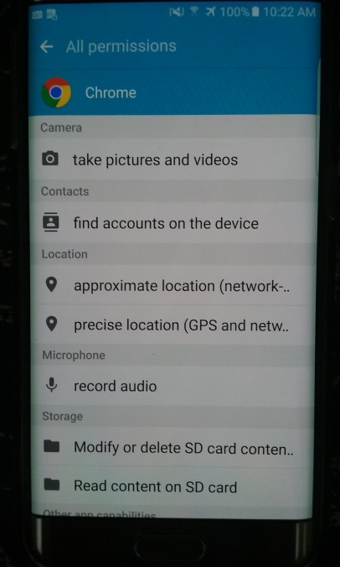
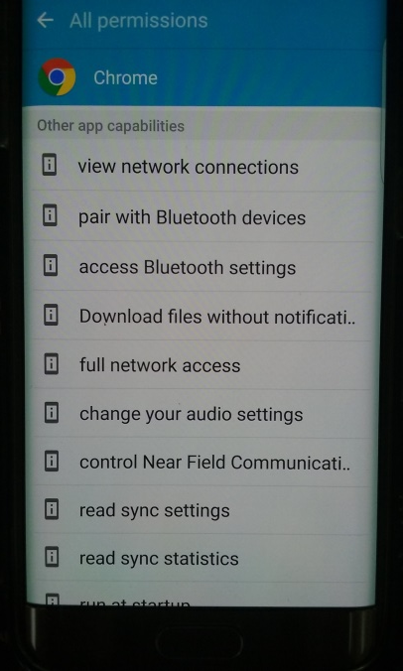
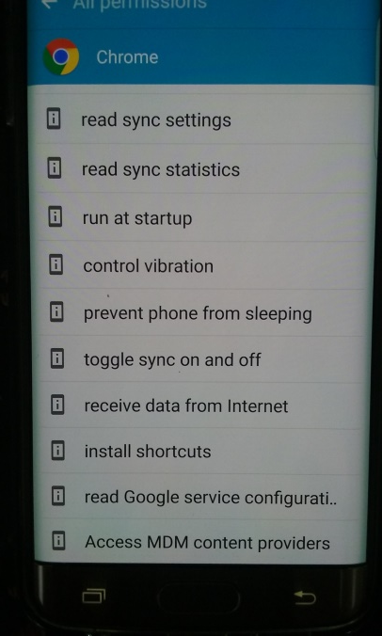
Context in communication
Issue: Computational devices collect information aka “context” … context affects communication.
Pros and cons of context:
Shared context makes communication efficient!
Imperfection in sharing introduces new sources for misunderstanding!
Communication Amid Uncertainty: study of settings where:
Context (shared info) makes communication efficient.
Robust protocols allow imperfectly shared context.

Slide 23
Communication with Uncertainty
$${Context}_{Alice}$$
$$=(f,R,P_{XY})$$
$${Context}_{Bob}$$
$$=(f,R,P_{XY})$$
$$=(f^{A},R^{A},P_{XY}^{A})$$
$$=(f^{B},R^{B},P_{XY}^{B})$$
$$x$$
$$y$$
$$f:\left(x,y\right)↦Σ$$
$$R=\$\$\$$$
Alice
Bob
$$f(x,y)$$
w.p. 2/3

Slide 24
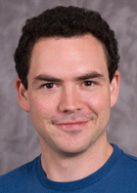
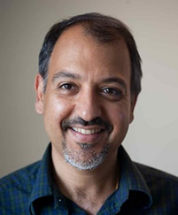
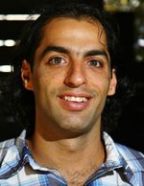
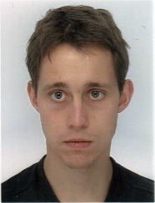
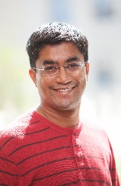
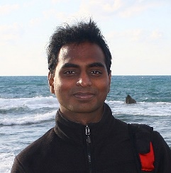
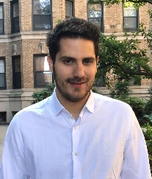
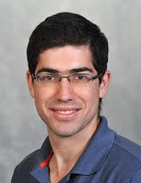
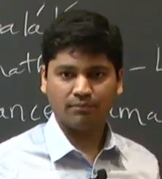
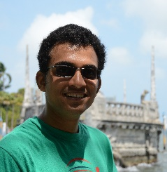
Communication with Uncertainty - II
[JKKS, ITCS 2011], [HS, ITCS 2014], [CGMS, ITCS 2015], [GKKS, SODA 2016], [GHKS, ITCS 2017], [GS, ICALP 2017]
Some sample results:
Compression does not require common knowledge of distribution.
Dictionary can be designed “distributedly”
Randomness does not have to be perfectly shared.
Nor does function being computed
… sporadic results – not yet a “theory”.

Slide 25
Compression as a proxy for language
Information theoretic study of language?
Goal of language: Effective means of expressing information/action.
Implicit objective of language: Make frequent messages short. Compression!
Frequency = Known globally? Learned locally?
If latter – every one can’t possibly agree on it;
Yet need to agree on language (mostly)!
Leads to problem of Uncertain Compression.
Studied formally in [Juba,Kalai,Khanna,S. 11, Haramaty,S. 14, Ghazi,Haramaty,Kamath,S. 17]

Slide 26
Conclusions
Theories of Communication
Saw a sampler … by no means exhaustive
Many surprises …
Still a divergence between
Theory of designed communication (well developed)
Theory of emergent communication (“emergent”?)
Can we model and explain eccentricities of human communication (language, ambiguity, grammar+violations)?
Will computer-speak exhibit same phenomena? Is that good/bad?

Slide 27
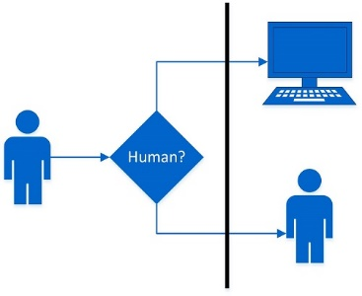
Afterthought: Lens of Communication
Turing Test:
(In-)distinguishability
Shannon: “Theory of Secrecy Systems”
Goldwasser-Micali: “Probabilistic Encryption”
Applicable to many other conundrums!
Intelligence?
Understanding?
Consciousness?
© Nate Clark

Slide 28
Thank You!

