Slide 1

Sparsification: Graphs, Codes, CSPs
Madhu Sudan
Harvard University
Joint work with
Sanjeev Khanna@Penn and Aaron (Louie) Putterman@Harvard

Slide 2
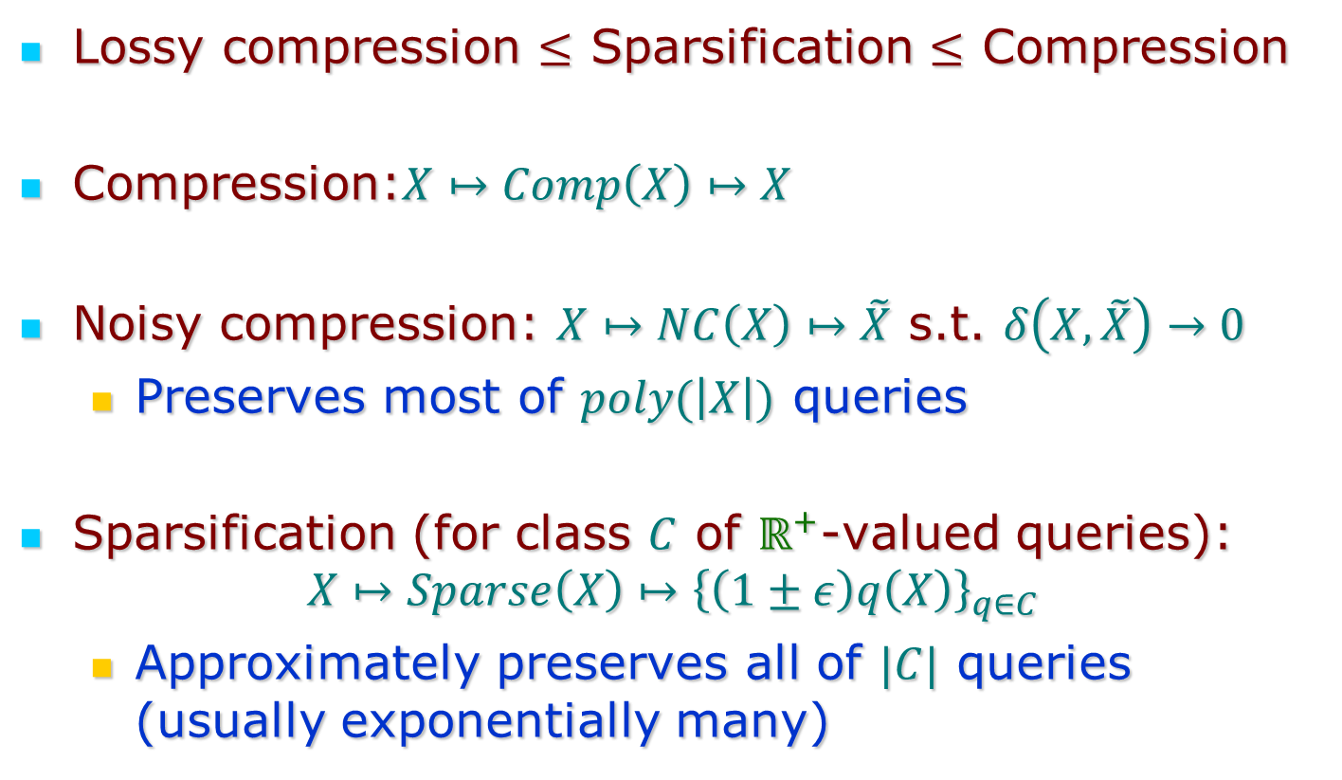
Sparsification
Lossy compression $≤$ Sparsification $≤$ Compression
Compression:$X↦Comp\left(X\right)↦X$
Noisy compression: $X↦NC\left(X\right)↦\tilde{X}$ s.t. $δ\left(X,\tilde{X}\right)→0$
  Preserves most of $poly(\left|X\right|)$ queries
Sparsification (for class $C$ of $ℝ^{+}$-valued queries):
$$X↦Sparse\left(X\right)↦{\left\{\left(1±ε\right)q\left(X\right)\right\}}_{q∈C}$$
  Approximately preserves all of $|C|$ queries (usually exponentially many)

Slide 3
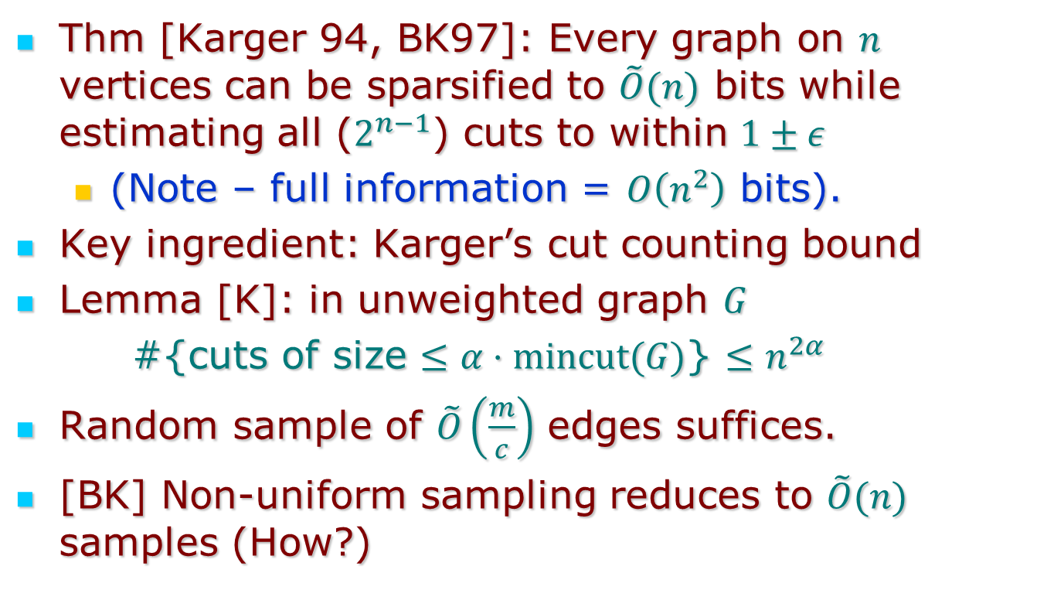
Benczur-Karger Cut Sparsification
Thm [Karger 94, BK97]: Every graph on $n$ vertices can be sparsified to $\tilde{O}(n)$ bits while estimating all ($2^{n−1}$) cuts to within $1±ε$
  (Note – full information = $O\left(n^{2}\right)$ bits).
Key ingredient: Karger’s cut counting bound
Lemma [K]: in unweighted graph $G$
#{cuts of size $≤α⋅mincut(G)$} $≤n^{2α}$
Random sample of $\tilde{O}\left(\frac{m}{c}\right)$ edges suffices.
[BK] Non-uniform sampling reduces to $\tilde{O}(n)$ samples (How?)

Slide 4
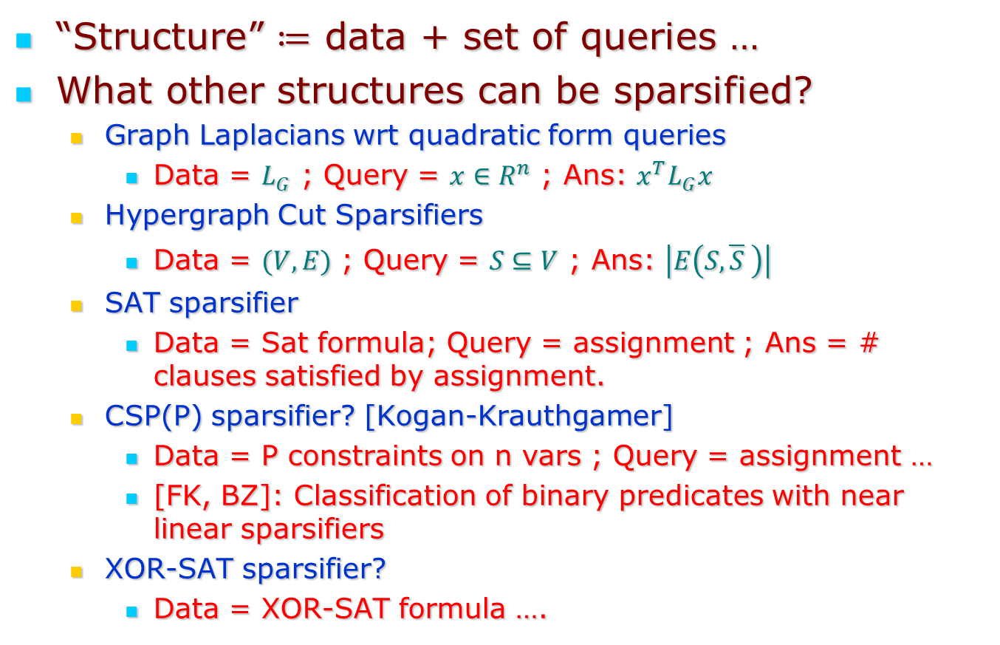
What else can be sparsified?
“Structure” $≔$ data + set of queries …
What other structures can be sparsified?
  Graph Laplacians wrt quadratic form queries
    Data = $L_{G}$ ; Query = $x∈R^{n}$ ; Ans: $x^{T}L_{G}x$
  Hypergraph Cut Sparsifiers
    Data = $(V,E)$ ; Query = $S⊆V$ ; Ans: $\left|E\left(S,\overline{S} \right)\right|$
  SAT sparsifier
    Data = Sat formula; Query = assignment ; Ans = # clauses satisfied by assignment.
  CSP(P) sparsifier? [Kogan-Krauthgamer]
    Data = P constraints on n vars ; Query = assignment …
    [FK, BZ]: Classification of binary predicates with near linear sparsifiers
  XOR-SAT sparsifier?
    Data = XOR-SAT formula ….

Slide 5
This talk:
Code sparsification (more generally – additive codes over abelian groups):
  Data = (generator matrix of) linear code.
  Query = message
  Ans = (Hamming) weight of its encoding.
Motivation: Generalizes graph- and hypergraph-sparsification.
Applications to CSP sparsification:
  Classification of ternary Boolean CSPs
  Classification of all symmetric Boolean CSPs
  Classification* of all Boolean CSPs with non-trivial sparsification

Slide 6
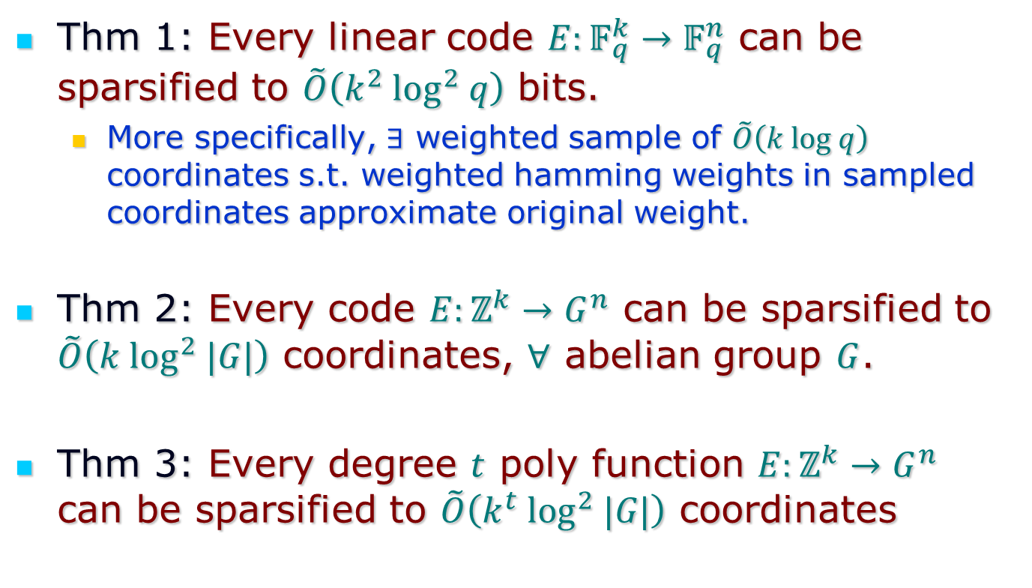
Some theorems
Thm 1: Every linear code $E:𝔽_{q}^{k}→𝔽_{q}^{n}$ can be sparsified to $\tilde{O}\left(k^{2} \log^{2} q\right)$ bits.
  More specifically, $∃$ weighted sample of $\tilde{O}\left(k log q\right)$ coordinates s.t. weighted hamming weights in sampled coordinates approximate original weight.
Thm 2: Every code $E:ℤ^{k}→G^{n}$ can be sparsified to $\tilde{O}\left(k \log^{2} |G|\right)$ coordinates, $∀$ abelian group $G$.
Thm 3: Every degree $t$ poly function $E:ℤ^{k}→G^{n}$ can be sparsified to $\tilde{O}\left(k^{t} \log^{2} |G|\right)$ coordinates

Slide 7
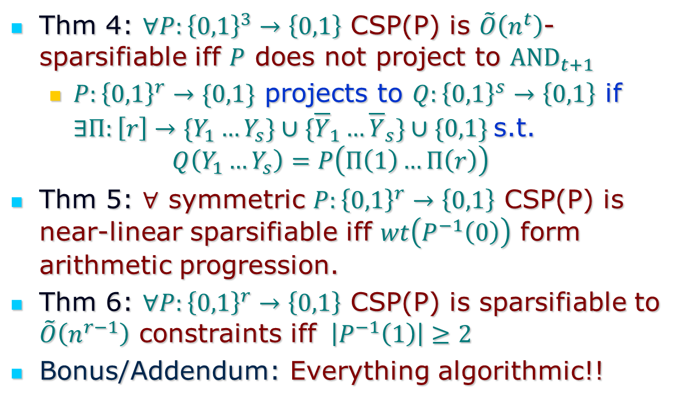
Some CSP theorems
Thm 4: $∀P:{\left\{0,1\right\}}^{3}→\left\{0,1\right\}$ CSP(P) is $\tilde{O}\left(n^{t}\right)$-sparsifiable iff $P$ does not project to ${AND}_{t+1}$
  $P:{\left\{0,1\right\}}^{r}→\{0,1\}$ projects to $Q:{\left\{0,1\right\}}^{s}→\left\{0,1\right\}$ if $∃Π:\left[r\right]→\{Y_{1}…Y_{s}\}∪\{{\overline{Y}}_{1}…{\overline{Y}}_{s}\}∪\{0,1\}$s.t.
  $$Q\left(Y_{1}…Y_{s}\right)=P\left(Π\left(1\right)…Π\left(r\right)\right)$$
Thm 5: $∀$ symmetric $P:{\left\{0,1\right\}}^{r}→\left\{0,1\right\}$ CSP(P) is near-linear sparsifiable iff $wt\left(P^{−1}\left(0\right)\right)$ form arithmetic progression.
Thm 6: $∀P:{\left\{0,1\right\}}^{r}→\left\{0,1\right\}$ CSP(P) is sparsifiable to $\tilde{O}\left(n^{r−1}\right)$ constraints iff $\left|P^{−1}\left(1\right)\right|≥2$
Bonus/Addendum: Everything algorithmic!!

Slide 8
Proofs

Slide 9
Graph Sparsification

Slide 10
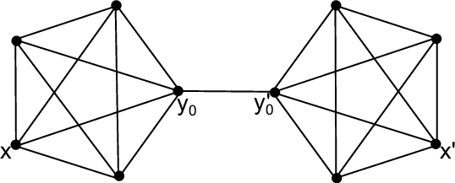
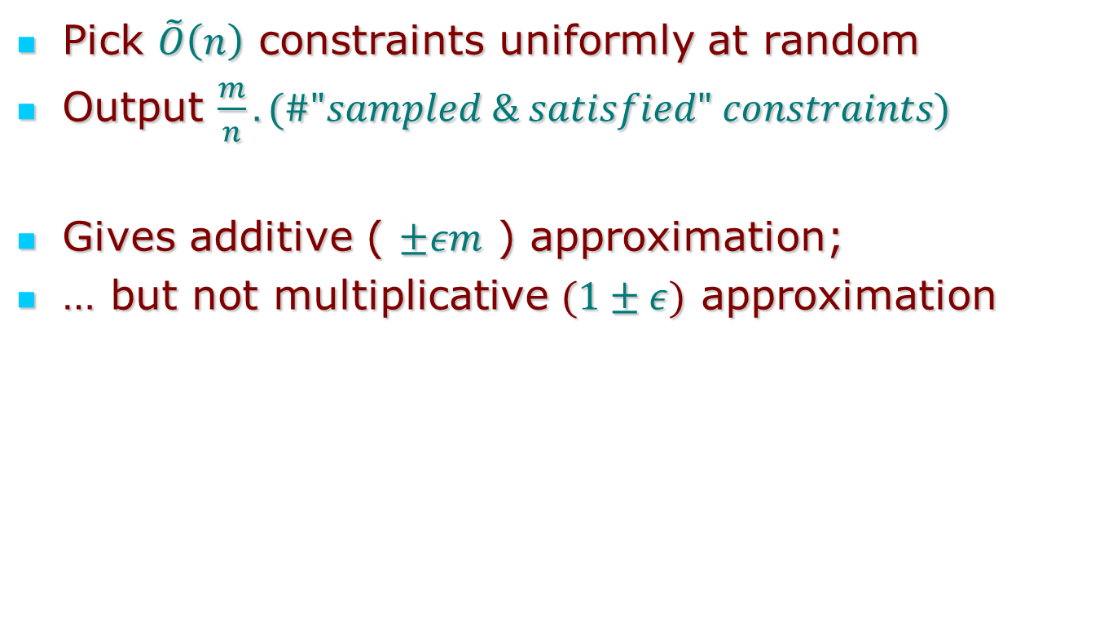
Why does a random sample not work?
Pick $\tilde{O}\left(n\right)$ constraints uniformly at random
Output $\frac{m}{n}.(\#"sampled \& satisfied" constraints)$
Gives additive ( $±εm$ ) approximation;
… but not multiplicative $(1±ε)$ approximation

Slide 11
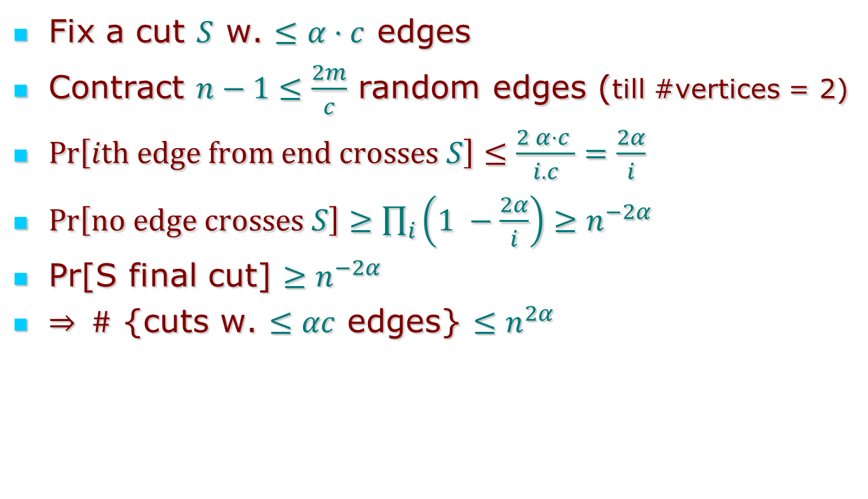
Karger’s cut counting bound
Fix a cut $S$ w. $≤α⋅c$ edges
Contract $n−1≤\frac{2m}{c}$ random edges (till #vertices = 2)
$Pr\left[ith edge from end crosses S\right]≤\frac{2 α⋅c }{i.c}=\frac{2α}{i}$
$Pr\left[no edge crosses S\right]≥\prod_{i}{\left(1 −\frac{2α}{i}\right)}≥n^{−2α}$
Pr[S final cut] $≥n^{−2α}$
$⇒ \#$ {cuts w. $≤αc$ edges} $≤n^{2α}$

Slide 12
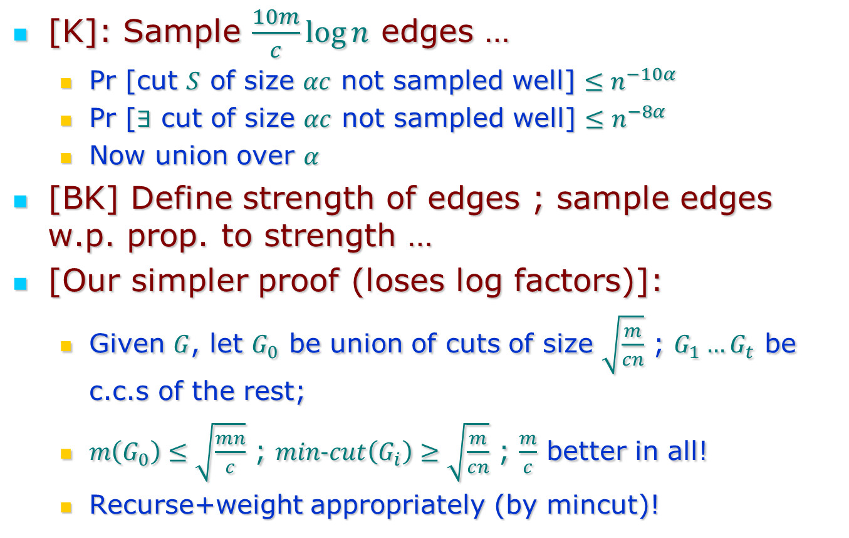
Graph Sparsifiers from c.c. bound
[K]: Sample $\frac{10m}{c}\log{n}$ edges …
  Pr [cut $S$ of size $αc$ not sampled well] $≤n^{−10α}$
  Pr [$∃$ cut of size $αc$ not sampled well] $≤n^{−8α}$
  Now union over $α$
[BK] Define strength of edges ; sample edges w.p. prop. to strength …
[Our simpler proof (loses log factors)]:
  Given $G$, let $G_{0}$ be union of cuts of size $\sqrt{\frac{m}{cn}}$ ; $G_{1}…G_{t}$ be c.c.s of the rest;
  $m\left(G_{0}\right)≤\sqrt{\frac{mn}{c}}$ ; $min−cut\left(G_{i}\right)≥\sqrt{\frac{m}{cn}}$ ; $\frac{m}{c}$ better in all!
  Recurse+weight appropriately (by mincut)!

Slide 13
Code Sparsification

Slide 14
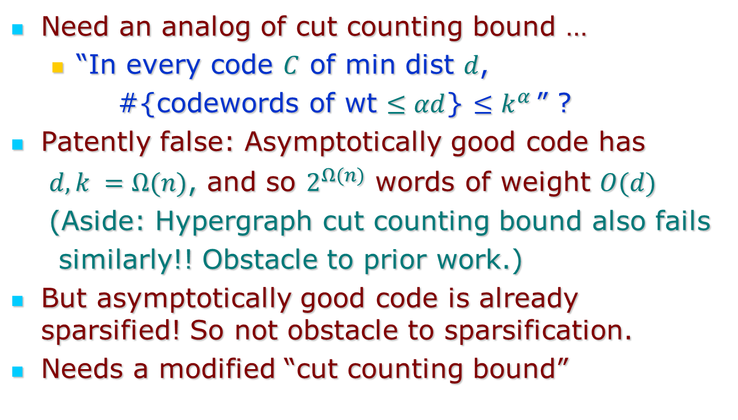
Code Sparsification
Need an analog of cut counting bound …
  “In every code $C$ of min dist $d$,
  #{codewords of wt $≤αd$} $≤k^{α }$” ?
Patently false: Asymptotically good code has
$d,k =Ω(n)$, and so $2^{Ω(n)}$ words of weight $O(d)$
(Aside: Hypergraph cut counting bound also fails
similarly!! Obstacle to prior work.)
But asymptotically good code is already sparsified! So not obstacle to sparsification.
Needs a modified “cut counting bound”

Slide 15
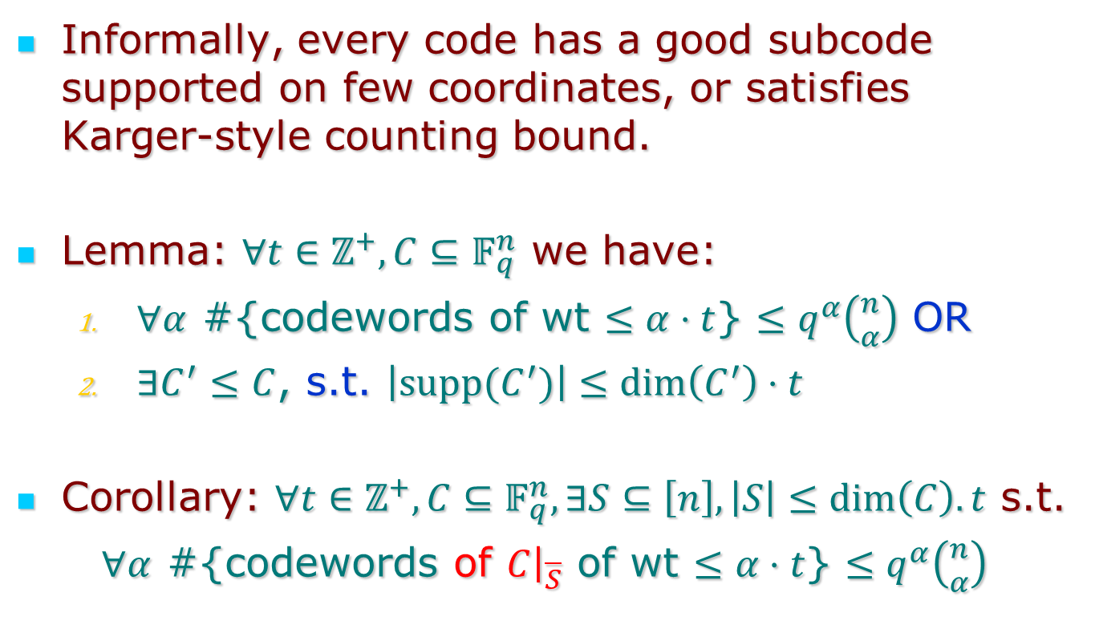
Code counting Lemma
Informally, every code has a good subcode supported on few coordinates, or satisfies Karger-style counting bound.
Lemma: $∀t∈ℤ^{+}, C⊆𝔽_{q}^{n}$ we have:
  $∀α$ #{codewords of wt $≤α⋅t$} $≤q^{α}\left({n \atop α}\right)$ OR
  $∃C^{′}≤C$, s.t. $\left|supp(C^{′})\right|≤dim\left(C^{′}\right)⋅t$
Corollary: $∀t∈ℤ^{+}, C⊆𝔽_{q}^{n}, ∃S⊆\left[n\right], \left|S\right|≤dim\left(C\right).t$ s.t.
$∀α$ #{codewords of $C{\left.​\right|}_{\overline{S}}$ of wt $≤α⋅t$} $≤q^{α}\left({n \atop α}\right)$

Slide 16
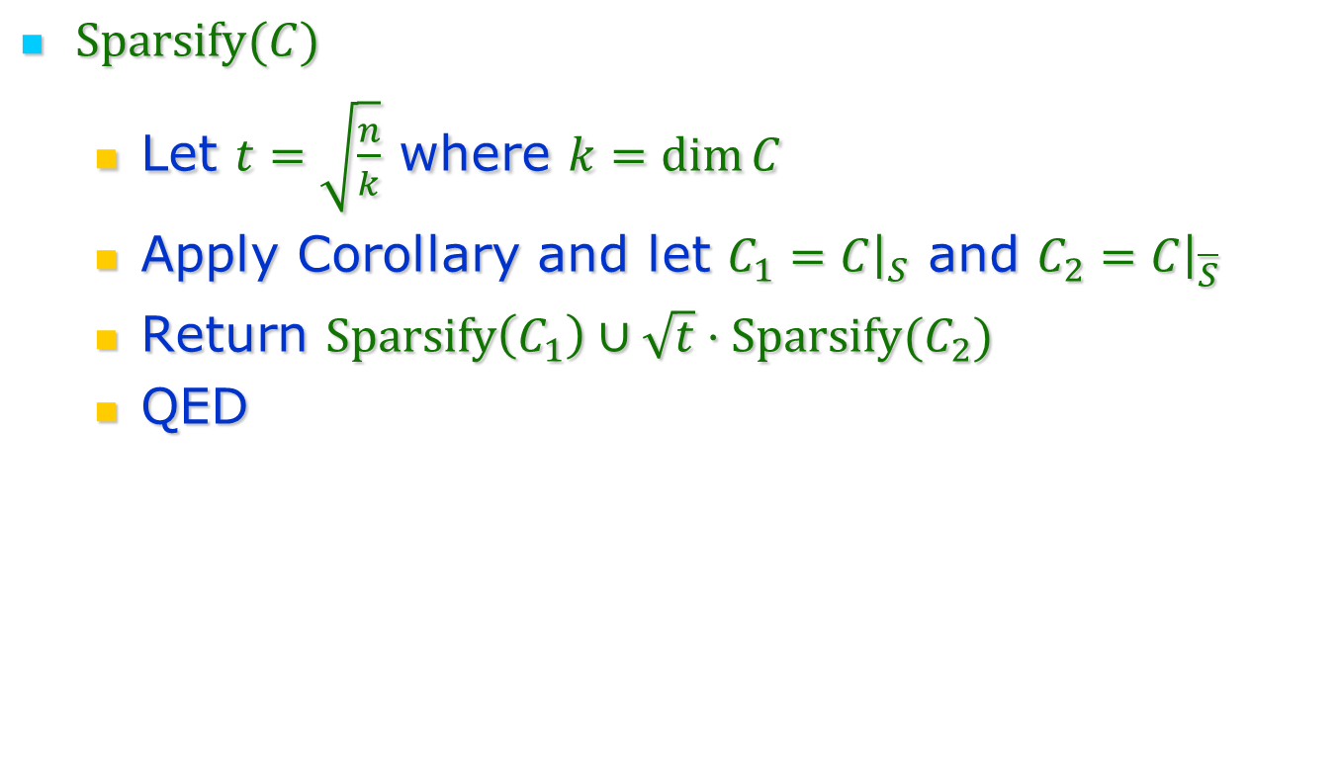
Code Counting $⇒$ Sparsification
$Sparsify(C)$
  Let $t=\sqrt{\frac{n}{k}}$ where $k=\dim{C}$
  Apply Corollary and let $C_{1}=C{\left.​\right|}_{S}$ and $C_{2}=C{\left.​\right|}_{\overline{S}}$
  Return $Sparsify\left(C_{1}\right)∪\sqrt{t}⋅Sparsify(C_{2})$
  QED

Slide 17
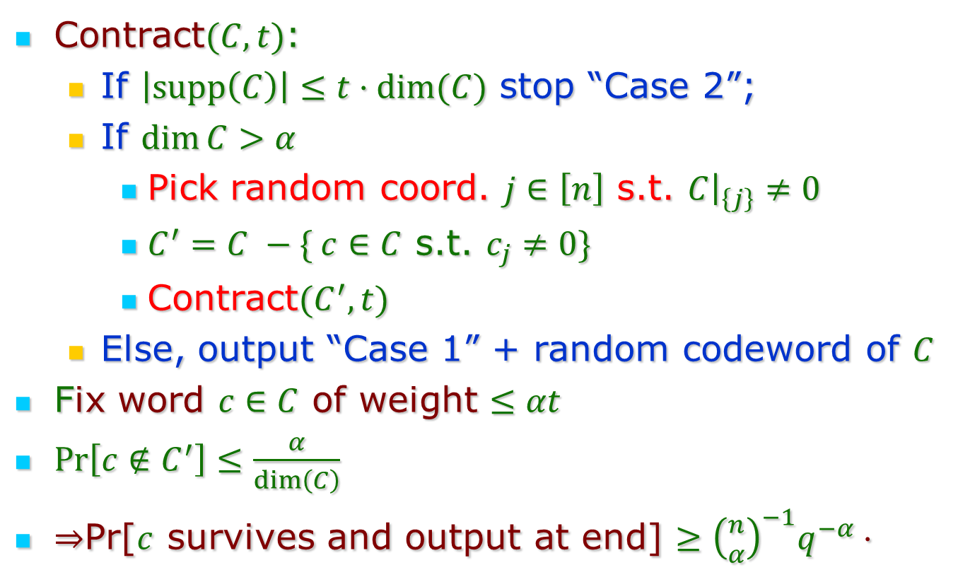
Proof of Code Counting
Contract$(C,t)$:
  If $\left|supp\left(C\right)\right|≤t⋅dim(C)$ stop “Case 2”;
  If $\dim{C>α}$
    Pick random coord. $j∈\left[n\right]$ s.t. $C{\left.​\right|}_{\left\{j\right\}}≠0$
    $C^{′}=C −\{ c∈C$ s.t. $c_{j}≠0\}$
    Contract$(C^{′},t)$
  Else, output “Case 1” + random codeword of $C$
Fix word $c∈C$ of weight $≤αt$
$Pr\left[c∉C^{′}\right]≤\frac{α}{dim\left(C\right)}$
$⇒$Pr[$c$ survives and output at end] $≥{\left({n \atop α}\right)}^{−1}q^{−α}⋅$

Slide 18
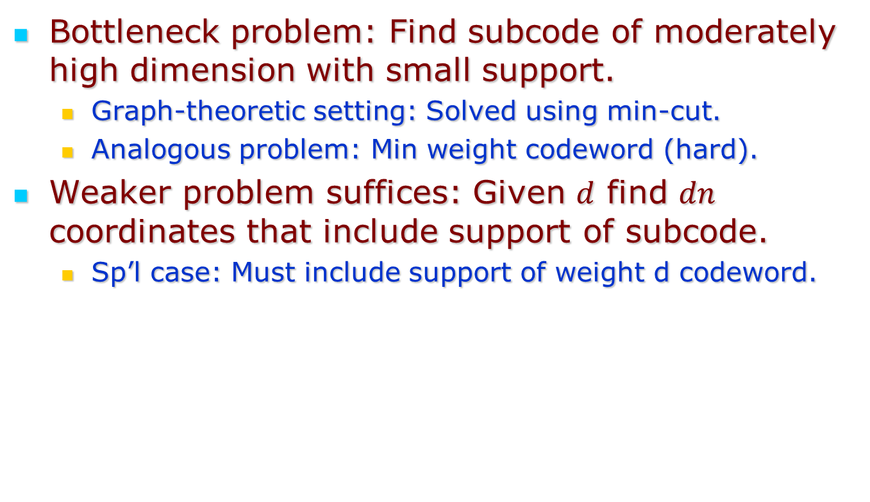
Aside: Efficient Sparsification
Bottleneck problem: Find subcode of moderately high dimension with small support.
  Graph-theoretic setting: Solved using min-cut.
  Analogous problem: Min weight codeword (hard).
Weaker problem suffices: Given $d$ find $dn$ coordinates that include support of subcode.
  Sp’l case: Must include support of weight d codeword.

Slide 19
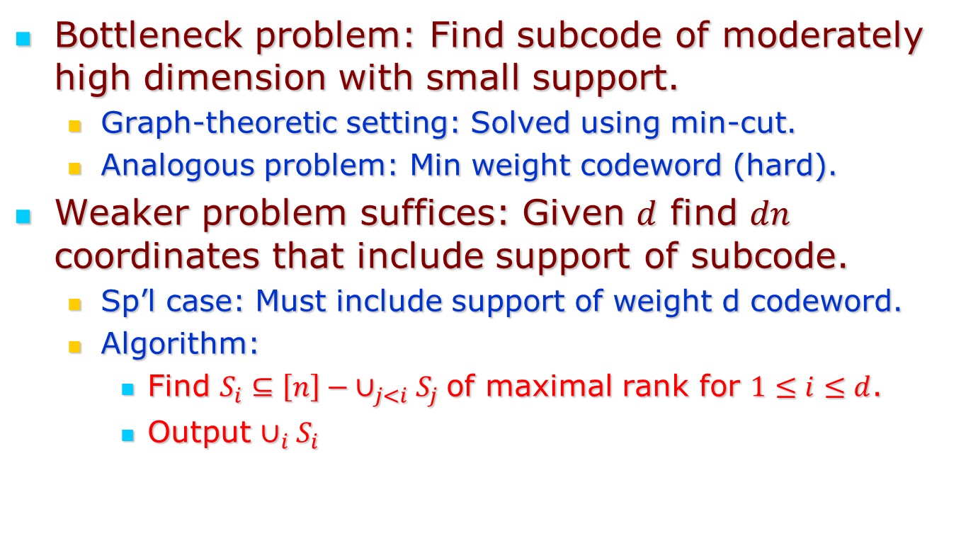
Aside: Efficient Sparsification
Bottleneck problem: Find subcode of moderately high dimension with small support.
  Graph-theoretic setting: Solved using min-cut.
  Analogous problem: Min weight codeword (hard).
Weaker problem suffices: Given $d$ find $dn$ coordinates that include support of subcode.
  Sp’l case: Must include support of weight d codeword.
  Algorithm:
    Find $S_{i}⊆\left[n\right]− ∪_{j<i}S_{j}$of maximal rank for $1≤i≤d$.
    Output $∪_{i}S_{i}$

Slide 20
Implications + Extensions

Slide 21
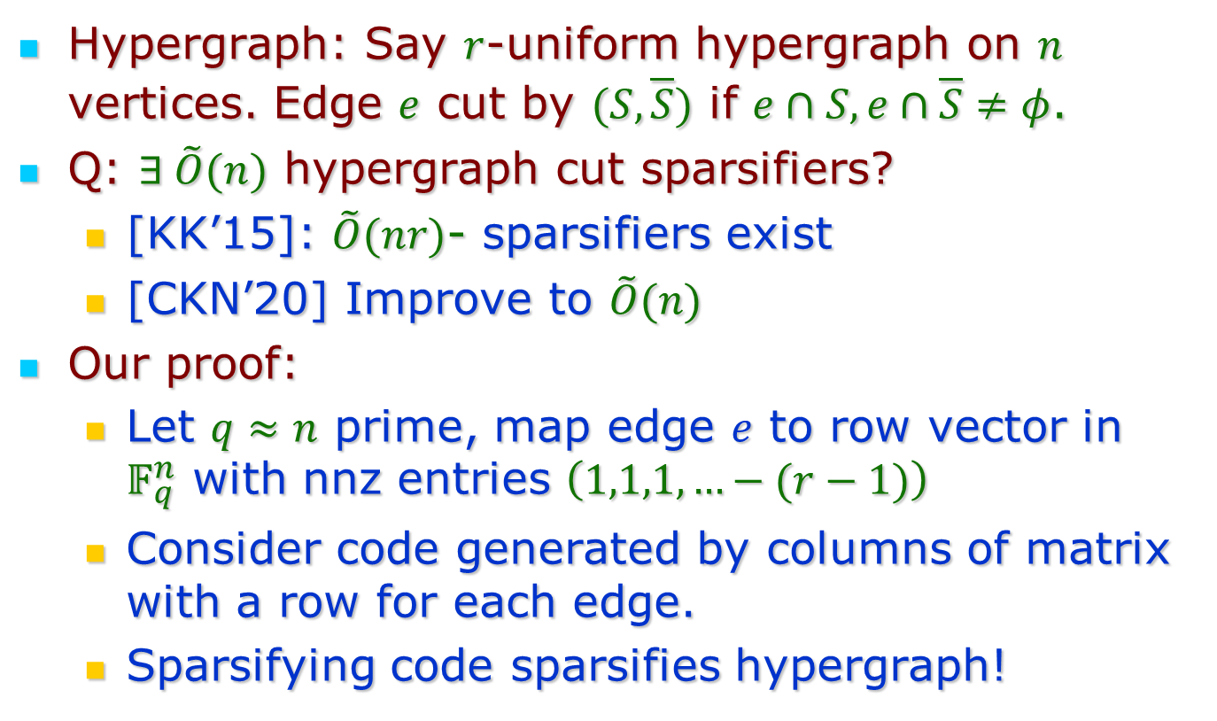
Hypergraph Sparsification
Hypergraph: Say $r$-uniform hypergraph on $n$ vertices. Edge $e$ cut by $(S,\overline{S})$ if $e∩S, e∩\overline{S}≠φ$.
Q: $∃ \tilde{O}(n)$ hypergraph cut sparsifiers?
  [KK’15]: $\tilde{O}(nr)$- sparsifiers exist
  [CKN’20] Improve to $\tilde{O}(n)$
Our proof:
  Let $q≈n$ prime, map edge $e$ to row vector in $𝔽_{q}^{n}$ with nnz entries $\left(1,1,1,…−(r−1)\right)$
  Consider code generated by columns of matrix with a row for each edge.
  Sparsifying code sparsifies hypergraph!

Slide 22
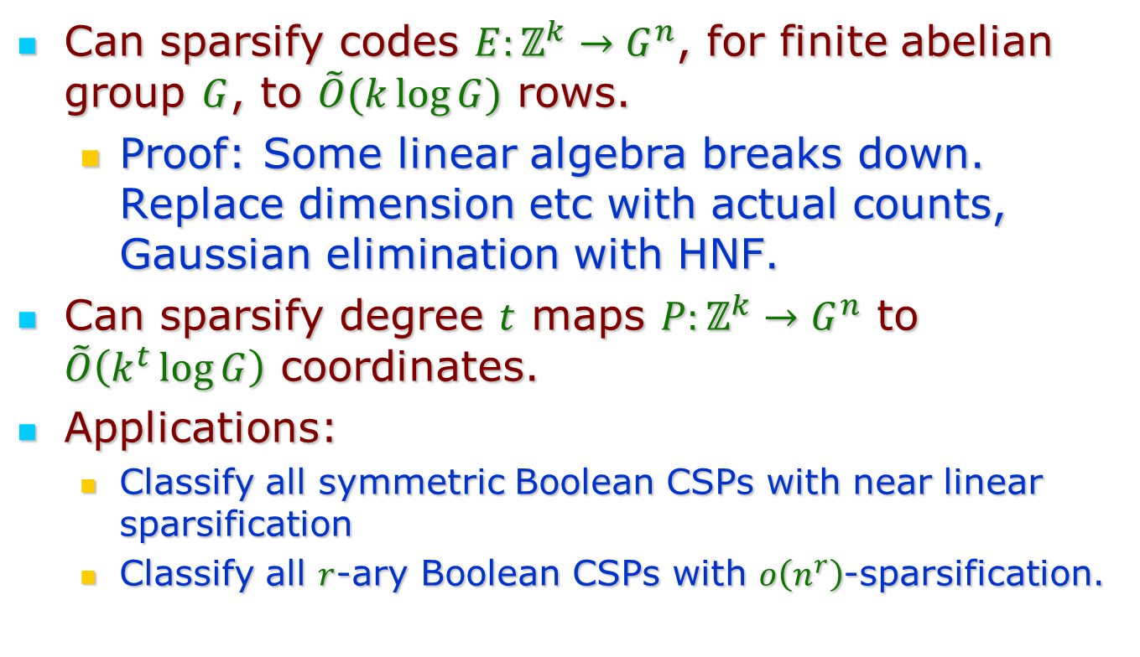
Variations
Can sparsify codes $E:ℤ^{k}→G^{n}$, for finite abelian group $G$, to $\tilde{O}(k\log{G})$ rows.
  Proof: Some linear algebra breaks down. Replace dimension etc with actual counts, Gaussian elimination with HNF.
Can sparsify degree $t$ maps $P:ℤ^{k}→G^{n}$ to $\tilde{O}\left(k^{t}\log{G}\right)$ coordinates.
Applications:
  Classify all symmetric Boolean CSPs with near linear sparsification
  Classify all $r$-ary Boolean CSPs with $o\left(n^{r}\right)$-sparsification.

Slide 23
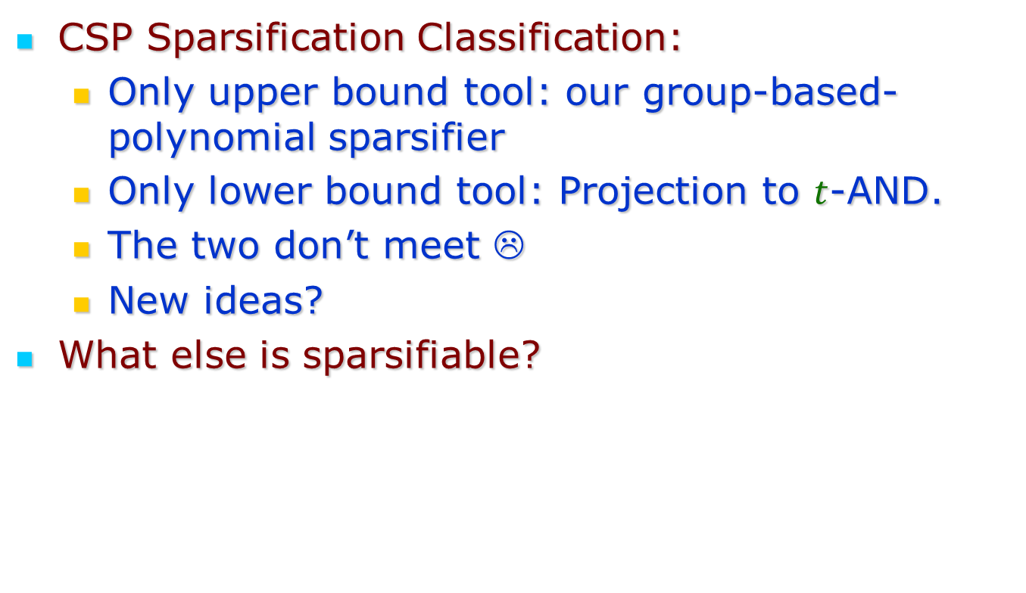
Open Questions
CSP Sparsification Classification:
  Only upper bound tool: our group-based-polynomial sparsifier
  Only lower bound tool: Projection to $t$-AND.
  The two don’t meet ☹
  New ideas?
What else is sparsifiable?

Slide 24
Thank You!

