Slide 1



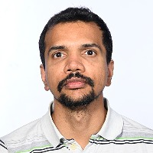


$$Local Correction of Linear Functions$$
$$on the Boolean Cube$$
Prashanth Amireddy
(Harvard)
Amik Raj Behara
(Aarhus)
Manaswi Paraashar
(Aarhus)
Srikanth Srinivasan
(Copenhagen)
Madhu Sudan
(Harvard)

Slide 2
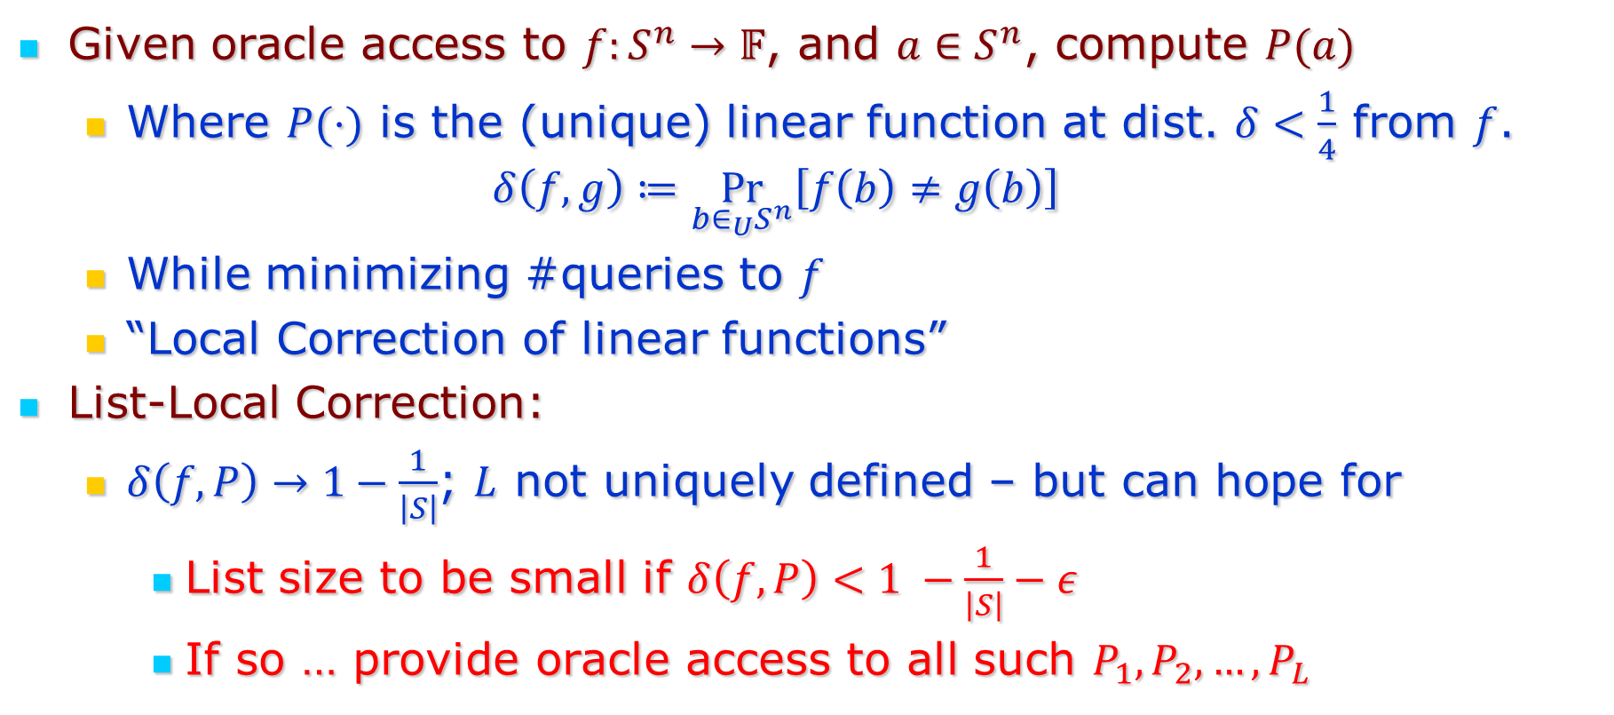
The Problem(s)
Given oracle access to $f:S^{n}→𝔽$, and $a∈S^{n}$, compute $P(a)$
  Where $P(⋅)$ is the (unique) linear function at dist. $δ<\frac{1}{4}$ from $f$.
  $$δ\left(f,g\right)≔\underset{b∈_{U}S^{n}}{Pr}\left[f\left(b\right)≠g\left(b\right)\right]$$
  While minimizing #queries to $f$
  “Local Correction of linear functions”
List-Local Correction:
  $δ\left(f,P\right)→1−\frac{1}{\left|S\right|}$; $L$ not uniquely defined – but can hope for
    List size to be small if $δ\left(f,P\right)<1 −\frac{1}{\left|S\right|}−ε$
    If so … provide oracle access to all such $P_{1}, P_{2},…,P_{L}$

Slide 3
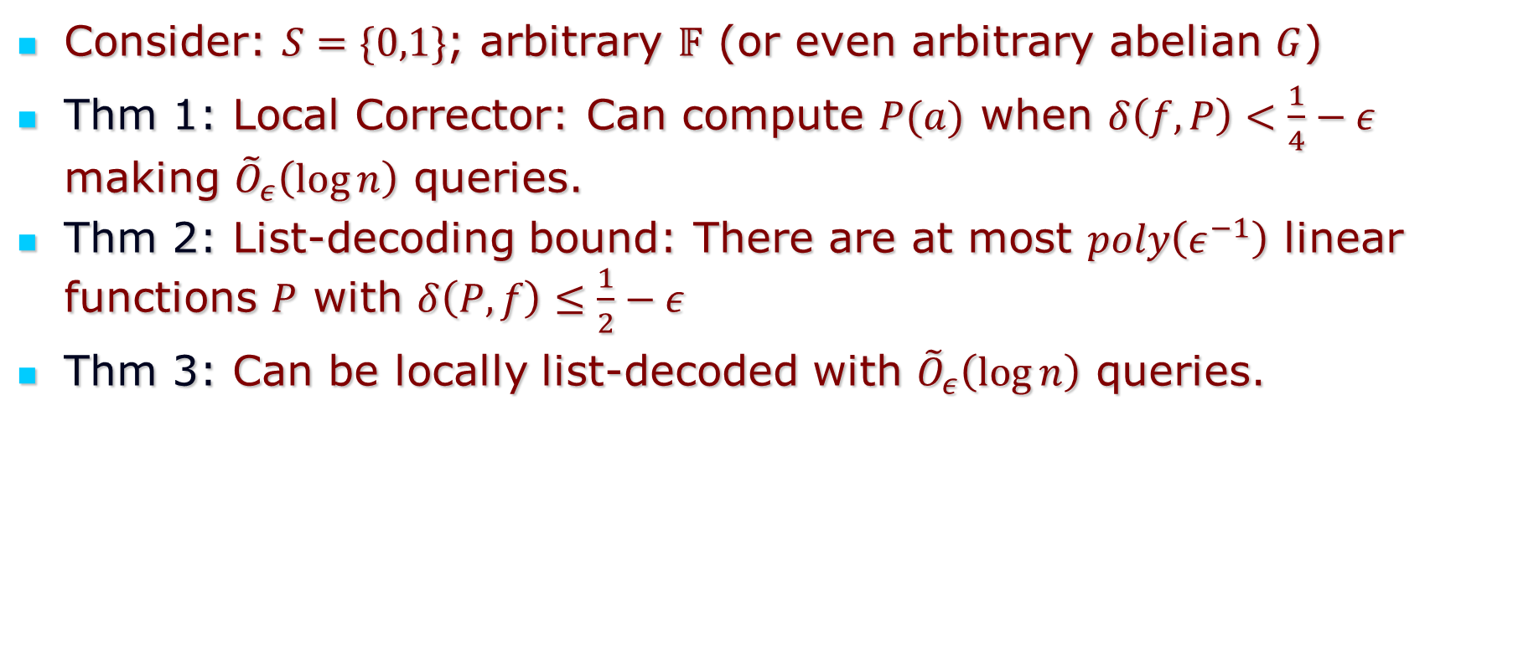
The results
Consider: $S=\{0,1\}$; arbitrary $𝔽$ (or even arbitrary abelian $G$)
Thm 1: Local Corrector: Can compute $P(a)$ when $δ\left(f,P\right)<\frac{1}{4}−ε$ making ${\tilde{O}}_{ε}\left(\log{n}\right)$ queries.
Thm 2: List-decoding bound: There are at most $poly\left(ε^{−1}\right)$ linear functions $P$ with $δ\left(P,f\right)≤\frac{1}{2}−ε$
Thm 3: Can be locally list-decoded with ${\tilde{O}}_{ε}\left(\log{n}\right)$ queries.

Slide 4
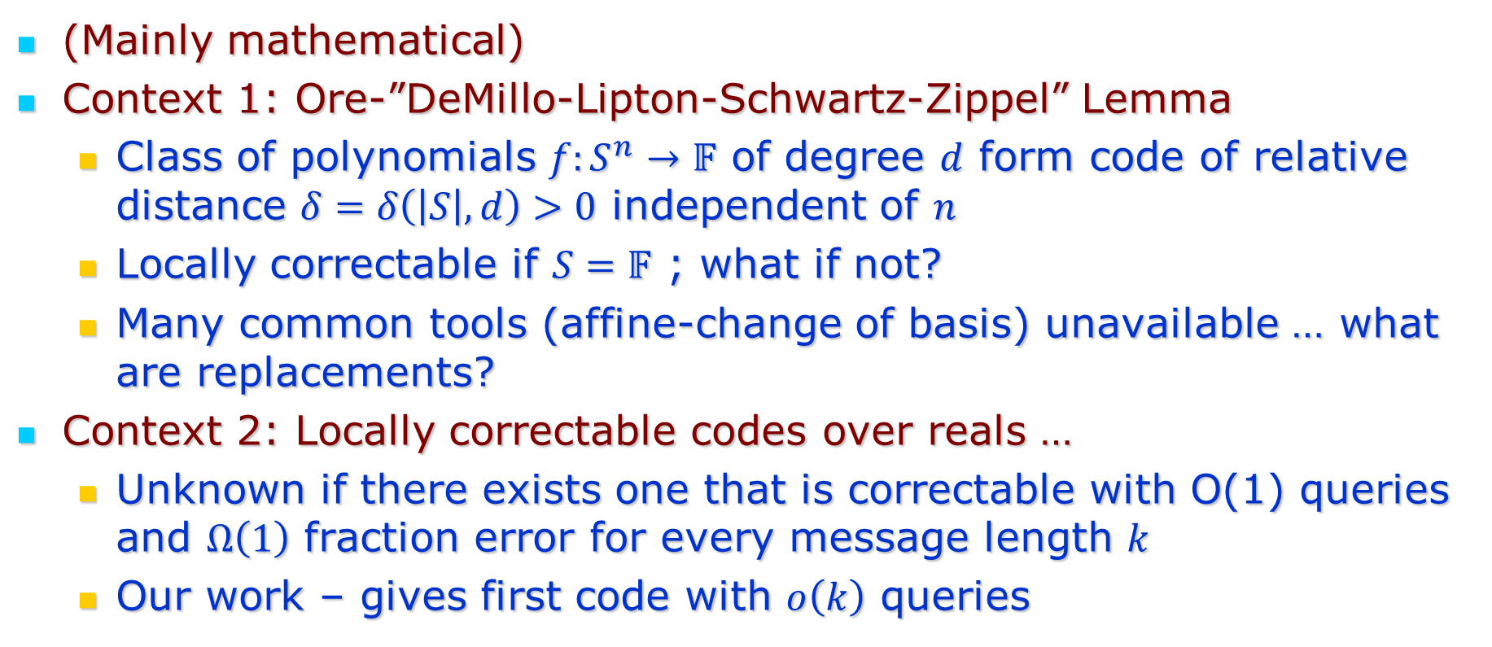
Motivation/Context
(Mainly mathematical)
Context 1: Ore-”DeMillo-Lipton-Schwartz-Zippel” Lemma
  Class of polynomials $f:S^{n}→𝔽$ of degree $d$ form code of relative distance $δ=δ\left(\left|S\right|,d\right)>0$ independent of $n$
  Locally correctable if $S=𝔽$ ; what if not?
  Many common tools (affine-change of basis) unavailable … what are replacements?
Context 2: Locally correctable codes over reals …
  Unknown if there exists one that is correctable with O(1) queries and $Ω\left(1\right)$ fraction error for every message length $k$
  Our work – gives first code with $o\left(k\right)$ queries

Slide 5
Part 1: Decoding from $\frac{1}{4}−ε$ fraction errors

Slide 6
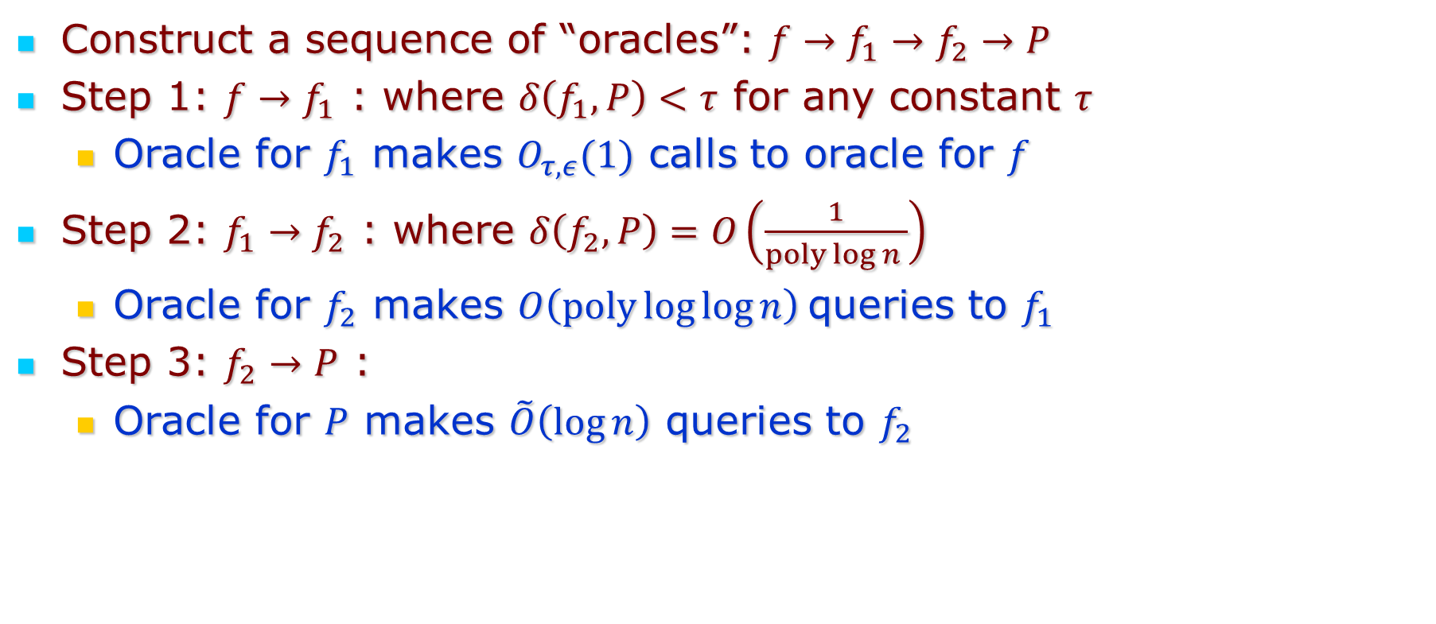
3 Step approach:
Construct a sequence of “oracles”: $f→f_{1}→f_{2}→P$
Step 1: $f→f_{1}$ : where $δ\left(f_{1},P\right)<τ$ for any constant $τ$
  Oracle for $f_{1}$ makes $O_{τ,ε}(1)$ calls to oracle for $f$
Step 2: $f_{1}→f_{2}$ : where $δ\left(f_{2},P\right)=O\left(\frac{1}{poly\log{n} }\right)$
  Oracle for $f_{2}$ makes $O\left(poly\log{\log{n}}\right)$queries to $f_{1}$
Step 3: $f_{2}→P$ :
  Oracle for $P$ makes $\tilde{O}\left(\log{n}\right)$ queries to $f_{2}$

Slide 7
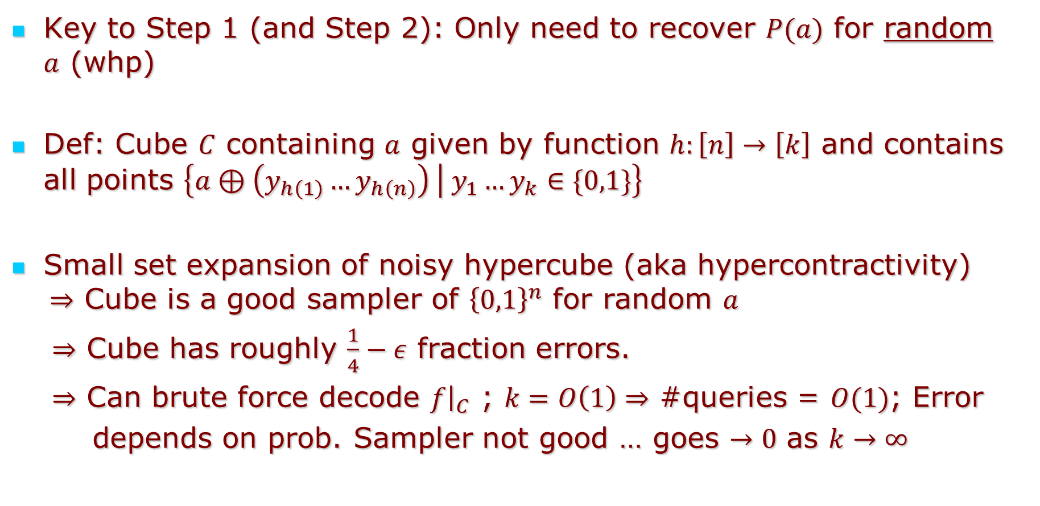
Step 1
Key to Step 1 (and Step 2): Only need to recover $P(a)$ for random $a$ (whp)
Def: Cube $C$ containing $a$ given by function $h:\left[n\right]→\left[k\right]$ and contains all points $\left\{a⊕\left(y_{h\left(1\right)}…y_{h\left(n\right)}\right) | y_{1}…y_{k}∈\{0,1\}\right\}$
Small set expansion of noisy hypercube (aka hypercontractivity) $⇒$ Cube is a good sampler of ${\left\{0,1\right\}}^{n}$ for random $a$
$⇒$ Cube has roughly $\frac{1}{4}−ε$ fraction errors.
$⇒$ Can brute force decode $f{\left.​\right|}_{C}$ ; $k=O\left(1\right)⇒$ #queries = $O(1)$; Error
depends on prob. Sampler not good … goes $→0$ as $k→∞$

Slide 8
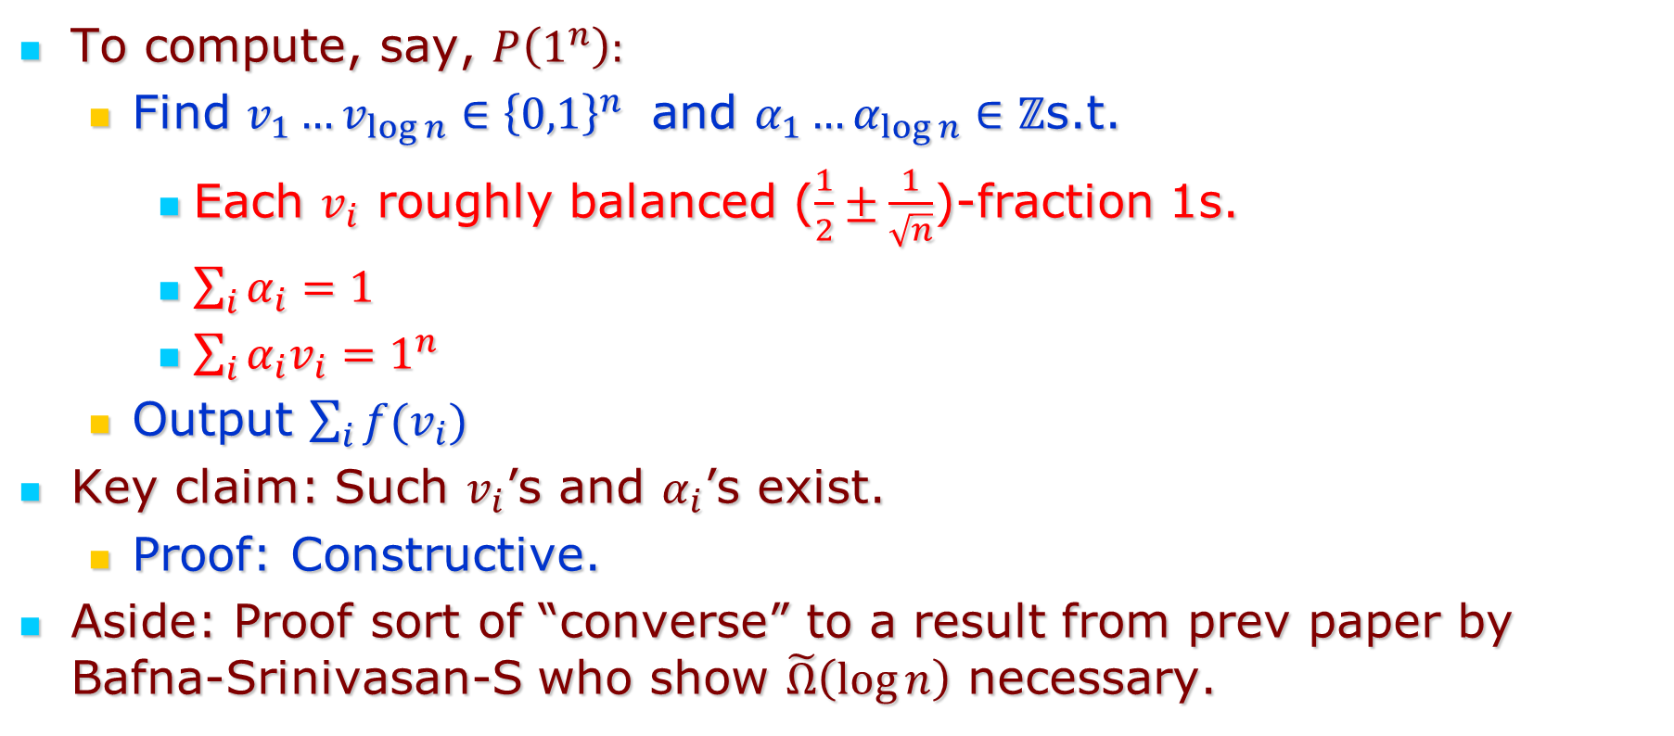
Step 3:
To compute, say, $P\left(1^{n}\right):$
  Find $v_{1}…v_{\log{n}}∈{\left\{0,1\right\}}^{n}$ and $α_{1}…α_{\log{n}}∈ℤ$s.t.
    Each $v_{i}$ roughly balanced ($\frac{1}{2}±\frac{1}{\sqrt{n}}$)-fraction 1s.
    $\sum_{i}{α_{i}=1}$
    $\sum_{i}{α_{i}v_{i}=1^{n}}$
  Output $\sum_{i}{f(v_{i})}$
Key claim: Such $v_{i}$’s and $α_{i}$’s exist.
  Proof: Constructive.
Aside: Proof sort of “converse” to a result from prev paper by Bafna-Srinivasan-S who show $\tilde{Ω}\left(\log{n}\right)$ necessary.

Slide 9
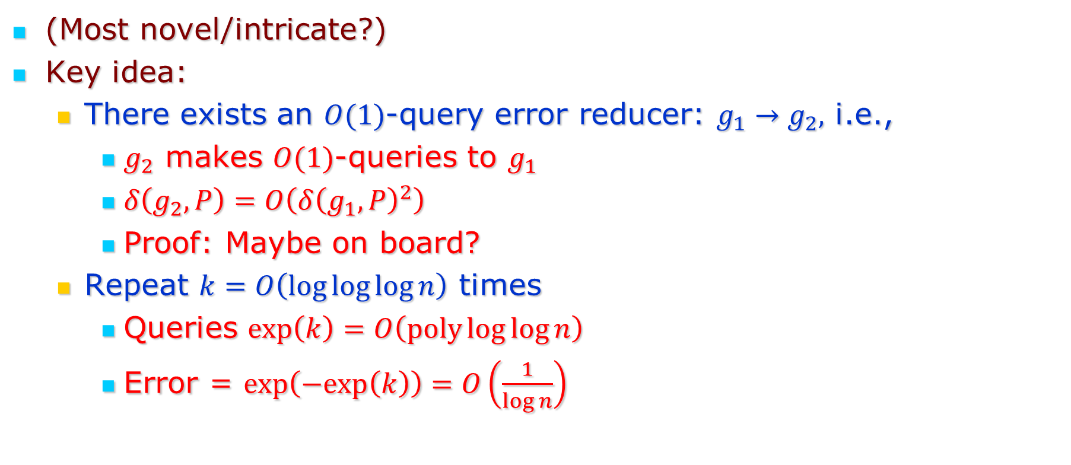
Step 2:
(Most novel/intricate?)
Key idea:
  There exists an $O(1)$-query error reducer: $g_{1}→g_{2},$ i.e.,
    $g_{2}$ makes $O(1)$-queries to $g_{1}$
    $δ\left(g_{2},P\right)=O\left(δ{\left(g_{1},P\right)}^{2}\right)$
    Proof: Maybe on board?
  Repeat $k=O\left(\log{\log{\log{n}}}\right)$ times
    Queries $\exp\left(k\right)=O\left(poly\log{\log{n}}\right)$
    Error = $\exp\left(−exp\left(k\right)\right)=O\left(\frac{1}{\log{n}}\right)$

Slide 10
Part 2: List-Decodability from $\frac{1}{2}−ε$ fraction errors

Slide 11
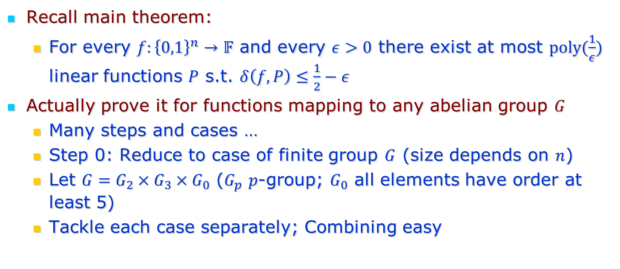
Overview
Recall main theorem:
  For every $f:{\left\{0,1\right\}}^{n}→𝔽$ and every $ε>0$ there exist at most $poly(\frac{1}{ε})$ linear functions $P$ s.t. $δ\left(f,P\right)≤\frac{1}{2}−ε$
Actually prove it for functions mapping to any abelian group $G$
  Many steps and cases …
  Step 0: Reduce to case of finite group $G$ (size depends on $n$)
  Let $G=G_{2}×G_{3}×G_{0}$ ($G_{p}$ $p$-group; $G_{0}$ all elements have order at least 5)
  Tackle each case separately; Combining easy

Slide 12
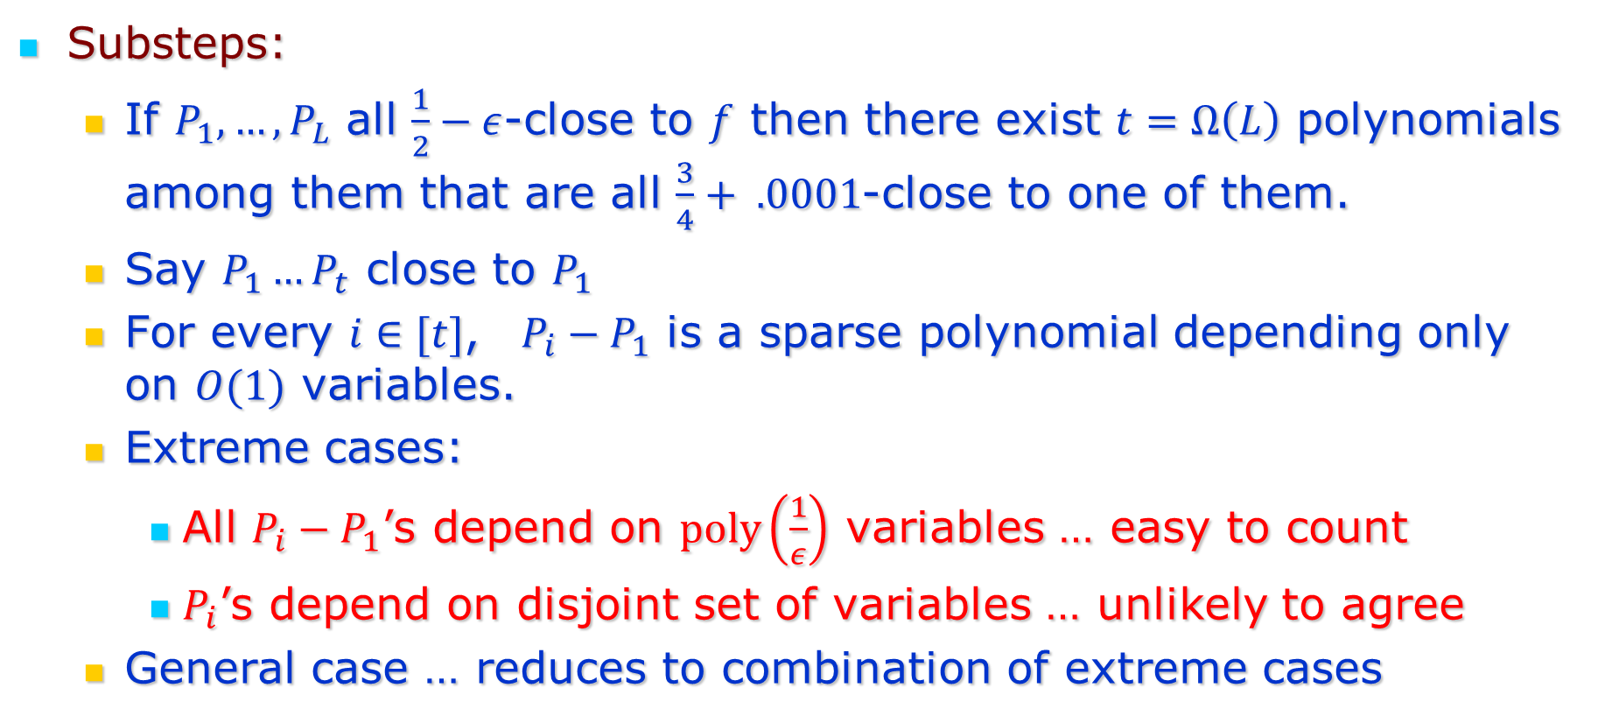
The $G_{0}$ case
Substeps:
  If $P_{1}, …, P_{L}$ all $\frac{1}{2}−ε$-close to $f$ then there exist $t=Ω\left(L\right)$ polynomials among them that are all $\frac{3}{4}+ .0001$-close to one of them.
  Say $P_{1}…P_{t}$ close to $P_{1}$
  For every $i∈[t]$, $P_{i}−P_{1}$ is a sparse polynomial depending only on $O(1)$ variables.
  Extreme cases:
    All $P_{i}−P_{1}$’s depend on $poly\left(\frac{1}{ε}\right)$ variables … easy to count
    $P_{i}$’s depend on disjoint set of variables … unlikely to agree
  General case … reduces to combination of extreme cases

Slide 13

The $G_{2}$ & $G_{3}$ cases
$G_{2}$ case essentially known … but new proof in this paper.
Unified with $G_{3}$ case; main ingredients
  Extended Johnson Bound for ranges $ℤ_{2}$ and $ℤ_{3}$
  “Special Intersection Properties” of agreement sets to lift results to $G_{2}$, $G_{3}$

Slide 14
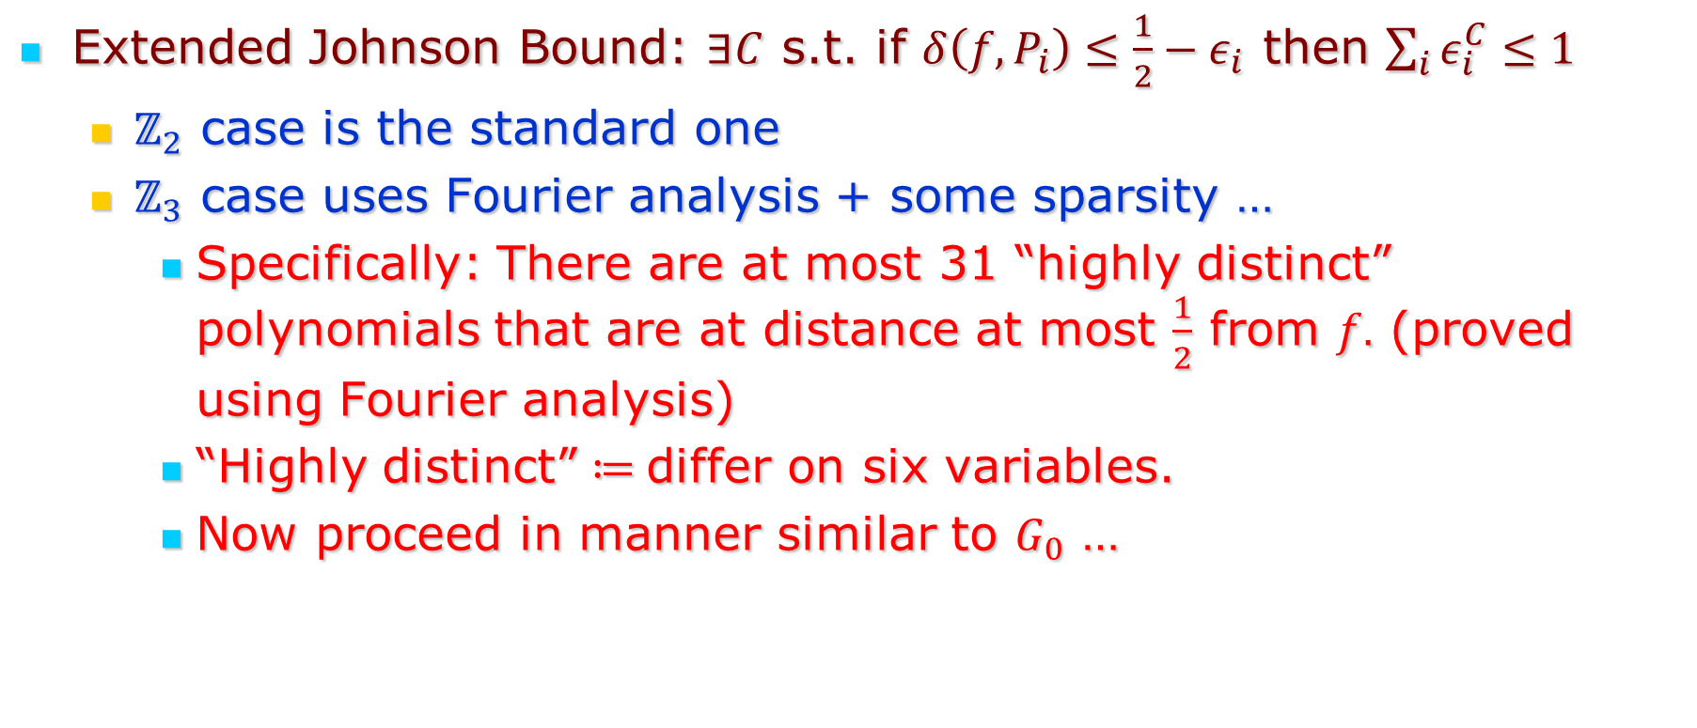
Extended Johnson Bound
Extended Johnson Bound: $∃C$ s.t. if $δ\left(f,P_{i}\right)≤\frac{1}{2}−ε_{i}$ then $\sum_{i}{ε_{i}^{C}≤1}$
  $ℤ_{2}$ case is the standard one
  $ℤ_{3}$ case uses Fourier analysis + some sparsity …
    Specifically: There are at most 31 “highly distinct” polynomials that are at distance at most $\frac{1}{2}$ from $f.$ (proved using Fourier analysis)
    “Highly distinct” $≔$differ on six variables.
    Now proceed in manner similar to $G_{0}$ …

Slide 15
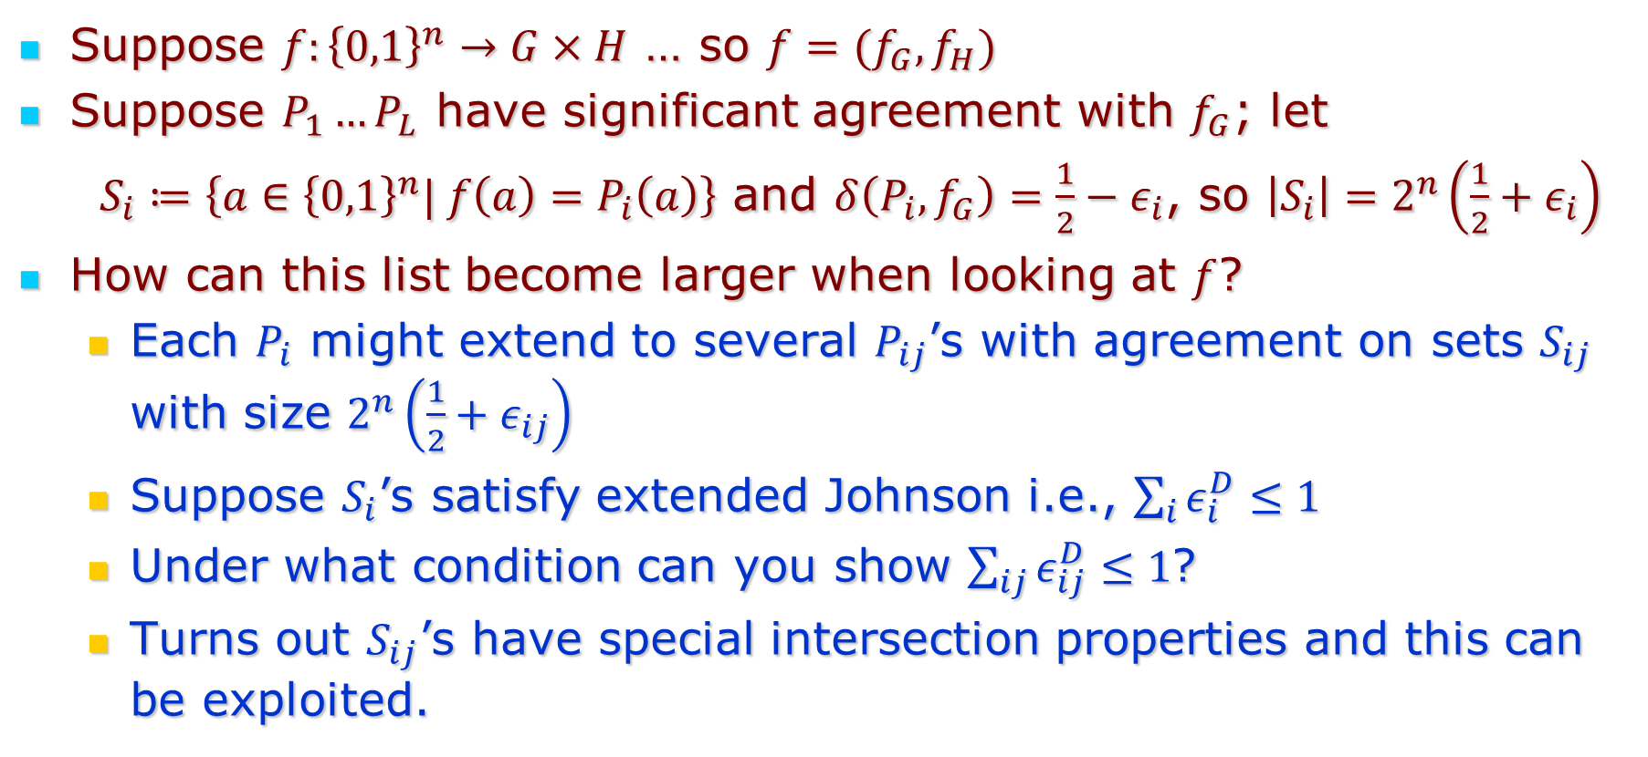
Special Intersection Properties [DGKS]
Suppose $f:{\left\{0,1\right\}}^{n}→G×H$ … so $f=(f_{G},f_{H})$
Suppose $P_{1}…P_{L}$ have significant agreement with $f_{G}$; let
$S_{i}≔\left\{a∈{\left\{0,1\right\}}^{n}| f\left(a\right)=P_{i}\left(a\right)\right\}$ and $δ\left(P_{i},f_{G}\right)=\frac{1}{2}−ε_{i}$, so $\left|S_{i}\right|=2^{n}\left(\frac{1}{2}+ε_{i}\right)$
How can this list become larger when looking at $f$?
  Each $P_{i}$ might extend to several $P_{ij}$’s with agreement on sets $S_{ij}$ with size $2^{n}\left(\frac{1}{2}+ε_{ij}\right)$
  Suppose $S_{i}$’s satisfy extended Johnson i.e., $\sum_{i}{ε_{i}^{D}≤1}$
  Under what condition can you show $\sum_{ij}{ε_{ij}^{D}≤1}$?
  Turns out $S_{ij}$’s have special intersection properties and this can be exploited.

Slide 16
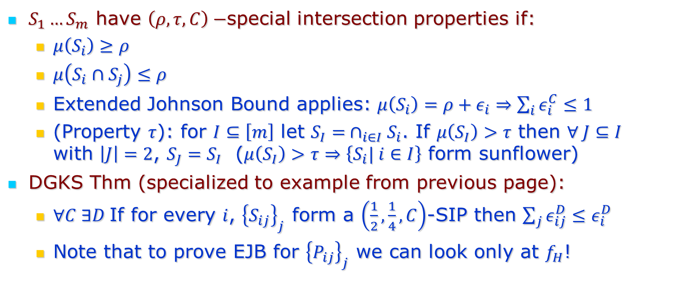
S.I.P. (contd.)
$S_{1}…S_{m}$ have $\left(ρ,τ,C\right)−$special intersection properties if:
  $μ\left(S_{i}\right)≥ρ$
  $μ\left(S_{i}∩S_{j}\right)≤ρ$
  Extended Johnson Bound applies: $μ\left(S_{i}\right)=ρ+ε_{i}⇒\sum_{i}{ε_{i}^{C}≤1}$
  (Property $τ$): for $I⊆\left[m\right]$ let $S_{I}= ∩_{i∈I}S_{i}$. If $μ\left(S_{I}\right)>τ$ then $∀ J⊆I$ with $\left|J\right|=2$, $S_{J}=S_{I}$ ($μ\left(S_{I}\right)>τ⇒\left\{S_{i}| i∈I\right\}$ form sunflower)
DGKS Thm (specialized to example from previous page):
  $∀C ∃D$If for every $i$, ${\left\{S_{ij}\right\}}_{j}$ form a $\left(\frac{1}{2},\frac{1}{4},C\right)$-SIP then $\sum_{j}{ε_{ij}^{D}≤ε_{i}^{D}}$
  Note that to prove EJB for ${\left\{P_{ij}\right\}}_{j}$ we can look only at $f_{H}$!

Slide 17

Brief aside on use of SIP
DGKS – roughly apply it once to lift from $ℤ_{2}$ to $ℤ_{2^{t}}$ and once more (say) to $ℤ_{2^{t}}^{s}$
  Works fine, gets worse exponent $D$
Our new application: directly works with $G mod H$ and $H$ (even when $G≠\left(G mod H\right)×H$): so a single lifting step gets to $ℤ_{2^{t}}^{s}$

Slide 18
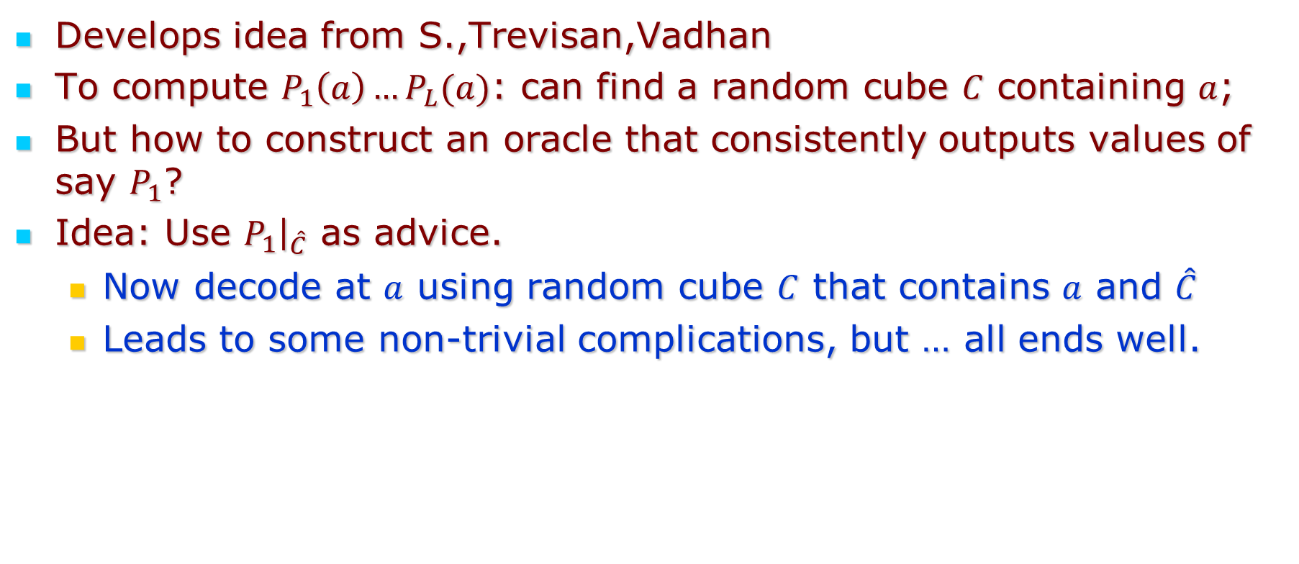
Part 3: Algorithmic List-Decoding
Develops idea from S.,Trevisan,Vadhan
To compute $P_{1}\left(a\right)…P_{L}(a)$: can find a random cube $C$ containing $a$;
But how to construct an oracle that consistently outputs values of say $P_{1}$?
Idea: Use $P_{1}{\left.​\right|}_{\hat{C}}$ as advice.
  Now decode at $a$ using random cube $C$ that contains $a$ and $\hat{C}$
  Leads to some non-trivial complications, but … all ends well.

Slide 19
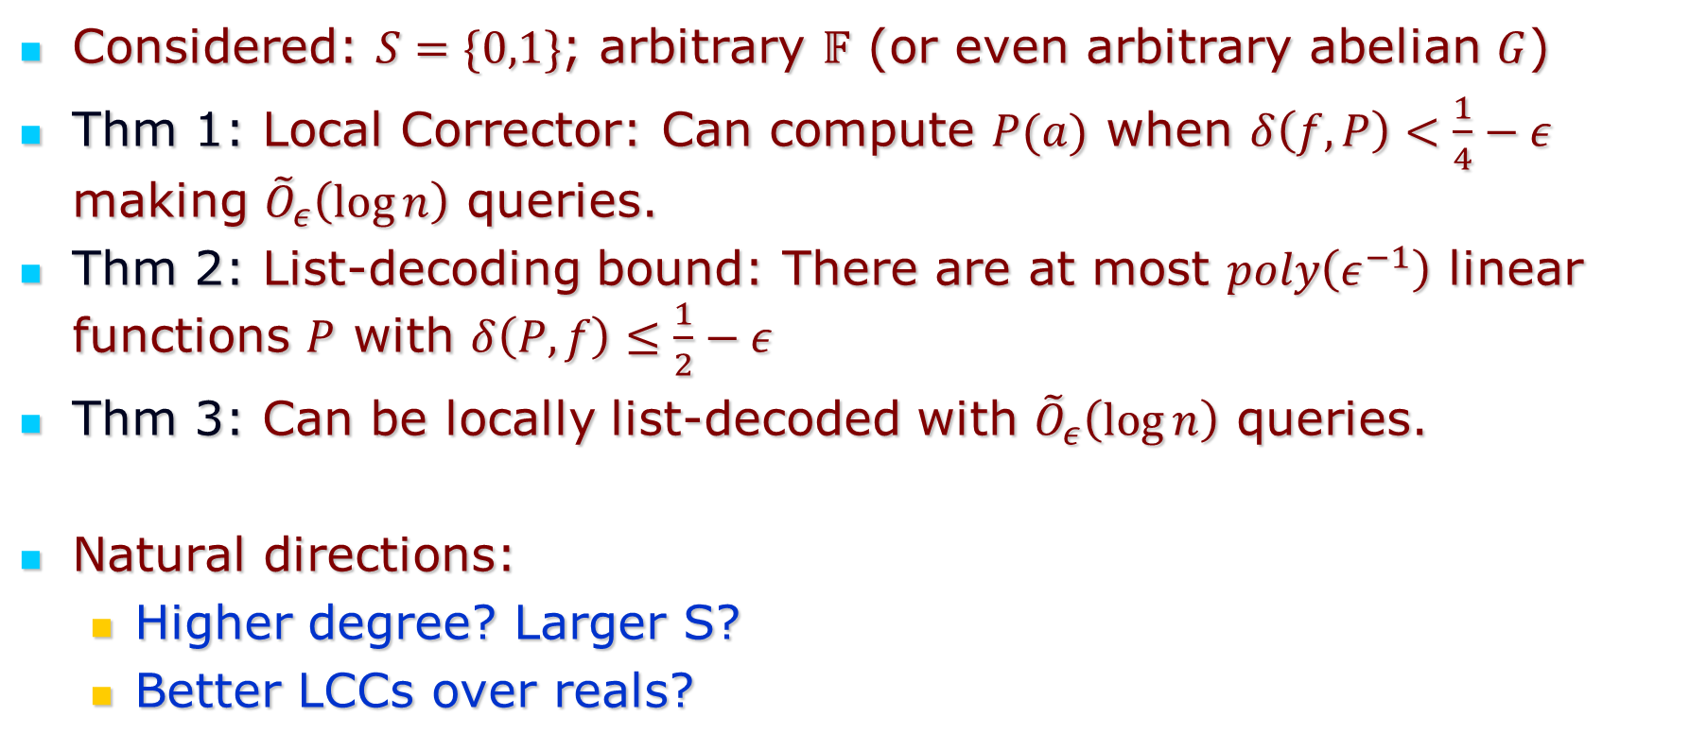
Summary
Considered: $S=\{0,1\}$; arbitrary $𝔽$ (or even arbitrary abelian $G$)
Thm 1: Local Corrector: Can compute $P(a)$ when $δ\left(f,P\right)<\frac{1}{4}−ε$ making ${\tilde{O}}_{ε}\left(\log{n}\right)$ queries.
Thm 2: List-decoding bound: There are at most $poly\left(ε^{−1}\right)$ linear functions $P$ with $δ\left(P,f\right)≤\frac{1}{2}−ε$
Thm 3: Can be locally list-decoded with ${\tilde{O}}_{ε}\left(\log{n}\right)$ queries.
Natural directions:
  Higher degree? Larger S?
  Better LCCs over reals?

Slide 20
Thank you!

